Slide 1
Chapter 4
Partitioning
and Divide-and-Conquer Strategies

Slide 2
Partitioning
Partitioning simply divides the problem into parts.
Divide and Conquer
Characterized by dividing problem into sub-problems of same form as larger problem. Further divisions into still smaller sub-problems, usually done by recursion.
Recursive divide and conquer amenable to parallelization because separate processes can be used for divided parts. Also usually data is naturally localized.
4.1

Slide 3
Partitioning/Divide and Conquer
Examples
Many possibilities.
• Operations on sequences of number such as simply adding them together
• Several sorting algorithms can often be partitioned or constructed in a recursive fashion
• Numerical integration
• N-body problem
4.2

Slide 4
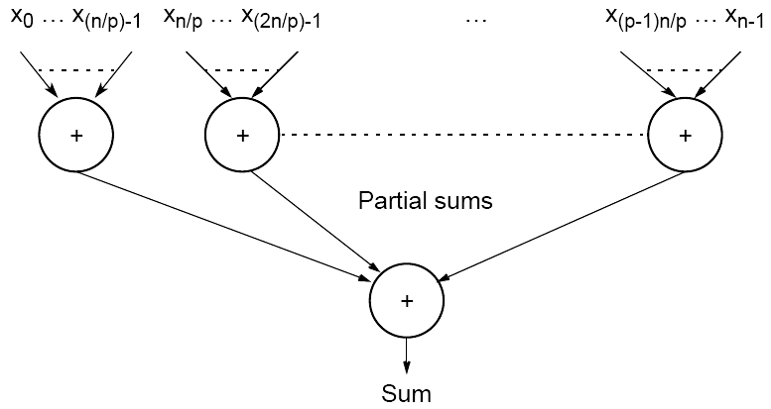
Partitioning a sequence of numbers into parts and adding the parts
4.3

Slide 5
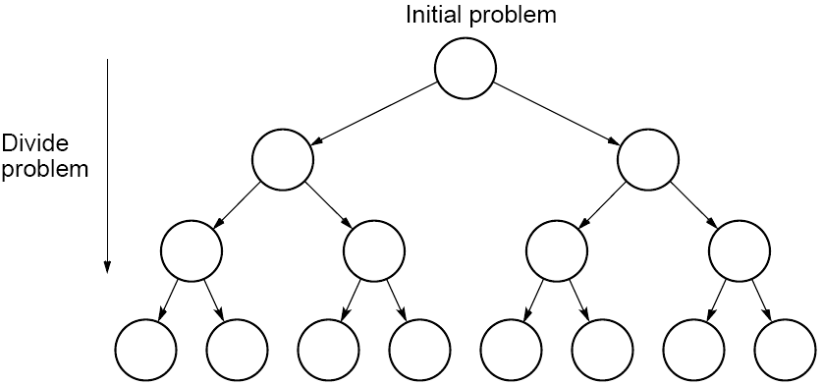
Tree construction
4.4

Slide 6
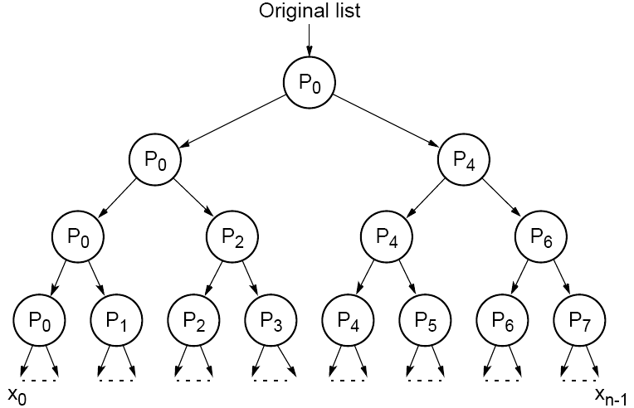
Dividing a list into parts
4.5

Slide 7
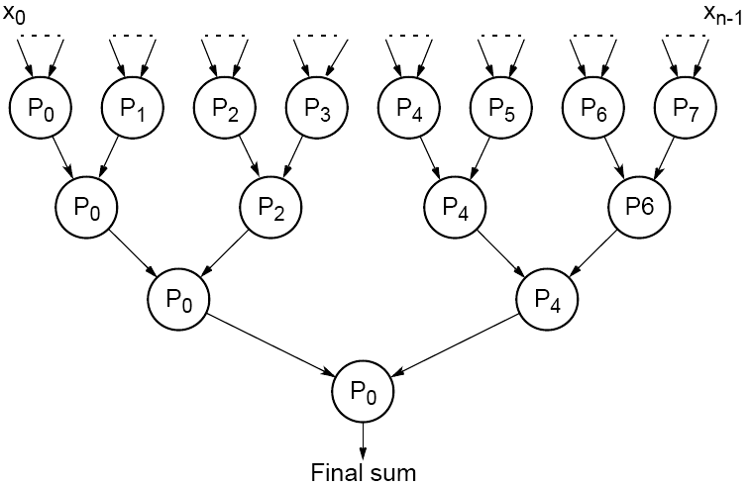
Partial summation
4.6

Slide 8
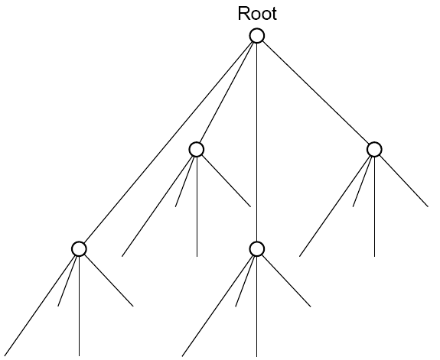
Quadtree
4.7

Slide 9
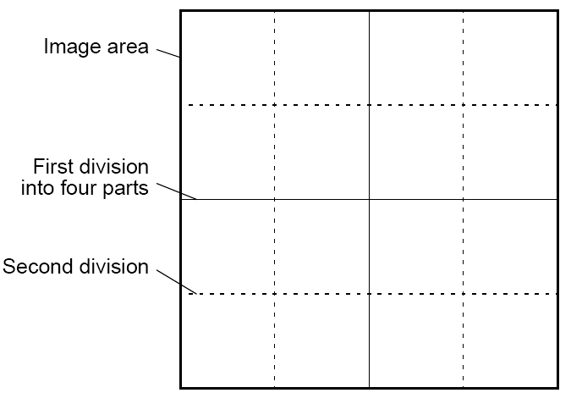
Dividing an image
4.8

Slide 10
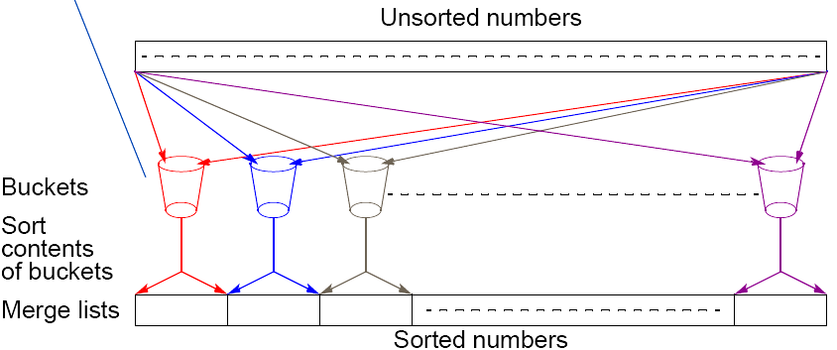
Bucket sort
One “bucket” assigned to hold numbers that fall within each region.
Numbers in each bucket sorted using a sequential sorting algorithm.
Sequential sorting time complexity: O(nlog(n/m).
Works well if the original numbers uniformly distributed across a known interval, say 0 to a - 1.
4.9

Slide 11
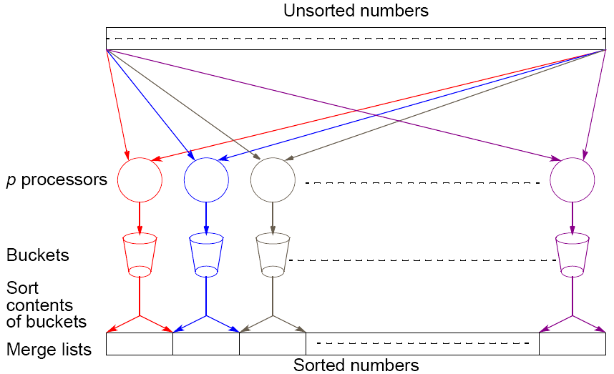
Parallel version of bucket sort
Simple approach
Assign one processor for each bucket.
4.10

Slide 12
Further Parallelization
Partition sequence into m regions, one region for each processor.
Each processor maintains p “small” buckets and separates numbers in its region into its own small buckets.
Small buckets then emptied into p final buckets for sorting, which requires each processor to send one small bucket to each of the other processors (bucket i to processor i).
4.11

Slide 13
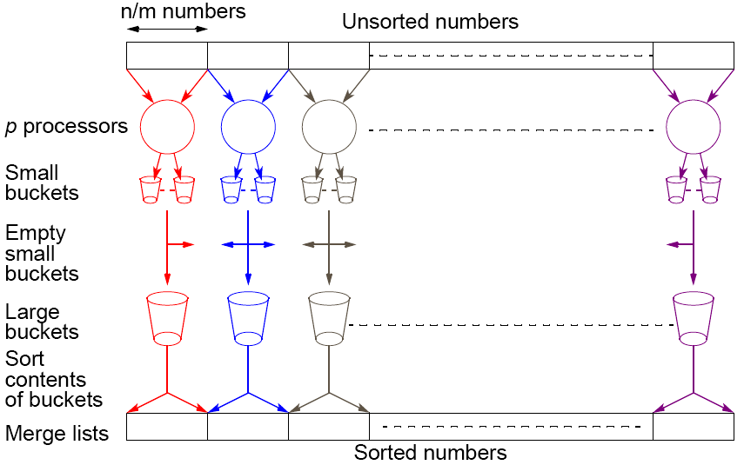
Another parallel version of bucket sort
Introduces new message-passing operation - all-to-all broadcast.
4.12

Slide 14
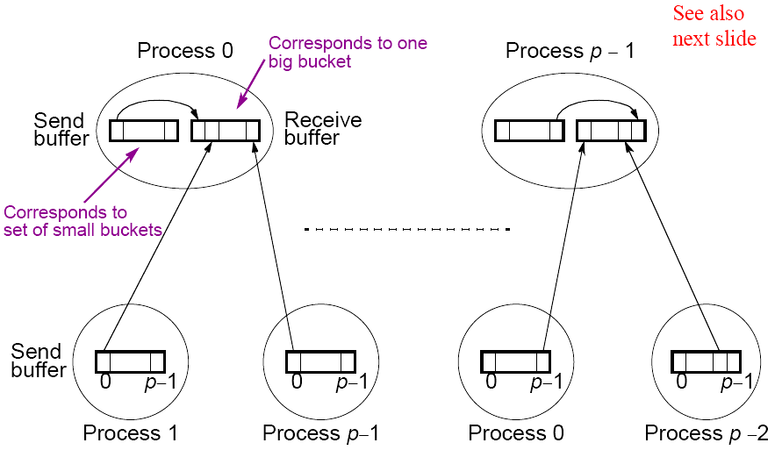
“all-to-all” broadcast routine
Sends data from each process to every other process
4.13

Slide 15
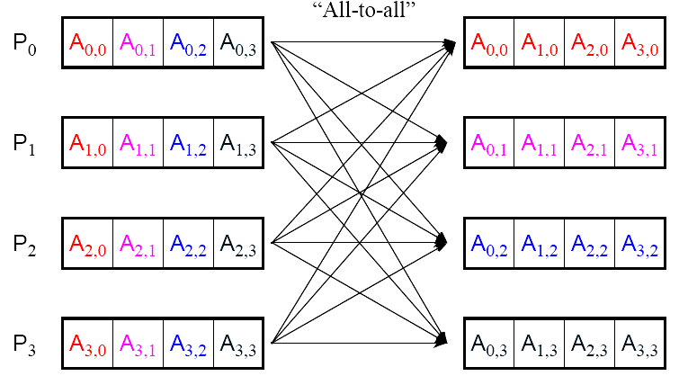
“all-to-all” routine actually transfers rows of an array to columns:
Transposes a matrix.
4.14

Slide 16
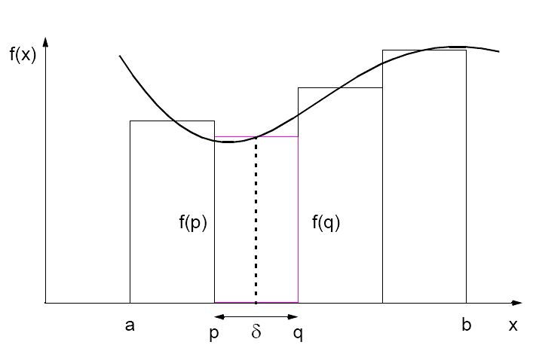
Numerical integration using rectangles
Each region calculated using an approximation given by rectangles:
Aligning the rectangles:
4.15

Slide 17
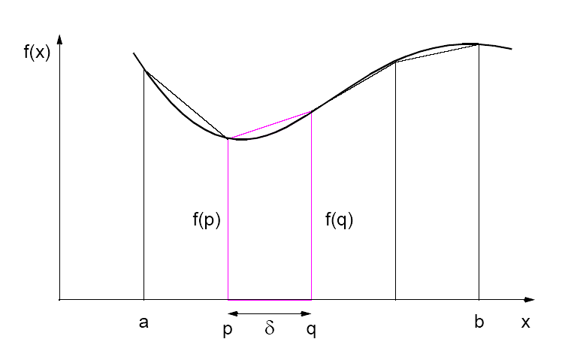
Numerical integration using trapezoidal method
May not be better!
4.16

Slide 18
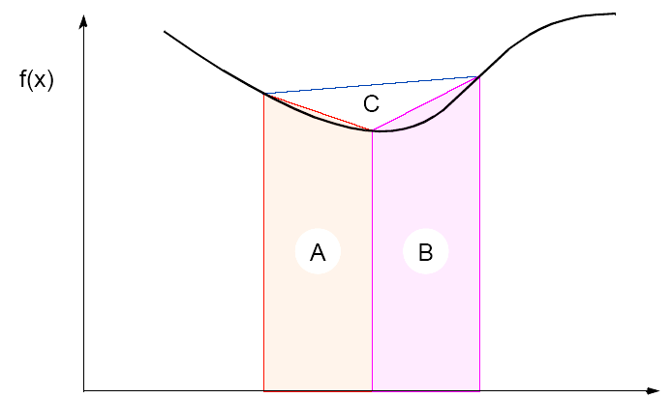
Adaptive Quadrature
Solution adapts to shape of curve. Use three areas, A, B, and C. Computation terminated when largest of A and B sufficiently close to sum of remain two areas .
4.17

Slide 19
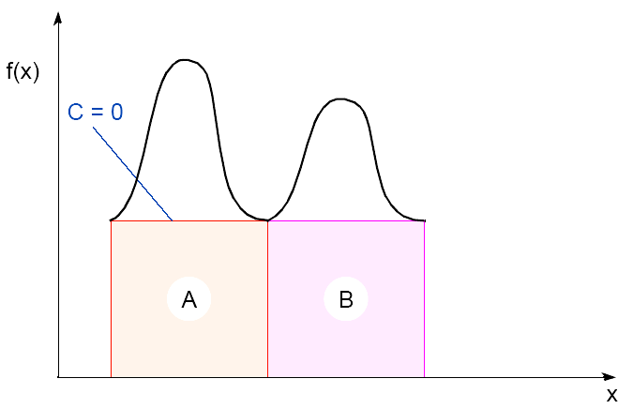
Adaptive quadrature with false termination.
Some care might be needed in choosing when to terminate.
Might cause us to terminate early, as two large regions are the same (i.e., C = 0).
4.18

Slide 20
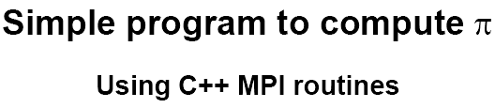
3.19

Slide 21
/*********************************************************************************
pi_calc.cpp calculates value of pi and compares with actual
value (to 25digits) of pi to give error. Integrates function f(x)=4/(1+x^2).
July 6, 2001 K. Spry CSCI3145
**********************************************************************************/
#include <math.h> //include files
#include <iostream.h>
#include "mpi.h“
void printit(); //function prototypes
int main(int argc, char *argv[])
{
double actual_pi = 3.141592653589793238462643;
//for comparison later
int n, rank, num_proc, i;
double temp_pi, calc_pi, int_size, part_sum, x;
char response = 'y', resp1 = 'y';
MPI::Init(argc, argv); //initiate MPI
4.20

Slide 22
num_proc = MPI::COMM_WORLD.Get_size();
rank = MPI::COMM_WORLD.Get_rank();
if (rank == 0) printit(); /* I am root node, print out welcome */
while (response == 'y') {
if (resp1 == 'y') {
if (rank == 0) { /*I am root node*/
cout <<"__________________________________" <<endl;
cout <<"\nEnter the number of intervals: (0 will exit)" << endl;
cin >> n;}
} else n = 0;
MPI::COMM_WORLD.Bcast(&n, 1, MPI::INT, 0); //broadcast n
if (n==0) break; //check for quit condition
4.21

Slide 23
else {
int_size = 1.0 / (double) n; //calcs interval size
part_sum = 0.0;
for (i = rank + 1; i <= n; i += num_proc)
{ //calcs partial sums
x = int_size * ((double)i - 0.5);
part_sum += (4.0 / (1.0 + x*x));
}
temp_pi = int_size * part_sum;
//collects all partial sums computes pi
MPI::COMM_WORLD.Reduce(&temp_pi,&calc_pi, 1, MPI::DOUBLE, MPI::SUM, 0);
4.22

Slide 24
if (rank == 0) { /*I am server*/
cout << "pi is approximately " << calc_pi
<< ". Error is " << fabs(calc_pi - actual_pi)
<< endl
<<"_______________________________________"
<< endl;
}
} //end else
if (rank == 0) { /*I am root node*/
cout << "\nCompute with new intervals? (y/n)" << endl; cin >> resp1;
}
}//end while
MPI::Finalize(); //terminate MPI
return 0;
} //end main
4.23

Slide 25
//functions
void printit()
{
cout << "\n*********************************" << endl
<< "Welcome to the pi calculator!" << endl
<< "Programmer: K. Spry" << endl
<< "You set the number of divisions \nfor estimating the integral:
\n\tf(x)=4/(1+x^2)"
<< endl
<< "*********************************" << endl;
} //end printit
4.24

Slide 26
Gravitational N-Body Problem
Finding positions and movements of bodies in space subject to gravitational forces from other bodies, using Newtonian laws of physics.
4.25

Slide 27

Gravitational N-Body Problem Equations
Gravitational force between two bodies of masses m_{a} and m_{b} is:
G is the gravitational constant and r the distance between the bodies. Subject to forces, body accelerates according to Newton’s 2nd law:
F = ma
m is mass of the body, F is force it experiences, and a the resultant acceleration.
4.26

Slide 28
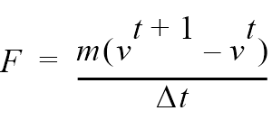
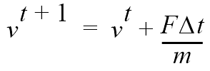

Details
Let the time interval be t. For a body of mass m, the force is:
New velocity is:
where v^{t+1} is the velocity at time t + 1 and v^{t} is the velocity at time t.
Over time interval Δt, position changes by
where x^{t} is its position at time t.
Once bodies move to new positions, forces change. Computation has to be repeated.
4.27

Slide 29
Sequential Code
Overall gravitational N-body computation can be described by:
for (t = 0; t < tmax; t++) /* for each time period */
for (i = 0; i < N; i++) { /* for each body */
F = Force_routine(i); /* compute force on ith body */
v[i]new = v[i] + F * dt / m; /* compute new velocity */
x[i]new = x[i] + v[i]new * dt; /* and new position */
}
for (i = 0; i < nmax; i++) { /* for each body */
x[i] = x[i]new; /* update velocity & position*/
v[i] = v[i]new;
}
3.28

Slide 30
Parallel Code
The sequential algorithm is an O(N²) algorithm (for one iteration) as each of the N bodies is influenced by each of the other N - 1 bodies.
Not feasible to use this direct algorithm for most interesting N-body problems where N is very large.
4.29

Slide 31
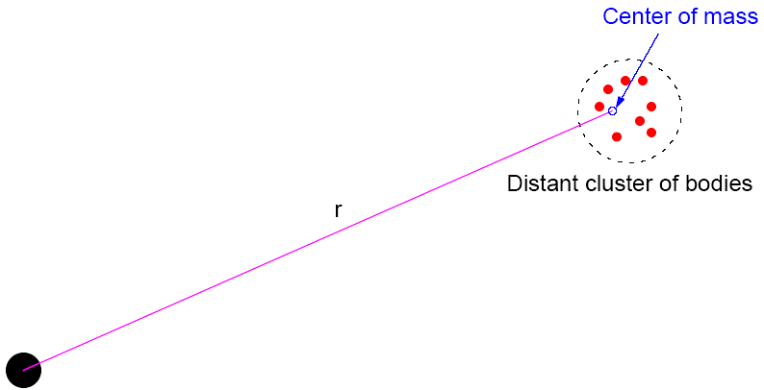
Time complexity can be reduced approximating a cluster of distant bodies as a single distant body with mass sited at the center of mass of the cluster:
4.30

Slide 32
Barnes-Hut Algorithm
Start with whole space in which one cube contains the bodies (or particles).
• First, this cube is divided into eight subcubes.
• If a subcube contains no particles, subcube deleted from further consideration.
• If a subcube contains one body, subcube retained.
• If a subcube contains more than one body, it is recursively divided until every subcube contains one body.
4.31

Slide 33
Creates an octtree - a tree with up to eight edges from each node.
The leaves represent cells each containing one body.
After the tree has been constructed, the total mass and center of mass of the subcube is stored at each node.
4.32

Slide 34

Force on each body obtained by traversing tree starting at root, stopping at a node when the clustering approximation can be used, e.g. when:
where is a constant typically 1.0 or less.
Constructing tree requires a time of O(nlogn), and so does computing all the forces, so that overall time complexity of method is O(nlogn).
4.33

Slide 35
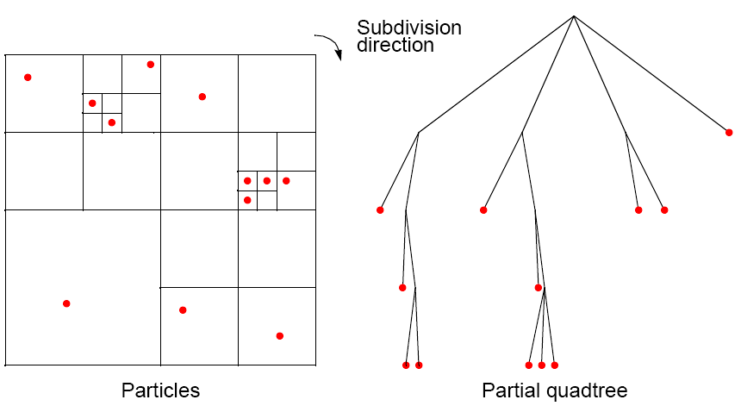
Recursive division of 2-dimensional space
4.34

Slide 36
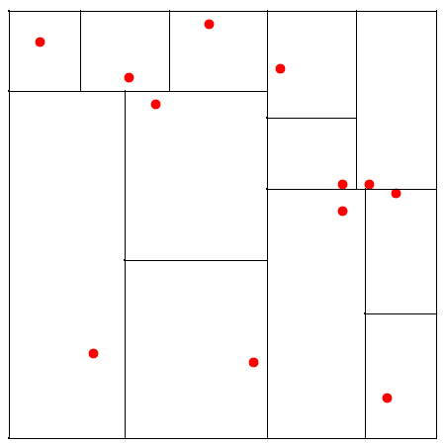
Orthogonal Recursive Bisection
(For 2-dimensional area) First, a vertical line found that divides area into two areas each with equal number of bodies. For each area, a horizontal line found that divides it into two areas each with equal number of bodies. Repeated as required.
4.35

Slide 37
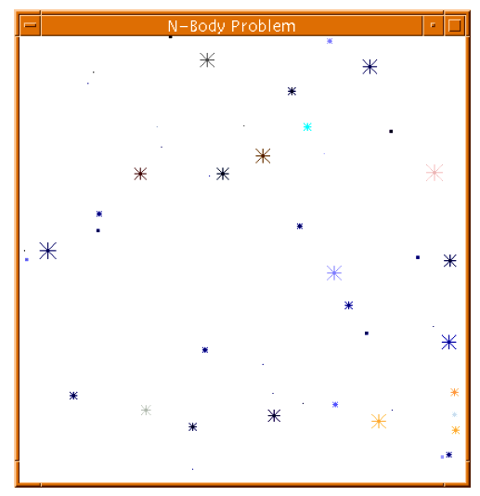
Astrophysical N-body simulation
By Scott Linssen (UNCC student, 1997) using O(N²) algorithm.
4.36

Slide 38
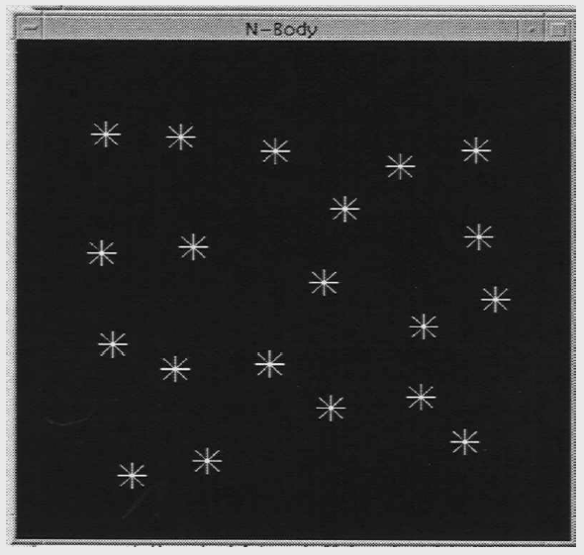
Astrophysical N-body simulation
By David Messager (UNCC student 1998) using Barnes-Hut algorithm.
4.37

