Slide 1
Chapter 6
Synchronous Computations
6.1

Slide 2
Synchronous Computations
In a (fully) synchronous application, all the processes synchronized at regular points.
Barrier
A basic mechanism for synchronizing processes - inserted at the point in each process where it must wait.
All processes can continue from this point when all the processes have reached it (or, in some implementations, when a stated number of processes have reached this point).
6.2

Slide 3
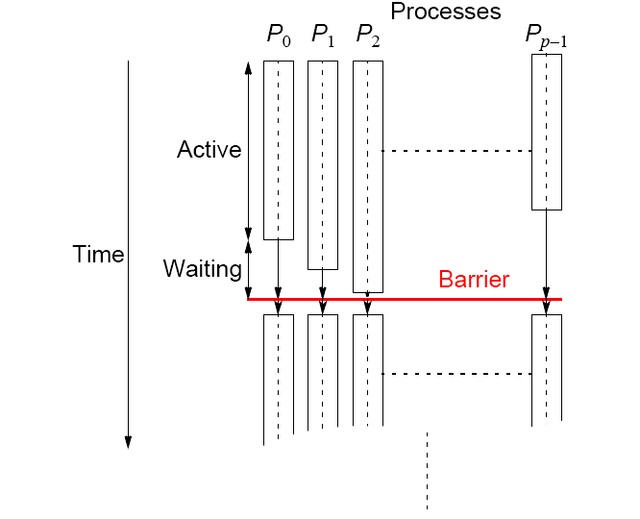
Processes reaching barrier
at different times
6.3

Slide 4
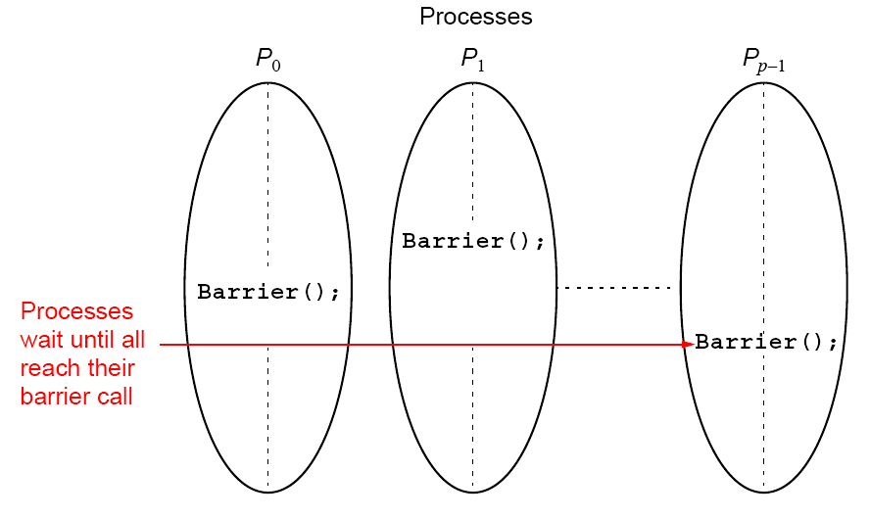
In message-passing systems, barriers provided with library
routines:
6.4

Slide 5
MPI
MPI_Barrier()
Barrier with a named communicator being the only parameter.
Called by each process in the group, blocking until all members of the group have reached the barrier call and only returning then.
6.5

Slide 6
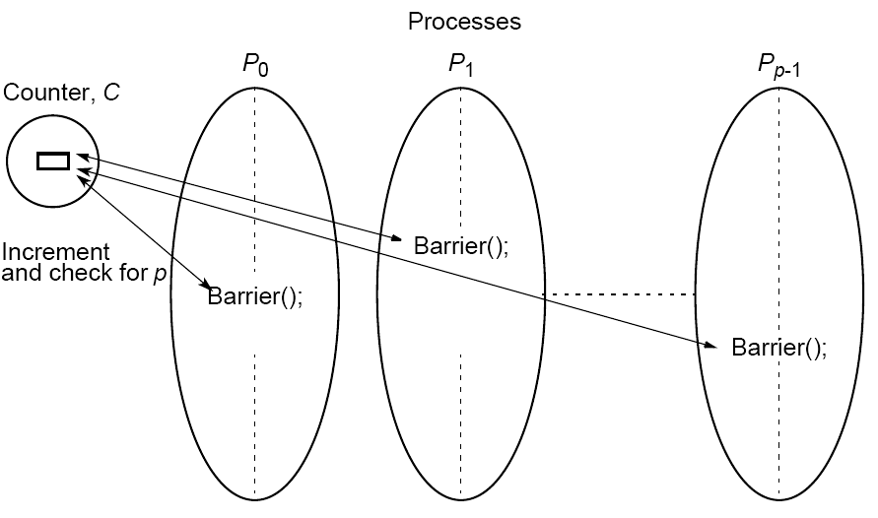
Barrier Implementation
Centralized counter implementation (a linear barrier):
6.6

Slide 7
Good barrier implementations must take into account that a barrier might be used more than once in a process.
Might be possible for a process to enter the barrier for a second time before previous processes have left the barrier for the first time.
6.7

Slide 8
Counter-based barriers often have two phases:
• A process enters arrival phase and does not leave this
phase until all processes have arrived in this phase.
• Then processes move to departure phase and are released.
Two-phase handles the reentrant scenario.
6.8

Slide 9
Example code:
Master:
for (i = 0; i < n; i++) /*count slaves as they reach barrier*/
recv(Pany);
for (i = 0; i < n; i++) /* release slaves */
send(Pi);
Slave processes:
send(Pmaster);
recv(Pmaster);
6.9

Slide 10
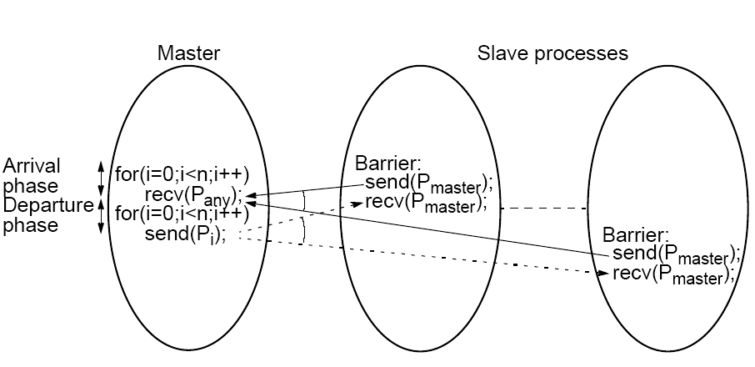
Barrier implementation in
a message-passing system
6.10

Slide 11
Tree Implementation
More efficient. O(log p) steps
Suppose 8 processes, P0, P1, P2, P3, P4, P5, P6, P7:
1st stage: P1 sends message to P0; (when P1 reaches its barrier)
P3 sends message to P2; (when P3 reaches its barrier)
P5 sends message to P4; (when P5 reaches its barrier)
P7 sends message to P6; (when P7 reaches its barrier)
2nd stage: P2 sends message to P0; (P2 & P3 reached their barrier)
P6 sends message to P4; (P6 & P7 reached their barrier)
3rd stage: P4 sends message to P0; (P4, P5, P6, & P7 reached barrier)
P0 terminates arrival phase;
(when P0 reaches barrier & received message from P4)
Release with a reverse tree construction.
6.11

Slide 12
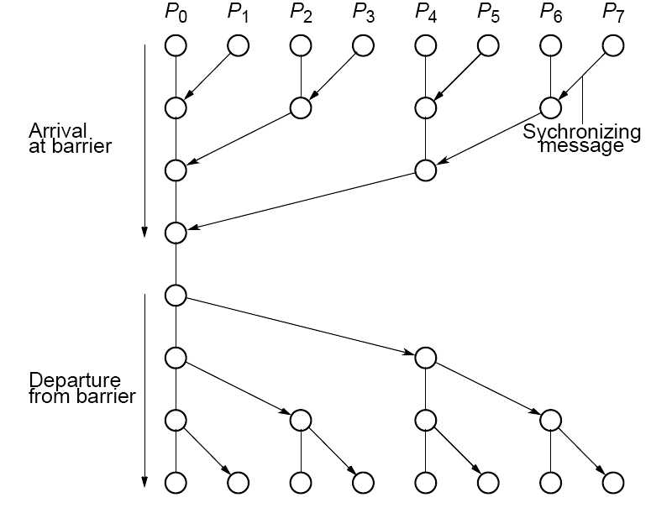
Tree barrier
6.12

Slide 13
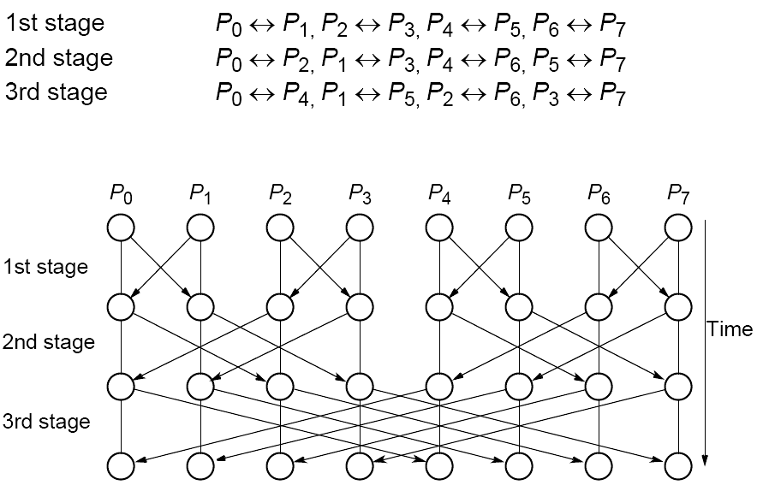
Butterfly Barrier
6.13

Slide 14
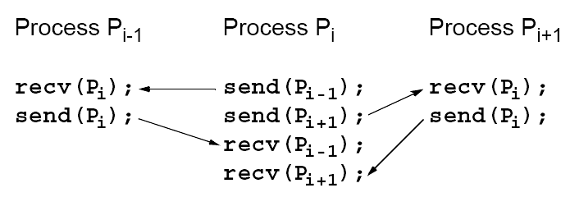
Local Synchronization
Suppose a process Pi needs to be synchronized and to exchange data with process Pi-1 and process Pi+1 before continuing:
Not a perfect three-process barrier because process Pi-1 will only synchronize with Pi and continue as soon as Pi allows. Similarly, process Pi+1 only synchronizes with Pi.
6.14

Slide 15
Deadlock
When a pair of processes each send and receive from each other, deadlock may occur.
Deadlock will occur if both processes perform the send, using synchronous routines first (or blocking routines without sufficient buffering). This is because neither will return; they will wait for matching receives that are never reached.
6.15

Slide 16
A Solution
Arrange for one process to receive first and then send and the other process to send first and then receive.
Example
Linear pipeline, deadlock can be avoided by arranging so the even-numbered processes perform their sends first and the odd-numbered processes perform their receives first.
6.16

Slide 17
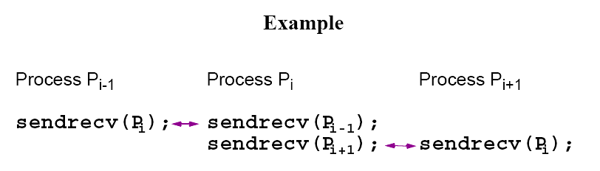
Combined deadlock-free blocking
sendrecv() routines
MPI provides MPI_Sendrecv() and MPI_Sendrecv_replace().
MPI sendrev()s actually has 12 parameters!
6.17

Slide 18
Synchronized Computations
Can be classififed as:
• Fully synchronous
or
• Locally synchronous
In fully synchronous, all processes involved in the computation must be synchronized.
In locally synchronous, processes only need to synchronize with a set of logically nearby processes, not all processes involved in the computation
6.18

Slide 19
Fully Synchronized Computation Examples
Data Parallel Computations
Same operation performed on different data elements
simultaneously; i.e., in parallel.
Particularly convenient because:
• Ease of programming (essentially only one program).
• Can scale easily to larger problem sizes.
• Many numeric and some non-numeric problems can be
cast in a data parallel form.
6.19

Slide 20
Example
To add the same constant to each element of an array:
for (i = 0; i < n; i++)
a[i] = a[i] + k;
The statement:
a[i] = a[i] + k;
could be executed simultaneously by multiple processors, each using a different index i (0 < i <= n).
6.20

Slide 21
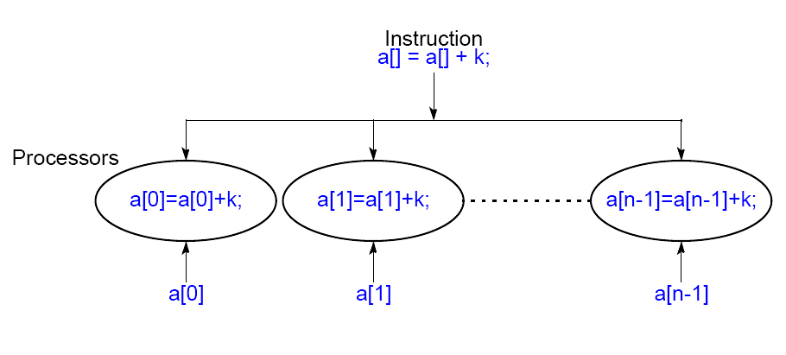
Data Parallel Computation
6.21

Slide 22
forall construct
Special “parallel” construct in parallel programming languages to specify data parallel operations
Example
forall (i = 0; i < n; i++) {
body
}
states that n instances of the statements of the body can be
executed simultaneously.
One value of the loop variable i is valid in each instance of the
body, the first instance has i = 0, the next i = 1, and so on.
6.22

Slide 23
To add k to each element of an array, a, we can write
forall (i = 0; i < n; i++)
a[i] = a[i] + k;
6.23

Slide 24
Data parallel technique applied to multiprocessors and multicomputers
Example
To add k to the elements of an array:
i = myrank;
a[i] = a[i] + k; /* body */
barrier(mygroup);
where myrank is a process rank between 0 and n - 1.
6.24

Slide 25
Data Parallel Example Prefix Sum Problem
Given a list of numbers, x₀, …, x_{n-1}, compute all the partial summations, i.e.:
x₀ + x₁; x₀ + x₁ + x₂; x₀ + x₁ + x₂ + x₃; … ).
Can also be defined with associative operations other than addition.
Widely studied. Practical applications in areas such as processor allocation, data compaction, sorting, and polynomial evaluation.
6.25

Slide 26
Data parallel method of adding all partial sums of 16 numbers
6.26

Slide 27
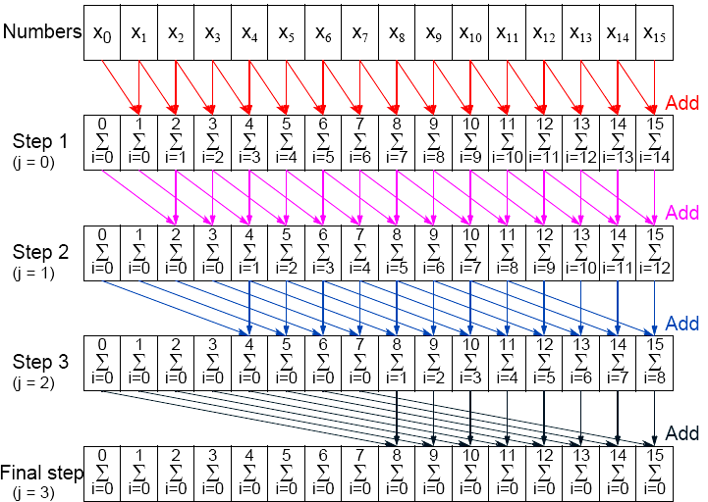
Data parallel prefix sum operation
6.27

Slide 28
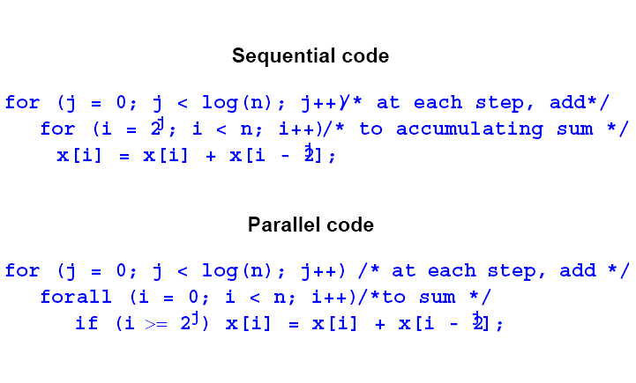
6.28

Slide 29
Synchronous Iteration
(Synchronous Parallelism)
Each iteration composed of several processes that start together at beginning of iteration. Next iteration cannot begin until all processes have finished previous iteration.
Using forall construct:
for (j = 0; j < n; j++) /*for each synch. iteration */
forall (i = 0; i < N; i++) { /*N procs each using*/
body(i); /* specific value of i */
}
6.29

Slide 30
Using message passing barrier:
for (j = 0; j < n; j++) { /*for each synchr.iteration */
i = myrank; /*find value of i to be used */
body(i);
barrier(mygroup);
}
6.30

Slide 31
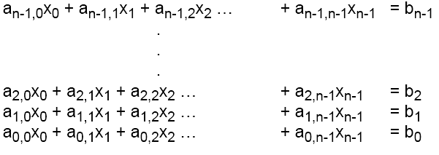
Another fully synchronous computation example
Solving a General System of Linear Equations by Iteration
Suppose the equations are of a general form with n equations and n unknowns
where the unknowns are x₀, x₁, x₂, … x_{n-1} (0 <= i < n).
6.31

Slide 32
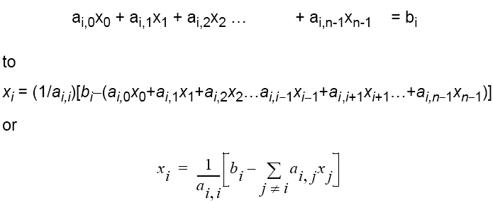
By rearranging the ith equation:
This equation gives x_{i} in terms of the other unknowns.
Can be be used as an iteration formula for each of the unknowns to obtain better approximations.
6.32

Slide 33

Jacobi Iteration
All values of x are updated together.
Can be proven that Jacobi method will converge if diagonal values of a have an absolute value greater than sum of the absolute values of the other a’s on the row (the array of a’s is diagonally dominant) i.e. if
This condition is a sufficient but not a necessary condition.
6.33

Slide 34
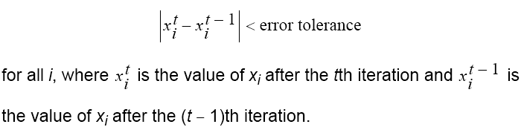
Termination
A simple, common approach. Compare values computed in one iteration to values obtained from the previous iteration. Terminate computation when all values are within given tolerance; i.e., when
However, this does not guarantee the solution to that accuracy.
6.34

Slide 35
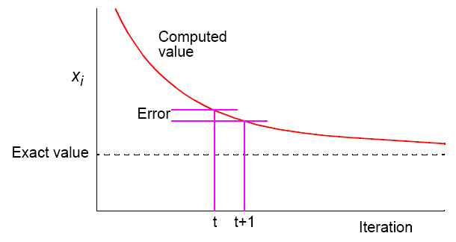
Convergence Rate
6.35

Slide 36
Parallel Code
Process Pi could be of the form
x[i] = b[i]; /*initialize unknown*/
for (iteration = 0; iteration < limit; iteration++) {
sum = -a[i][i] * x[i];
for (j = 0; j < n; j++) /* compute summation */
sum = sum + a[i][j] * x[j];
new_x[i] = (b[i] - sum) / a[i][i]; /* compute unknown */
allgather(&new_x[i]); /*bcast/rec values */
global_barrier(); /* wait for all procs */
}
allgather() sends the newly computed value of x[i] from process i to every other process and collects data broadcast from the other processes.
6.36

Slide 37
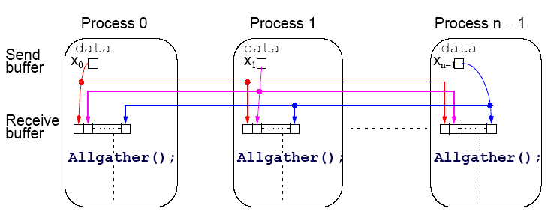
Introduce a new message-passing operation - Allgather.
Allgather
Broadcast and gather values in one composite construction.
6.37

Slide 38
Partitioning
Usually number of processors much fewer than number of data items to be processed. Partition the problem so that processors take on more than one data item.
6.38

Slide 39
block allocation – allocate groups of consecutive unknowns to processors in increasing order.
cyclic allocation – processors are allocated one unknown in order; i.e., processor P₀ is allocated x₀, x_{p}, x_{2p}, …, x_{((n/p)-1)p}, processor P₁ is allocated x₁, x_{p+1}, x_{2p+1}, …, x_{((n/p)-1)p+1}, and so on.
Cyclic allocation no particular advantage here (Indeed, may be disadvantageous because the indices of unknowns have to be computed in a more complex way).
6.39

Slide 40
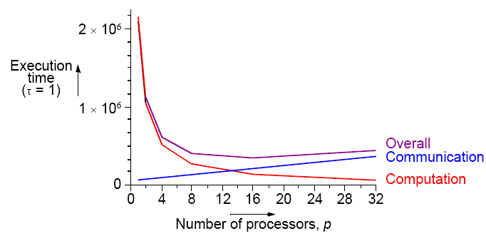
Effects of computation and communication in Jacobi iteration
Consequences of different numbers of processors done in textbook.
Get:
6.40

Slide 41
Locally Synchronous Computation
Heat Distribution Problem
An area has known temperatures along each of its edges.
Find the temperature distribution within.
6.41

Slide 42

Divide area into fine mesh of points, h_{i,j}.
Temperature at an inside point taken to be average of temperatures of four neighboring points. Convenient to describe edges by points.
Temperature of each point by iterating the equation:
(0 < i < n, 0 < j < n) for a fixed number of iterations or until the difference between iterations less than some very small amount.
6.42

Slide 43
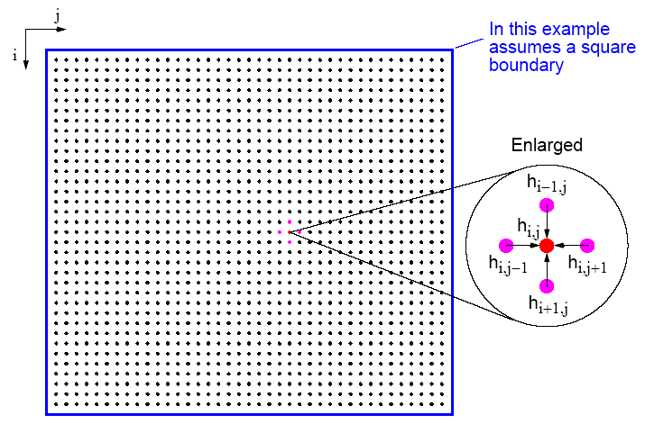
Heat Distribution Problem
6.43

Slide 44
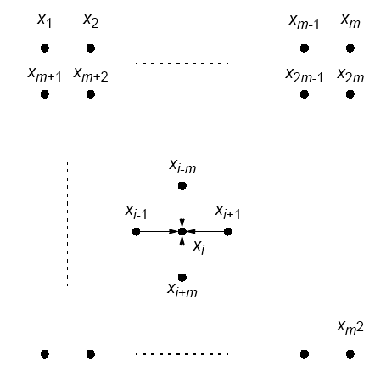
Natural ordering of heat distribution problem
6.44

Slide 45


Number points from 1 for convenience and include those representing the edges. Each point will then use the equation
Could be written as a linear equation containing the unknowns xi-m, xi-1, xi+1, and xi+m:
Notice: solving a (sparse) system
Also solving Laplace’s equation.
6.45

Slide 46
Sequential Code
Using a fixed number of iterations
for (iteration = 0; iteration < limit; iteration++) {
for (i = 1; i < n; i++)
for (j = 1; j < n; j++)
g[i][j] = 0.25*(h[i-1][j]+h[i+1][j]+h[i][j-1]+h[i][j+1]);
for (i = 1; i < n; i++) /* update points */
for (j = 1; j < n; j++)
h[i][j] = g[i][j];
}
using original numbering system (n x n array).
6.46

Slide 47
To stop at some precision:
do {
for (i = 1; i < n; i++)
for (j = 1; j < n; j++)
g[i][j] = 0.25*(h[i-1][j]+h[i+1][j]+h[i][j-1]+h[i][j+1]);
for (i = 1; i < n; i++) /* update points */
for (j = 1; j < n; j++)
h[i][j] = g[i][j];
continue = FALSE; /* indicates whether to continue */
for (i = 1; i < n; i++)/* check each pt for convergence */
for (j = 1; j < n; j++)
if (!converged(i,j) {/* point found not converged */
continue = TRUE;
break;
}
} while (continue == TRUE);
6.47

Slide 48
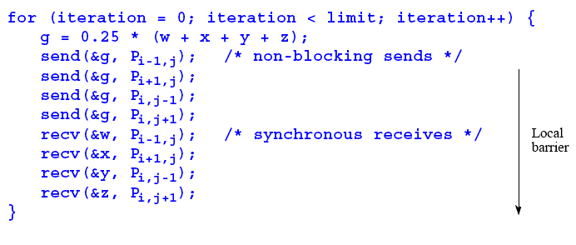
Parallel Code
With fixed number of iterations, P_{i,j}
(except for the boundary points):
Important to use send()s that do not block while waiting for recv()s; otherwise processes would deadlock, each waiting for a recv() before moving on - recv()s must be synchronous and wait for send()s.
6.48

Slide 49
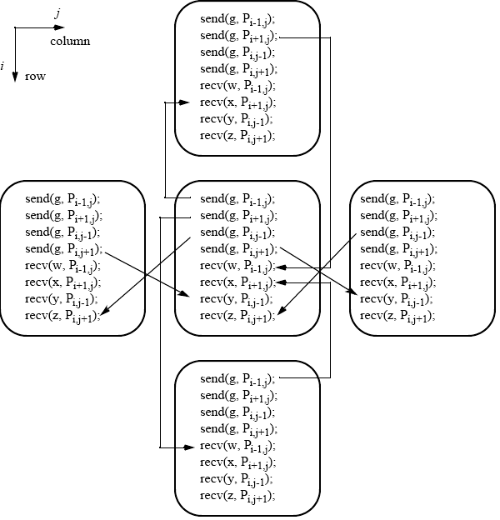
Message passing for heat distribution problem
6.49

Slide 50
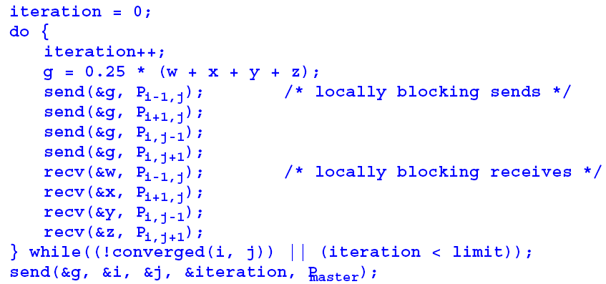
Version where processes stop when they reach their required precision:
6.50

Slide 51
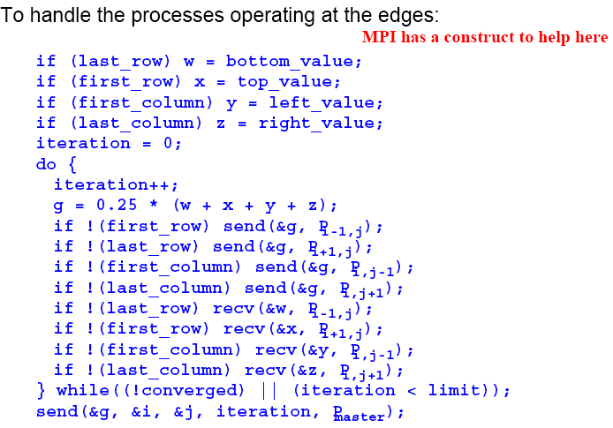
6.51

Slide 52
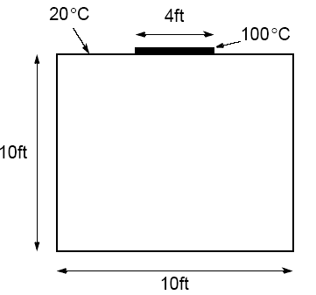
Example
A room has four walls and a fireplace. Temperature of wall is 20°C, and temperature of fireplace is 100°C. Write a parallel program using Jacobi iteration to compute the temperature inside the room and plot (preferably in color) temperature contours at 10°C intervals using Xlib calls or similar graphics calls as available on your system.
6.52

Slide 53
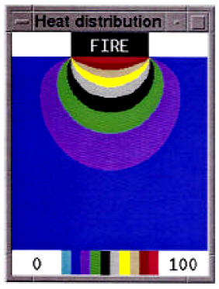
Sample student output
6.53

Slide 54
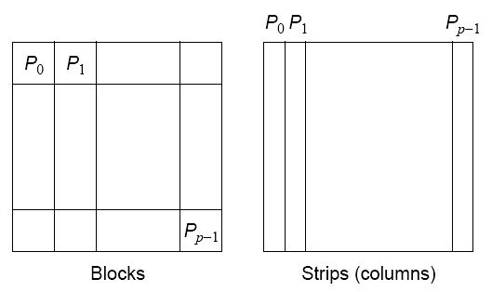
Partitioning
Normally allocate more than one point to each processor, because many more points than processors.
Points could be partitioned into square blocks or strips:
6.54

Slide 55
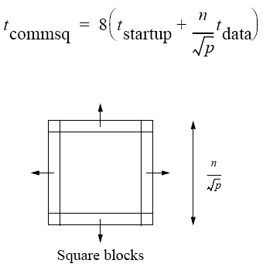
Block partition
Four edges where data points exchanged.
Communication time given by
6.55

Slide 56
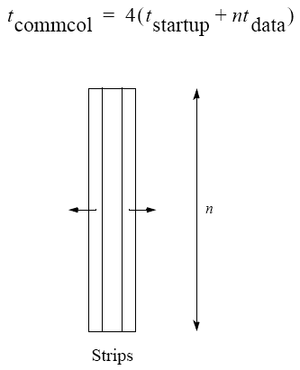
Strip partition
Two edges where data points are exchanged.
Communication time is given by
6.56

Slide 57
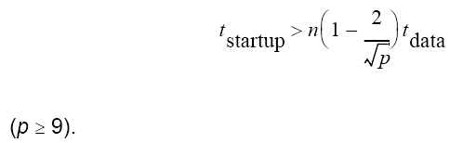
Optimum
In general, strip partition best for large startup time, and block
partition best for small startup time.
With the previous equations, block partition has a larger communication time than strip partition if
6.57

Slide 58
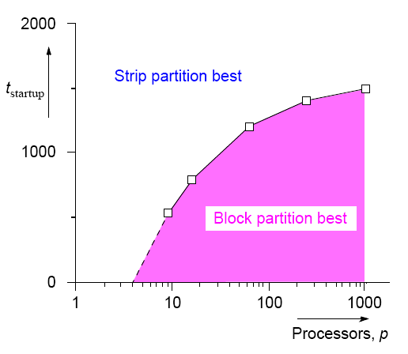
Startup times for block and
strip partitions
6.58

Slide 59
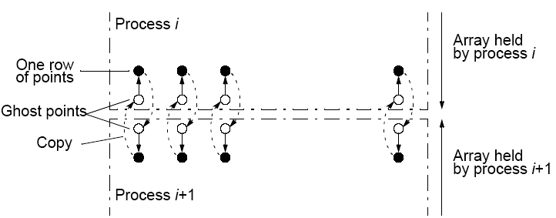
Ghost Points
Additional row of points at each edge that hold values from adjacent edge. Each array of points increased to accommodate ghost rows.
6.59

Slide 60
Safety and Deadlock
When all processes send their messages first and then receive all of their messages is “unsafe” because it relies upon buffering in the send()s. The amount of buffering is not specified in MPI.
If insufficient storage available, send routine may be delayed from returning until storage becomes available or until the message can be sent without buffering.
Then, a locally blocking send() could behave as a synchronous send(), only returning when the matching recv() is executed. Since a matching recv() would never be executed if all the send()s are synchronous, deadlock would occur.
6.60

Slide 61
Making the code safe
Alternate the order of the send()s and recv()s in adjacent
processes so that only one process performs the send()s first.
Then even synchronous send()s would not cause deadlock.
Good way you can test for safety is to replace message-passing routines in a program with synchronous versions.
6.61

Slide 62
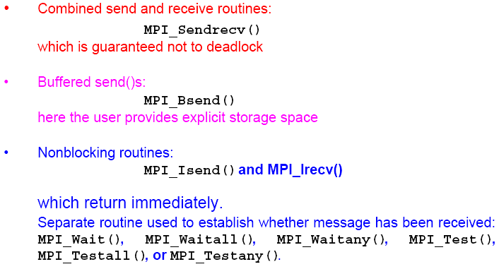
MPI Safe Message Passing Routines
MPI offers several methods for safe communication:
6.62

Slide 63
Other fully synchronous problems
Cellular Automata
The problem space is divided into cells.
Each cell can be in one of a finite number of states.
Cells affected by their neighbors according to certain rules, and all cells are affected simultaneously in a “generation.”
Rules re-applied in subsequent generations so that cells evolve, or change state, from generation to generation.
Most famous cellular automata is the “Game of Life” devised by John Horton Conway, a Cambridge mathematician.
6.63

Slide 64
The Game of Life
Board game - theoretically infinite two-dimensional array of cells. Each cell can hold one “organism” and has eight neighboring cells, including those diagonally adjacent. Initially, some cells occupied.
The following rules apply:
1. Every organism with two or three neighboring organisms
survives for the next generation.
2. Every organism with four or more neighbors dies from
overpopulation.
3. Every organism with one neighbor or none dies from isolation.
4. Each empty cell adjacent to exactly three occupied neighbors
will give birth to an organism.
These rules were derived by Conway “after a long period of experimentation.”
6.64

Slide 65
Simple Fun Examples of Cellular Automata
“Sharks and Fishes”
An ocean could be modeled as a three-dimensional array of cells.
Each cell can hold one fish or one shark (but not both).
Fish and sharks follow “rules.”
6.65

Slide 66
Fish
Might move around according to these rules:
If there is one empty adjacent cell, the fish moves to this cell.
2. If there is more than one empty adjacent cell, the fish moves to one cell chosen at random.
3. If there are no empty adjacent cells, the fish stays where it is.
4. If the fish moves and has reached its breeding age, it gives birth to a baby fish, which is left in the vacating cell.
5. Fish die after x generations.
6.66

Slide 67
Sharks
Might be governed by the following rules:
1. If one adjacent cell is occupied by a fish, the shark moves to
this cell and eats the fish.
2. If more than one adjacent cell is occupied by a fish, the shark chooses one fish at random, moves to the cell occupied by the fish, and eats the fish.
3. If no fish are in adjacent cells, the shark chooses an
unoccupied adjacent cell to move to in a similar manner as fish move.
4. If the shark moves and has reached its breeding age, it gives birth to a baby shark, which is left in the vacating cell.
5. If a shark has not eaten for y generations, it dies.
6.67

Slide 68
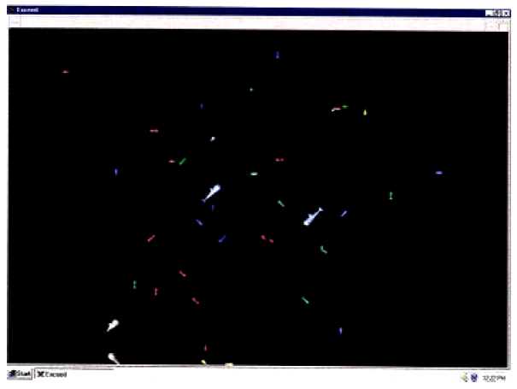
Sample Student Output
6.68

Slide 69
Similar examples:
“foxes and rabbits” - Behavior of rabbits to move around happily whereas behavior of foxes is to eat any rabbits they come across.
6.69

Slide 70
Serious Applications for Cellular Automata
Examples
• fluid/gas dynamics
• the movement of fluids and gases around objects
• diffusion of gases
• biological growth
• airflow across an airplane wing
• erosion/movement of sand at a beach or riverbank.
6.70

Slide 71
Partially Synchronous Computations
Computations in which individual processes operate without needing to synchronize with other processes on every iteration.
Important idea because synchronizing processes is an expensive operation which very significantly slows the computation and a major cause for reduced performance of parallel programs is due to the use of synchronization.
Global synchronization done with barrier routines. Barriers cause processor to wait sometimes needlessly.
6.71

Slide 72
Heat Distribution Problem Re-visited
To solve heat distribution problem, solution space divided into a two dimensional array of points. The value of each point computed by taking average of four points around it repeatedly until values converge on the solution to a sufficient accuracy.
The waiting can be reduced by not forcing synchronization at each iteration.
6.72

Slide 73
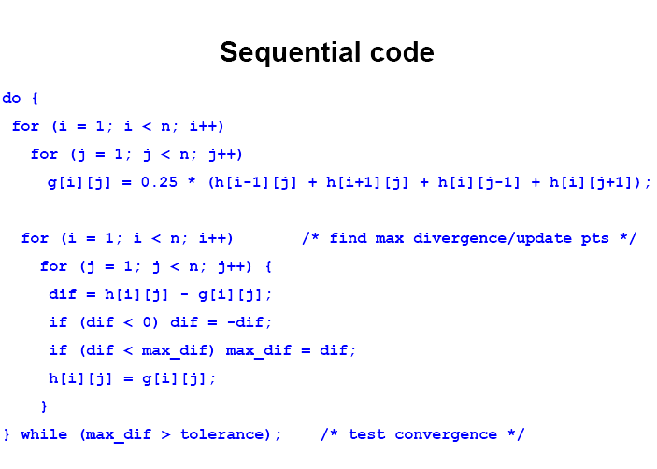
6.73

Slide 74
First section of code computing the next iteration values based on the immediate previous iteration values is traditional Jacobi iteration method.
Suppose however, processes are to continue with the next iteration before other processes have completed.
Then, the processes moving forward would use values computed from not only the previous iteration but maybe from earlier iterations.
Method then becomes an asynchronous iterative method.
6.74

Slide 75
Asynchronous Iterative
Method – Convergence
Mathematical conditions for convergence may be more strict.
Each process may not be allowed to use any previous iteration values if the method is to converge.
6.75

Slide 76
Chaotic Relaxation
A form of asynchronous iterative method introduced by Chazan and Miranker (1969) in which the conditions are stated as:
“there must be a fixed positive integer s such that, in carrying out the evaluation of the ith iterate, a process cannot make use of any value of the components of the jth iterate if j < i - s”
(Baudet, 1978).
6.76

Slide 77
The final part of the code, checking for convergence of every iteration can also be reduced. It may be better to allow iterations to continue for several iterations before checking for convergence.
6.77

Slide 78
Overall Parallel Code
Each process allowed to perform s iterations before being synchronized and also to update the array as it goes. At s iterations, maximum divergence recorded. Convergence is checked then.
The actual iteration corresponding to the elements of the array being used at any time may be from an earlier iteration but only up to s iterations previously. May be a mixture of values of different iterations as array is updated without synchronizing with other processes - truly a chaotic situation.
6.78

