Slide 1
Chapter 7
Load Balancing and Termination
Detection

Slide 2
Load balancing – used to distribute computations fairly across processors in order to obtain the highest possible execution speed.
Termination detection – detecting when a computation has been completed. More difficult when the computation is distributed.

Slide 3
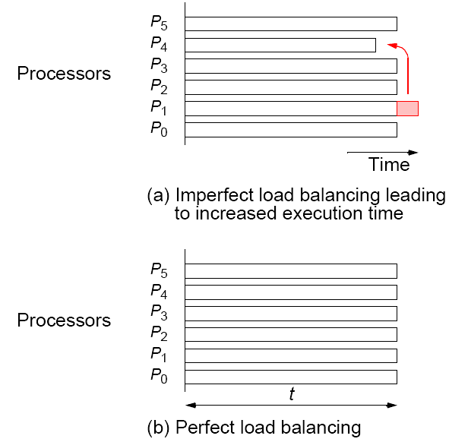
Load balancing

Slide 4
Static Load Balancing
Before execution of any process.
Some potential static load balancing techniques:
• Round robin algorithm — passes out tasks in sequential order of processes coming back to the first when all processes have been given a task
• Randomized algorithms — selects processes at random to take tasks
• Recursive bisection — recursively divides the problem into sub-problems of equal computational effort while minimizing message passing
• Simulated annealing — an optimization technique
• Genetic algorithm — another optimization technique

Slide 5
Several fundamental flaws with static load balancing even if a mathematical solution exists:
• Very difficult to estimate accurately execution times of various parts of a program without actually executing the parts.
• Communication delays that vary under different Circumstances
• Some problems have an indeterminate number of steps to reach their solution.

Slide 6
Dynamic Load Balancing
Vary load during the execution of the processes.
All previous factors taken into account by making division of load dependent upon execution of the parts as they are being executed.
Does incur an additional overhead during execution, but it is much more effective than static load balancing

Slide 7
Processes and Processors
Computation will be divided into work or tasks to be performed, and processes perform these tasks. Processes are mapped onto processors.
Since our objective is to keep the processors busy, we are interested in the activity of the processors.
However, often map a single process onto each processor, so will use the terms process and processor somewhat interchangeably.

Slide 8
Dynamic Load Balancing
Can be classified as:
• Centralized
• Decentralized

Slide 9
Centralized dynamic load balancing
Tasks handed out from a centralized location. Master-slave structure.

Slide 10
Decentralized dynamic load balancing
Tasks are passed between arbitrary processes.
A collection of worker processes operate upon the problem and interact among themselves, finally reporting to a single process.
A worker process may receive tasks from other worker processes and may send tasks to other worker processes (to complete or pass on at their discretion).

Slide 11
Centralized Dynamic Load Balancing
Master process(or) holds collection of tasks to be performed.
Tasks sent to slave processes. When a slave process completes one task, it requests another task from the master process.
Terms used : work pool, replicated worker, processor farm.

Slide 12
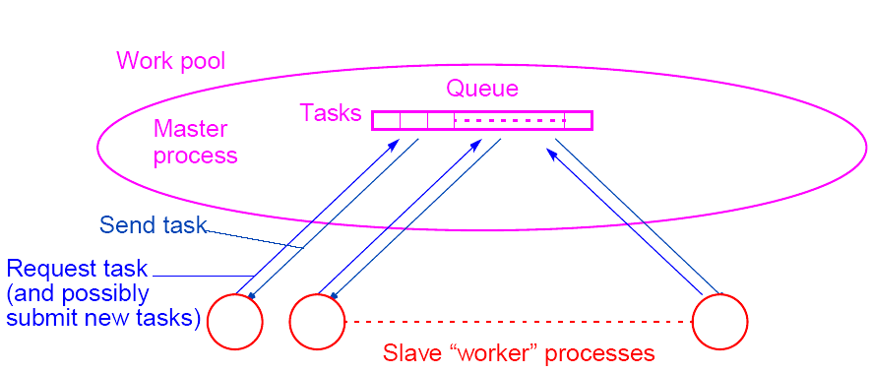
Centralized work pool

Slide 13
Termination
Computation terminates when:
• The task queue is empty and
• Every process has made a request for another task without
any new tasks being generated
Not sufficient to terminate when task queue empty if one or more processes are still running if a running process may provide new tasks for task queue.

Slide 14
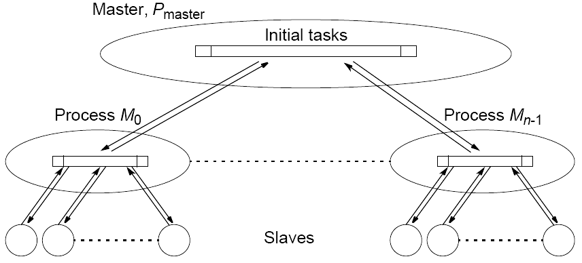
Decentralized Dynamic Load Balancing
Distributed Work Pool

Slide 15
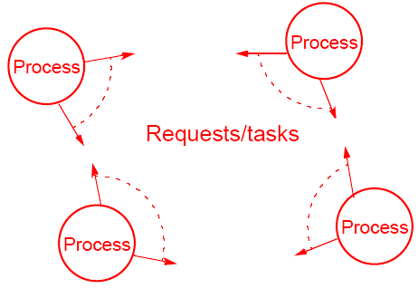
Fully Distributed Work Pool
Processes to execute tasks from each other

Slide 16
Task Transfer Mechanisms
Receiver-Initiated Method
A process requests tasks from other processes it selects.
Typically, a process would request tasks from other processes when it has few or no tasks to perform.
Method has been shown to work well at high system load.
Unfortunately, it can be expensive to determine process loads.

Slide 17
Sender-Initiated Method
A process sends tasks to other processes it selects.
Typically, a process with a heavy load passes out some of its tasks to others that are willing to accept them.
Method has been shown to work well for light overall system loads.

Slide 18
Another option is to have a mixture of methods.
Unfortunately, it can be expensive to determine process loads.
In very heavy system loads, load balancing can also be difficult to achieve because of the lack of available processes.

Slide 19
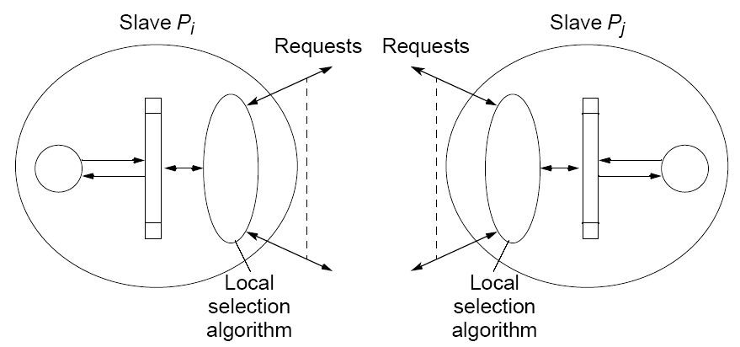
Decentralized selection algorithm requesting tasks between slaves

Slide 20
Process Selection
Algorithms for selecting a process:
Round robin algorithm – process P_{i} requests tasks from process P_{x}, where x is given by a counter that is incremented after each request, using modulo n arithmetic (n processes), excluding x = i.
Random polling algorithm – process P_{i} requests tasks from process P_{x}, where x is a number that is selected randomly between 0 and n - 1 (excluding i).

Slide 21
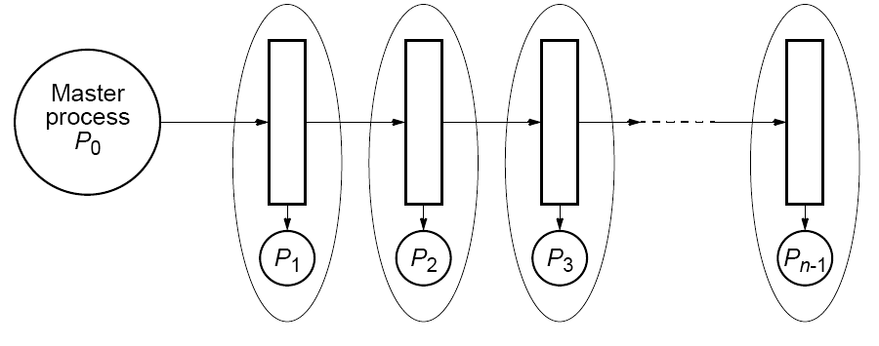
Load Balancing Using a Line Structure

Slide 22
Master process (P₀) feeds queue with tasks at one end, and tasks are shifted down queue.
When a process, P_{i} (1 <= i < n), detects a task at its input from queue and process is idle, it takes task from queue.
Then tasks to left shuffle down queue so that space held by task is filled. A new task is inserted into e left side end of queue.
Eventually, all processes have a task and queue filled with new tasks. High-priority or larger tasks could be placed in queue first.

Slide 23
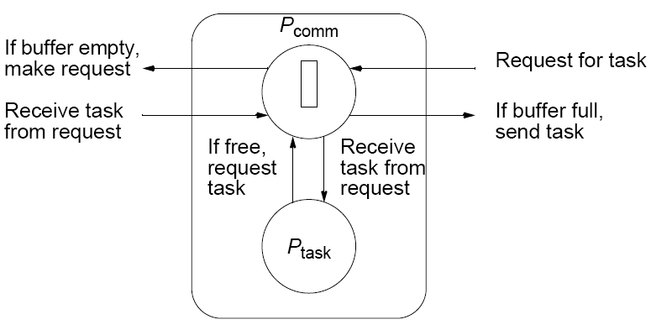
Shifting Actions
Could be orchestrated by using messages between adjacent processes:
• For left and right communication
• For the current task

Slide 24
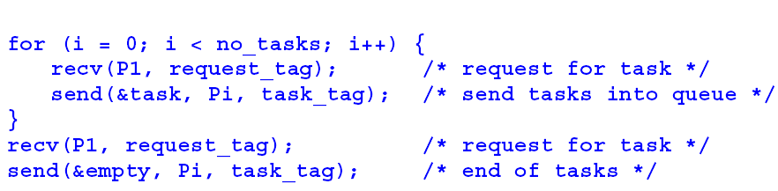
Code Using Time Sharing Between
Communication and Computation
Master process (P0)

Slide 25
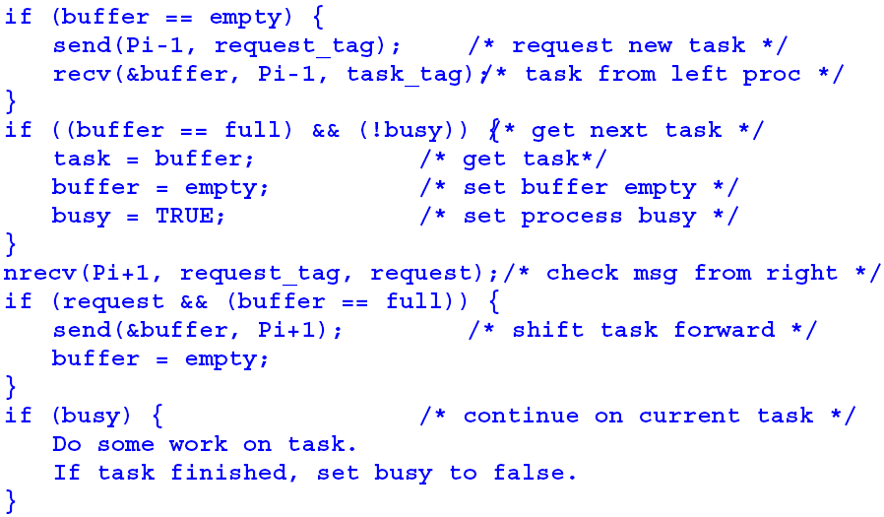
Process P_{i} (1 < i < n)
Nonblocking nrecv() necessary to check for a request being received from right.

Slide 26
Nonblocking Receive Routines
MPI
Nonblocking receive, MPI_Irecv(), returns a request “handle,” which is used in subsequent completion routines to wait for the message or to establish whether message has actually been received at that point (MPI_Wait() and MPI_Test(), respectively).
In effect, nonblocking receive, MPI_Irecv(), posts a request for message and returns immediately.

Slide 27
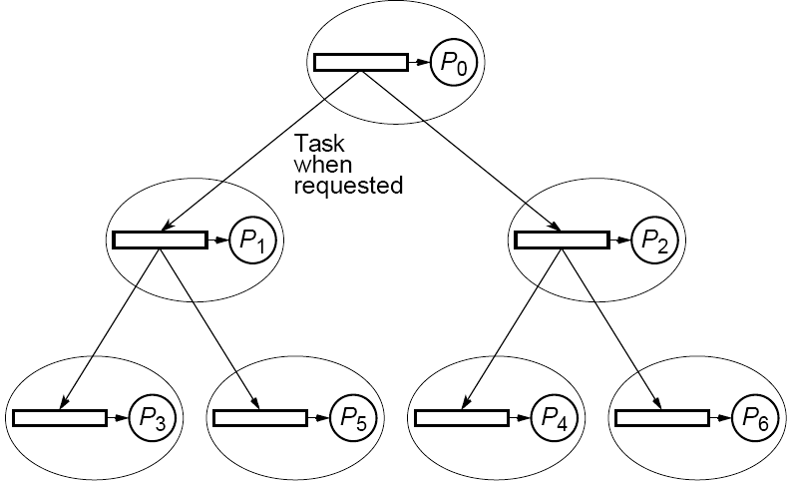
Load balancing using a tree
Tasks passed from node into one of the two nodes below it when node buffer empty.

Slide 28
Distributed Termination Detection Algorithms
Termination Conditions
At time t requires the following conditions to be satisfied:
• Application-specific local termination conditions exist
throughout the collection of processes, at time t.
• There are no messages in transit between processes at time t.
Subtle difference between these termination conditions and those given for a centralized load-balancing system is having to take into account messages in transit.
Second condition necessary because a message in transit might
restart a terminated process. More difficult to recognize. Time for
messages to travel between processes not known in advance.

Slide 29
Very general distributed termination
algorithm
Each process in one of two states:
Inactive - without any task to perform
2. Active
Process that sent task to make a process enter the active state becomes its “parent.”

Slide 30
When process receives a task, it immediately sends an acknowledgment message, except if the process it receives the task from is its parent process. Only sends an acknowledgment message to its parent when it is ready to become inactive, i.e. when
• Its local termination condition exists (all tasks are completed), and
• It has transmitted all its acknowledgments for tasks it has received, and
• It has received all its acknowledgments for tasks it has sent out.
A process must become inactive before its parent process. When first process becomes idle, the computation can terminate.

Slide 31
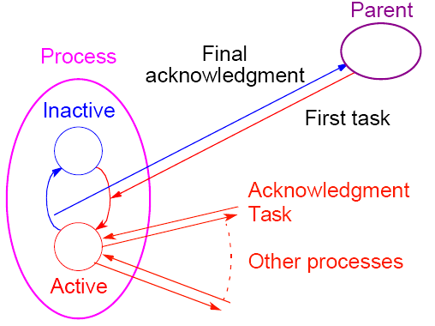
Termination using message acknowledgments
Other termination algorithms in textbook.

Slide 32
Ring Termination Algorithms
Single-pass ring termination algorithm
When P₀ terminated, it generates token passed to P₁.
2. When P_{i} (1 <=i < n) receives token and has already terminated, it passes token onward to P_{i+1}. Otherwise, it waits for its local termination condition and then passes token onward. P_{n-1} passes token to P₀.
3. When P₀ receives a token, it knows that all processes in the ring have terminated. A message can then be sent to all processes informing them of global termination, if necessary.
Algorithm assumes that a process cannot be reactivated after reaching its local termination condition. Does not apply to work pool problems in which a process can pass a new task to an idle process

Slide 33
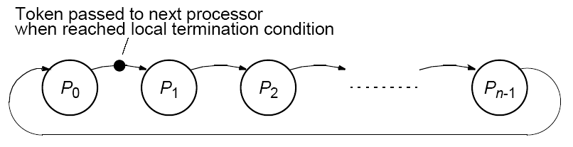
Ring termination detection algorithm

Slide 34
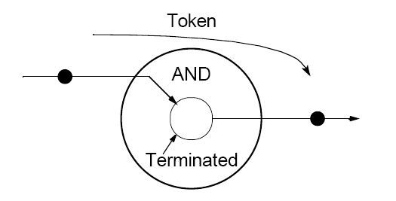
Process algorithm for local termination

Slide 35
Dual-Pass Ring Termination Algorithm
Can handle processes being reactivated but requires two passes around the ring.
Reason for reactivation is for process Pi, to pass a task to Pj where j < i and after a token has passed Pj,. If this occurs, the token must recirculate through the ring a second time.
To differentiate circumstances, tokens colored white or black. Processes are also colored white or black.
Receiving a black token means that global termination may not have occurred and token must be recirculated around ring again.

Slide 36
Algorithm is as follows, again starting at P₀:
1.P₀ becomes white when terminated and generates white token to P₁.
2.Token passed from one process to next when each process terminated, but color of token may be changed. If P_{i} passes a task to P_{j} where j < i (before this process in the ring), it becomes a black process; otherwise it is a white process. A black process will color token black and pass it on. A white process will pass on token in its original color (either black or white). After P_{i} passed on a token, it becomes a white process. P_{n-1} passes token to P₀.
3.When P₀ receives a black token, it passes on a white token; if it receives a white token, all processes have terminated.
In both ring algorithms, P₀ becomes central point for global termination. Assumes acknowledge signal generated to each request.

Slide 37
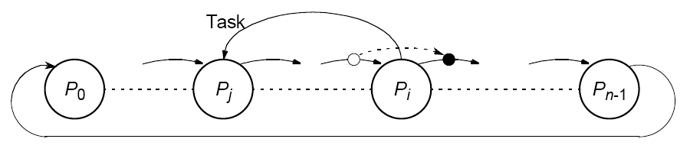
Passing task to previous processes

Slide 38
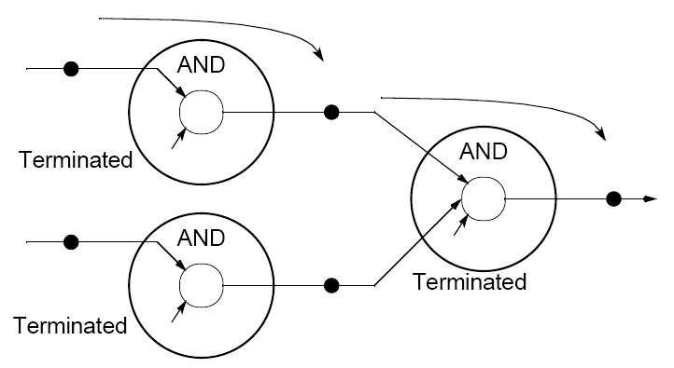
Tree Algorithm
Local actions described can be applied to various structures,
notably a tree structure, to indicate that processes up to that point have terminated.

Slide 39
Fixed Energy Distributed Termination Algorithm
A fixed quantity within system, colorfully termed “energy.”
• System starts with all energy being held by the root process.
• Root process passes out portions of energy with tasks to processes making requests for tasks.
• If these processes receive requests for tasks, energy divided further and passed to these processes.
• When a process becomes idle, it passes energy it holds back before requesting a new task.
• A process will not hand back its energy until all energy it handed out returned and combined to total energy held.
• When all energy returned to root and root becomes idle, all
processes must be idle and computation can terminate.

Slide 40
Fixed Energy Distributed Termination Algorithm
Significant disadvantage - dividing energy will be of finite precision and adding partial energies may not equate to original energy.
In addition, can only divide energy so far before it becomes essentially zero.

Slide 41
Load balancing/termination detection
Example
Shortest Path Problem
Finding the shortest distance between two points on a graph.
It can be stated as follows:
Given a set of interconnected nodes where the links between the nodes are marked with “weights,” find the path from one specific node to another specific node that has the smallest accumulated weights.

Slide 42
The interconnected nodes can be described by a graph.
The nodes are called vertices, and the links are called edges.
If the edges have implied directions (that is, an edge can only be traversed in one direction, the graph is a directed graph.

Slide 43
Graph used to find solution to many different problems; eg:
1. Shortest distance between two towns or other points on a map, where the weights represent distance
2. Quickest route to travel, where weights represent time (
quickest route may not be shortest route if different modes
of travel available; for example, flying to certain towns)
3. Least expensive way to travel by air, where weights
represent cost of flights between cities (the vertices)
4. Best way to climb a mountain given a terrain map with contours
5. Best route through a computer network for minimum message delay (vertices represent computers, and weights represent delay between two computers)
6. Most efficient manufacturing system, where weights
represent hours of work

Slide 44
“The best way to climb a mountain” will be used as an example.

Slide 45
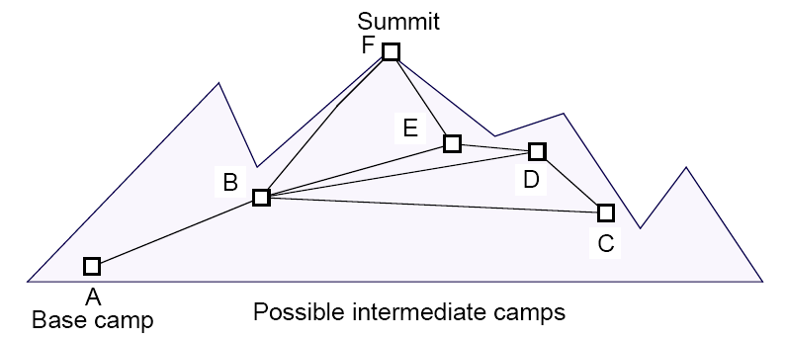
Example:
The Best Way to Climb a Mountain

Slide 46
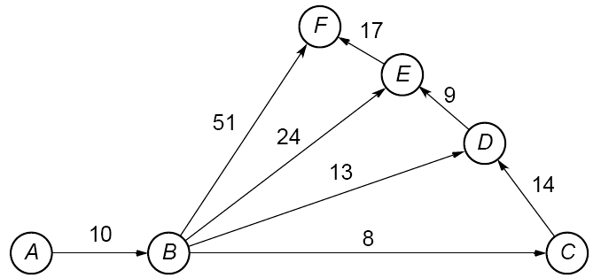
Graph of mountain climb
Weights in graph indicate amount of effort that would be expended in traversing the route between two connected camp sites.
The effort in one direction may be different from the effort in the opposite direction (downhill instead of uphill!). (directed graph)

Slide 47
Graph Representation
Two basic ways that a graph can be represented in a program:
1. Adjacency matrix — a two-dimensional array, a, in which
a[i][j] holds the weight associated with the edge between
vertex i and vertex j if one exists
2. Adjacency list — for each vertex, a list of vertices directly
connected to the vertex by an edge and the corresponding
weights associated with the edges
Adjacency matrix used for dense graphs. Adjacency list used for
sparse graphs.
Difference based upon space (storage) requirements. Accessing
the adjacency list is slower than accessing the adjacency matrix.

Slide 48
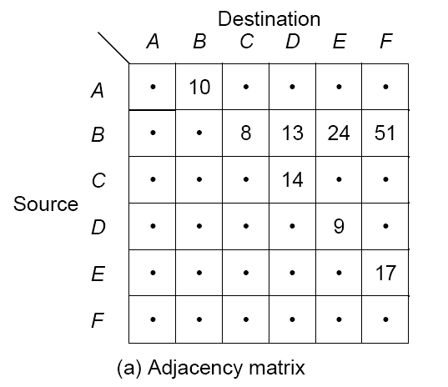
Representing the graph

Slide 49
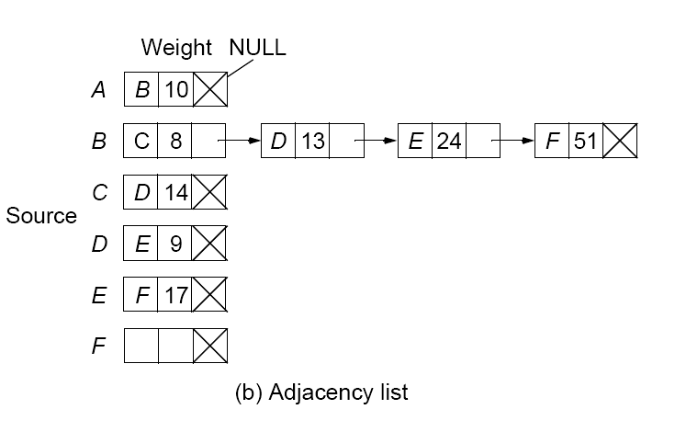

Slide 50
Searching a Graph
Two well-known single-source shortest-path algorithms:
• Moore’s single-source shortest-path algorithm (Moore, 1957)
• Dijkstra’s single-source shortest-path algorithm (Dijkstra, 1959)
which are similar.
Moore’s algorithm is chosen because it is more amenable to parallel implementation although it may do more work.
The weights must all be positive values for the algorithm to work.

Slide 51
Moore’s Algorithm
Starting with the source vertex, the basic algorithm implemented when vertex i is being considered as follows.
Find the distance to vertex j through vertex i and compare with the current minimum distance to vertex j.
Change the minimum distance if the distance through vertex i is shorter. If d_{i} is the current minimum distance from source vertex to vertex i and w_{i,j} is weight of edge from vertex i to vertex j:
d_{j} = min(d_{j}, d_{i} + w_{i,j})

Slide 52
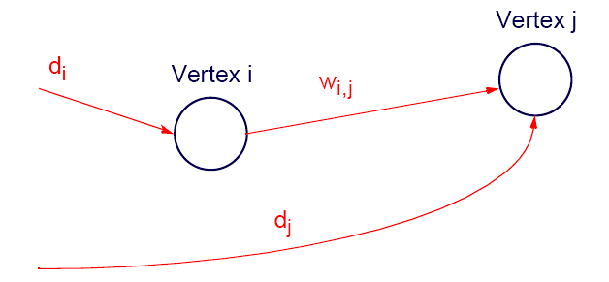
Moore’s Shortest-path Algorithm

Slide 53
Data Structures
First-in-first-out vertex queue created to hold a list of vertices to examine. Initially, only source vertex is in queue.
Current shortest distance from source vertex to vertex i stored in array dist[i]. At first, none of these distances known and array elements are initialized to infinity.

Slide 54
Code
Suppose w[i][j] holds the weight of the edge from vertex i and
vertex j (infinity if no edge). The code could be of the form
newdist_j = dist[i] + w[i][j];
if (newdist_j < dist[j]) dist[j] = newdist_j;
When a shorter distance is found to vertex j, vertex j is added to the queue (if not already in the queue), which will cause vertex j to be examined again - Important aspect of this algorithm, which is not present in Dijkstra’s algorithm.

Slide 55
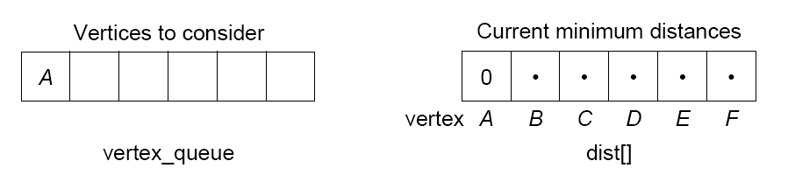
Stages in Searching a Graph
Example
The initial values of the two key data structures are

Slide 56
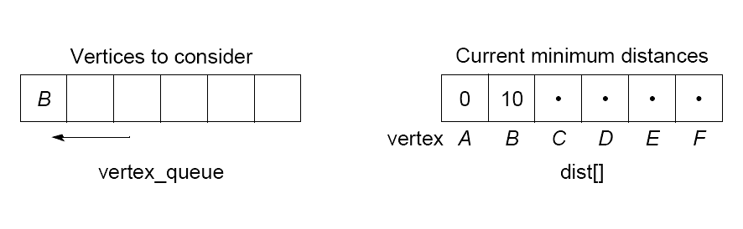
After examining A to

Slide 57
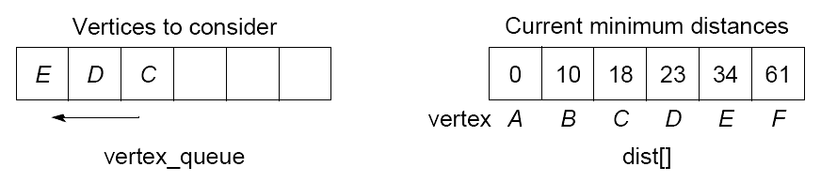
After examining B to F, E, D, and C::

Slide 58
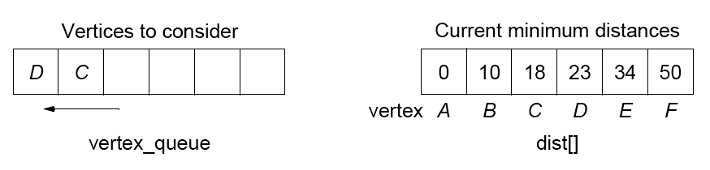
After examining E to F
51

Slide 59
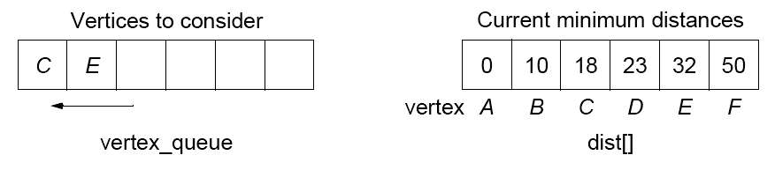
After examining D to E:
51

Slide 60
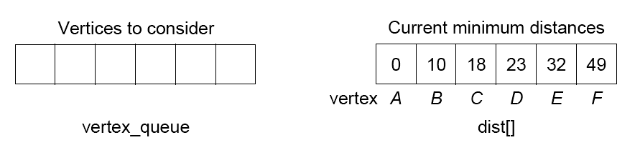
After examining C to D: No changes.
After examining E (again) to F :
No more vertices to consider. Have minimum distance from vertex A to each of the other vertices, including destination vertex, F.
Usually, path required in addition to distance. Then, path stored as distances recorded. Path in our case is A -> B -> D -> E ->F.

Slide 61
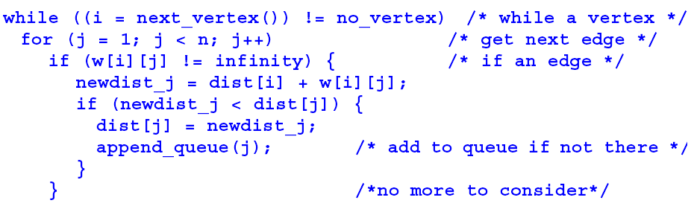
Sequential Code
Let next_vertex() return the next vertex from the vertex queue or no_vertex if none.
Assume that adjacency matrix used, named w[ ][ ].

Slide 62
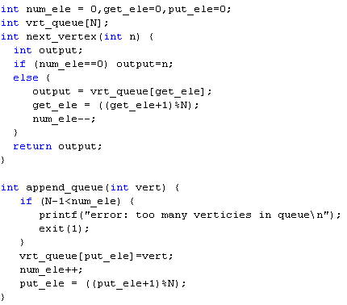
Sequential Code

Slide 63
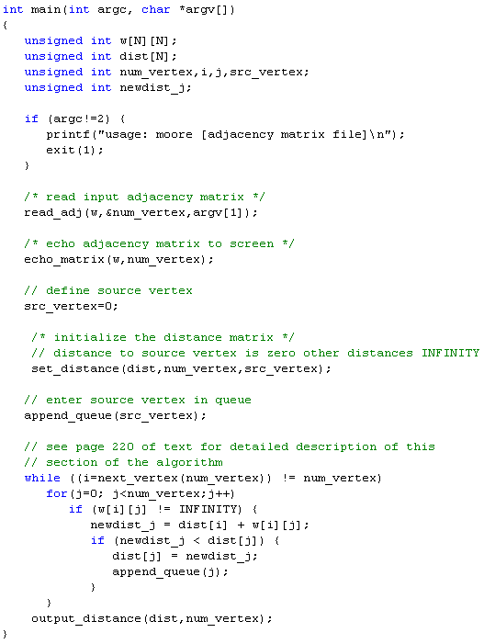
Sequential Code

Slide 64
Parallel Implementations
Centralized Work Pool
Centralized work pool holds vertex queue, vertex_queue[] as tasks.
Each slave takes vertices from vertex queue and returns new vertices.
Since the structure holding the graph weights is fixed, this structure could be copied into each slave, say a copied adjacency matrix.

Slide 65
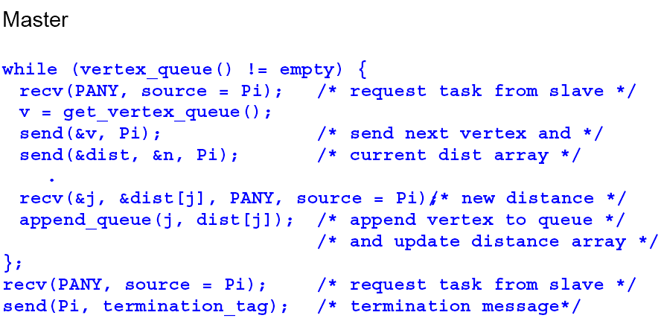

Slide 66
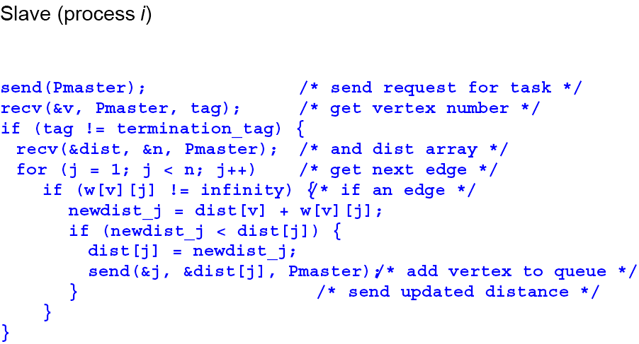

Slide 67
Decentralized Work Pool
Convenient approach is to assign slave process i to search around vertex i only and for it to have the vertex queue entry for vertex i if this exists in the queue.
The array dist[ ] distributed among processes so that process i maintains current minimum distance to vertex i.
Process also stores adjacency matrix/list for vertex i, for the purpose of identifying the edges from vertex i.

Slide 68
Search Algorithm
Vertex A is the first vertex to search. The process assigned to vertex A is activated.
This process will search around its vertex to find distances to connected vertices.
Distance to process j will be sent to process j for it to compare with its currently stored value and replace if the currently stored value is larger.
In this fashion, all minimum distances will be updated during the search.
If the contents of d[i] changes, process i will be reactivated to search again.

Slide 69
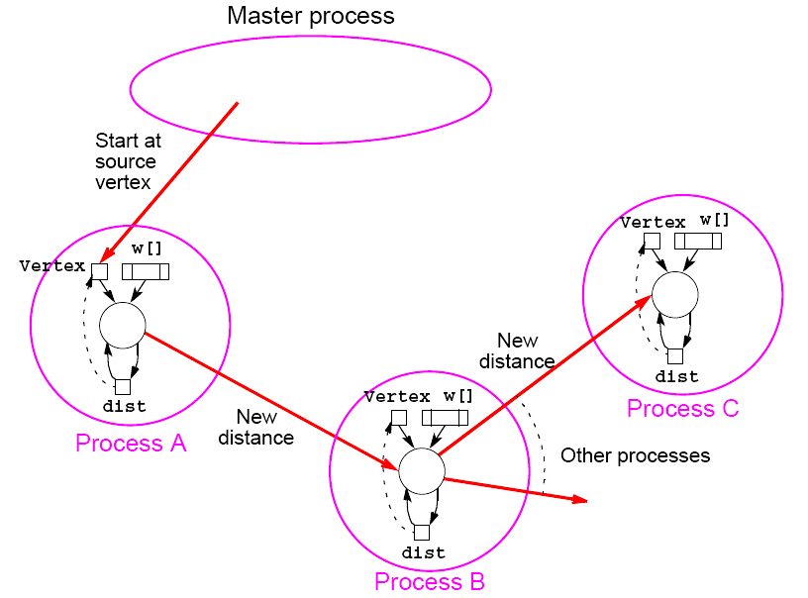
Distributed graph search

Slide 70
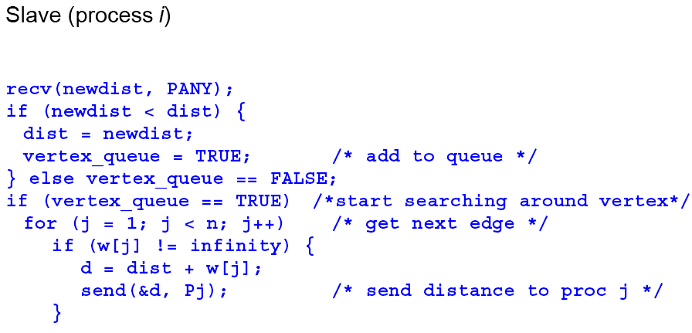

Slide 71
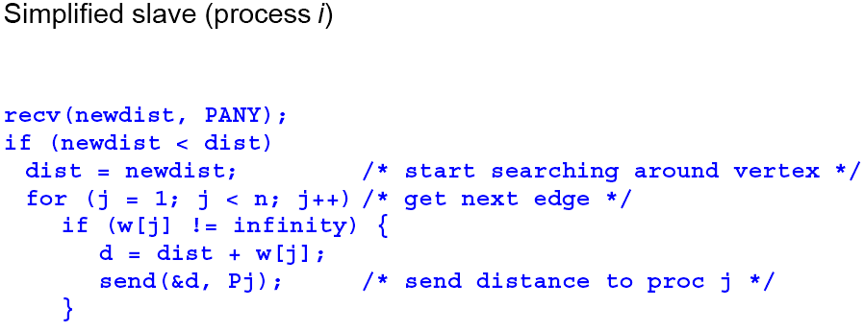

Slide 72
Mechanism necessary to repeat actions and terminate when all processes idle - must cope with messages in transit.
Simplest solution
Use synchronous message passing, in which a process cannot proceed until destination has received message.
Process only active after its vertex is placed on queue. Possible for many processes to be inactive, leading to an inefficient solution.
Impractical for a large graph if one vertex is allocated to each processor. Group of vertices could be allocated to each processor.

