Slide 1
Chapter 8
Programming with Shared Memory

Slide 2
Shared memory multiprocessor system
Any memory location can be accessible by any of the processors.
A single address space exists, meaning that each memory location is given a unique address within a single range of addresses.
Generally, shared memory programming more convenient although it does require access to shared data to be controlled by the programmer (using critical sections etc.)

Slide 3
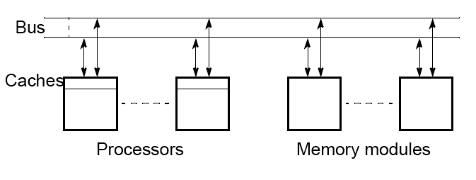
Shared memory multiprocessor
using a single bus

Slide 4
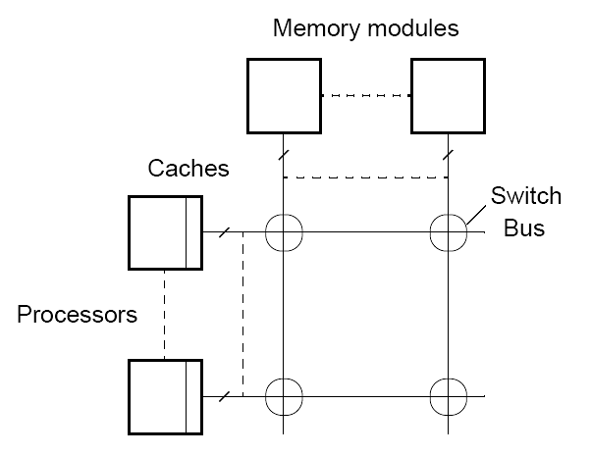
Shared memory multiprocessor
using a crossbar switch

Slide 5
Alternatives for Programming Shared
Memory Multiprocessors:
• Using heavy weight processes.
• Using threads. Example Pthreads
• Using a completely new programming language for
parallel programming - not popular. Example Ada.
• Using library routines with an existing sequential
programming language.
• Modifying the syntax of an existing sequential
programming language to create a parallel programing
language. Example UPC
• Using an existing sequential programming language
supplemented with compiler directives for specifying
parallelism. Example OpenMP

Slide 6
Using Heavyweight Processes
Operating systems often based upon notion of a process.
Processor time shares between processes, switching from one process to another. Might occur at regular intervals or when an active process becomes delayed.
Offers opportunity to deschedule processes blocked from proceeding for some reason, e.g. waiting for an I/O operation to complete.
Concept could be used for parallel programming. Not much used
because of overhead but fork/join concepts used elsewhere.

Slide 7
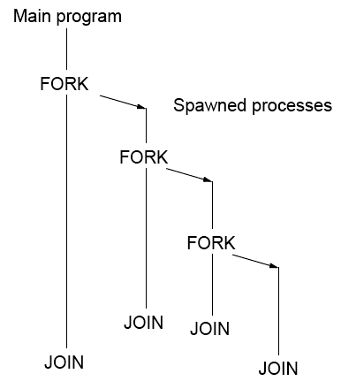
FORK-JOIN construct

Slide 8
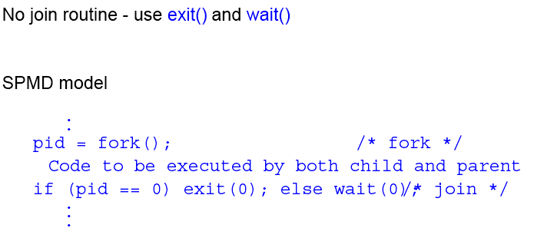
UNIX System Calls

Slide 9
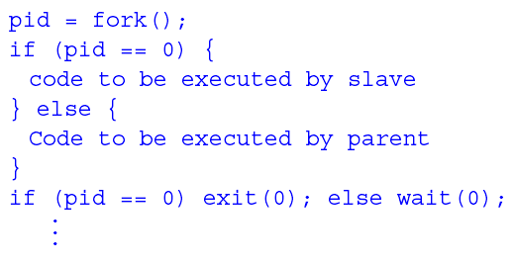
UNIX System Calls
SPMD model with different code for master process and forked slave process.

Slide 10
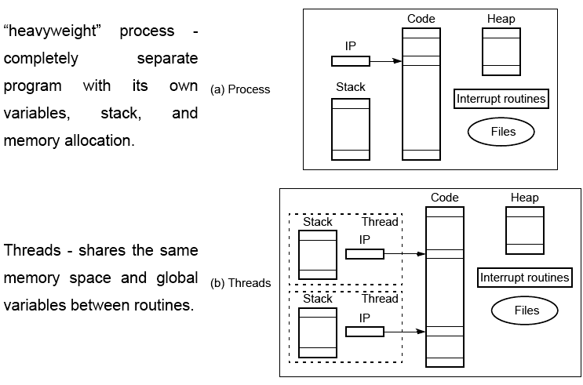
Differences between a process and threads

Slide 11
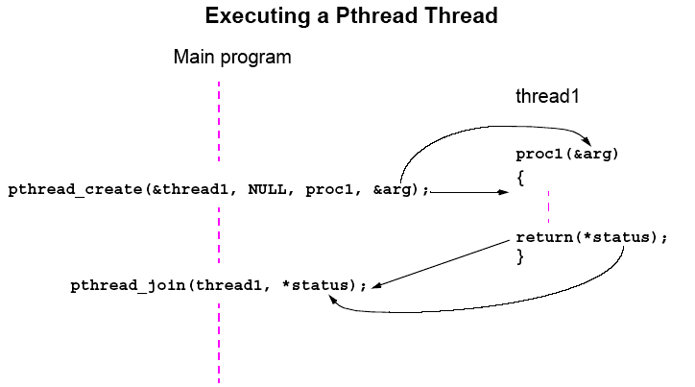
Pthreads
IEEE Portable Operating System Interface, POSIX, sec. 1003.1 standard

Slide 12
Detached Threads
It may be that thread are not bothered when a thread it creates terminates and then a join not needed.
Threads not joined are called detached threads.
When detached threads terminate, they are destroyed and their resource released.

Slide 13
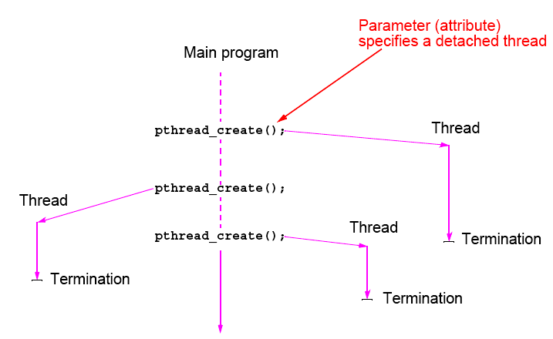
Pthreads Detached Threads

Slide 14
Statement Execution Order
Single processor: Processes/threads typically executed until blocked.
Multiprocessor: Instructions of processes/threads interleaved in time.
Example
Process 1 Process 2
Instruction 1.1 Instruction 2.1
Instruction 1.2 Instruction 2.2
Instruction 1.3 Instruction 2.3
Several possible orderings, including
Instruction 1.1
Instruction 1.2
Instruction 2.1
Instruction 1.3
Instruction 2.2
Instruction 2.3
assuming instructions cannot be divided into smaller steps.

Slide 15
If two processes were to print messages, for example, the messages could appear in different orders depending upon the scheduling of processes calling the print routine.
Worse, the individual characters of each message could be interleaved if the machine instructions of instances of the print routine could be interleaved.

Slide 16
Compiler/Processor Optimizations
Compiler and processor reorder instructions for optimization.
Example
The statements
a = b + 5;
x = y + 4;
could be compiled to execute in reverse order:
x = y + 4;
a = b + 5;
and still be logically correct.
May be advantageous to delay statement a = b + 5 because a
previous instruction currently being executed in processor needs
more time to produce the value for b. Very common for processors to execute machines instructions out of order for increased speed .

Slide 17
Thread-Safe Routines
Thread safe if they can be called from multiple threads
simultaneously and always produce correct results.
Standard I/O thread safe (prints messages without interleaving the characters).
System routines that return time may not be thread safe.
Routines that access shared data may require special care to be made thread safe.

Slide 18
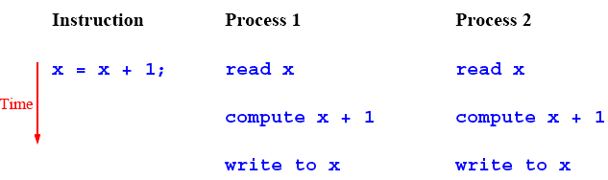
Accessing Shared Data
Accessing shared data needs careful control.
Consider two processes each of which is to add one to a shared data item, x. Necessary for the contents of the location x to be read, x + 1 computed, and the result written back to the location:

Slide 19
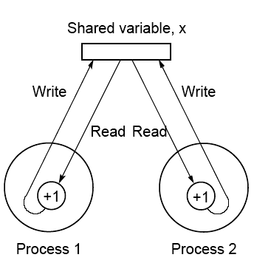
Conflict in accessing shared variable

Slide 20
Critical Section
A mechanism for ensuring that only one process accesses a particular resource at a time is to establish sections of code involving the resource as so-called critical sections and arrange that only one such critical section is executed at a time
This mechanism is known as mutual exclusion.
This concept also appears in an operating systems.

Slide 21
Locks
Simplest mechanism for ensuring mutual exclusion of critical
sections.
A lock is a 1-bit variable that is a 1 to indicate that a process has entered the critical section and a 0 to indicate that no process is in the critical section.
Operates much like that of a door lock:
A process coming to the “door” of a critical section and finding it open may enter the critical section, locking the door behind it to prevent other processes from entering. Once the process has finished the critical section, it unlocks the door and leaves.

Slide 22
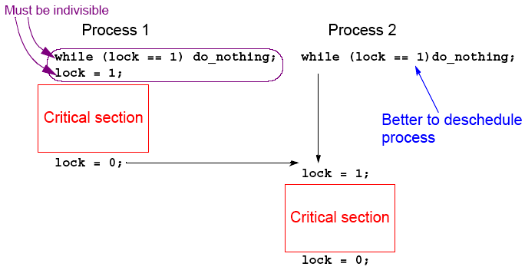
Control of critical sections through busy waiting

Slide 23
Pthread Lock Routines
Locks are implemented in Pthreads with mutually exclusive lock variables, or “mutex” variables:
.
pthread_mutex_lock(&mutex1);
critical section
pthread_mutex_unlock(&mutex1);
.
If a thread reaches a mutex lock and finds it locked, it will wait for the lock to open. If more than one thread is waiting for the lock to open when it opens, the system will select one thread to be allowed to proceed. Only the thread that locks a mutex can unlock it.

Slide 24
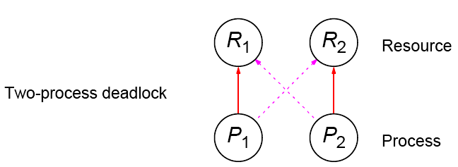
Deadlock
Can occur with two processes when one requires a resource held by the other, and this process requires a resource held by the first process.

Slide 25
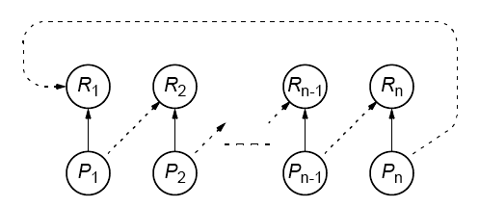
Deadlock (deadly embrace)
Deadlock can also occur in a circular fashion with several processes having a resource wanted by another.

Slide 26
Pthreads
Offers one routine that can test whether a lock is actually closed without blocking the thread:
pthread_mutex_trylock()
Will lock an unlocked mutex and return 0 or will return with EBUSY if the mutex is already locked – might find a use in overcoming deadlock.

Slide 27
Semaphores
A positive integer (including zero) operated upon by two operations:
P operation on semaphore s
Waits until s is greater than zero and then decrements s by one and allows the process to continue.
V operation on semaphore s
Increments s by one and releases one of the waiting processes (if any).

Slide 28
P and V operations are performed indivisibly.
Mechanism for activating waiting processes is also implicit in P and V operations. Though exact algorithm not specified, algorithm expected to be fair. Processes delayed by P(s) are kept in abeyance until released by a V(s) on the same semaphore.
Devised by Dijkstra in 1968. Letter P is from the Dutch word passeren, meaning “to pass,” and letter V is from the Dutch word vrijgeven, meaning “to release.”)

Slide 29
Mutual exclusion of critical sections can be achieved with one
semaphore having the value 0 or 1 (a binary semaphore), which
acts as a lock variable, but the P and V operations include a process
scheduling mechanism:
Process 1 Process 2 Process 3
Noncritical section Noncritical section Noncritical section
. . .
. . .
. . .
P(s) P(s) P(s)
Critical section Critical section Critical section
V(s) V(s) V(s)
. . .
. . .
. . .
Noncritical section Noncritical section Noncritical section

Slide 30
General semaphore
(or counting semaphore)
Can take on positive values other than zero and one.
Provide, for example, a means of recording the number of “resource units” available or used and can be used to solve producer/ consumer problems. - more on that in operating system courses.
Semaphore routines exist for UNIX processes.
Not exist in Pthreads as such, though they can be written
Do exist in real-time extension to Pthreads.

Slide 31
Monitor
Suite of procedures that provides only way to access shared resource. Only one process can use a monitor procedure at any instant.
Could be implemented using a semaphore or lock to protect entry, i.e.,
monitor_proc1()
{
lock(x);
.
monitor body
.
unlock(x);
return;
}

Slide 32
Condition Variables
Often, a critical section is to be executed if a specific global
condition exists; for example, if a certain value of a variable has been reached.
With locks, the global variable would need to be examined at
frequent intervals (“polled”) within a critical section.
Very time-consuming and unproductive exercise.
Can be overcome by introducing so-called condition variables.

Slide 33
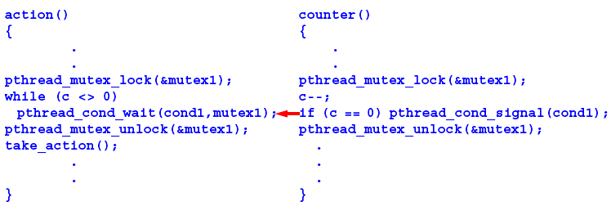
Pthread Condition Variables
Pthreads arrangement for signal and wait:
Signals not remembered - threads must already be waiting for a signal to receive it.

Slide 34
Language Constructs for Parallelism
Shared Data
Shared memory variables might be declared as shared with, say,
shared int x;

Slide 35
par Construct
For specifying concurrent statements:
par {
S1;
S2;
.
.
Sn;
}

Slide 36
forall Construct
To start multiple similar processes together:
forall (i = 0; i < n; i++) {
S1;
S2;
.
.
Sm;
}
which generates n processes each consisting of the statements forming the body of the for loop, S1, S2, …, Sm. Each process uses a different value of i.

Slide 37
Example
forall (i = 0; i < 5; i++)
a[i] = 0;
clears a[0], a[1], a[2], a[3], and a[4] to zero concurrently.

Slide 38
Dependency Analysis
To identify which processes could be executed together.
Example
Can see immediately in the code
forall (i = 0; i < 5; i++)
a[i] = 0;
that every instance of the body is independent of other instances and all instances can be executed simultaneously.
However, it may not be that obvious. Need algorithmic way of recognizing dependencies, for a parallelizing compiler.

Slide 39
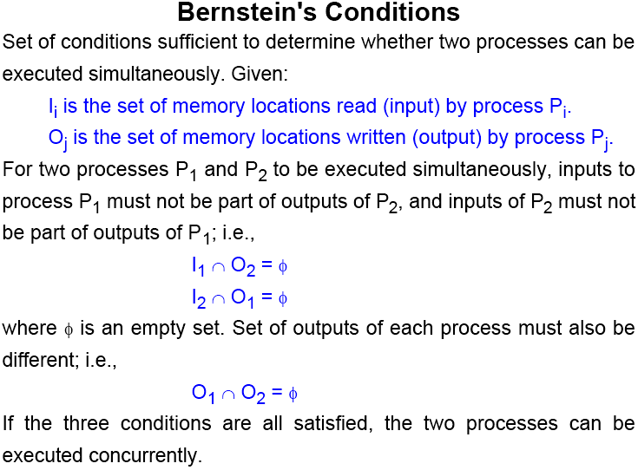

Slide 40
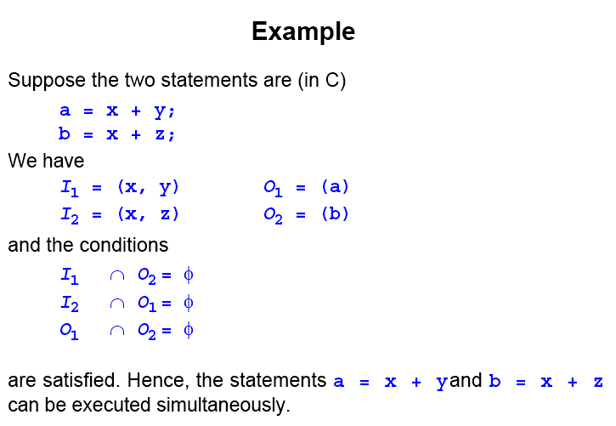

Slide 41
What is a thread?
process:
  an address space with 1 or more threads executing within that address space, and the required system resources for those threads
  a program that is running
thread:
  a sequence of control within a process
  shares the resources in that process

Slide 42
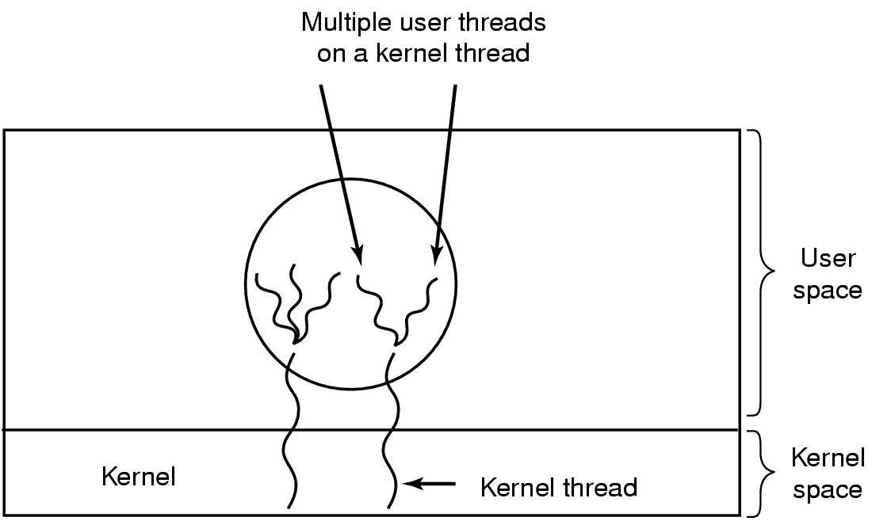
Hybrid Implementations
Multiplexing user-level threads onto kernel-level threads

Slide 43
Advantages and Drawbacks of Threads
Advantages:
  the overhead for creating a thread is significantly less than that for creating a process (~ 2 milliseconds for threads)
  multitasking, i.e., one process serves multiple clients
  switching between threads requires the OS to do much less work than switching between processes

Slide 44
Drawbacks:
  not as widely available as longer established features
  writing multithreaded programs require more careful thought
  more difficult to debug than single threaded programs
  for single processor machines, creating several threads in a program may not necessarily produce an increase in performance (only so many CPU cycles to be had)

Slide 45
POSIX Threads (pthreads)
IEEE's POSIX Threads Model:
  programming models for threads in a UNIX platform
  pthreads are included in the international standards ISO/IEC9945-1
pthreads programming model:
  creation of threads
  managing thread execution
  managing the shared resources of the process

Slide 46
Pthread Operations
POSIX function | description
pthread_cancel | terminate another thread
pthread_create | create a thread
pthread_detach | set thread to release resources
pthread_equal | test two thread IDs for equality
pthread_exit | exit a thread without exiting process
pthread_kill | send a signal to a thread
pthread_join | wait for a thread
pthread_self | find out own thread ID

Slide 47
main thread:
  initial thread created when main() (in C++) are invoked by the process loader
  once in the main(), the application has the ability to create daughter threads
  if the main thread returns, the process terminates even if there are running threads in that process, unless special precautions are taken
  to explicitly avoid terminating the entire process, use pthread_exit()

Slide 48
thread termination methods:
  implicit termination:
    thread function execution is completed
  explicit termination:
    calling pthread_exit() within the thread
    calling pthread_cancel() to terminate other threads
for numerically intensive routines, it is suggested that the application creates p threads if there are p available processor cores

Slide 49
Exiting and Cancellation
A process can terminate when:
  it calls exit directly
  one of its threads calls exit()
  it returns from main()
  it receives a termination signal
In any of these cases, all threads of the process terminate.

Slide 50
Thread Exit
When a thread is done, it can return from its first function (the one used by pthread_create) or it can call pthread_exit
void pthread_exit(void *value_ptr);
Common uses:
Return value is often a pointer to the original struct or a malloc’d struct (memory must be free’d by joining thread)
Use the heap not the stack!!!

Slide 51
Canceling a thread!
One thread can request that another exit by using pthread_cancel
int pthread_cancel(pthread_t thread);
The pthread_cancel returns after making the request.

Slide 52
Sample Pthreads Program in C++
The program in C++ calls the pthread.h header file. Pthreads related statements are preceded by the pthread_ prefix (except for semaphores).
In Pthreads knowing how to manipulate pointers is very important!

Slide 53
/*
Pthreads Example - Hello World - C/C++ Version
File: hello_world_PTH2.cpp
Compilation on altix.asc.edu
to compile the program
icc hello_world_PTH2.cpp -o hello_world_PTH2 -lpthread
to run type
./hello_world_PTH2
*/
using namespace std;
#include <iostream>
#include <fstream>
#include <pthread.h>
#define NTHREADS 8 /* set number of threads to 8 */
pthread_mutex_t MUTEX; // globaly defined lock variable used to insure
// uninterrupted print operations from each thread
ofstream filestr("file_nm"); // filestr: file stream common to all threads
// This is the worker thread code
void *hello(void * arg) {
int myid=*(int *) arg;
sleep(1);
// enter critical region
pthread_mutex_lock(&MUTEX);
filestr << "Hello World, from PThread " << myid << endl;
// exit critical region
pthread_mutex_unlock(&MUTEX);
return arg; // could use pthread_exit(NULL) function as well
}

Slide 54
Thread Synchronization Mechanisms
Mutual exclusion (mutex):
  guard against multiple threads modifying the same shared data simultaneously
  provides locking/unlocking critical code sections where shared data is modified
  each thread waits for the mutex to be unlocked (by the thread who locked it) before performing the code section

Slide 55
Basic Mutex Functions:
  int pthread_mutex_init(pthread_mutex_t *mutex, const pthread_mutexattr_t *mutexattr);
  int pthread_mutex_lock(pthread_mutex_t *mutex);
  int pthread_mutex_unlock(pthread_mutex_t *mutex);
  int pthread_mutex_destroy(pthread_mutex_t *mutex);
  a new data type named pthread_mutex_t is designated for mutexes
  a mutex is like a key (to access the code section) that is handed to only one thread at a time
  the attribute of a mutex can be controlled by using the pthread_mutex_init() function
  the lock/unlock functions work in tandem

Slide 56
#include <pthread.h>
...
pthread_mutex_t my_mutex; // should be of global scope
...
int main()
{
int tmp;
...
// initialize the mutex
tmp = pthread_mutex_init( &my_mutex, NULL );
...
// create threads
...
pthread_mutex_lock( &my_mutex );
do_something_private();
pthread_mutex_unlock( &my_mutex );
...
return 0;
}
Whenever a thread reaches the lock/unlock block, it first determines if the mutex is locked. If so, it waits until it is unlocked. Otherwise, it takes the mutex, locks the succeeding code, then frees the mutex and unlocks the code when it's done.

Slide 57
/*
Pthreads Example - Hello World - C/C++ Version
File: hello_world_PTH2.cpp
Compilation on altix.asc.edu
to compile the program
icc hello_world_PTH2.cpp -o hello_world_PTH2 -lpthread
to run type
./hello_world_PTH2
*/
using namespace std;
#include <iostream>
#include <fstream>
#include <pthread.h>
#define NTHREADS 8 /* set number of threads to 8 */
pthread_mutex_t MUTEX; // globaly defined lock variable used to insure
// uninterrupted print operations from each thread
ofstream filestr("file_nm"); // filestr: file stream common to all threads

Slide 58
// This is the worker thread code
void *hello(void * arg) {
int myid=*(int *) arg;
// enter critical region
pthread_mutex_lock(&MUTEX);
filestr << "Hello World, from PThread " << myid << endl;
// exit critical region
pthread_mutex_unlock(&MUTEX);
return arg; // could use pthread_exit(NULL) function as well
}

Slide 59
// this is the main thread's code -- it spawns the worker threads and
// then waits for all the worker threads to return before it exits
int main(int argc,char *argv[])
{
int tid; // tid thread number
pthread_t threads[NTHREADS]; // holds various thread info
int ids[NTHREADS]; // holds thread args
int errcode; // pthread error code
pthread_attr_t tattr; // pthread attribute object
// the following code sets up the Pthread attribute object
// not really necessary if you like the defaults
if (errcode = pthread_attr_init(&tattr)) {
cerr << "Failed to create attribute object: " << strerror(errcode) << endl;
}
// make threads joinable (for detatched threads use PTHREAD_CREATE_DETACHED)
else if (errcode = pthread_attr_setdetachstate(&tattr,PTHREAD_CREATE_JOINABLE)) {
cerr << "Failed to set attribute state: " << strerror(errcode) << endl;
}
// allow threads to be scheduled system wise not just process wise
else if (errcode = pthread_attr_setscope(&tattr,PTHREAD_SCOPE_SYSTEM)) {
cerr << "Failed to set attribute scope: " << strerror(errcode) << endl;
}
// initialize mutex variable -- this variable is used to insure that
// all couts are automic meaning that they are not interrupted
pthread_mutex_init(&MUTEX,NULL);

Slide 60
Settable Properties of Thread Attributes
property | function
attribute objects | pthread_attr_destroy
 | pthread_attr_init
detach state | pthread_attr_getdetachstate
 | pthread_attr_setdetachstate
stack | pthread_attr_getguardsize
 | pthread_attr_setguardsize
 | pthread_attr_getstack
 | pthread_attr_setstack
scheduling | pthread_attr_getinheritsched
 | pthread_attr_setinheritsched
 | pthread_attr_getschedparam
 | pthread_attr_setschedparam
 | pthread_attr_getschedpolicy
 | pthread_attr_setschedpolicy
 | pthread_attr_getscope
 | pthread_attr_setscope

Slide 61
Thread Attributes
detach state attribute:
  int pthread_attr_setdetachstate(pthread_attr_t *attr, int detachstate);
  detached – main thread continues working without waiting for the daughter threads to terminate
  joinable – main thread waits for the daughter threads to terminate before continuing further

Slide 62
Detaching a Thread
int pthread_detach(pthread_t threadid);
Indicate that system resources for the specified thread should be reclaimed when the thread ends
  If the thread is already ended, resources are reclaimed immediately
  This routine does not cause the thread to end
A detached thread’s thread ID is undetermined
Threads are detached
  after a pthread_detach() call
  after a pthread_join() call
  if a thread terminates and the PTHREAD_CREATE_DETACHED attribute was set on creation

Slide 63
contention scope attribute:
  int pthread_attr_setscope(pthread_attr_t *attr, int *scope);
  system scope – threads are mapped one-to-one on the OS's kernel threads (kernel threads are entities that scheduled onto processors by the OS)
  process scope – threads share a kernel thread with other process scoped threads

Slide 64
Threads Programming Model
pipeline model – threads are run one after the other
master-slave model – master (main) thread doesn't do any work, it just waits for the slave threads to finish working
equal-worker model – all threads work

Slide 65
/* create the threads */
for (tid=0; tid<NTHREADS; tid++) {
ids[tid]=tid;
errcode=pthread_create(
&threads[tid],// thread information structure
&tattr, // thread attributes -- NULL means assume defaults
hello, // function name that is to represent thread
&ids[tid]); // pthread created thread id for the created thread
// check for error during thread creation
if (errcode) {
cerr << "Pthread Creation Error: " << strerror(errcode) << endl;
exit(1);
}
}

Slide 66
Creating a thread:
  int pthread_create( pthread_t *thread, pthread_attr_t *attr, void *(*thread_function)(void *), void *arg );
  first argument – pointer to the identifier of the created thread
  second argument – thread attributes
  third argument – pointer to the function the thread will execute
  fourth argument – the argument of the executed function (usually a struct)
  returns 0 for success

Slide 67
// output number of threads
pthread_mutex_lock(&MUTEX); // enter critical region
filestr << "Number of threads = " << NTHREADS << endl;
pthread_mutex_unlock(&MUTEX); // exit critical region
// wait for all threads to return before exiting main program (process)
for (tid=0; tid<NTHREADS; tid++) {
// wait for each thread to terminate
errcode=pthread_join(
threads[tid], //thread scheduler id information of selected thread
NULL); //thread return value -- not used in this case
if (errcode) {
cerr << "Pthread Join Error: " << strerror(errcode) << endl;
exit(1);
}
}
filestr.close(); // close open file
}

Slide 68
Waiting for the threads to finish:
  int pthread_join( pthread_t thread, void **thread_return )
  main thread will wait for daughter thread thread to finish
  first argument – the thread to wait for
  second argument – pointer to a pointer to the return value from the thread
  returns 0 for success
  threads should always be joined; otherwise, a thread might keep on running even when the main thread has already terminated

Slide 69
Counting Semaphores:
  permit a limited number of threads to execute a section of the code
  similar to mutexes
  should include the semaphore.h header file
  semaphore functions do not have pthread_ prefixes; instead, they have sem_ prefixes

Slide 70
Basic Semaphore Functions:
  creating a semaphore:
  int sem_init(sem_t *sem, int pshared, unsigned int value);
    initializes a semaphore object pointed to by sem
    pshared is a sharing option; a value of 0 means the semaphore is local to the calling process
    gives an initial value value to the semaphore
  terminating a semaphore:
  int sem_destroy(sem_t *sem);
    frees the resources allocated to the semaphore sem
    usually called after pthread_join()
    an error will occur if a semaphore is destroyed for which a thread is waiting

Slide 71
  semaphore control:
    int sem_post(sem_t *sem);
    int sem_wait(sem_t *sem);
    sem_post atomically increases the value of a semaphore by 1, i.e., when 2 threads call sem_post simultaneously, the semaphore's value will also be increased by 2 (there are 2 atoms calling)
    sem_wait atomically decreases the value of a semaphore by 1; but always waits until the semaphore has a non-zero value first

Slide 72
#include <pthread.h>
#include <semaphore.h>
...
void *thread_function( void *arg );
...
sem_t semaphore; // also a global variable just like mutexes
...
int main()
{
int tmp;
...
// initialize the semaphore
tmp = sem_init( &semaphore, 0, 0 );
...
// create threads
pthread_create( &thread[i], NULL, thread_function, NULL );
...
while ( still_has_something_to_do() )
{
sem_post( &semaphore );
...
}
...
pthread_join( thread[i], NULL );
sem_destroy( &semaphore );
return 0;
}

Slide 73
void *thread_function( void *arg )
{
sem_wait( &semaphore );
perform_task_when_sem_open();
...
pthread_exit( NULL );
}
  the main thread increments the semaphore's count value in the while loop
  the threads wait until the semaphore's count value is non-zero before performing perform_task_when_sem_open() and further
  daughter thread activities stop only when pthread_join() is called

Slide 74
Condition Variables:
  used for communicating information about the state of shared data
  can make the execution of sections of a codes by a thread depend on the state of a data structure or another running thread
  condition variables are for signaling, not for mutual exclusion; a mutex is needed to synchronize access to shared data

Slide 75
Condition Variables
Often, a critical section is to be executed if a specific global
condition exists; for example, if a certain value of a variable has been reached.
With locks, the global variable would need to be examined at
frequent intervals (“polled”) within a critical section.
Very time-consuming and unproductive exercise.
Can be overcome by introducing so-called condition variables.

Slide 76
Pthread Condition Variables
Pthreads arrangement for signal and wait:
Signals not remembered - threads must already be waiting for a signal to receive it.

Slide 77
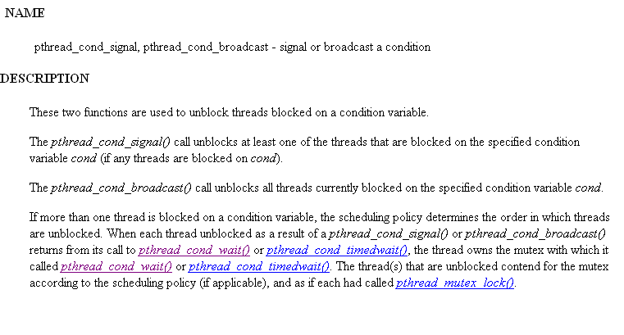

Slide 78
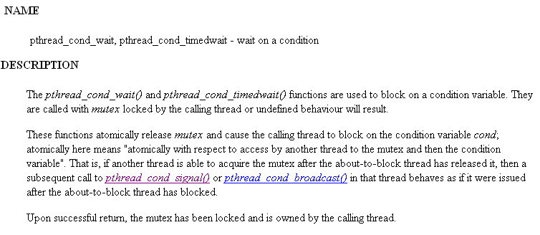

Slide 79
OpenMP
An accepted standard developed in the late 1990s by a group of industry specialists.
Consists of a small set of compiler directives, augmented with a small set of library routines and environment variables using the base language Fortran and C/C++.
The compiler directives can specify such things as the par and forall operations described previously.
http://www.openmp.org
Current spec is OpenMP 3.0
318 Pages
(combined C/C++ and Fortran)

Slide 80
OpenMP
Standard and widely available (supported at compiler level)
  gcc
  Intel
  PGI
  IBM
Compiler directives are generally simple and easy to use than thread API’s

Slide 81
Fork-Join Parallelism but thread based:
Master thread spawns a team of threads as needed
Parallelism can be added incrementally
  sequential program evolves into a parallel program
Master Thread
Parallel Regions

Slide 82
Most of the constructs in OpenMP are compiler directives or pragmas
  For C and C++, the pragmas take the form:
Include <omp.h> if using OpenMP API functions
  Needed for use in most compilers such as icc, gcc, and g++
#pragma omp construct [clause [clause]…]

Slide 83
#pragma omp construct [clause [clause]…]
May be additional parameters (clauses) after the construct for different options.
Some directives require code to specified in a structured block (a statement or statements) that follows the directive and then the directive and structured block form a “construct”.

Slide 84
Parallel Region & Structured Blocks (C/C++)
OpenMP constructs apply to structured blocks
  Structured block: a block with one point of entry at the top and one point of exit at the bottom
#pragma omp parallel
{
int id = random() % N;
more: res[id] = do_big_job (id);
if (conv(res[id])) goto more;
}
printf (“All done\n”);
if (go_now()) goto more;
#pragma omp parallel
{
int id = random() % N;
more: res[id] = do_big_job(id);
if (!conv(res[id])) goto done;
goto more;
}
done: if (!really_done()) goto more;
A structured block
Not a structured block

Slide 85
parallel directive creates a team of threads with a specified block of code executed by the multiple threads in parallel. The exact number of threads in the team determined by one of several ways.
Other directives used within a parallel construct to specify
parallel for loops and different blocks of code for threads.

Slide 86
Parallel Directive
#pragma omp parallel
structured_block
creates multiple threads, each one executing the specified
structured_block, either a single statement or a compound
statement created with { ...} with a single entry point and a single exit point.
There is an implicit barrier at the end of the construct.
The directive corresponds to forall construct.

Slide 87
Data Scoping – What’s shared
OpenMP uses a shared-memory programming model
Shared variable - a variable whose name provides access to a the same block of storage for each thread
  The OpenMP shared clause can be used to make items explicitly shared
  Global variables are shared among tasks
    C/C++: File scope variables, namespace scope variables, static variables, Variables with const-qualified type having no mutable member are shared, Static variables which are declared in a scope inside the construct are shared.

Slide 88
Data Scoping – What’s private
But, not everything is shared...
Examples of implicitly determined private variables:
  Stack (local) variables in functions called from parallel regions are PRIVATE
  Automatic variables within a statement block are PRIVATE
  Loop iteration variables on worksharing construct are PRIVATE
  Implicitly declared private variables within tasks will be treated as firstprivate

Slide 89
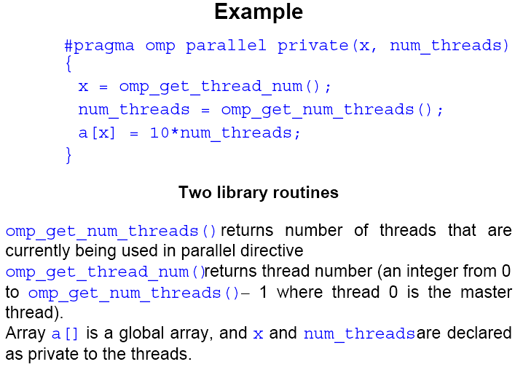

Slide 90
Number of threads in a team
Established by either:
1. num_threads clause after the parallel directive, or
2. omp_set_num_threads() library routine being previously called,
or
3. the environment variable OMP_NUM_THREADS is defined
in the order given or is system dependent if none of the above.
Number of threads available can also be altered automatically to achieve best use of system resources by a “dynamic adjustment” mechanism.

Slide 91
Work-Sharing
Worksharing is the general term used in OpenMP to describe distribution of work across threads.
Three examples in this classification:
omp sections construct
omp for construct
omp single construct
omp task construct {to be discussed later}
In all cases, there is an implicit barrier at the end of the construct unless a nowait clause is included.
Note that these constructs do not start a new team of threads. That done by an enclosing parallel construct.

Slide 92
Sections
The construct
#pragma omp sections
{
#pragma omp section
structured_block
#pragma omp section
structured_block
.
.
.
}
cause the structured blocks to be shared among threads in team.
#pragma omp sections precedes the set of structured blocks.
#pragma omp section prefixes each structured block.
The first section directive is optional.

Slide 93
For Loop
#pragma omp for
for_loop
causes the for loop to be divided into parts and parts shared among threads in the team. The for loop must be of a simple form.
Way that for loop divided can be specified by an additional “schedule” clause. Example: the clause schedule (static, chunk_size) cause the for loop be divided into sizes specified by chunk_size and allocated to threads in a round robin fashion.

Slide 94
schedule Clause
The schedule clause affects how loop iterations are mapped onto threads
    Blocks of iterations of size “chunk” to threads
    Round robin distribution
    Low overhead, may cause load imbalance
    Threads grab “chunk” iterations
    When done with iterations, thread requests next set
    Higher threading overhead, can reduce load imbalance
    Dynamic schedule starting with large block
    Size of the blocks shrink; no smaller than “chunk”
  schedule(static [,chunk])
  schedule(dynamic[,chunk])
  schedule(guided[,chunk])

Slide 95
schedule Clause Example
#pragma omp parallel for schedule (static, 8)
for( int i = 3; i <= end; i += 2 )
{
if ( TestForPrime(i) ) gPrimesFound++;
}
Iterations are divided into chunks of 8
  Since the first value assigned to i is 3, the first chunk is
    {3,5,7,9,11,13,15,17}

Slide 96
private Clause
Reproduces the variable for each task
  Variables are un-initialized; C++ object is default constructed
  Any value external to the parallel region is undefined
void* work(float* c, int N) {
float x, y;
int i, j;
#pragma omp parallel for private(x, y, j)
for (i = 0; i < N; i++) {
x = a[i];
for (j = 0; j < N; j += (i+1)) {
y = b[j];
c[i] = x + y;
}
}
}

Slide 97
Single
The directive
#pragma omp single
structured block
cause the structured block to be executed by one thread only.

Slide 98
Combined Parallel Work-sharing Constructs
If a parallel directive is followed by a single for directive, it can be combined into:
#pragma omp parallel for
for_loop
with similar effects, i.e. it has the effect of each thread executing the same for loop.

Slide 99
Combining constructs
These two code segments are equivalent
#pragma omp parallel
{
#pragma omp for
for (i = 0;i < MAX; i++) { res[i] = huge();
}
}
#pragma omp parallel for
for (i = 0;i < MAX; i++) {
res[i] = huge();
}

Slide 100
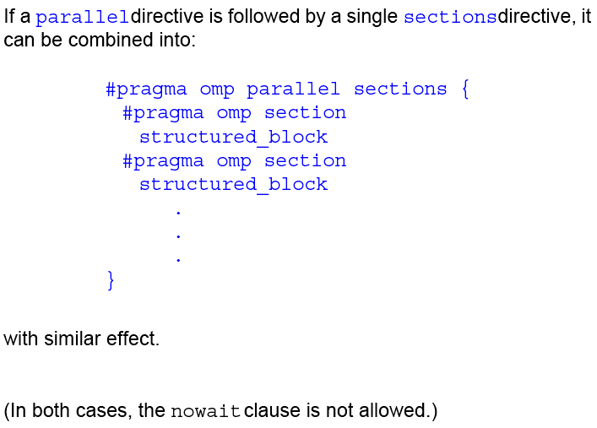

Slide 101
Master Directive
#pragma omp master
structured_block
causes the master thread to execute the structured block.
Different to those in the work sharing group in that there is no implied barrier at the end of the construct (nor the beginning). Other threads encountering this directive will ignore it and the associated structured block, and will move on.
#pragma omp parallel
{
DoManyThings();
#pragma omp master
{ // if not master skip to next stmt
ExchangeBoundaries();
}
DoManyMoreThings();
}

Slide 102
Synchronization Constructs
Critical
The critical directive will only allow one thread execute the
associated structured block. When one or more threads reach the
critical directive:
#pragma omp critical name
structured_block
they will wait until no other thread is executing the same critical section (one with the same name), and then one thread will proceed to execute the structured block. name is optional. All critical sections with no name map to one undefined name.

Slide 103
critical Construct
Defines a critical region on a structured block
#pragma omp critical [(lock_name)]
Threads wait their turn
Only one thread at a time calls Consum() and updates RES (preventing race condition)
Naming the critical construct RES_lock is optional
float RES;
#pragma omp parallel
{ float B;
#pragma omp for
for(int i = 0; i < niters; i++){
B = Big_Job(i);
#pragma omp critical (RES_lock)
RES += Consum(B);
}
}
Good Practice – Name all critical sections

Slide 104
reduction Clause
The variables in “list” must be shared in the enclosing parallel region
Inside parallel or work-sharing region:
  A PRIVATE copy of each list variable is created and initialized depending on the “op”
  These copies are updated locally by threads
  At end of construct, local copies are combined through “op” into a single value and combined with the value in the original SHARED variable
reduction (op : list)

Slide 105
Example – Dot Product
Private copy of sum for each thread is created
  Initialized to zero
At end of paralell region, all private copies of sum added together and result stored in shared variable
#pragma omp parallel for reduction(+:sum)
for(i = 0; i < N; i++) {
sum += a[i] * b[i];
}

Slide 106
C/C++ Reduction Operations
A range of associative operands can be used with reduction
Initial values are the ones that make sense mathematically
  Typically identity element of operation
Operand | Initial Value
+ | 0
* | 1
- | 0
^ | 0
Operand | Initial Value
& | ~0
| | 0
&& | 1
|| | 0

Slide 107
Barrier
When a thread reaches the barrier
#pragma omp barrier
it waits until all threads have reached the barrier and then they all proceed together.
There are restrictions on the placement of barrier directive in a
program. In particular, all threads must be able to reach the barrier.

Slide 108
barrier directive
Explicit barrier synchronization
Each thread waits until all threads arrive
#pragma omp parallel shared (A, B, C)
{
DoSomeWork(A,B);
cout << “Processed A into B” << endl;
#pragma omp barrier
DoSomeWork(B,C);
cout << “Processed B into C” << endl;
}

Slide 109
Implicit Barriers
Several OpenMP constructs have implicit barriers
  Parallel region – necessary barrier – cannot be removed
  Loop worksharing (parallel for) construct
  single construct
Unnecessary barriers hurt performance and can be removed with the nowait clause
The nowait clause is applicable to:
  Loop worksharing (parallel for) construct
  single construct

Slide 110
nowait Clause
Use when threads unnecessarily wait between independent computations
#pragma omp for nowait
for(...)
{...};
#pragma single nowait
{ [...] }
#pragma omp for schedule(dynamic,1) nowait
for(int i=0; i<n; i++)
a[i] = bigFunc1(i);
#pragma omp for schedule(dynamic,1)
for(int j=0; j<m; j++)
b[j] = bigFunc2(j);

Slide 111
Atomic
The atomic directive
#pragma omp atomic
expression_statement
implements a critical section efficiently when the critical section simply updates a variable (adds one, subtracts one, or does some other simple arithmetic operation as defined by expression_statement).

Slide 112
atomic directive
Applies only to simple update of memory location
#pragma omp parallel for shared(x, y, index, n)
for (i = 0; i < n; i++) {
#pragma omp atomic
x[index[i]] += Work1(i);
y[i] += work2(i);
}
#pragma omp parallel for shared(x, y, index, n)
for (i = 0; i < n; i++) {
#pragma omp critical
x[index[i]] += Work1(i);
y[i] += work2(i);
}

Slide 113
Flush Directive
A synchronization point which causes thread to have a “consistent” view of certain or all shared variables in memory. All current read and write operations on the variables allowed to complete and values written back to memory but any memory operations in the code after flush are not started, thereby creating a “memory fence”. Format:
#pragma omp flush (variable_list)
Only applied to thread executing flush, not to all threads in the team.
Flush occurs automatically at the entry and exit of parallel and critical directives (and combined parallel for and parallel sections directives), and at the exit of for, sections, and single (if a no-wait clause is not present).

Slide 114
Ordered
Used in conjunction with for and parallel for directives to cause an iteration to be executed in the order that it would have occurred if written as a sequential loop.
See Appendix C of textbook for further details.

Slide 115
New Addition to OpenMP
Tasks – Main change for OpenMP 3.0
Allows parallelization of irregular problems
  unbounded loops
  recursive algorithms
  producer/consumer algorithms

Slide 116
What are tasks?
Tasks are independent units of work
Threads are assigned to perform the work of each task
Tasks may be deferred or executed immediately
  The OpenMP runtime system decides
Tasks are composed of:
  code to execute
  data environment
  internal control variables (ICV)
Serial
Parallel

Slide 117
Task Construct – Explicit Task View
Team of threads is created at parallel region
A single thread, T0, is chosen
T0 executes the while loop, creates tasks, and fetches next pointers
Each task runs in its own thread
Threads wait at single barrier; proceed when all tasks done
#pragma omp parallel
{
#pragma omp single
{ // block 1
node * p = head;
while (p) {
#pragma omp task
process(p); // block 2
p = p->next; // block 3
}
} // tasks done
}

Slide 118
Why are tasks useful?
Single Threaded
T0 T1 T2 T3
Potential to parallelize irregular patterns and recursive function calls
Block 1
Block 1
Block 2
Task 1
Block 3
Block 2
Task 1
Block 3
Block 2
Task 2
#pragma omp parallel
{
#pragma omp single
{ // block 1
node * p = head;
while (p) {
#pragma omp task
process(p); // block 2
p = p->next; // block 3
}
} // tasks done
}
Block 3
Block 2
Task 3
Idle
Idle
Block 2
Task 2
Time
Block 3
Time Saved
Block 2
Task 3

Slide 119
When are tasks complete?
At thread or task barriers
  At implicit barrier of single thread spawning tasks
  At the directive: #pragma omp barrier
  At the directive: #pragma omp taskwait

