Slide 1
HW #1
Hello World Programs

Slide 2
Parallel Processing programming environments discussed in this class
• Using heavy weight processes that are explicitly
created or that are implicitly created by the software
compilation process Example MPI. (message
passing paradigm)
• Using threads. Example Pthreads (shared memory)
• Using an existing sequential programming language
supplemented with compiler directives for specifying
parallelism. Example OpenMP (shared memory)

Slide 3
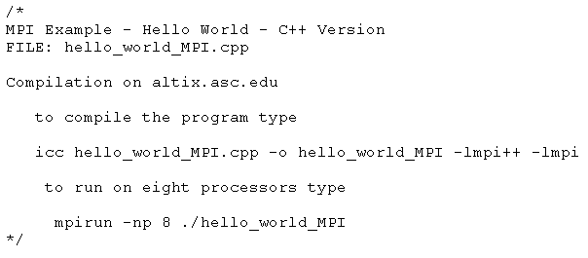
Hello World MPI Program

Slide 4
Heavyweight Processes
Operating systems often based upon notion of a process.
Processor time is shared between processes, switching from one process to another. Might occur at regular intervals or when an active process becomes delayed or blocked.
Offers opportunity to de-schedule processes blocked from proceeding for some reason, e.g. waiting for an I/O operation to complete.
Concept can be used for parallel programming. Heavy weight process creation is expensive.

Slide 5
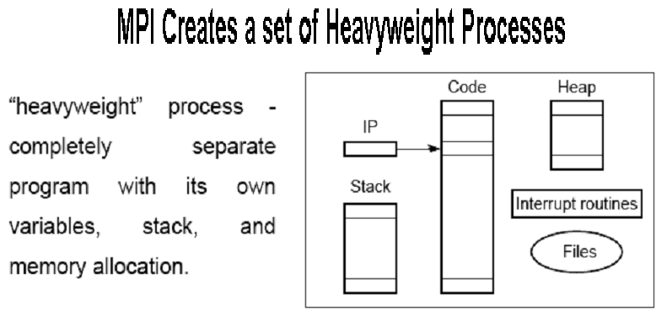

Slide 6
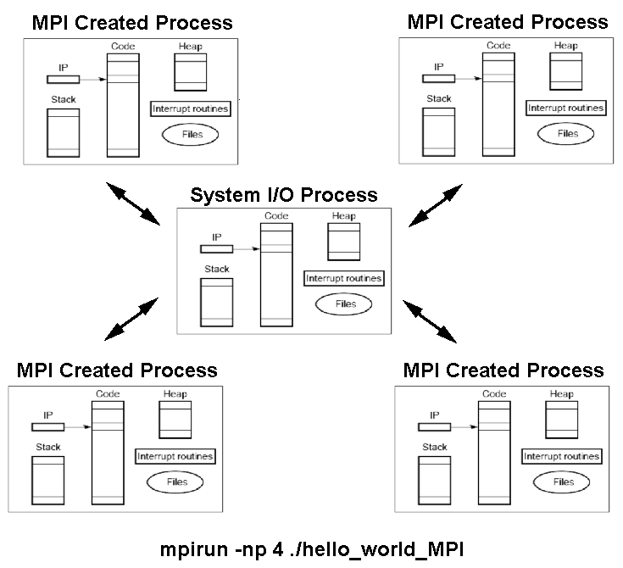

Slide 7
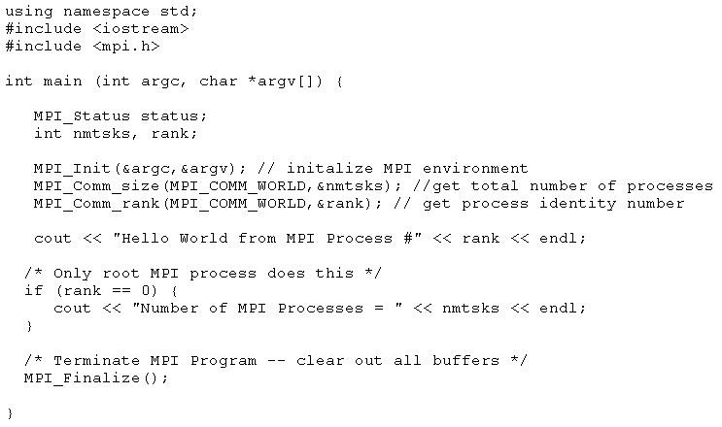
Hello World MPI Program

Slide 8
MPI_Init
NAME
MPI_Init - Initializes the MPI execution environment
SYNOPSIS
C:
#include <mpi.h>
int MPI_Init ( int *argc, char ***argv );
C++:
#include <mpi.h>
void Init()
DESCRIPTION
The MPI_Init routine initializes the MPI execution environment. This
routine accepts the following parameters:
argc Specifies a pointer to the number of arguments
argv Specifies a pointer to the argument vector
ierror Specifies the return code value for successful completion,
which is in MPI_SUCCESS. MPI_SUCCESS is defined in the
mpif.h file.
MPI specifies no command-line arguments, but does allow an MPI
implementation to make use of them.

Slide 9
MPI_Comm_size
NAME
MPI_Comm_size - Determines the size of the group associated with a communicator
SYNOPSIS
C:
#include <mpi.h>
int MPI_Comm_size ( MPI_Comm comm, int *size );
C++:
#include <mpi.h>
int Comm::Get_size() const
DESCRIPTION
The MPI_Comm_size routine determines the number of processes in the
group associated with a communicator. This routine accepts the
following parameters:
comm Specifies the communicator (handle)
size Returns the number of processes in the group of comm
(integer)
ierror Specifies the return code value for successful completion, which is in MPI_SUCCESS.
MPI_SUCCESS is defined in the mpif.h file.

Slide 10
MPI_Finalize
NAME
MPI_Finalize - Terminates the MPI execution environment
SYNOPSIS
C:
#include <mpi.h>
int MPI_Finalize ();
C++:
#include <mpi.h>
void Finalize ()
DESCRIPTION
The MPI_Finalize routine terminates the MPI execution environment. All
processes must call this routine before exiting. The number of
processes running after this routine is called is undefined.
ierror Specifies the return code value for successful completion,
which is in MPI_SUCCESS. MPI_SUCCESS is defined in the
mpif.h file.

Slide 11
Shared memory multiprocessor system
Any memory location can be accessible by any of the processors.
A single address space exists, meaning that each memory location is given a unique address within a single range of addresses.
Generally, shared memory programming more convenient although it does require access to shared data to be controlled by the programmer (using critical sections etc.)

Slide 12
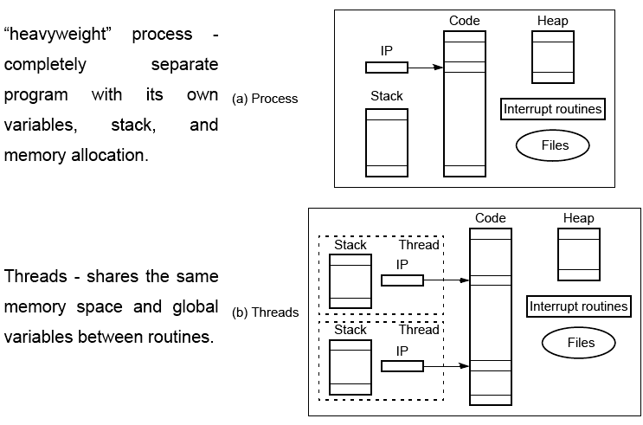
Differences between a process and threads

Slide 13
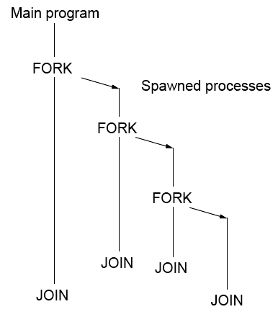
FORK-JOIN construct

Slide 14
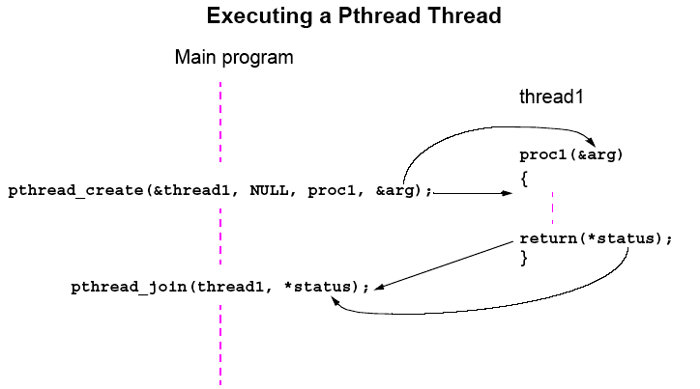
Pthreads
IEEE Portable Operating System Interface, POSIX, sec. 1003.1 standard

Slide 15
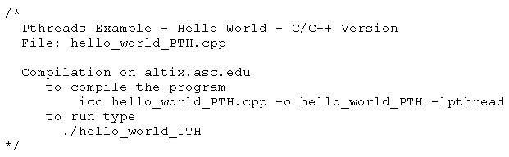
Hello World Pthread Program

Slide 16
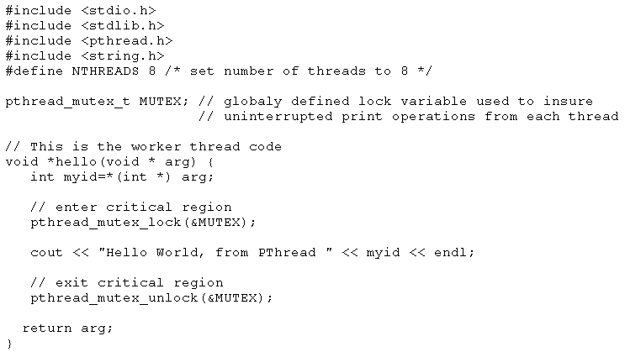
Hello World Pthread Program

Slide 17
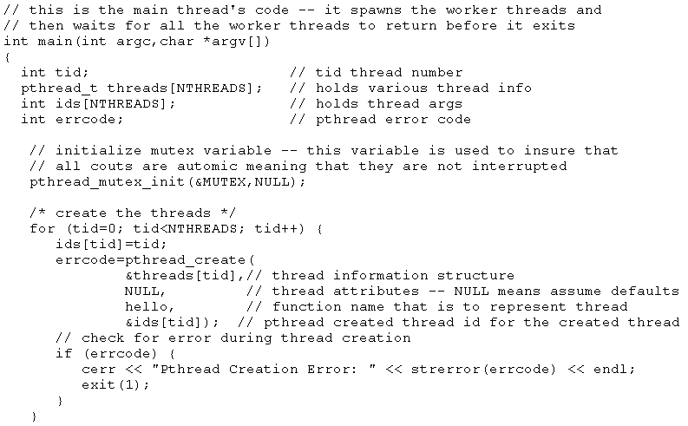
Hello World Pthread Program

Slide 18
pthread_create
SYNOPSIS
#include <pthread.h>
int pthread_create(pthread_t *restrict thread,
const pthread_attr_t *restrict attr,
void *(*start_routine)(void*), void *restrict arg);
DESCRIPTION
The pthread_create() function shall create a new thread, with attributes specified by attr, within a process. If attr is NULL, the default attributes shall be used. If the attributes specified by attr are modified later, the thread's attributes shall not be affected. Upon
successful completion, pthread_create() shall store the ID of the created thread in the location referenced by thread.
The thread is created executing start_routine with arg as its sole argument. If the start_routine returns, the effect shall be as if there
was an implicit call to pthread_exit() using the return value of start_routine as the exit status. Note that the thread in which main() was originally invoked differs from this. When it returns from main(), the effect shall be as if there was an implicit call to exit() using
the return value of main() as the exit status.

Slide 19
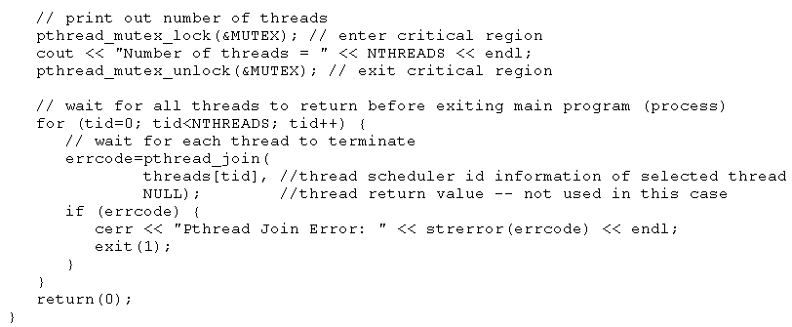
Hello World Pthread Program

Slide 20
pthread_join
NAME
pthread_join - wait for thread termination
SYNOPSIS
#include <pthread.h>
int pthread_join(pthread_t thread, void **value_ptr);
DESCRIPTION
The pthread_join() function shall suspend execution of the calling thread until
the target thread terminates, unless the target thread has already terminated. On
return from a successful pthread_join() call with a non-NULL value_ptr argument,
the value passed to pthread_exit() by the terminating thread shall be made availâ[m
able in the location referenced by value_ptr. When a pthread_join() returns sucâ[m
cessfully, the target thread has been terminated. The results of multiple simultaâ[m
neous calls to pthread_join() specifying the same target thread are undefined. If
the thread calling pthread_join() is canceled, then the target thread shall not be
detached.

Slide 21
Statement Execution Order
Single processor: Processes/threads typically executed until blocked.
Multiprocessor: Instructions of processes/threads interleaved in time.
Example
Process 1 Process 2
Instruction 1.1 Instruction 2.1
Instruction 1.2 Instruction 2.2
Instruction 1.3 Instruction 2.3
Several possible orderings, including
Instruction 1.1
Instruction 1.2
Instruction 2.1
Instruction 1.3
Instruction 2.2
Instruction 2.3
assuming instructions cannot be divided into smaller steps.

Slide 22
If two processes were to print messages, for example, the messages could appear in different orders depending upon the scheduling of processes calling the print routine.
Worse, the individual characters of each message could be interleaved if the machine instructions of instances of the print routine could be interleaved.

Slide 23
OpenMP
An accepted standard developed in the late 1990s by a group of industry specialists.
Consists of a small set of compiler directives, augmented with a small set of library routines and environment variables using the base language Fortran and C/C++.
The compiler directives can specify such things as the par and forall operations described previously.
Several OpenMP compilers available.

Slide 24
For C/C++, the OpenMP directives are contained in #pragma
statements. The OpenMP #pragma statements have the format:
#pragma omp directive_name ...
where omp is an OpenMP keyword.
May be additional parameters (clauses) after the directive name for different options.
Some directives require code to specified in a structured block (a statement or statements) that follows the directive and then the directive and structured block form a “construct”.

Slide 25
OpenMP uses “fork-join” model but thread-based.
Initially, a single thread is executed by a master thread.
Parallel regions (sections of code) can be executed by multiple threads (a team of threads).
parallel directive creates a team of threads with a specified block of code executed by the multiple threads in parallel. The exact number of threads in the team determined by one of several ways.
Other directives used within a parallel construct to specify
parallel for loops and different blocks of code for threads.

Slide 26
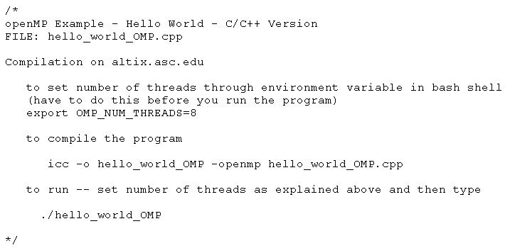
Hello World OpenMP Program

Slide 27
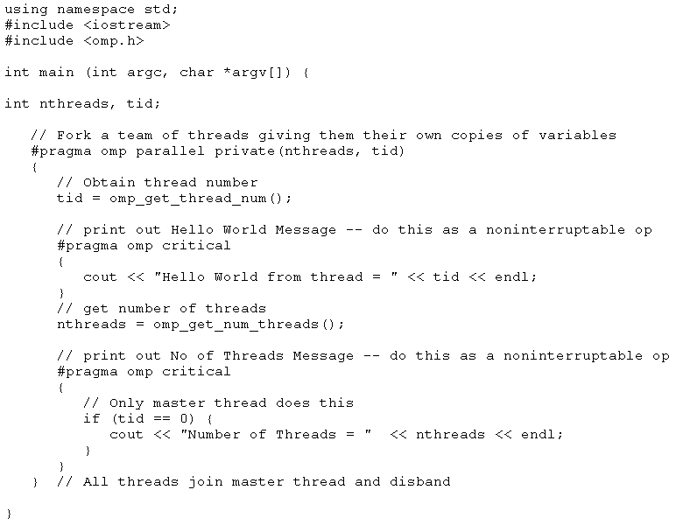
Hello World OpenMP Program

Slide 28
Parallel Directive
#pragma omp parallel
structured_block
creates multiple threads, each one executing the specified
structured_block, either a single statement or a compound
statement created with { ...} with a single entry point and a single exit point.
There is an implicit barrier at the end of the construct.
The directive corresponds to forall construct.

Slide 29
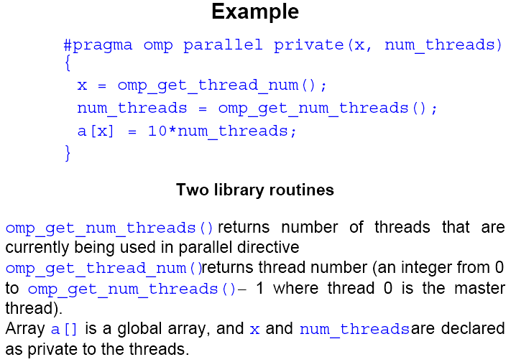

Slide 30
Number of threads in a team
Established by either:
1. num_threads clause after the parallel directive, or
2. omp_set_num_threads() library routine being previously called,
or
3. the environment variable OMP_NUM_THREADS is defined
in the order given or is system dependent if none of the above.
Number of threads available can also be altered automatically to achieve best use of system resources by a “dynamic adjustment” mechanism.

