Slide 1
Parallel Computers
Chapter 1

Slide 2
Functional Parallelism
(Spatial Parallelism)
Functional Parallelism may be possible when there are independent processes or threads that apply different operations to different data items

Slide 3
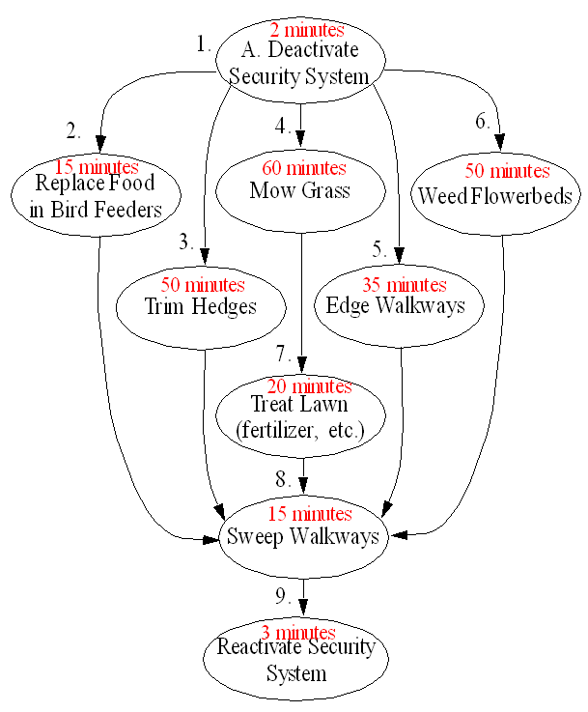
Landscape Management
Example

Slide 4
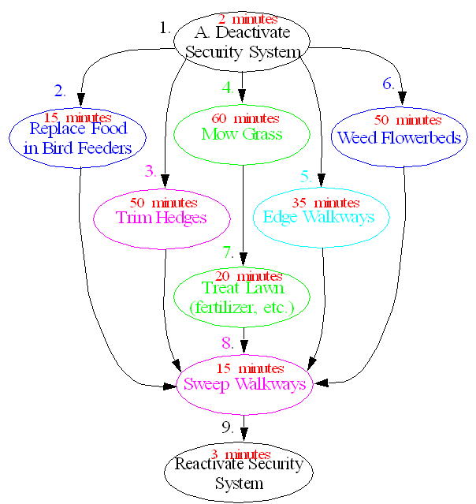
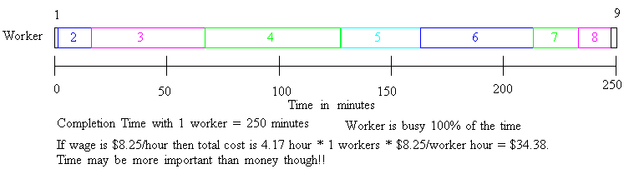

Slide 6
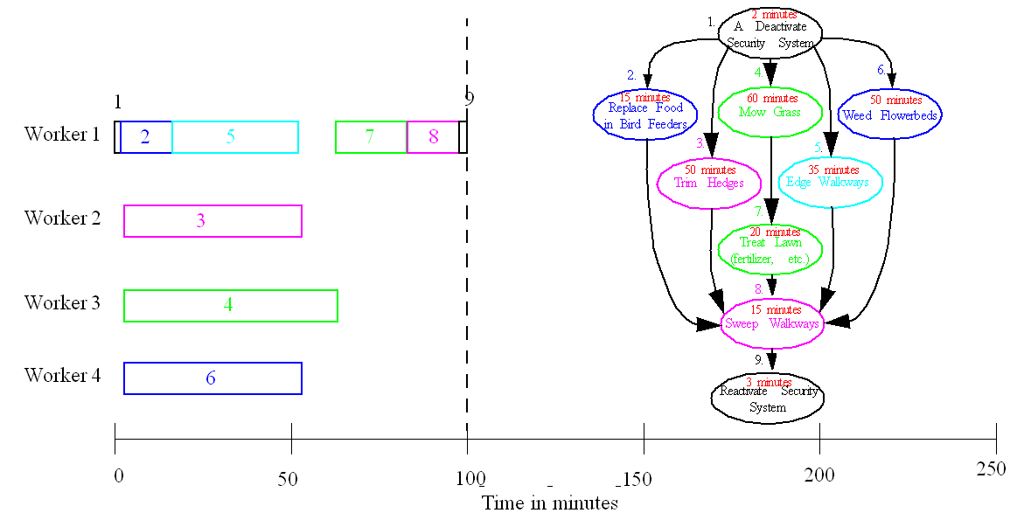

Slide 7
Data Parallelism
(Spatial Parallelism)
Data Parallelism may be possible when there are independent tasks that apply the same operation to different data items

Slide 8
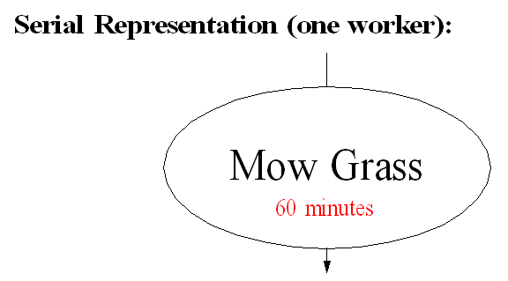
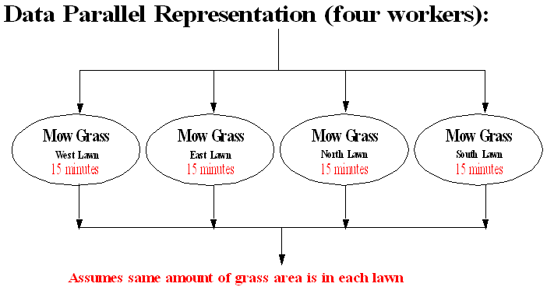

Slide 9
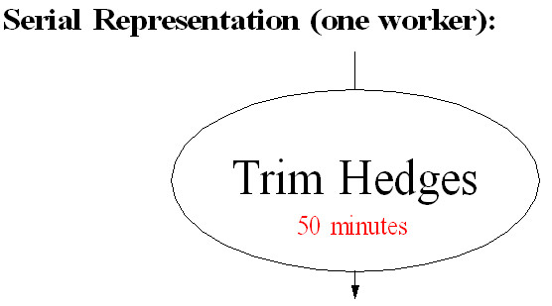
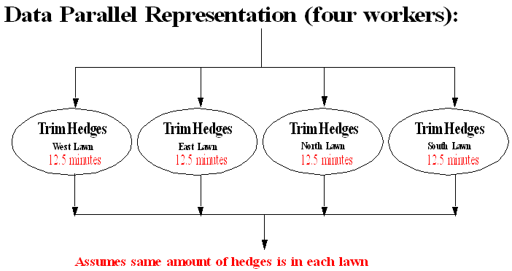

Slide 10
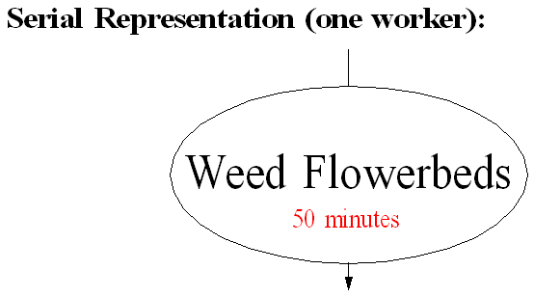
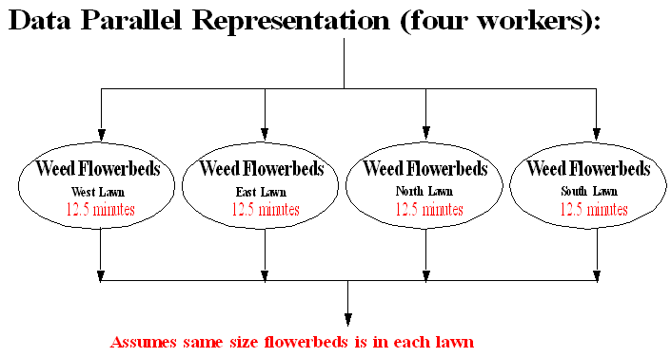

Slide 11
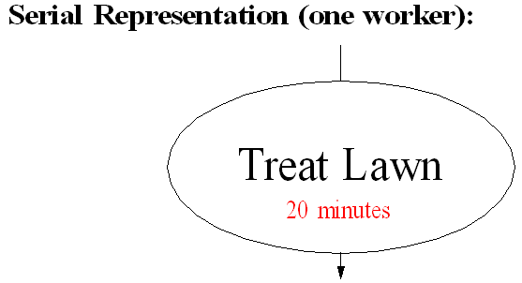
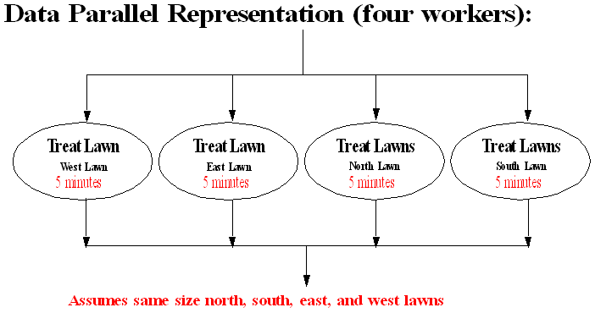

Slide 12
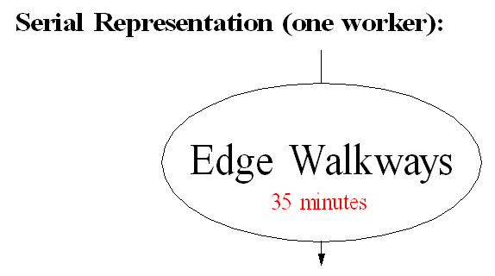
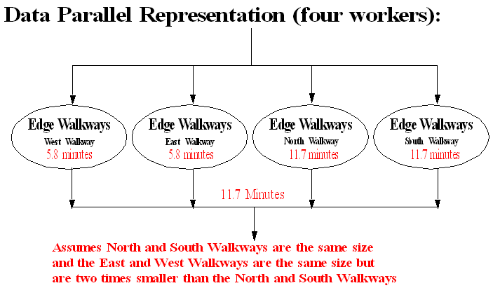

Slide 13
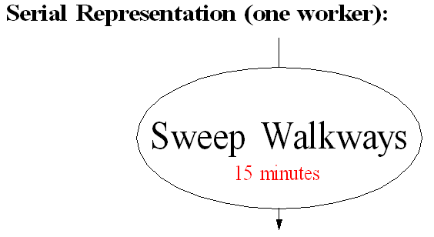
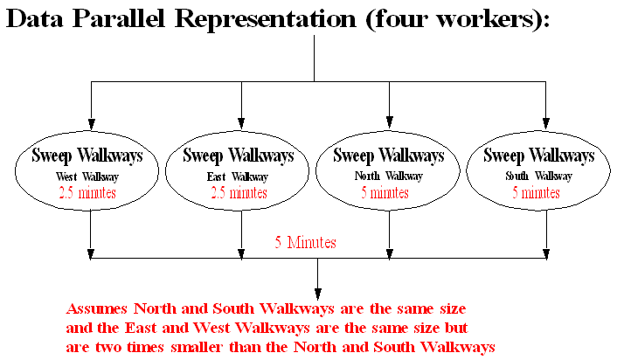

Slide 14
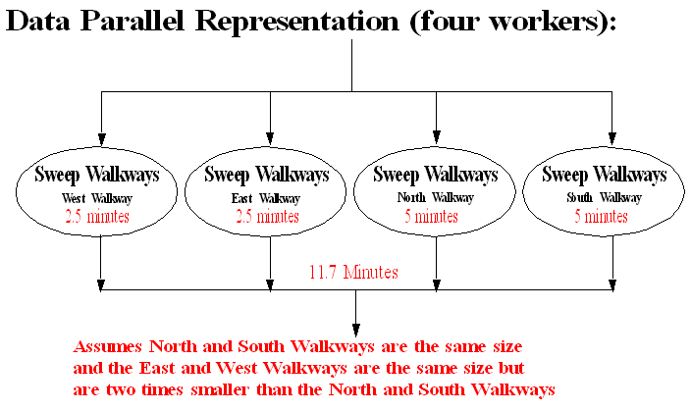
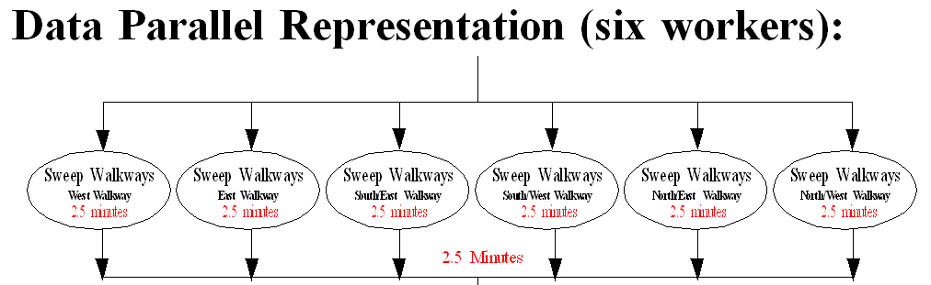

Slide 15
Hybrid Functional and Data Parallel Implementations
Often applications can simultaneously exploit both Functional and Data Parallelism

Slide 16
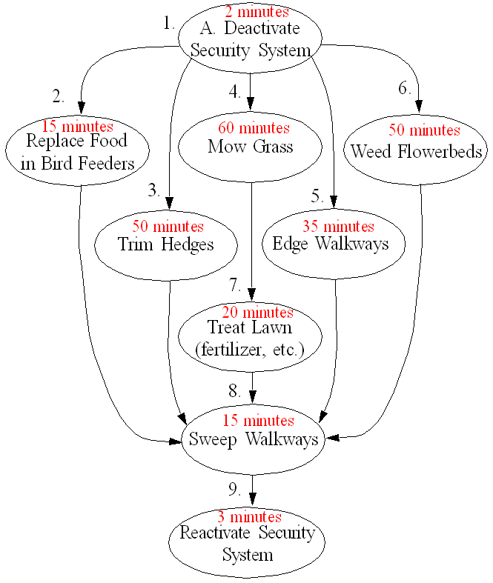
Landscape Management
Example

Slide 17
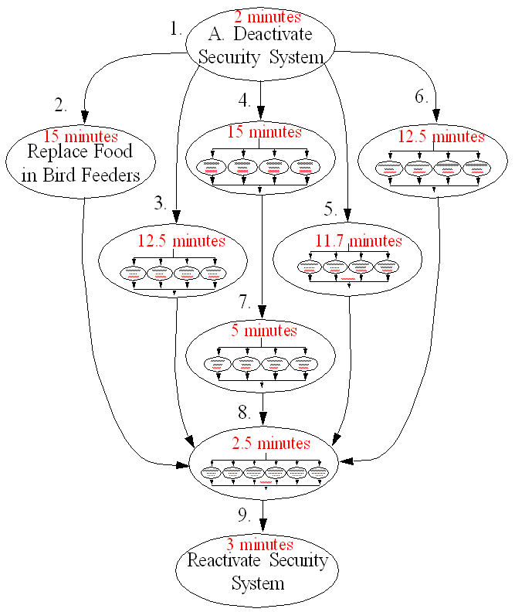
Landscape Management
Example

Slide 18


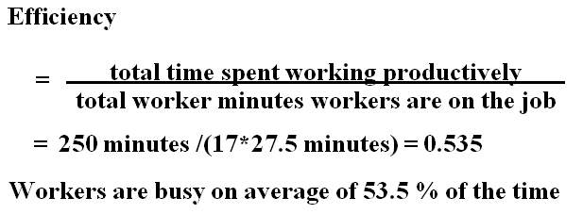

Landscape Management Example

Slide 19
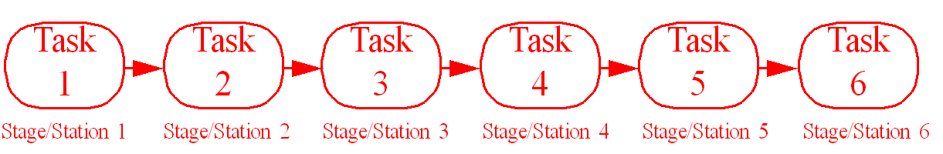
Temporal Parallelism
Pipelined Computations
Problem is divided into a series of tasks that have to be completed one after the other (the basis of sequential programming). Each task executed by a separate process or processor.
5.2

Slide 20

Analogous to the Assembly Line Problem

Slide 21
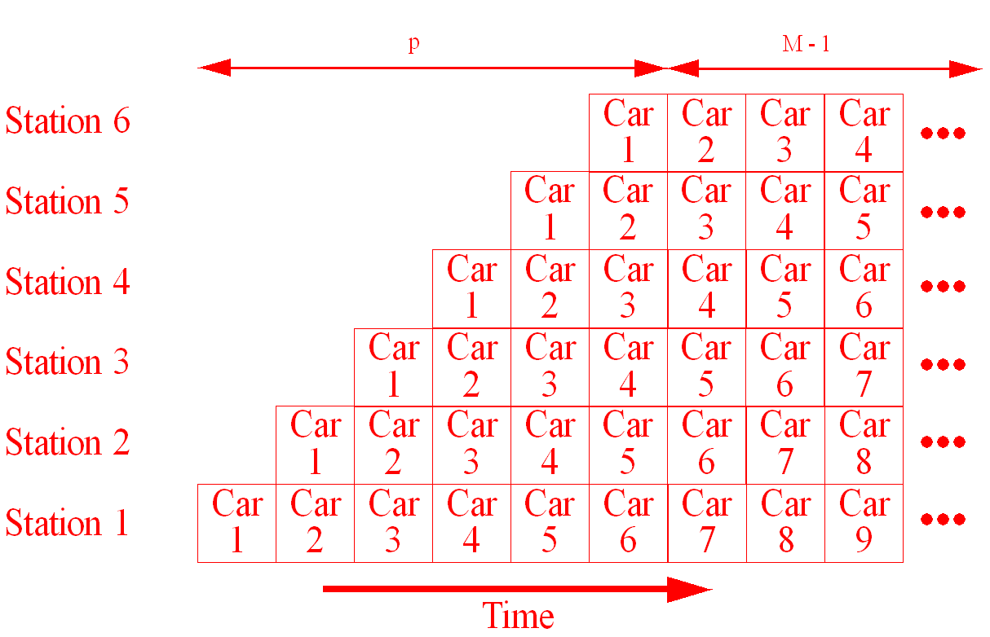
Assembly Line/Pipelining

Slide 22
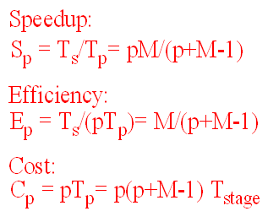
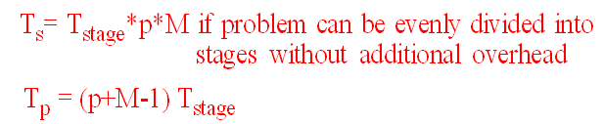
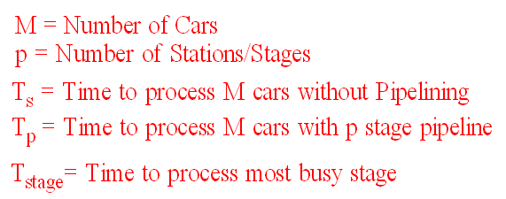

Slide 23
Hybrid Spatial and Temporal Parallel Implementations
Often applications can simultaneously exploit both Functional and Data Parallelism and Pipelining!

Slide 24
Flynn’s Classifications
Flynn (1966) created a classification for computers based upon instruction streams and data streams:
  Single instruction stream-single data stream (SISD) computer
Single processor computer - single stream of instructions generated from program. Instructions operate upon a single stream of data items.

Slide 25
Single Instruction Stream-Multiple Data Stream (SIMD) Computer
A specially designed computer - a single instruction stream from a single program, but multiple data streams exist. Instructions from program broadcast to more than one processor. Each processor executes same instruction in synchronism, but using different data.
Developed because a number of important applications that mostly operate upon arrays of data.

Slide 26
Multiple Instruction Stream-Single Data Stream (MISD) Computer
A computer with multiple instruction streams, but only a single data stream. It is “a pepeline of multiple independently executing functional units operating on a single stream of data, forwarding results from one functional unit to the next”
Example: Systolic Arrays

Slide 27
Multiple Instruction Stream-Multiple Data Stream (MIMD) Computer
General-purpose multiprocessor system - each processor has a separate program and one instruction stream is generated from each program for each processor. Each instruction operates upon different data.
Both the shared memory and the message-passing multiprocessors so far described are in the MIMD classification.

Slide 28
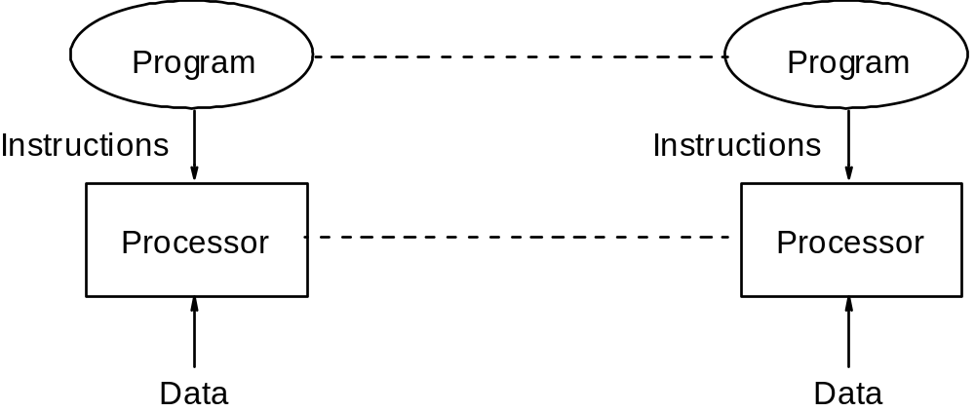
Multiple Program Multiple Data (MPMD) Structure
Within the MIMD classification, each processor will have its own program to execute:

Slide 29
Single Program Multiple Data (SPMD) Structure
Single source program written and each processor executes its personal copy of this program, although independently and not in synchronism.
Source program can be constructed so that parts of the program are executed by certain computers and not others depending upon the identity of the computer.

Slide 30
Types of Parallel Computers
Two principal types:
Shared memory multiprocessor
Distributed memory multicomputer

Slide 31
Shared Memory Multiprocessor

Slide 32
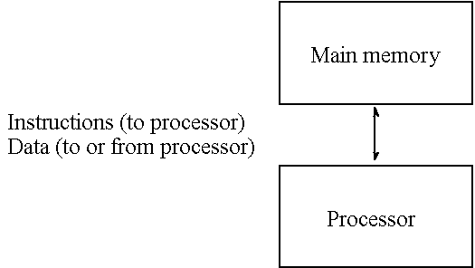
Conventional Computer
Consists of a processor executing a program stored in a (main) memory:
Each main memory location located by its address. Addresses start at 0 and extend to 2^{b} - 1 when there are b bits (binary digits) in address.

Slide 33
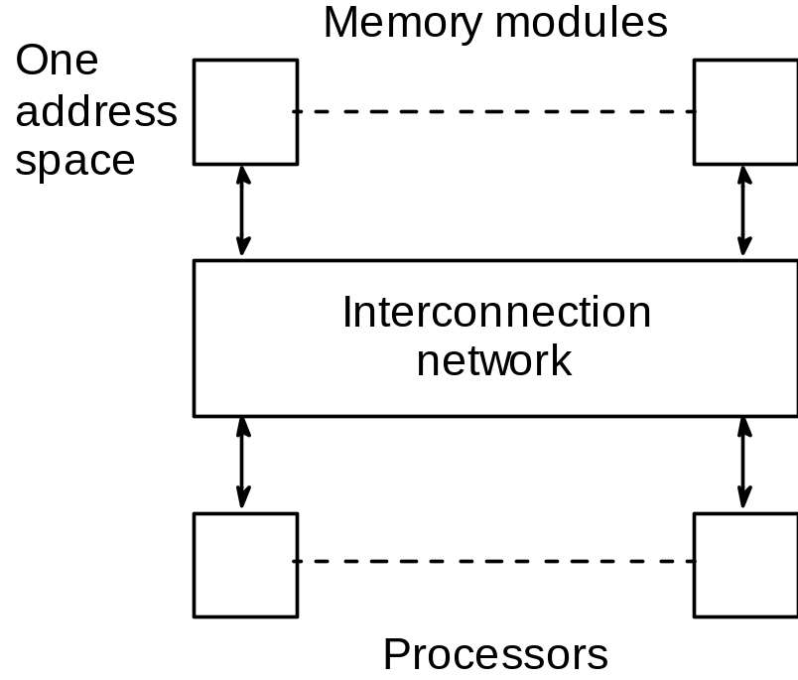
Shared Memory Multiprocessor System
Natural way to extend single processor model - have multiple processors connected to multiple memory modules, such that each processor can access any memory module :

Slide 34
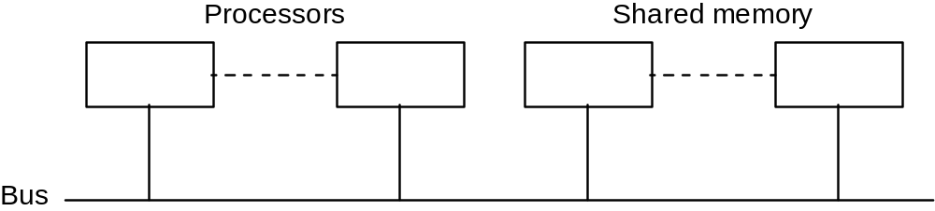
Simplistic view of a small shared memory multiprocessor
Examples:
Dual Pentiums
Quad Pentiums

Slide 35
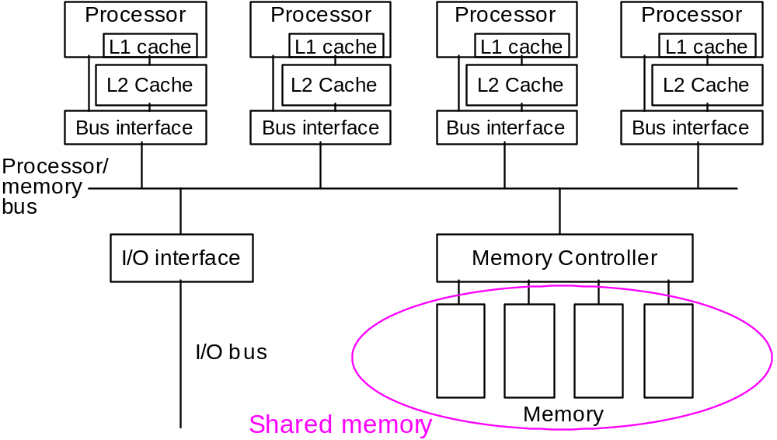
Quad Pentium Shared Memory Multiprocessor

Slide 36
Programming Shared Memory Multiprocessors
Use:
Threads - programmer decomposes program into individual parallel sequences, (threads), each being able to access variables declared outside threads.
Example Pthreads
Sequential programming language with preprocessor compiler directives to declare shared variables and specify parallelism.
Example OpenMP - industry standard - needs OpenMP compiler
Sequential programming language with added syntax to declare shared variables and specify parallelism.
Example UPC (Unified Parallel C) - needs a UPC compiler.
Parallel programming language with syntax to express parallelism - compiler creates executable code for each processor (not now common)
Sequential programming language and ask parallelizing compiler to convert it into parallel executable code. - also not now common

Slide 37
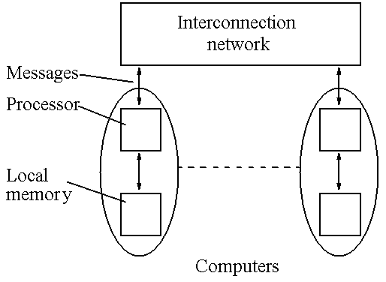
Message-Passing Multicomputer
Complete computers connected through an interconnection network:

