Slide 1
An Introduction to POSIX Threads
Eduardo Cuansing
cuansing@physics.purdue.edu
http://www.physics.purdue.edu/~cuansing/pthreads.ppt

Slide 2
What is a thread?
process:
  an address space with 1 or more threads executing within that address space, and the required system resources for those threads
  a program that is running
thread:
  a sequence of control within a process
  shares the resources in that process

Slide 3
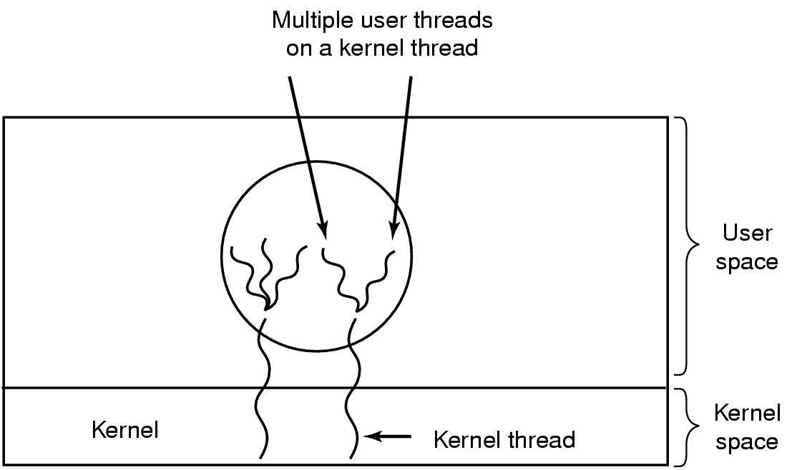
Hybrid Implementations
Multiplexing user-level threads onto kernel-level threads

Slide 4
Advantages and Drawbacks of Threads
Advantages:
  the overhead for creating a thread is significantly less than that for creating a process (~ 2 milliseconds for threads)
  multitasking, i.e., one process serves multiple clients
  switching between threads requires the OS to do much less work than switching between processes

Slide 5
Drawbacks:
  not as widely available as longer established features
  writing multithreaded programs require more careful thought
  more difficult to debug than single threaded programs
  for single processor machines, creating several threads in a program may not necessarily produce an increase in performance (only so many CPU cycles to be had)

Slide 6
POSIX Threads (pthreads)
IEEE's POSIX Threads Model:
  programming models for threads in a UNIX platform
  pthreads are included in the international standards ISO/IEC9945-1
pthreads programming model:
  creation of threads
  managing thread execution
  managing the shared resources of the process

Slide 7
Pthread Operations
POSIX function | description
pthread_cancel | terminate another thread
pthread_create | create a thread
pthread_detach | set thread to release resources
pthread_equal | test two thread IDs for equality
pthread_exit | exit a thread without exiting process
pthread_kill | send a signal to a thread
pthread_join | wait for a thread
pthread_self | find out own thread ID

Slide 8
main thread:
  initial thread created when main() (in C++) are invoked by the process loader
  once in the main(), the application has the ability to create daughter threads
  if the main thread returns, the process terminates even if there are running threads in that process, unless special precautions are taken
  to explicitly avoid terminating the entire process, use pthread_exit()

Slide 9
thread termination methods:
  implicit termination:
    thread function execution is completed
  explicit termination:
    calling pthread_exit() within the thread
    calling pthread_cancel() to terminate other threads
for numerically intensive routines, it is suggested that the application creates p threads if there are p available processor cores

Slide 10
Exiting and Cancellation
A process can terminate when:
  it calls exit directly
  one of its threads calls exit()
  it returns from main()
  it receives a termination signal
In any of these cases, all threads of the process terminate.

Slide 11
Thread Exit
When a thread is done, it can return from its first function (the one used by pthread_create) or it can call pthread_exit
void pthread_exit(void *value_ptr);
Common uses:
Return value is often a pointer to the original struct or a malloc’d struct (memory must be free’d by joining thread)
Use the heap not the stack!!!

Slide 12
Canceling a thread!
One thread can request that another exit by using pthread_cancel
int pthread_cancel(pthread_t thread);
The pthread_cancel returns after making the request.

Slide 13
Sample Pthreads Program in C++
The program in C++ calls the pthread.h header file. Pthreads related statements are preceded by the pthread_ prefix (except for semaphores).
In Pthreads knowing how to manipulate pointers is very important!

Slide 14
/*
Pthreads Example - Hello World - C/C++ Version
File: hello_world_PTH2.cpp
Compilation on altix.asc.edu
to compile the program
icc hello_world_PTH2.cpp -o hello_world_PTH2 -lpthread
to run type
./hello_world_PTH2
*/
using namespace std;
#include <iostream>
#include <fstream>
#include <pthread.h>
#define NTHREADS 8 /* set number of threads to 8 */
pthread_mutex_t MUTEX; // globaly defined lock variable used to insure
// uninterrupted print operations from each thread
ofstream filestr("file_nm"); // filestr: file stream common to all threads
// This is the worker thread code
void *hello(void * arg) {
int myid=*(int *) arg;
sleep(1);
// enter critical region
pthread_mutex_lock(&MUTEX);
filestr << "Hello World, from PThread " << myid << endl;
// exit critical region
pthread_mutex_unlock(&MUTEX);
return arg; // could use pthread_exit(NULL) function as well
}

Slide 15
Thread Synchronization Mechanisms
Mutual exclusion (mutex):
  guard against multiple threads modifying the same shared data simultaneously
  provides locking/unlocking critical code sections where shared data is modified
  each thread waits for the mutex to be unlocked (by the thread who locked it) before performing the code section

Slide 16
Basic Mutex Functions:
  int pthread_mutex_init(pthread_mutex_t *mutex, const pthread_mutexattr_t *mutexattr);
  int pthread_mutex_lock(pthread_mutex_t *mutex);
  int pthread_mutex_unlock(pthread_mutex_t *mutex);
  int pthread_mutex_destroy(pthread_mutex_t *mutex);
  a new data type named pthread_mutex_t is designated for mutexes
  a mutex is like a key (to access the code section) that is handed to only one thread at a time
  the attribute of a mutex can be controlled by using the pthread_mutex_init() function
  the lock/unlock functions work in tandem

Slide 17
#include <pthread.h>
...
pthread_mutex_t my_mutex; // should be of global scope
...
int main()
{
int tmp;
...
// initialize the mutex
tmp = pthread_mutex_init( &my_mutex, NULL );
...
// create threads
...
pthread_mutex_lock( &my_mutex );
do_something_private();
pthread_mutex_unlock( &my_mutex );
...
return 0;
}
Whenever a thread reaches the lock/unlock block, it first determines if the mutex is locked. If so, it waits until it is unlocked. Otherwise, it takes the mutex, locks the succeeding code, then frees the mutex and unlocks the code when it's done.

Slide 18
/*
Pthreads Example - Hello World - C/C++ Version
File: hello_world_PTH2.cpp
Compilation on altix.asc.edu
to compile the program
icc hello_world_PTH2.cpp -o hello_world_PTH2 -lpthread
to run type
./hello_world_PTH2
*/
using namespace std;
#include <iostream>
#include <fstream>
#include <pthread.h>
#define NTHREADS 8 /* set number of threads to 8 */
pthread_mutex_t MUTEX; // globaly defined lock variable used to insure
// uninterrupted print operations from each thread
ofstream filestr("file_nm"); // filestr: file stream common to all threads

Slide 19
// This is the worker thread code
void *hello(void * arg) {
int myid=*(int *) arg;
// enter critical region
pthread_mutex_lock(&MUTEX);
filestr << "Hello World, from PThread " << myid << endl;
// exit critical region
pthread_mutex_unlock(&MUTEX);
return arg; // could use pthread_exit(NULL) function as well
}

Slide 20
// this is the main thread's code -- it spawns the worker threads and
// then waits for all the worker threads to return before it exits
int main(int argc,char *argv[])
{
int tid; // tid thread number
pthread_t threads[NTHREADS]; // holds various thread info
int ids[NTHREADS]; // holds thread args
int errcode; // pthread error code
pthread_attr_t tattr; // pthread attribute object
// the following code sets up the Pthread attribute object
// not really necessary if you like the defaults
if (errcode = pthread_attr_init(&tattr)) {
cerr << "Failed to create attribute object: " << strerror(errcode) << endl;
}
// make threads joinable (for detatched threads use PTHREAD_CREATE_DETACHED)
else if (errcode = pthread_attr_setdetachstate(&tattr,PTHREAD_CREATE_JOINABLE)) {
cerr << "Failed to set attribute state: " << strerror(errcode) << endl;
}
// allow threads to be scheduled system wise not just process wise
else if (errcode = pthread_attr_setscope(&tattr,PTHREAD_SCOPE_SYSTEM)) {
cerr << "Failed to set attribute scope: " << strerror(errcode) << endl;
}
// initialize mutex variable -- this variable is used to insure that
// all couts are automic meaning that they are not interrupted
pthread_mutex_init(&MUTEX,NULL);

Slide 21
Settable Properties of Thread Attributes
property | function
attribute objects | pthread_attr_destroy
 | pthread_attr_init
detach state | pthread_attr_getdetachstate
 | pthread_attr_setdetachstate
stack | pthread_attr_getguardsize
 | pthread_attr_setguardsize
 | pthread_attr_getstack
 | pthread_attr_setstack
scheduling | pthread_attr_getinheritsched
 | pthread_attr_setinheritsched
 | pthread_attr_getschedparam
 | pthread_attr_setschedparam
 | pthread_attr_getschedpolicy
 | pthread_attr_setschedpolicy
 | pthread_attr_getscope
 | pthread_attr_setscope

Slide 22
Thread Attributes
detach state attribute:
  int pthread_attr_setdetachstate(pthread_attr_t *attr, int detachstate);
  detached – main thread continues working without waiting for the daughter threads to terminate
  joinable – main thread waits for the daughter threads to terminate before continuing further

Slide 23
Detaching a Thread
int pthread_detach(pthread_t threadid);
Indicate that system resources for the specified thread should be reclaimed when the thread ends
  If the thread is already ended, resources are reclaimed immediately
  This routine does not cause the thread to end
A detached thread’s thread ID is undetermined
Threads are detached
  after a pthread_detach() call
  after a pthread_join() call
  if a thread terminates and the PTHREAD_CREATE_DETACHED attribute was set on creation

Slide 24
contention scope attribute:
  int pthread_attr_setscope(pthread_attr_t *attr, int *scope);
  system scope – threads are mapped one-to-one on the OS's kernel threads (kernel threads are entities that scheduled onto processors by the OS)
  process scope – threads share a kernel thread with other process scoped threads

Slide 25
Threads Programming Model
pipeline model – threads are run one after the other
master-slave model – master (main) thread doesn't do any work, it just waits for the slave threads to finish working
equal-worker model – all threads work

Slide 26
/* create the threads */
for (tid=0; tid<NTHREADS; tid++) {
ids[tid]=tid;
errcode=pthread_create(
&threads[tid],// thread information structure
&tattr, // thread attributes -- NULL means assume defaults
hello, // function name that is to represent thread
&ids[tid]); // pthread created thread id for the created thread
// check for error during thread creation
if (errcode) {
cerr << "Pthread Creation Error: " << strerror(errcode) << endl;
exit(1);
}
}

Slide 27
Creating a thread:
  int pthread_create( pthread_t *thread, pthread_attr_t *attr, void *(*thread_function)(void *), void *arg );
  first argument – pointer to the identifier of the created thread
  second argument – thread attributes
  third argument – pointer to the function the thread will execute
  fourth argument – the argument of the executed function (usually a struct)
  returns 0 for success

Slide 28
// output number of threads
pthread_mutex_lock(&MUTEX); // enter critical region
filestr << "Number of threads = " << NTHREADS << endl;
pthread_mutex_unlock(&MUTEX); // exit critical region
// wait for all threads to return before exiting main program (process)
for (tid=0; tid<NTHREADS; tid++) {
// wait for each thread to terminate
errcode=pthread_join(
threads[tid], //thread scheduler id information of selected thread
NULL); //thread return value -- not used in this case
if (errcode) {
cerr << "Pthread Join Error: " << strerror(errcode) << endl;
exit(1);
}
}
filestr.close(); // close open file
}

Slide 29
Waiting for the threads to finish:
  int pthread_join( pthread_t thread, void **thread_return )
  main thread will wait for daughter thread thread to finish
  first argument – the thread to wait for
  second argument – pointer to a pointer to the return value from the thread
  returns 0 for success
  threads should always be joined; otherwise, a thread might keep on running even when the main thread has already terminated

Slide 30
Counting Semaphores:
  permit a limited number of threads to execute a section of the code
  similar to mutexes
  should include the semaphore.h header file
  semaphore functions do not have pthread_ prefixes; instead, they have sem_ prefixes

Slide 31
Basic Semaphore Functions:
  creating a semaphore:
  int sem_init(sem_t *sem, int pshared, unsigned int value);
    initializes a semaphore object pointed to by sem
    pshared is a sharing option; a value of 0 means the semaphore is local to the calling process
    gives an initial value value to the semaphore
  terminating a semaphore:
  int sem_destroy(sem_t *sem);
    frees the resources allocated to the semaphore sem
    usually called after pthread_join()
    an error will occur if a semaphore is destroyed for which a thread is waiting

Slide 32
  semaphore control:
    int sem_post(sem_t *sem);
    int sem_wait(sem_t *sem);
    sem_post atomically increases the value of a semaphore by 1, i.e., when 2 threads call sem_post simultaneously, the semaphore's value will also be increased by 2 (there are 2 atoms calling)
    sem_wait atomically decreases the value of a semaphore by 1; but always waits until the semaphore has a non-zero value first

Slide 33
#include <pthread.h>
#include <semaphore.h>
...
void *thread_function( void *arg );
...
sem_t semaphore; // also a global variable just like mutexes
...
int main()
{
int tmp;
...
// initialize the semaphore
tmp = sem_init( &semaphore, 0, 0 );
...
// create threads
pthread_create( &thread[i], NULL, thread_function, NULL );
...
while ( still_has_something_to_do() )
{
sem_post( &semaphore );
...
}
...
pthread_join( thread[i], NULL );
sem_destroy( &semaphore );
return 0;
}

Slide 34
void *thread_function( void *arg )
{
sem_wait( &semaphore );
perform_task_when_sem_open();
...
pthread_exit( NULL );
}
  the main thread increments the semaphore's count value in the while loop
  the threads wait until the semaphore's count value is non-zero before performing perform_task_when_sem_open() and further
  daughter thread activities stop only when pthread_join() is called

Slide 35
Condition Variables:
  used for communicating information about the state of shared data
  can make the execution of sections of a codes by a thread depend on the state of a data structure or another running thread
  condition variables are for signaling, not for mutual exclusion; a mutex is needed to synchronize access to shared data

Slide 36
Condition Variables
Often, a critical section is to be executed if a specific global
condition exists; for example, if a certain value of a variable has been reached.
With locks, the global variable would need to be examined at
frequent intervals (“polled”) within a critical section.
Very time-consuming and unproductive exercise.
Can be overcome by introducing so-called condition variables.

Slide 37
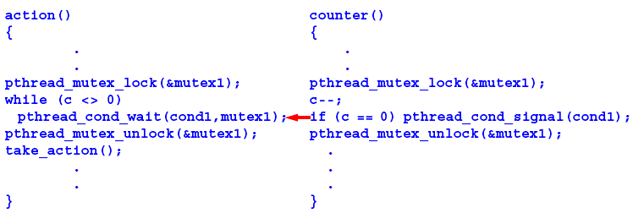
Pthread Condition Variables
Pthreads arrangement for signal and wait:
Signals not remembered - threads must already be waiting for a signal to receive it.

Slide 38
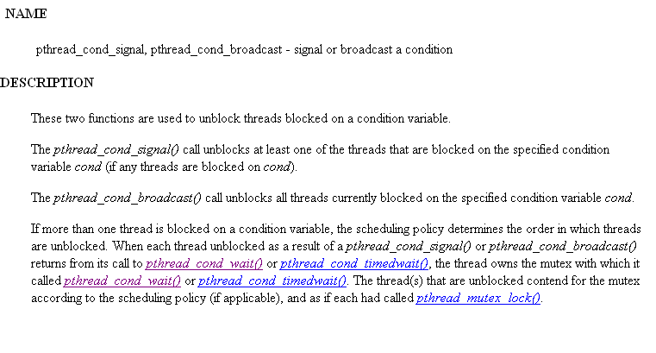

Slide 39
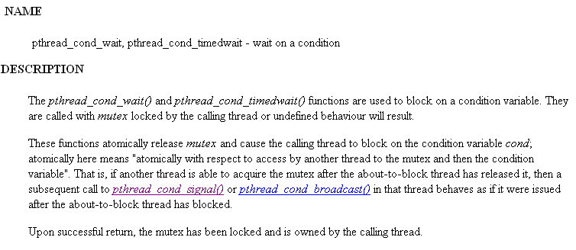

Slide 40
When mixing with MPI, the simplest way is to let only 1 thread handle the communications.
So why threads? In some cases, it is the only viable approach.

