Slide 1
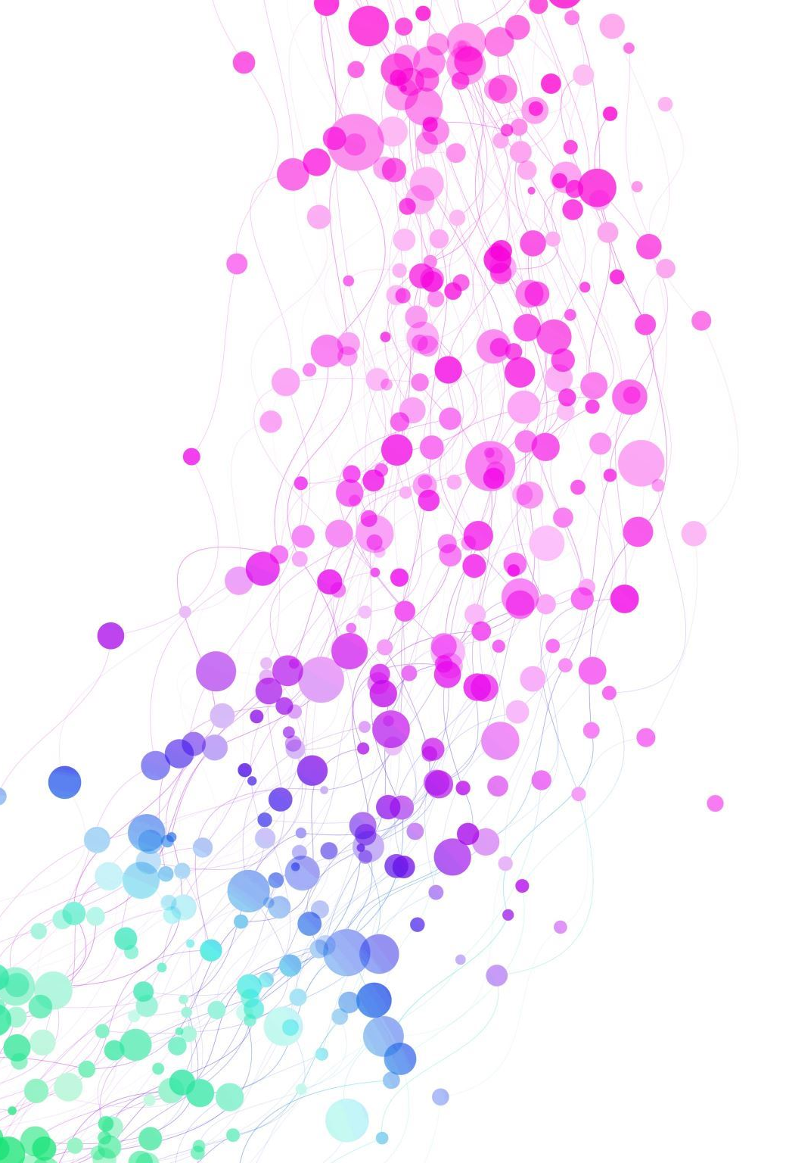
GNNs in Drug discovery
Tin M. Tunjic, Machine Learning Researcher @ Celeris Therapeutics

Slide 2
Summary
Theory:
Introduction​ to GNNs
Molecules represented as Graphs
​GNN Tasks
Graph Data Processing
​GCN
Implementation:
Tox21 Dataset
Summary of Experiments

Slide 3
WHY Graphs?

Slide 4
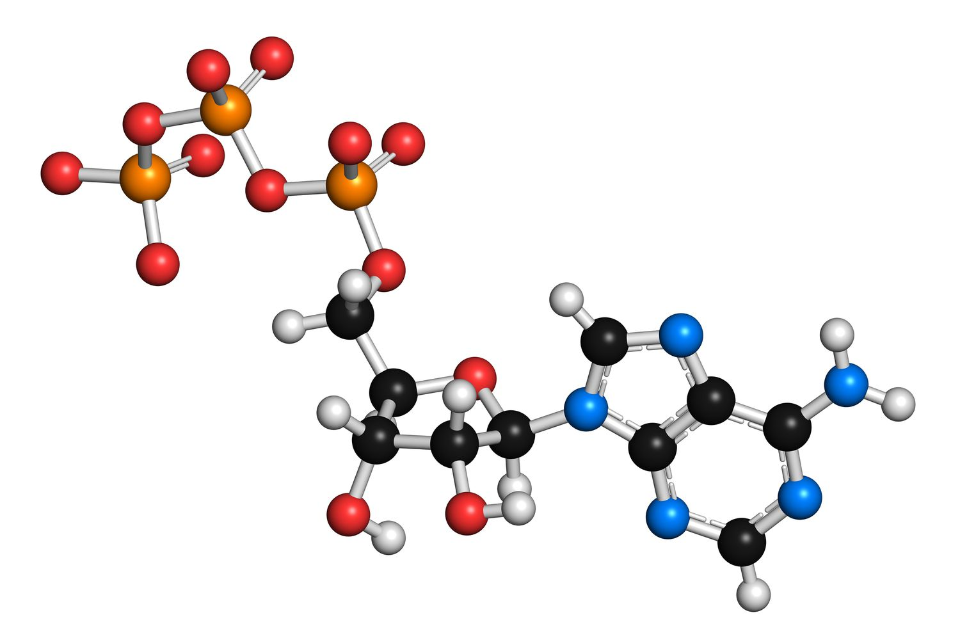
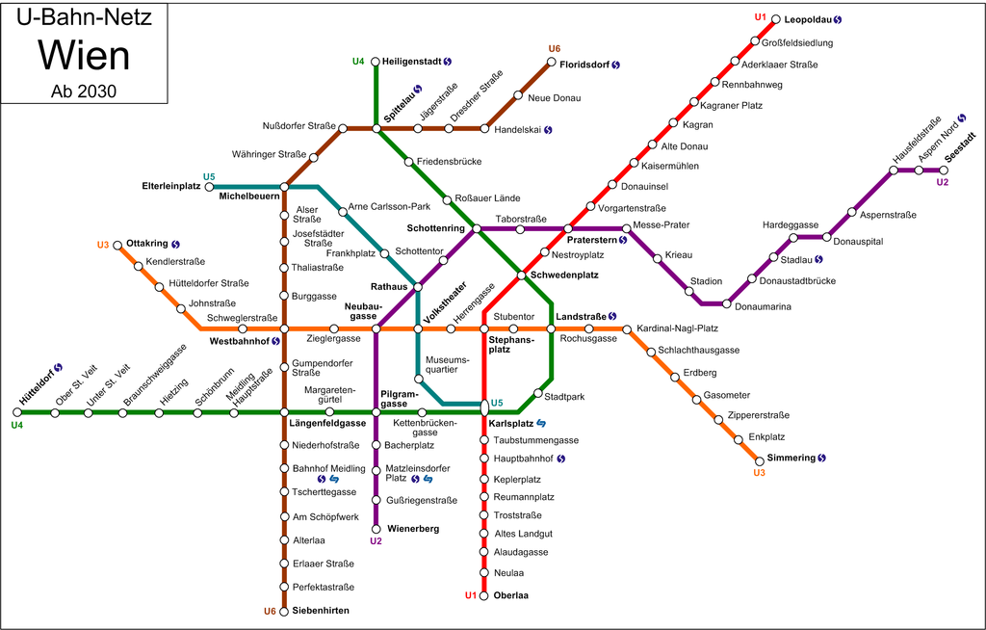

Graphs are everywhere!

Slide 5
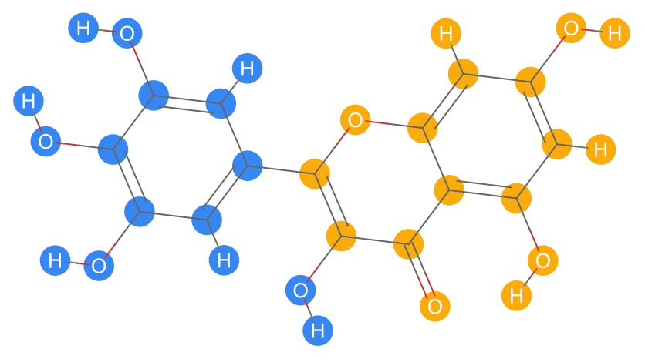
Molecules as graphs
Natural way of representing a molecule is as a graph
Atoms represented as nodes
Bonds represented as edges
Features atom type, mass, bond type

Slide 6
GNN Tasks
Three commonly used tasks:
Graph Classification
Link Prediction
Node Classification

Slide 7
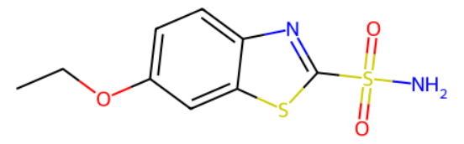
GNNs for molecule classification
Very often used in drug discovery
Can be used to predict if a drug is potent (binary classification)
GNN
Potent Drug?

Slide 8
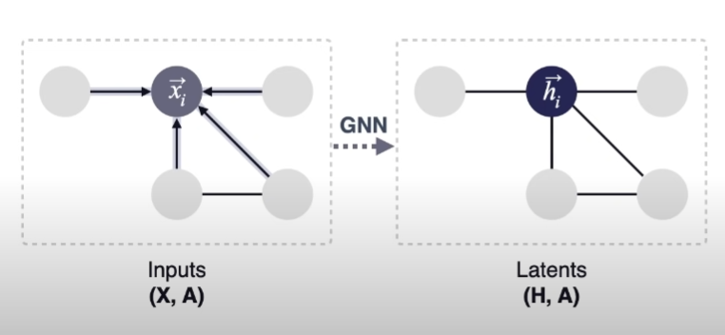
Graph processing
Graph can be seen as a strict generalisation of the images (nodes are pixels, neighbouring pixels represent adjacency matrix)
CNNs have convolutional operator to extract the image features
We need to generalise that to operate on arbitrary graphs

Slide 9
Graph processing
For unweighted and undirected graph:
Adjacency matrix: Aij = Aji = 1 (when i and j neighbours) or 0 (otherwise)
We aggregate neighbourhood (propagate information): H' = act(AHW),
where W is a weight matrix and act a nonlinear activation function

Slide 10


GCN (Kipf & Welling, 2017)
We can use symmetric normalisation and obtain a Graph Convolutional Network (GCN) update rule:
Node-wise rewritten:

Slide 11
Implementation

Slide 12
Tox21 Dataset
Collection of chemical compounds and their associated toxicological effects
It includes binary labels indicating whether a compound is active or inactive
With respect to 12 protein targets in the human body
There are 7831 rows, which are then divided into (train, valid and test sets)

Slide 13
Experiments
Multi task classification network vs GCN (out of the box models)
Writing our own GCN
Mean vs Max vs Sum Pooling

Slide 14
THANK YOU
Tin M. Tunjic
t.tunjic@celeristx.com

