Slide 1

Team 3
Develop a decentralized application for crowdfunding

Slide 2
INSTRUCTIONS MEMBERS
Name | ID
Vo Nguyen Thanh Tu | 20014641
Le Thi Ngoc Mai | 20005501
Tran Thi Minh Huyen | 20105231
Vo Quoc Thinh | 20078241
Do Quoc Tuan | 20079191
Nguyen Hoang Thai | 20009931

Slide 3
Table of contents
01.
02.
Introduction
System Design
03.
04.
05.
Methodology
Demo Application
Explaination of Source Code

Slide 4
INTRODUCTION
1
Decentrialize application for crowndfunding

Slide 5
Blockchain technology has the potential to revolutionize crowdfunding by creating a transparent and secure environment for fundraising. By using the Ethereum blockchain, our platform provides increased transparency, security, and efficiency. All transactions are recorded on a public ledger, making it easy to track the flow of funds and ensure they are being used as intended.

Slide 6
SYSTEM DESIGN
2
Decentrialize application for crowndfunding

Slide 7
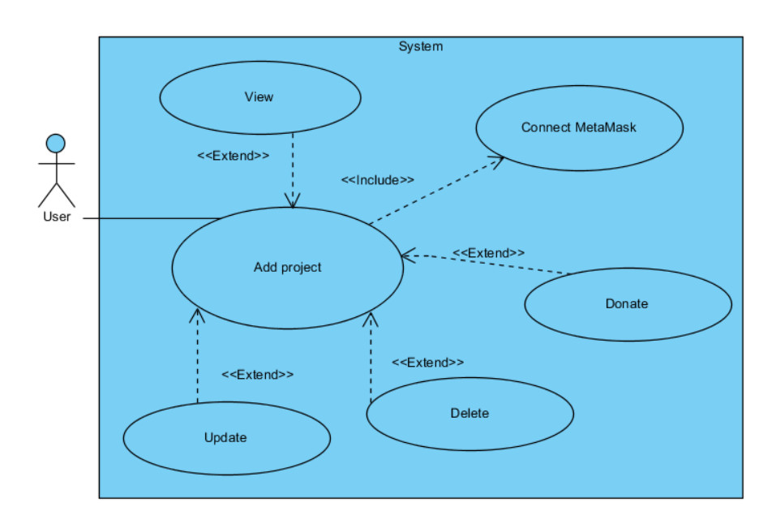

Slide 8
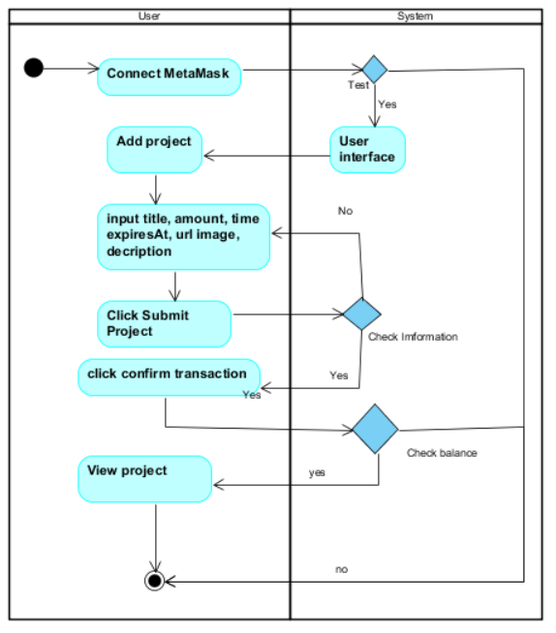

Slide 9
ABOUT THE PROJECT
Divided into 2 main parts: services and smart_contract.
Use tailwind css to create a faster and easier interface.
Use reactJS and Javascript to process.
Use solidity language to build and design Smart Contracts (smart contracts) on blockchain platforms.

Slide 10
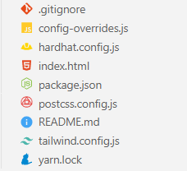
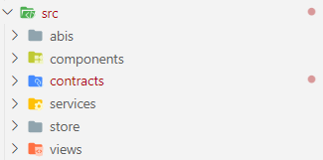
ABOUT THE PROJECT

Slide 11
METHODOLOGY
3
Decentrialize application for crowndfunding

Slide 12
Developing a decentralized application (dApp) for crowdfunding involves several key steps:
1. Identify the problem
2. Choose a blockchain platform
3. Design the dApp
4. Develop smart contracts
5. Develop the front-end and back-end
6. Test the dApp
7. Launch the dApp
8. Market the dApp
9. Maintain and update the dApp

Slide 13
EXPLAINATION OF SOURCE CODE
4
Decentrialize application for crowndfunding

Slide 14
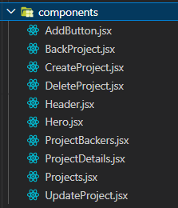
Use reactJS and Javascript to process
UI/UX interface part: component

Slide 15

Use solidity language to build and design Smart Contracts
Smart contract
Solidity smart contract that allows users to add transactions to a blockchain and retrieve information about past transactions

Slide 16
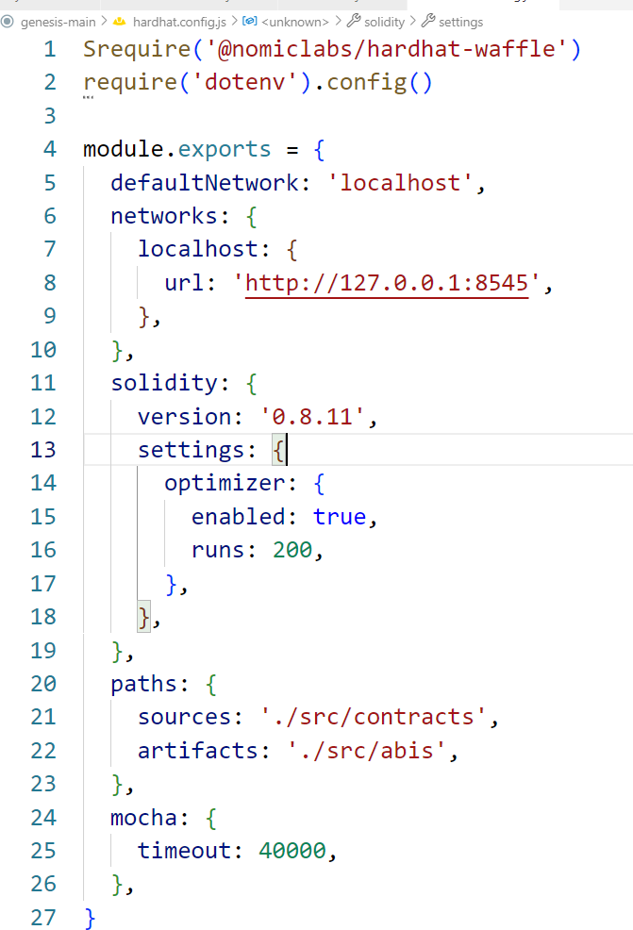
Functions and Files
The Hardhat development environment.
Solidity version 0.8.0 is being used. Using the Waffle testing framework. testing on the sepolia ETH test network.

Slide 17
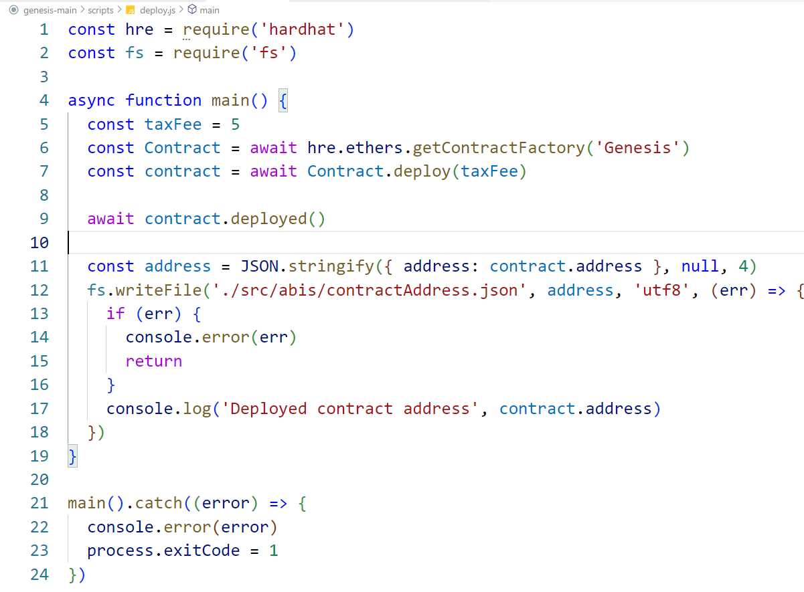


Functions and Files
Deploy.js
Service
Views

Slide 18
DEMO APP
4
Decentrialize application for crowndfunding

Slide 19

THANKS!

