Slide 1
Diploma work
Sergei Chulanov

Slide 2
Task description
Criteria | Related Module
SCM (Source code management) | git
Language | golang (front and api)
Tests | golang tests
Quality gate | golangci-lint, tflint, sonarqube
Vulnerability | trivy
IaC | terraform
Orchestration | eks
Logging | cloudwatch
Monitoring | cloudwatch
Runtime/Deployment | gitlab-ci (test and prod)
Scalability/redundancy | eks (hpa)
Cloud and Cost efficiency | infracost
Variant 3
Using API https://covidtracker.bsg.ox.ac.uk/about-api get all data about “By country over time" for current year.
Store it into your DB: date_value, country_code, confirmed, deaths, stringency_actual, stringency.
Output the data by country_code (the country_code is set) in form of a table and sort them by deaths (or date_value which is the same) in ascending order.

Slide 3
Application description
Name: goCovid
Language: golang (go version go1.17.6 linux/amd64)
Database: MariaDB (Amazon RDS)
3-tier application (front-end, back-end, database)
back-end:
retrieve a portion of data from API (see in your Variant) and store it in a database
update data on demand
update DB schema if needed on app’s update
front-end:
display any portion of the data stored in the DB
provide a method to trigger data update process

Slide 4
Tools and resources
Git
Make
Docker
Terraform
Ansible
Helm
EKS
Gitlab-ci
Infracost
Cloudflare
AWS
dbdiagram.io
app.diagrams.net

Slide 5

Source code management.
Git. Branching strategy.
https://nvie.com/posts/a-successful-git-branching-model/
Master
Develop
Feature branches
  From develop
  Merge to develop
Release branches
  From develop
  Merge into master and develop
  Name: release-*
Hotfix branches
  From master
  Merge into master and develop
  Name: hotfix-*

Slide 6
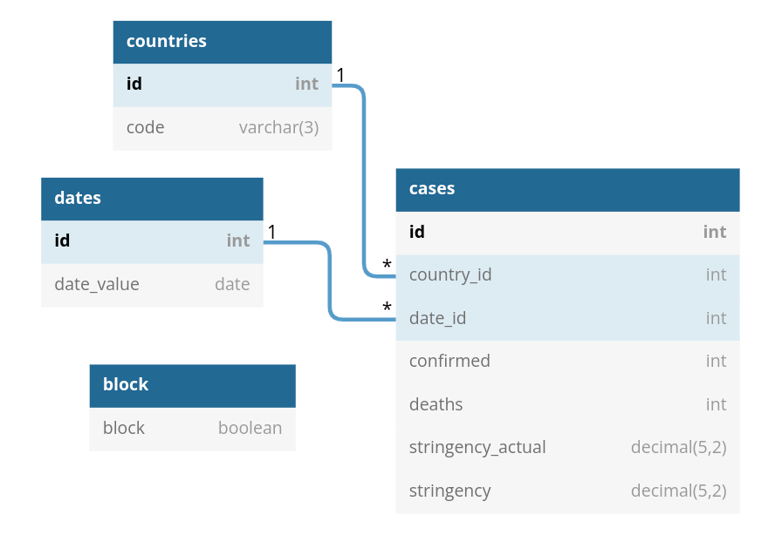
Database schema
https://dbdiagram.io/d/61a34baa8c901501c0d5ba2c
Table countries as C {
id int [pk, increment] // auto increment
code varchar(3)
}
Table cases {
id int [pk, increment] // auto increment
country_id int
date_id int
confirmed int
deaths int
stringency_actual decimal(5,2)
stringency decimal(5,2)
}
Table dates as DS {
id int [pk, increment] // auto increment
date_value date
}
Table block {
block boolean
}
Ref: cases.country_id > C.id
Ref: cases.date_id > DS.id

Slide 7


Backend (API)
/app # ls /app/configs/config.yml
/app/configs/config.yml
/app # ./api -help
Usage of ./api:
-addr string
API HTTP address (default "0.0.0.0:7000")
-fill
If it is true it fills db
/app # curl "http://localhost:7000/v1/help"
Hostname: 4abd5ea319b6
Examples:
curl -D - -s -X GET "http://localhost:7000/v1/health-check"
curl -D - -s -X GET "http://localhost:7000/v1/help"
curl -D - -s -X GET "http://localhost:7000/v1/state" (Block)
curl -D - -s -X GET "http://localhost:7000/v1/update" (Readiness)
curl -D - -s -X GET "http://localhost:7000/v1/refresh_data"
curl -D - -s -X GET "http://localhost:7000/v1/data?countryCode=RUS&&dateFrom=2022-01-01&&dateTo=2022-01-09&&sortBy=deaths"
SELECT
countries.code
,dates.date_value
,cases.deaths
,cases.confirmed
FROM
cases INNER JOIN countries
ON countries.id = cases.country_id INNER JOIN dates
ON dates.id = cases.date_id
WHERE
countries.code = 'USA'
AND date_value BETWEEN '2022-01-01' AND '2022-02-02'
ORDER BY
cases.deaths ASC

Slide 8
Frontend
Key points:
Generate html by golang
Go routine to run task on backend
JavaScript to run code on the client side
SessionStorage
Twitter Bootstrap
/app # ./web -help
Usage of ./web:
-addr string
HTTP address (default "localhost:4000")
-apiVers string
API version (default "v1")
-hostname string
API hostname (default "localhost")
-port string
API port (default "8080")

Slide 9
Docker build with Makefile
$ cat Makefile.Docker
.DEFAULT_GOAL := all
# the same that .DEFAULT_GOAL for older version of make (<= 3.80)
# .PHONY: default
# default: clean;
.PHONY: all
all: build run
.PHONY: build
build:
$(info -> build:)
go mod tidy
mkdir -p ./bin
GOARCH=${GOARCH} GOOS=${GOOS} go build -o ./bin/${BINARY_NAME}-linux ${PATH_TO_SOURCE}
.PHONY: run
run:
$(info -> run:)
./bin/${BINARY_NAME}-linux
.PHONY: clean
clean:
$(info -> clean:)
go clean
rm ./bin/${BINARY_NAME}-linux
.PHONY: messages
messages:
$(info test info message)
$(warning test warning message)
$(error test error message)

Slide 10
Docker multi-stage build with Makefile
FROM golang:1.17.6-alpine3.15 AS build
WORKDIR /app
ARG CGO_ENABLED=0 \
GOARCH=amd64 \
GOOS=linux \
BINARY_NAME=api \
PATH_TO_SOURCE=./cmd/api
RUN apk --no-cache add make
COPY go.mod ./
COPY go.sum ./
RUN go mod download
COPY . /app/
RUN make -f Makefile.Docker build
FROM alpine:3.15
ENV DB_HOSTNAME=localhost
ENV MIGRATIONS_DIR=/app/migrations
RUN apk --no-cache add curl
COPY --from=build /app/bin/api-linux /app/api
COPY --from=build /app/migrations /app/migrations
COPY --from=build /app/configs /app/configs
WORKDIR /app
EXPOSE 5000
CMD ["/app/api"]

Slide 11
Docker compose
version: '3.1'
services:
db:
image: mariadb:10.7.1
environment:
- MARIADB_DATABASE=$MARIADB_DATABASE
- MARIADB_USER=$MARIADB_USER
- MARIADB_PASSWORD=$MARIADB_PASSWORD
- MARIADB_RANDOM_ROOT_PASSWORD=yes
ports:
- 3306:3306
healthcheck:
test: ["CMD", "mysql" ,"$MARIADB_DATABASE", "-h", "localhost", "-P", "3306", "-u", "$MARIADB_USER", "-p$MARIADB_PASSWORD", "-e", "SELECT 1"]
interval: 3s
timeout: 3s
retries: 3
start_period: 1s
goose:
depends_on:
db:
condition: service_healthy
build: app/backend/migrations
links:
- db:mysql
environment:
- GOOSE_DRIVER=mysql
- GOOSE_DBSTRING=$MARIADB_USER:$MARIADB_PASSWORD@tcp(mysql:3306)/$MARIADB_DATABASE
command: ["goose", "up"]
api_data_init:
depends_on:
- goose
build: app/backend
links:
- db:mysql
command: ["/app/api", "-fill=true"]
api:
depends_on:
db:
condition: service_healthy
build: app/backend
ports:
- 8080:7000
links:
- db:mysql
environment:
- APP_ENDPOINT=0.0.0.0:7000
command: ["/app/api"]
web:
build: app/frontend
ports:
- 4000:4000
links:
- api:api
command: ["/app/web", "-addr", "0.0.0.0:4000", "-port", "7000", "-hostname", "api"]

Slide 12
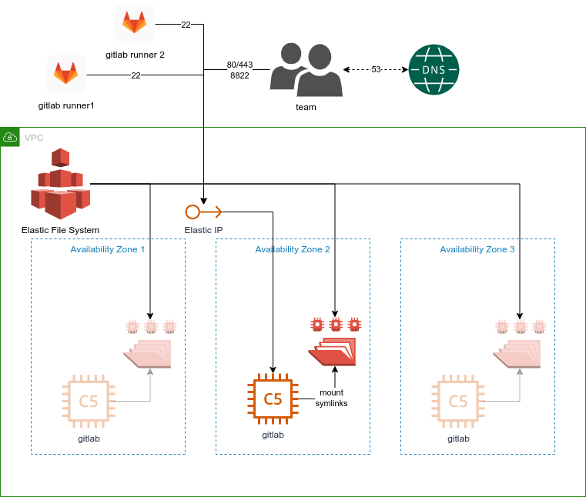
Omnibus GitLab
Terraform
  cloudflare_record
  template_file
  EFS
  Security groups
  VPC
  aws_instance
Ansible
  Nginx
  Letsencript
  Docker
  EFS mount
  -e "remove_gitlab_data=true"
gitlab-ci
Terraform state on gitlab
Env variables (test and prod)
Helm charts

Slide 13
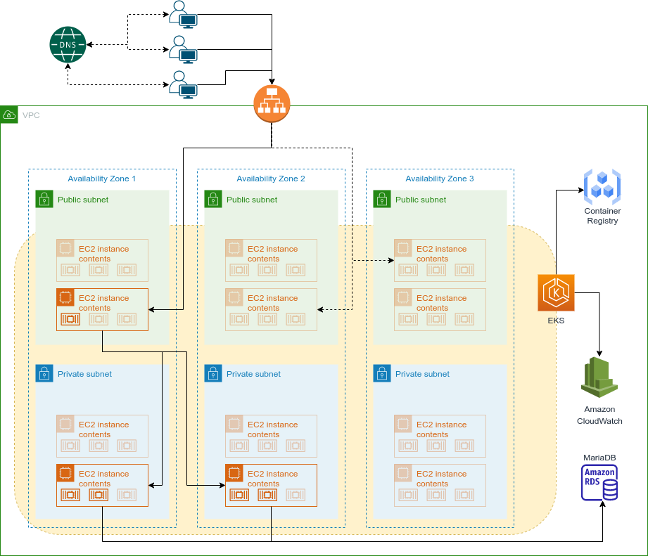
Application working diagram
Terraform
K8s
  Cloudflare (with alb)
  EKS Cluster
  Policies
  Amazon RDS (MariaDB)
  Elastic container registry
  Modules (openid_connect_provider)
  etc
Extra k8s
  Autoscaller
  Fluent-bit
  Metrics-server
  Container-insights
  Alb controller
  etc

Slide 14
Helm and manifests
$ ls helm/gocovid/
Chart.yaml conf templates values.yaml
$ ls helm/gocovid/conf
config.yml ( 1 )
$ ls helm/gocovid/templates
api_deploy.yml api_hpa.yml api_secret_data_config.yml api_service.yml front_deploy.yml front_hpa.yml front_service.yml goose_secrets.yml _helpers.tpl ingress.yml job_fill.yml namespace.yml
$ ls helm/gocovid/values.yaml
helm/gocovid/values.yaml
$ cat gocovid/templates/api_secret_data_config.yml
apiVersion: v1
kind: Secret
metadata:
creationTimestamp: null
name: {{ .Values.api.secretName }}
namespace: {{ include "namespace" . }}
type: Opaque
data:
config.yml: {{ include "apiConfig" . }} ( 4 )
$ cat helm/gocovid/conf/config.yml ( 2 )
migration_dir: {{ .Values.api.migrationDir }}
app_endpoint: {{ .Values.api.endpoint }}
db_host: {{ .Values.dbSettings.endpoint }}
db_name: {{ .Values.dbSettings.name }}
db_port: {{ .Values.dbSettings.port }}
db_user: {{ .Values.dbSettings.user }}
db_pass: {{ .Values.dbSettings.password }}
data_reset: false
cat gocovid/templates/_helpers.tpl ( 3 )
...
{{- define "apiConfig" -}}
{{ tpl (.Files.Get "conf/config.yml") . | b64enc }}
{{- end }}
…

Slide 15
GitLab-ci
Infra
  Pipeline stages
    init (cache)
    validate (terraform validate, tflint)
    build (artefacts: reports, environments)
    Infracost (only test)
    apply (test, prod, manual)
    extra-init (cache)
    extra-validate (terraform validate, tflint)
    extra-build (artefacts: reports, environments)
    extra-apply (test, prod, manual)
    extra-destroy (PHASE == "destroy")
    destroy (PHASE == "destroy")
    Env vars
  Terraform state
  Dependencies
  Needs
Application
  Pipeline stages
    lint (base)
    test
    Sonarqube (only master)
    build (base, trivy check)
    helm build (base, environments)
    deploy (base) (test, prod)
  base build (extends):
    only branches
    only protected tags
  Env vars
  Push docker images
  Push helm chart
  Needs to increase ...

Slide 16
Logs and Monitoring by CloudWatch
Log queries:
fields @timestamp, @message, kubernetes.namespace_name, kubernetes.pod_name
| sort @timestamp desc
| filter kubernetes.pod_name not like /^fluent.*.cz268$/
| limit 9999
fields @timestamp, @message, kubernetes.namespace_name, kubernetes.pod_name
| sort @timestamp desc
| filter kubernetes.namespace_name="gocovid"
| filter kubernetes.pod_name like /^deploy-gocovid.*/
| limit 9999
fields @timestamp, @message, kubernetes.namespace_name, kubernetes.pod_name
| sort @timestamp desc
| filter kubernetes.pod_name not like /^front.*/
| limit 9999
Monitoring:
  Alarms and SNS
  Build dashboards
  All LoadBalancer metrics
  All EKS metrics
  All RDS Metrics
  Tags

Slide 17
Possible project improvements
two-factor authentication to gitlab or vpn
change EFS with S3 bucket on gitlab
add redis for cache
generate full sql-query to decrease connection to database
return errors in main.go (process them in main.go)
Add .dockerignore file to the context directory
Describe some tests in Makefile
Increase tests coverage

Slide 18
Thank you for your attention

