Slide 1

Vegi New York
Choosing a location for a new vegetarian restaurant in New York

Slide 2
Rise of Vegetarian Diets
Growing trend of plant-based, vegetarian and vegan diets in USA.
Good for environment and for health.
New York City is one of the most vegetarian-friendly city in USA
Good business opportunity to open more vegetarian restaurants in New York City

Slide 3
NYC Vegi Scene
Many neighborhoods in Manhattan and Brooklyn already have many successful vegetarian restaurants
The neighborhoods with most popular vegetarian restaurants are
East Village
Flatiron
Greenwich Village
Our goal is to find neighborhoods similar to the above three neighborhoods which have similar clientele

Slide 4
Finding Similar Neighborhoods
Data Science technique is used to find similar neighborhoods
Collect venue data in all neighborhood using FourSquare
Use machine learning technique k-means clustering to cluster similar neighborhoods together based on popular venues.
Use visualization technique to understand results

Slide 5
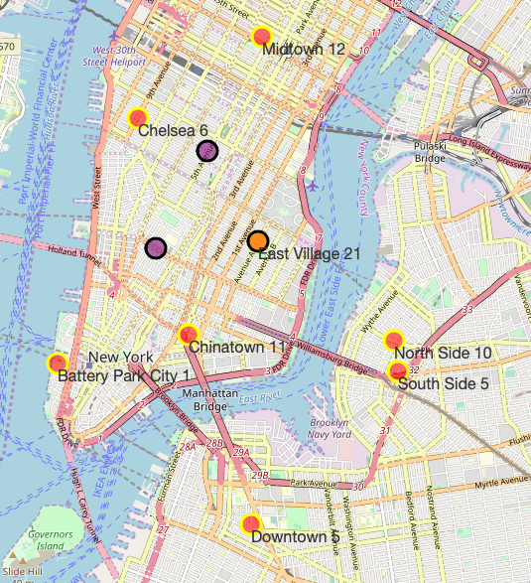
Neighborhoods in same Cluster as East Village
Midtown
Chelsea
Chinatown
Battery Park City
North Side (Brooklyn)
South Side (Brooklyn)
Downtown (Brooklyn)

Slide 6
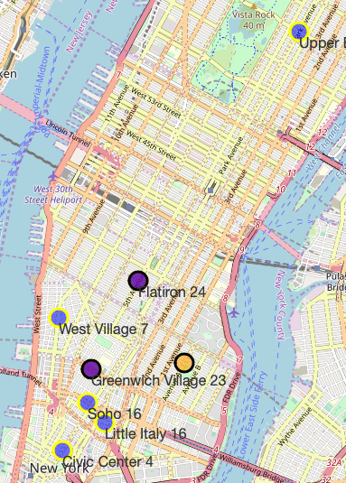
Neighborhoods in same cluster as Flatiron, Greenwich Village
West Village
Soho
Little Italy
Civic Center
Upper East Side

Slide 7
Filtering on potential neighborhoods
Eliminate neighborhoods ( Battery Park City) that has too few vegetarian restaurants
Eliminate neighborhoods (West Village, Chelsea) too close to established vegetarian neighborhood
Eliminate neighborhood ( Chinatown, Upper East Side) where median age is too different from the successful vegetarian-friendly neighborhood
Ideal neighborhood should have medium number of vegetarian restaurants, but still have demand to accommodate more

Slide 8
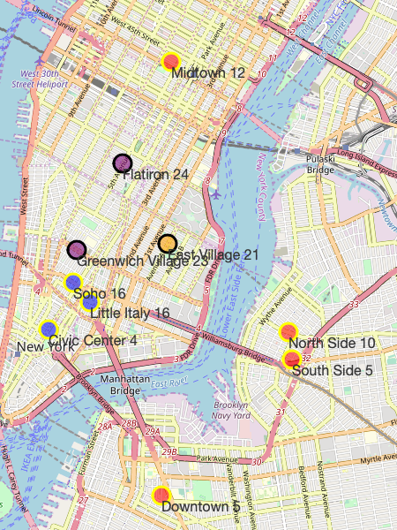
Recommendation: Desirable Neighborhoods for new Restaurant
Similar to East Village
Brooklyn: North Side, South Side, Downtown
Manhattan: Midtown
Similar to Flatiron and Greenwich Village
Manhattan: Soho, Little Italy, Civic Center

Slide 9
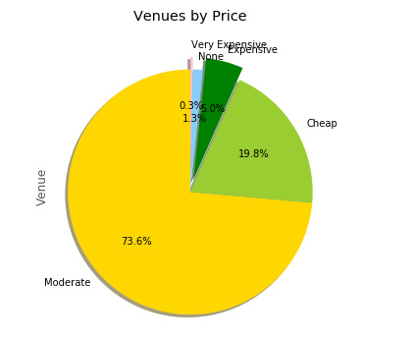
Recommendation: Price Range of new Restaurant
Recommendation for price range of the new restaurant is:
Moderate
since the majority of existing vegetarian venues are of moderate price range

Slide 10
Conclusion
Provided recommendation on multiple neighborhoods suitable for new vegetarian restaurant
Provided recommendation for restaurant price range
Client can further use information like neighborhood foot traffic, neighborhood rental price & availability to make final decision

