Slide 1
DMA DRIVER

Slide 2
DMA introduction
Direct memory access (DMA) is used in order to provide high-speed data transfer between peripherals and memory and between memory and memory. Data can be quickly moved by DMA without any CPU action. This keeps CPU resources free for other operations.
The DMA controller combines a powerful dual AHB master bus architecture with independent FIFO to optimize the bandwidth of the system, based on a complex bus matrix architecture.
The two DMA controllers have 16 streams in total (8 for each controller), each dedicated to managing memory access requests from one or more peripherals. Each stream can have up to 8 channels (requests) in total. And each has an arbiter for handling the priority between DMA requests.

Slide 3
DMA main features
Dual AHB master bus architecture, one dedicated to memory accesses and one dedicated to peripheral accesses
8 streams for each DMA controller, up to 8 channels (requests) per stream
Four-word depth 32 first-in, first-out memory buffers (FIFOs) per stream, that can be used in FIFO mode or direct mode:
+ FIFO mode: with threshold level software selectable between 1/4, 1/2 or 3/4 of the FIFO size
+ Direct mode Each DMA request immediately initiates a transfer from/to the memory. When it is configured in direct mode (FIFO disabled), to transfer data in memory-toperipheral mode, the DMA preloads only one data from the memory to the internal
- Each stream can be configured by hardware to be: – a regular channel that supports peripheral-to-memory, memory-to-peripheral and memory-to-memory transfers – a double buffer channel that also supports double buffering on the memory side
- Priorities between DMA stream requests are software-programmable (4 levels consisting of very high, high, medium, low) or hardware in case of equality (request 0 has priority over request 1, etc.)
Independent source and destination transfer width (byte, half-word, word): when the data widths of the source and destination are not equal, the DMA automatically packs/unpacks the necessary transfers to optimize the bandwidth. This feature is only available in FIFO mode
Incrementing or non-incrementing addressing for source and destination
Supports incremental burst transfers of 4, 8 or 16 beats. The size of the burst is software-configurable, usually equal to half the FIFO size of the peripheral
Each stream supports circular buffer management( chế độ truyền)

Slide 4
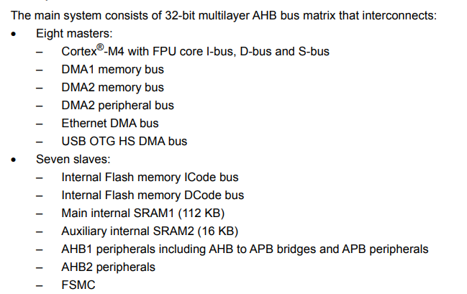
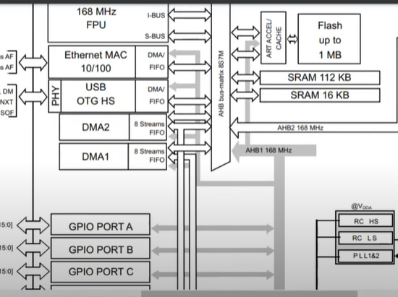

Slide 5
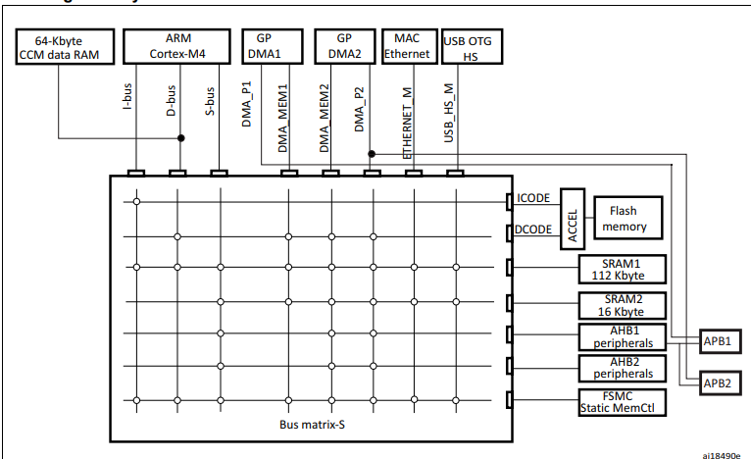
Master bus
Slave bus

Slide 6
Step to configure DMA active
DMA request base on DMA request mappings.
Stream: DMA2 stream 0
Direction: M2M, P2M, M2P.
Priority (– Very high priority – High priority – Medium priority – Low priority)
Source, destination and transfer modes
Use fifo or direction mode
Brust size or signal mode
Normal or circular mode

Slide 7
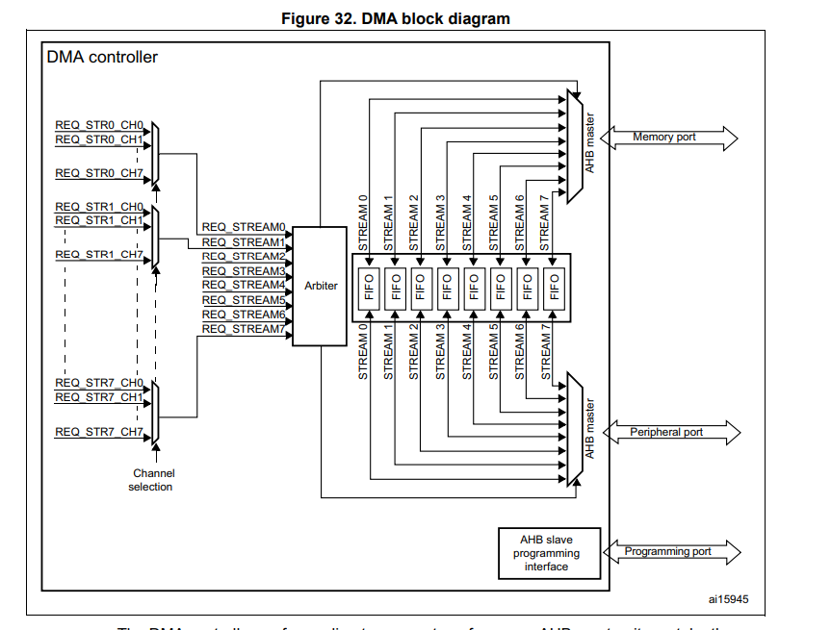
stream
Fifo
P2M, M2P, M2M
DMA request
Priority
P2M, M2P, M2M

Slide 8
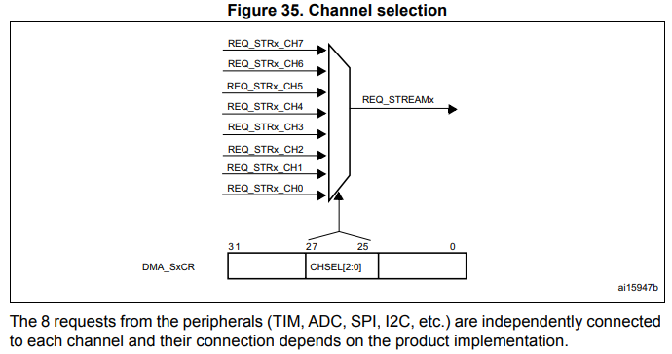
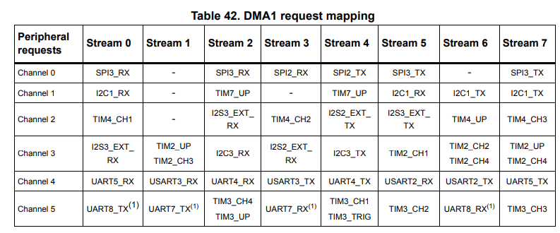

Slide 9
Arbiter
An arbiter manages the 8 DMA stream requests based on their priority for each of the two AHB master ports (memory and peripheral ports) and launches the peripheral/memory access sequences.
Priorities are managed in two stages:
• Software: each stream priority can be configured in the DMA_SxCR register. There are four levels:
– Very high priority
– High priority
– Medium priority
– Low priority
• Hardware: If two requests have the same software priority level, the stream with the lower number takes priority over the stream with the higher number. For example, Stream 2 takes priority over Stream
DMA streams
Each of the 8 DMA controller streams provides a unidirectional transfer link between a source and a destination. Each stream can be configured to perform:
• Regular type transactions: memory-to-peripherals, peripherals-to-memory or memoryto-memory transfers
• Double-buffer type transactions: double buffer transfers using two memory pointers for the memory (while the DMA is reading/writing from/to a buffer, the application can write/read to/from the other buffer).

Slide 10
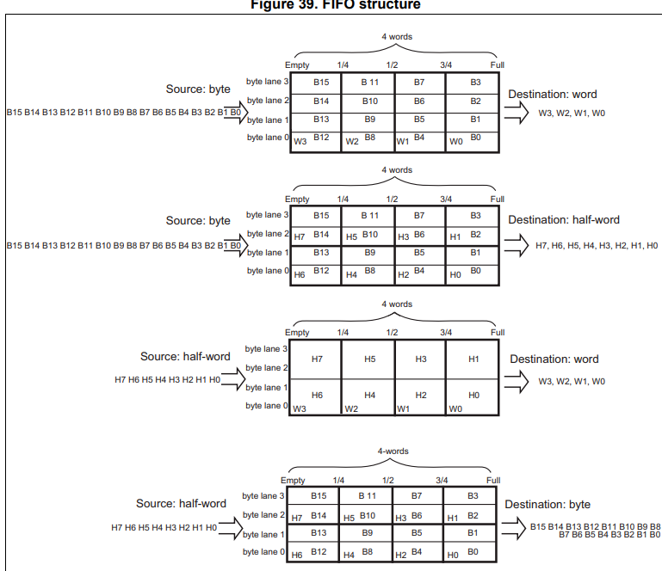
FIFO
- The FIFO is used to temporarily store data coming from the source before transmitting them to the destination.(khi đủ số lượng nó sẽ truyền đi)
- Each stream has an independent 4-word FIFO and the threshold level is softwareconfigurable between 1/4, 1/2, 3/4 or full.
- To enable the use of the FIFO threshold level, the direct mode must be disabled by setting the DMDIS bit in the DMA_SxFCR register.

Slide 11
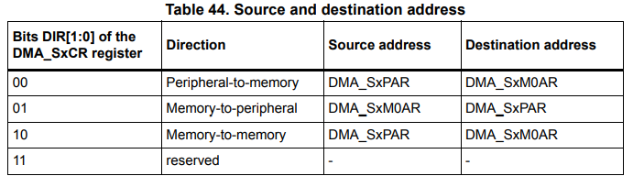
Source, destination and transfer modes
When the data width (programmed in the PSIZE or MSIZE bits in the DMA_SxCR register) is a half-word or a word, respectively, the peripheral or memory address written into the DMA_SxPAR or DMA_SxM0AR/M1AR registers has to be aligned on a word or half-word address boundary, respectively

Slide 12
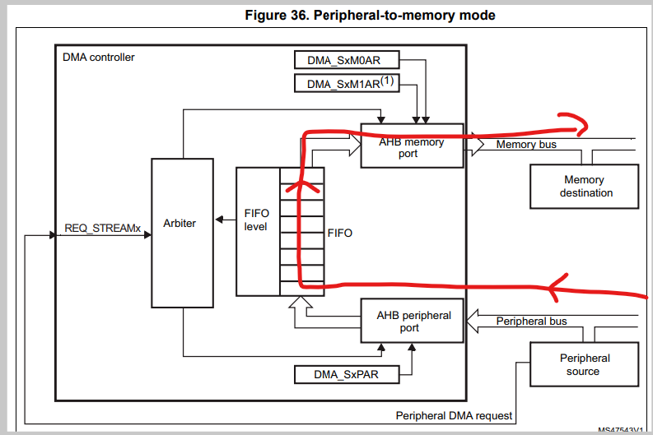
Peripheral-to-memory mode
When this mode is enabled (by setting the bit EN in the DMA_SxCR register), each time a peripheral request occurs, the stream initiates a transfer from the source to fill the FIFO.
The transfer stops once the DMA_SxNDTR register reaches zero, when the peripheral requests the end of transfers (in case of a peripheral flow controller) or when the EN bit in the DMA_SxCR register is cleared by software.
In direct mode (when the DMDIS value in the DMA_SxFCR register is ‘0’), the threshold level of the FIFO is not used: after each single data transfer from the peripheral to the FIFO, the corresponding data are immediately drained and stored into the destination.
The stream has access to the AHB source or destination port only if the arbitration of the corresponding stream is won. This arbitration is performed using the priority defined for each stream using the PL[1:0] bits in the DMA_SxCR register

Slide 13
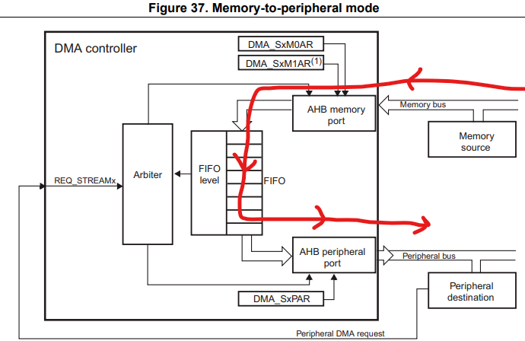
Memory-to-peripheral mode
When this mode is enabled (by setting the EN bit in the DMA_SxCR register), the stream immediately initiates transfers from the source to entirely fill the FIFO
Each time a peripheral request occurs, the contents of the FIFO are drained and stored into the destination. When the level of the FIFO is lower than or equal to the predefined threshold level, the FIFO is fully reloaded with data from the memory.
The transfer stops once the DMA_SxNDTR register reaches zero, when the peripheral requests the end of transfers (in case of a peripheral flow controller) or when the EN bit in the DMA_SxCR register is cleared by software.
In direct mode (when the DMDIS value in the DMA_SxFCR register is '0'), the threshold level of the FIFO is not used. Once the stream is enabled, the DMA preloads the first data to transfer into an internal FIFO. As soon as the peripheral requests a data transfer, the DMA transfers the preloaded value into the configured destination.

Slide 14
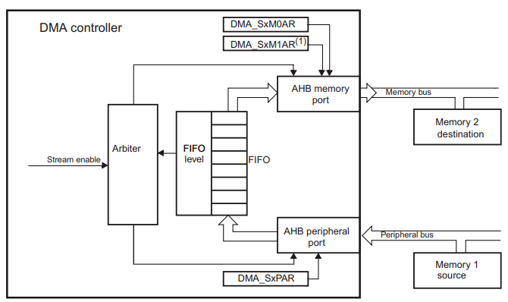
Memory-to-memory mode
The DMA channels can also work without being triggered by a request from a peripheral.
When the stream is enabled by setting the Enable bit (EN) in the DMA_SxCR register, the stream immediately starts to fill the FIFO up to the threshold level. When the threshold level is reached, the FIFO contents are drained and stored into the destination.
The transfer stops once the DMA_SxNDTR register reaches zero or when the EN bit in the DMA_SxCR register is cleared by software.
When memory-to-memory mode is used, the Circular and direct modes are not allowed.

Slide 15
Single and burst transfers
The DMA controller can generate single transfers or incremental burst transfers of 4, 8 or 16 beats.
The size of the burst is configured by software independently for the two AHB ports by using the MBURST[1:0] and PBURST[1:0] bits in the DMA_SxCR register.
The burst size indicates the number of beats in the burst, not the number of bytes transferred.
Depending on the single or burst configuration, each DMA request initiates a different number of transfers on the AHB peripheral port:
• When the AHB peripheral port is configured for single transfers, each DMA request generates a data transfer of a byte, half-word or word depending on the PSIZE[1:0] bits in the DMA_SxCR register.
• When the AHB peripheral port is configured for burst transfers, each DMA request generates 4,8 or 16 beats of byte, half word or word transfers depending on the PBURST[1:0] and PSIZE[1:0] bits in the DMA_SxCR register.

Slide 16
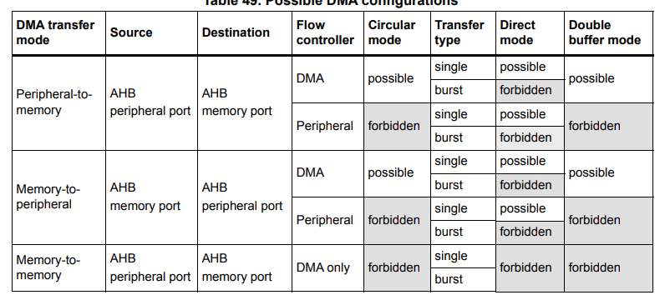

Slide 17
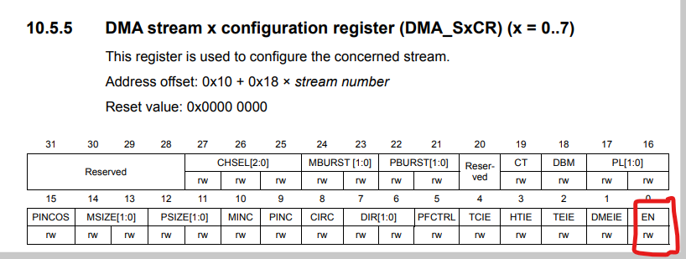
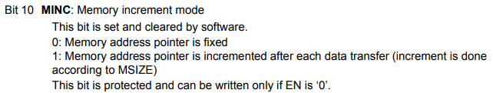
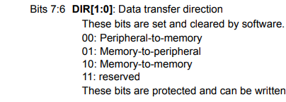
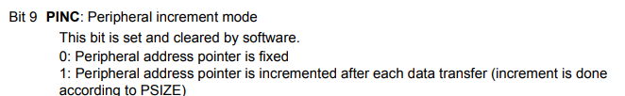
channel
stream

Slide 18
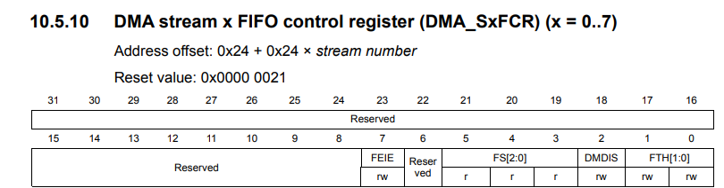

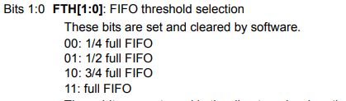

Slide 19
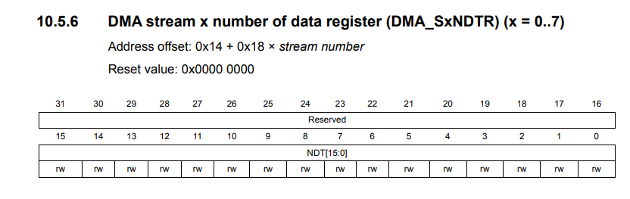

Slide 20
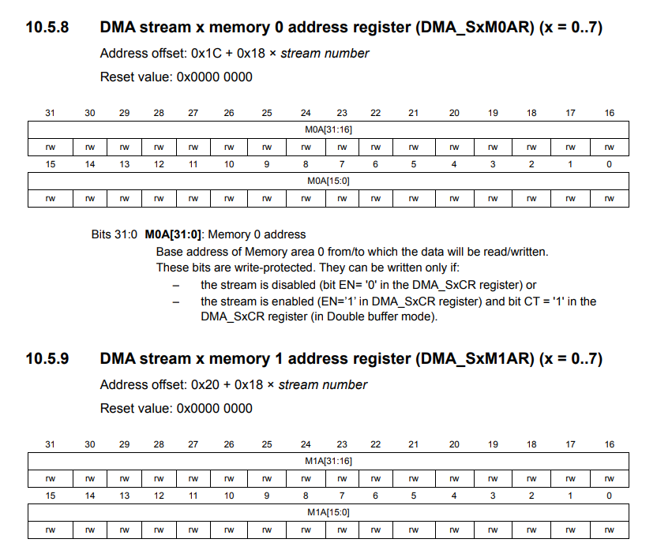

Slide 21
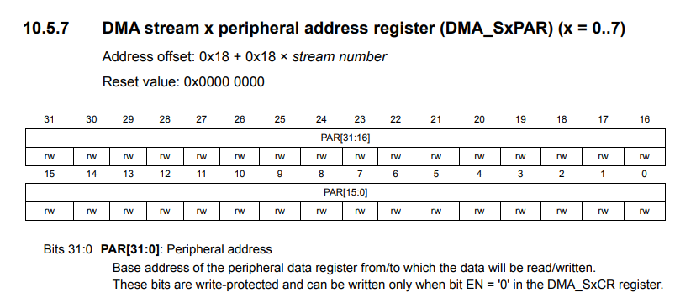

Slide 22
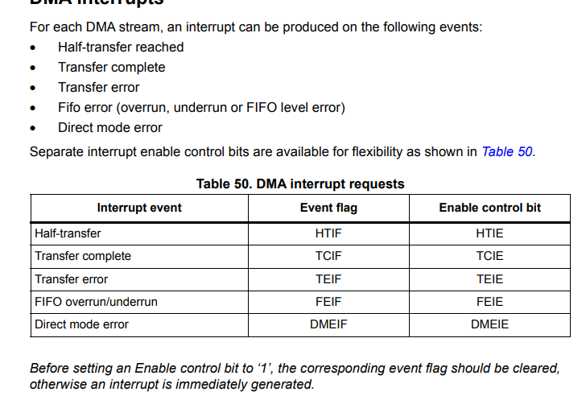

Slide 23
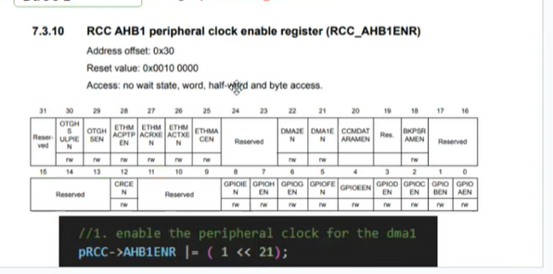
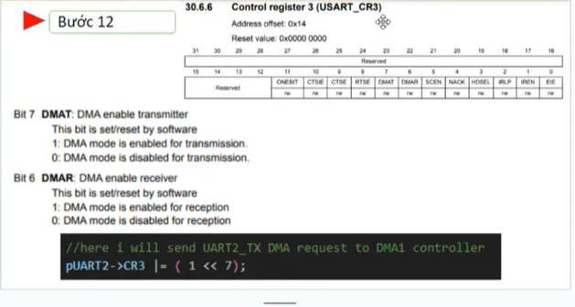
Enable cho phía pẻpheral

Slide 24
