Slide 1
SPI DRIVER

Slide 2
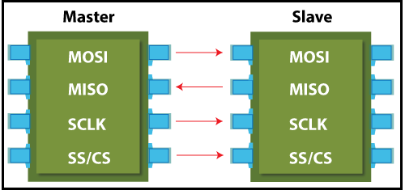
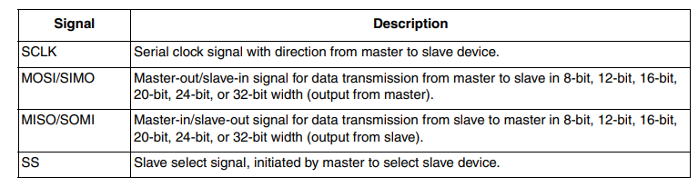
SPI introduction
Usually, the SPI is connected to external devices through four pins:
• MISO: Master In / Slave Out data. This pin can be used to transmit data in slave mode and receive data in master mode.
• MOSI: Master Out / Slave In data. This pin can be used to transmit data in master mode and receive data in slave mode.
• SCK: Serial Clock output for SPI masters and input for SPI slaves.
• NSS: Slave select

Slide 3
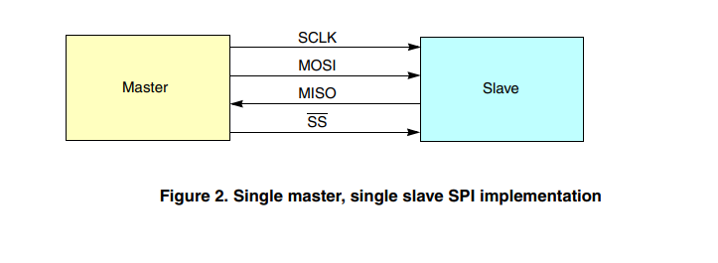
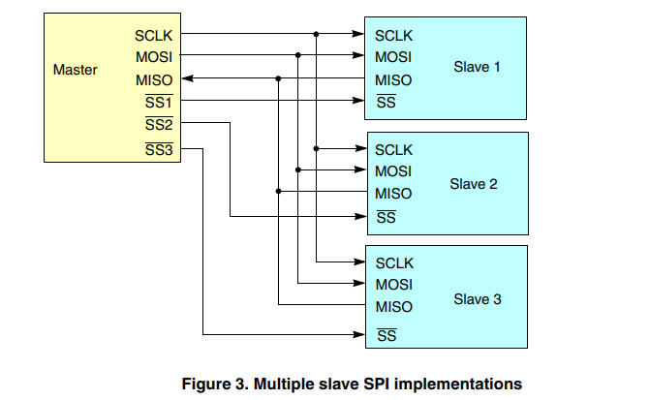

Slide 4
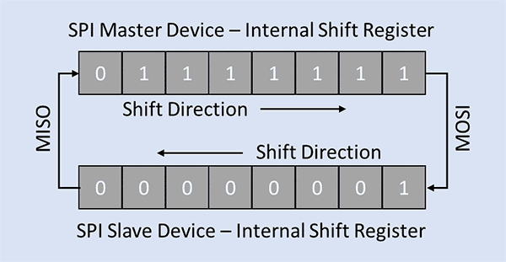

Slide 5
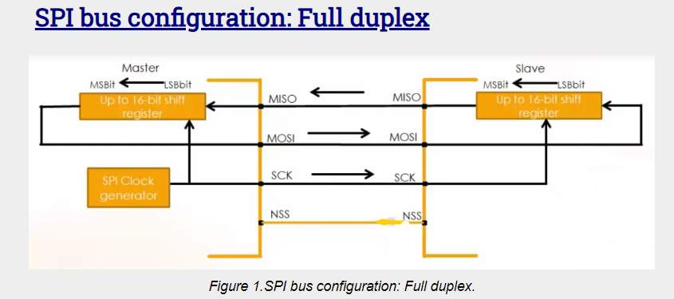
The master shift register transmits the data to the slave on the MOSI line, and the slave receives it.
At the same time, the slave shift register sends the data to the master on the MISO line, and the master gets it. Transmission may continue for any number of clock cycles. When complete, master idles the clock and releases the SS line.
So, in full-duplex communication shift registers of both master and slave are linked using two unidirectional lines between MOSI and MISO pins. By default, SPI configures for full-duplex communication.

Slide 6
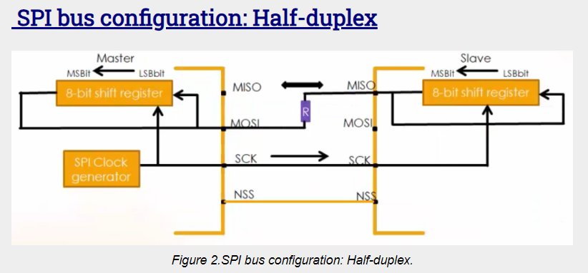
The SPI can communicate in half-duplex mode by setting the BIDIMODE bit in the SPIx_CR1 register.
In half-duplex data communication, one single cross-connection line is used to link the shift registers.
In this data communication, there is only one data line. The MOSI of the master connects to the MISO of the slave.
And there must be one resistor in between a typical value may be 1kiloohm.

Slide 7
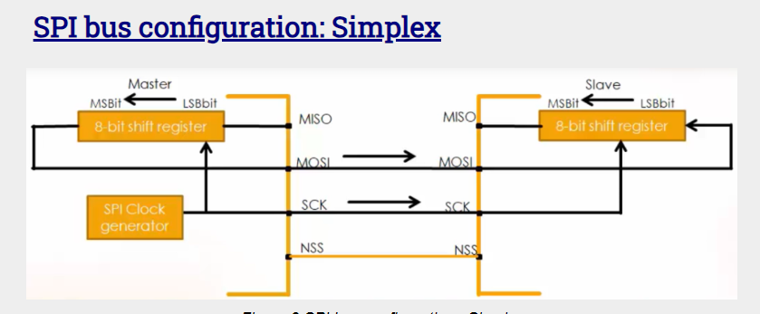
The SPI can communicate in simplex mode by setting the SPI in transmit-only or receive-only using the RX ONLY bit in the SPIx_CR2 register. Simplex, as its name indicates the communication is in simple mode.
There are two types of communication in simplex mode, one is transmitting only, and the other one is receiving only.

Slide 8
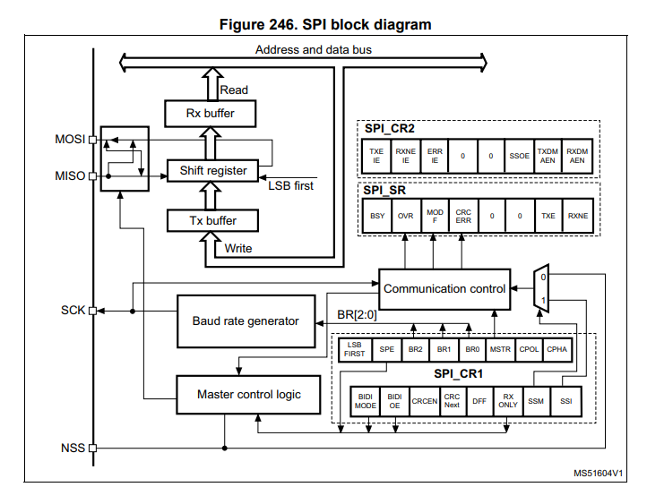

Slide 9
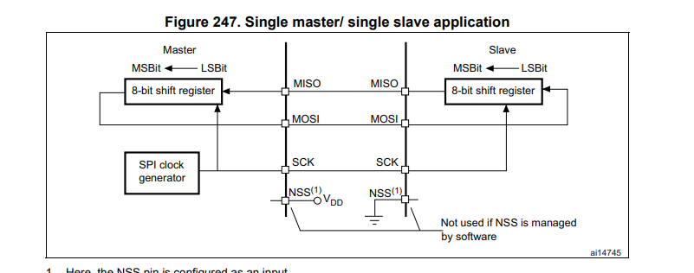
The MOSI pins are connected together and the MISO pins are connected together. In this way data is transferred serially between master and slave (most significant bit first)
The communication is always initiated by the master. When the master device transmits data to a slave device via the MOSI pin, the slave device responds via the MISO pin. This implies full-duplex communication with both data out and data in synchronized with the same clock signal (which is provided by the master device via the SCK pin).

Slide 10
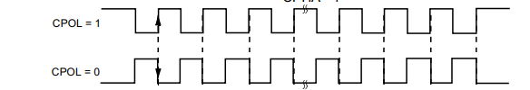
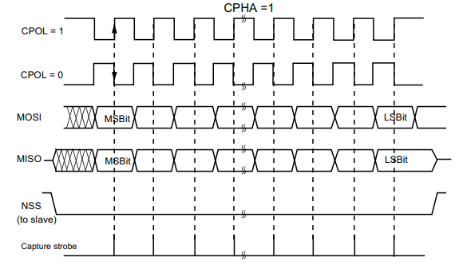
Clock phase and clock polarity
Four possible timing relationships may be chosen by software, using the CPOL and CPHA bits in the SPI_CR1 register
The CPOL (clock polarity) bit controls the steady state value of the clock when no data is being transferred. This bit affects both master and slave modes
If CPOL is reset, the SCK pin has a low-level idle state. If CPOL is set, the SCK pin has a high-level idle state.
If the CPHA (clock phase) bit is set, the second edge on the SCK pin (falling edge if the CPOL bit is reset, rising edge if the CPOL bit is set) is the MSBit capture strobe

Slide 11
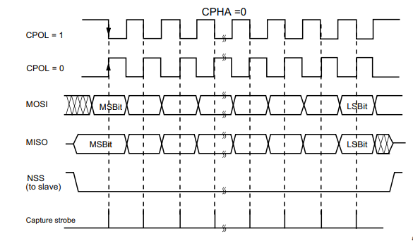
If the CPHA bit is reset, the first edge on the SCK pin (falling edge if CPOL bit is set, rising edge if CPOL bit is reset) is the MSBit capture strobe. Data are latched on the occurrence of the first clock transition.
The combination of the CPOL (clock polarity) and CPHA (clock phase) bits selects the data
capture clock edge.

Slide 12
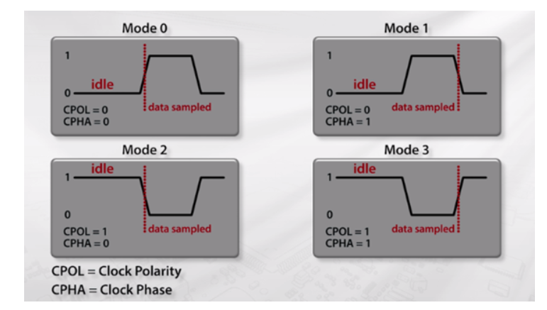
There are four different modes available, one mode each combination clocking in a low state and high state, with a data being read in a rising edge or falling edge of the clock signal.

Slide 13
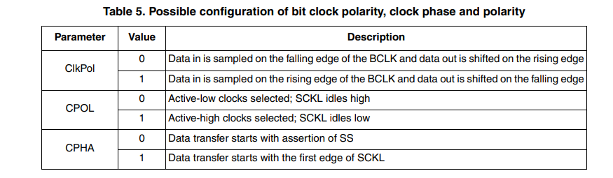
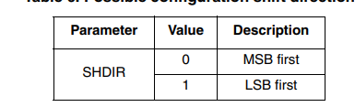
Shift direction
The SPI support MSB and LSB shift direction

Slide 14
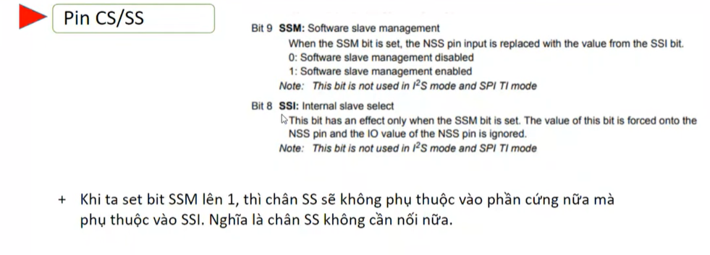
Slave select (NSS) pin management
Hardware or software slave select management can be set using the SSM bit in the SPI_CR1 register.
• Software NSS management (SSM = 1) The slave select information is driven internally by the value of the SSI bit in the SPI_CR1 register. The external NSS pin remains free for other application uses
• Hardware NSS management (SSM = 0)
Two configurations are possible depending on the NSS output configuration (SSOE bit in register SPI_CR2
– NSS output enabled (SSM = 0, SSOE = 1) This configuration is used only when the device operates in master mode. The NSS signal is driven low when the master starts the communication and is kept low until the SPI is disabled.
– NSS output disabled (SSM = 0, SSOE = 0) This configuration allows multimaster capability for devices operating in master mode. For devices set as slave, the NSS pin acts as a classical NSS input: the slave is selected when NSS is low and deselected when NSS high.

Slide 15
Configuring the SPI in master mode (full duplex)
In the master configuration, the serial clock is generated on the SCK pin. Select master mode in SPI control register 1 (SPI_CR1)
Bit 2 MSTR: Master selection
0: Slave configuration
1: Master configuration
Procedure
1. Select the BR[2:0] bits to define the serial clock baud rate (see SPI_CR1 register).
2. Select the CPOL and CPHA bits to define one of the four relationships between the data transfer and the serial clock (see Figure 248). This step is not required when the TI mode is selected
3.Set the DFF bit to define 8- or 16-bit data frame format
4. Configure the LSBFIRST bit in the SPI_CR1 register to define the frame format. This step is not required when the TI mode is selected.
5. If the NSS pin is required in input mode, in hardware mode, connect the NSS pin to a high-level signal during the complete byte transmit sequence.
In NSS software mode, set the SSM and SSI bits in the SPI_CR1 register.
If the NSS pin is required in output mode, the SSOE bit only should be set. This step is not required when the TI mode is selected.
6. Set the FRF bit in SPI_CR2 to select the TI protocol for serial communications
7. The MSTR and SPE bits must be set (they remain set only if the NSS pin is connected to a high-level signal).
In this configuration the MOSI pin is a data output and the MISO pin is a data input.
(full duplex)

Slide 16
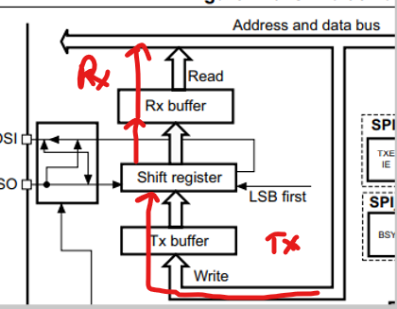
Transmit sequence
The transmit sequence begins when a byte is written in the Tx Buffer.
The data byte is parallel-loaded into the shift register (from the internal bus) during the first bit transmission and then shifted out serially to the MOSI pin MSB first or LSB first depending on the LSBFIRST bit in the SPI_CR1 register. The TXE flag is set on the transfer of data from the Tx Buffer to the shift register and an interrupt is generated if the TXEIE bit in the SPI_CR2 register is set
Receive sequence
For the receiver, when data transfer is complete:
• The data in the shift register is transferred to the RX Buffer and the RXNE flag is set
• An interrupt is generated if the RXNEIE bit is set in the SPI_CR2 register
At the last sampling clock edge the RXNE bit is set, a copy of the data byte received in the shift register is moved to the Rx buffer. When the SPI_DR register is read, the SPI peripheral returns this buffered value.
Configuring the SPI in slave mode (tuongw tuwj)

Slide 17
Configuring the SPI for half-duplex communication
The SPI is capable of operating in half-duplex mode in 2 configurations.
• 1 clock and 1 bidirectional data wire
• 1 clock and 1 data wire (receive-only or transmit-only) (simplex)
1 clock and 1 bidirectional data wire (BIDIMODE = 1)
This mode is enabled by setting the BIDIMODE bit in the SPI_CR1 register
In this mode SCK is used for the clock and MOSI in master or MISO in slave mode is used for data communication
The transfer direction (Input/Output) is selected by the BIDIOE bit in the SPI_CR1 register.
1 clock and 1 unidirectional data wire (BIDIMODE = 0)
In this mode, the application can use the SPI either in transmit-only mode or in receive-only mode.
• Transmit-only mode is similar to full-duplex mode (BIDIMODE=0, RXONLY=0): the data are transmitted on the transmit pin (MOSI in master mode or MISO in slave mode) and the receive pin (MISO in master mode or MOSI in slave mode) can be used as a general-purpose IO. In this case, the application just needs to ignore the Rx buffer (if the data register is read, it does not contain the received value).
• In receive-only mode, the application can disable the SPI output function by setting the RXONLY bit in the SPI_CR1 register. In this case, it frees the transmit IO pin (MOSI in master mode or MISO in slave mode), so it can be used for other purposes.

Slide 18
Data transmission and reception procedures
Rx and Tx buffers
In reception, data are received and then stored into an internal Rx buffer while In transmission, data are first stored into an internal Tx buffer before being transmitted.
A read access of the SPI_DR register returns the Rx buffered value whereas a write access to the SPI_DR stores the written data into the Tx buffer.
Start sequence in master mode
• In full-duplex (BIDIMODE=0 and RXONLY=0)
– The sequence begins when data are written into the SPI_DR register (Tx buffer).
– The data are then parallel loaded from the Tx buffer into the 8-bit shift register during the first bit transmission and then shifted out serially to the MOSI pin.
– At the same time, the received data on the MISO pin is shifted in serially to the 8- bit shift register and then parallel loaded into the SPI_DR register (Rx buffer).
• In unidirectional receive-only mode (BIDIMODE=0 and RXONLY=1)
– The sequence begins as soon as SPE=1
– Only the receiver is activated and the received data on the MISO pin are shifted in serially to the 8-bit shift register and then parallel loaded into the SPI_DR register (Rx buffer).

Slide 19
• In bidirectional mode, when transmitting (BIDIMODE=1 and BIDIOE=1)
– The sequence begins when data are written into the SPI_DR register (Tx buffer).
– The data are then parallel loaded from the Tx buffer into the 8-bit shift register during the first bit transmission and then shifted out serially to the MOSI pin.
– No data are received.
• In bidirectional mode, when receiving (BIDIMODE=1 and BIDIOE=0)
– The sequence begins as soon as SPE=1 and BIDIOE=0.
– The received data on the MOSI pin are shifted in serially to the 8-bit shift register and then parallel loaded into the SPI_DR register (Rx buffer).
– The transmitter is not activated and no data are shifted out serially to the MOSI pin.

Slide 20
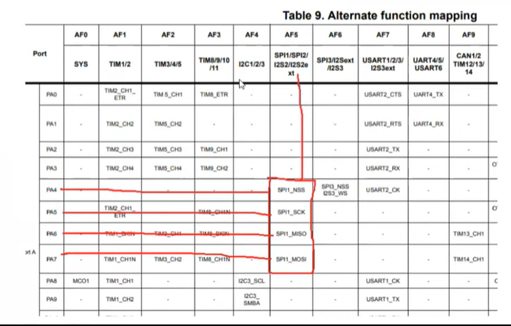

Slide 21
