Slide 1
USART
The universal synchronous asynchronous receiver transmitter

Slide 2
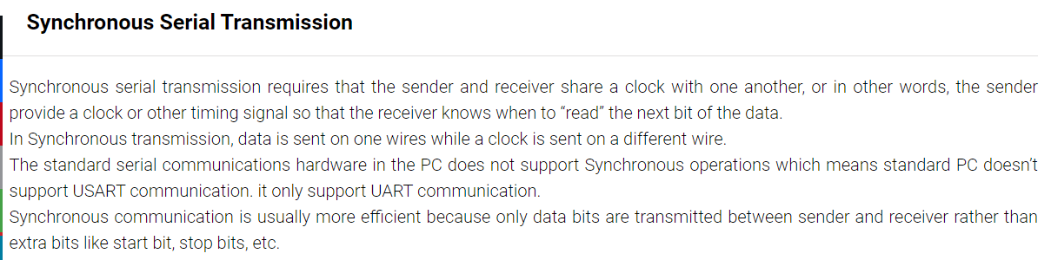
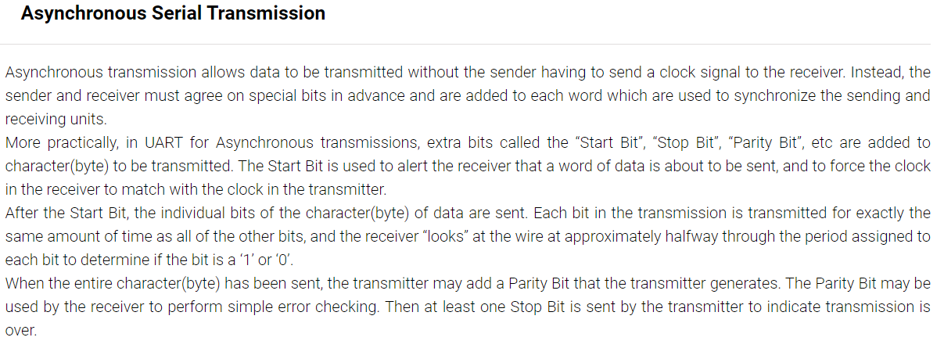
UART & USART - What's the difference

Slide 3
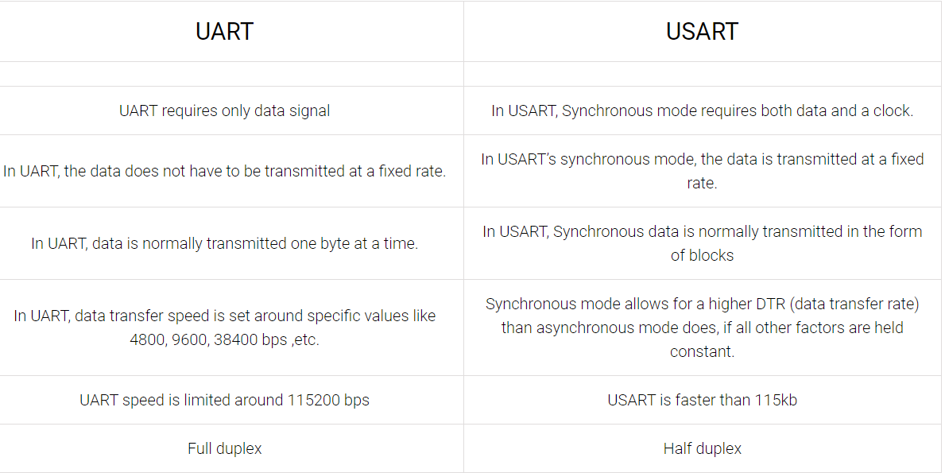

Slide 4
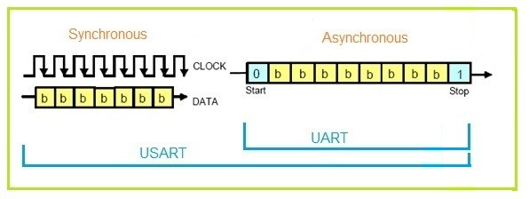
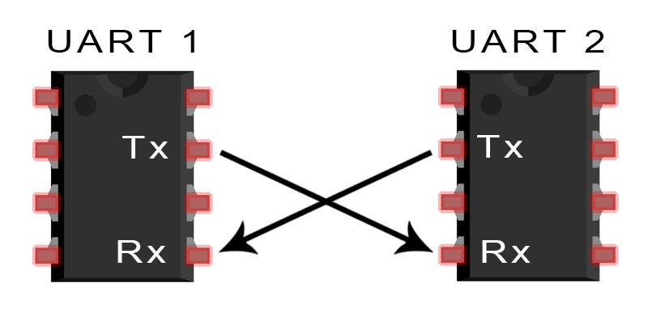

Slide 5
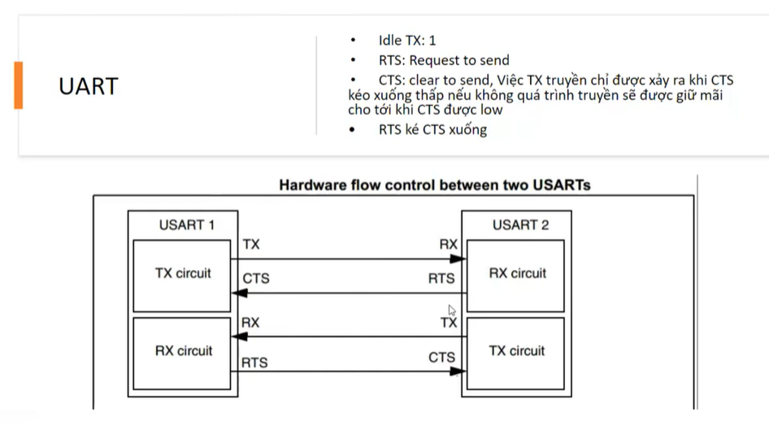

Slide 6
USART character description
Word length may be selected as being either 8 or 9 bits by programming the M bit in the USART_CR1 register
The TX pin is in low state during the start bit. It is in high state during the stop bit.
An Idle character is interpreted as an entire frame of “1”s followed by the start bit of the next frame which contains data (The number of “1” ‘s will include the number of stop bits)
A Break character is interpreted on receiving “0”s for a frame period.
Transmission and reception are driven by a common baud rate generator, the clock for each is generated when the enable bit is set respectively for the transmitter and receiver.

Slide 7
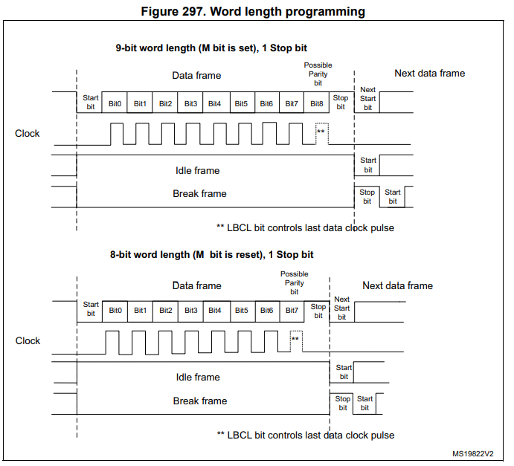

Slide 8
Trong giao tiếp chuỗi (serial communication), bit parity được sử dụng để phát hiện lỗi. Nó được áp dụng trong các chuẩn giao tiếp như UART (Universal Asynchronous Receiver-Transmitter).
Bit parity là một bit được thêm vào vào cuối các byte dữ liệu để đảm bảo tính toàn vẹn của dữ liệu khi truyền qua kết nối. Có hai loại bit parity chính:
Parity Even (Chẵn): Trong trường hợp này, một bit được thêm vào để đảm bảo tổng số bit 1 trong byte dữ liệu là số chẵn. Ví dụ, nếu tổng số bit 1 trong byte dữ liệu là lẻ, bit parity sẽ được đặt thành 1 để làm tổng số bit 1 trở thành số chẵn.
Parity Odd (Lẻ): Tương tự như parity even, trong trường hợp này, bit parity được thêm vào để đảm bảo tổng số bit 1 trong byte dữ liệu là số lẻ. Ví dụ, nếu tổng số bit 1 trong byte dữ liệu là chẵn, bit parity sẽ được đặt thành 1 để làm tổng số bit 1 trở thành số lẻ.
Khi byte dữ liệu được gửi đi, bit parity cũng được gửi cùng với nó. Khi byte dữ liệu được nhận, bit parity được kiểm tra để xác định xem có lỗi trong quá trình truyền hay không. Nếu số bit 1 trong byte dữ liệu (kể cả bit parity) không khớp với loại bit parity đã được chỉ định, điều đó cho thấy có lỗi xảy ra trong quá trình truyền.

Slide 9
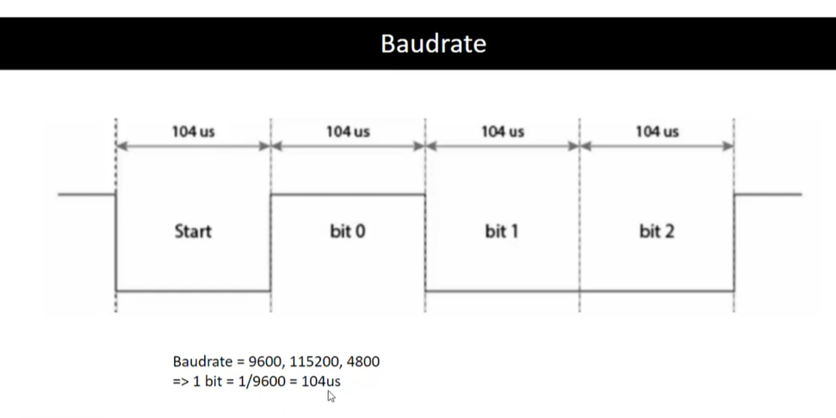

Slide 10
USART functional description
RX: Receive Data Input is the serial data input. Oversampling techniques are used for data recovery by discriminating between valid incoming data and noise.
TX: Transmit Data Output. When the transmitter is disabled, the output pin returns to its I/O port configuration. When the transmitter is enabled and nothing is to be transmitted, the TX pin is at high level. In single-wire and smartcard modes, this I/O is used to transmit and receive the data (at USART level, data are then received on SW_RX).
Through these pins, serial data is transmitted and received in normal USART mode as frames comprising:
• An Idle Line prior to transmission or reception
• A start bit
• A data word (8 or 9 bits) least significant bit first
• 0.5,1, 1.5, 2 Stop bits indicating that the frame is complete
• This interface uses a fractional baud rate generator - with a 12-bit mantissa and 4-bit fraction
• A status register (USART_SR)
• Data Register (USART_DR)
• A baud rate register (USART_BRR) - 12-bit mantissa and 4-bit fraction.
• A Guardtime Register (USART_GTPR) in case of Smartcard mode.

Slide 11
The following pin is required to interface in synchronous mode:
• CK: Transmitter clock output. This pin outputs the transmitter data clock for synchronous transmission corresponding to SPI master mode (no clock pulses on start bit and stop bit, and a software option to send a clock pulse on the last data bit). In parallel data can be received synchronously on RX. This can be used to control peripherals that have shift registers (e.g. LCD drivers). The clock phase and polarity are software programmable. In smartcard mode, CK can provide the clock to the smartcard.
The following pins are required in Hardware flow control mode:
• CTS: Clear To Send blocks the data transmission at the end of the current transfer when high
• RTS: Request to send indicates that the USART is ready to receive a data (when low).

Slide 12
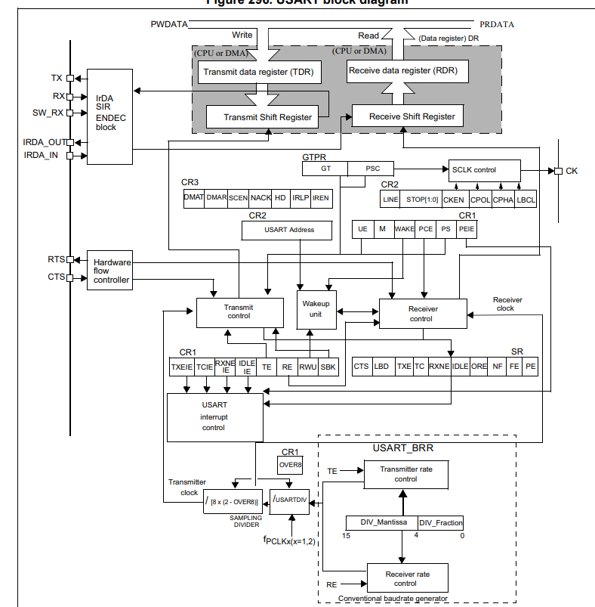

Slide 13
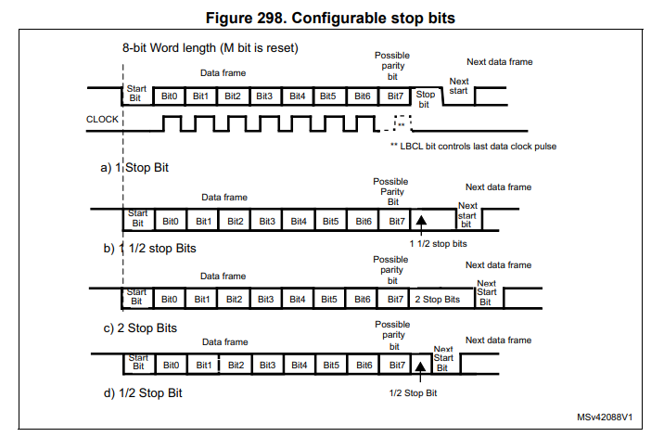
Transmitter
Configurable stop bits
The number of stop bits to be transmitted with every character can be programmed in Control register 2
• 1 stop bit: This is the default value of number of stop bits.
• 2 Stop bits: This will be supported by normal USART, single-wire and modem modes.
• 0.5 stop bit: To be used when receiving data in Smartcard mode.
• 1.5 stop bits: To be used when transmitting and receiving data in Smartcard mode.

Slide 14
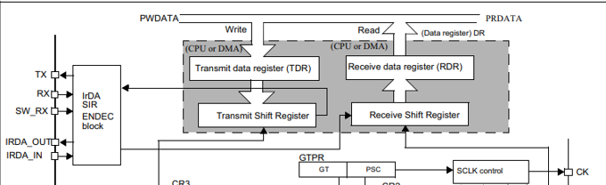
Procedure:
The transmitter can send data words of either 8 or 9 bits depending on the M bit status.
1. Enable the USART by writing the UE bit in USART_CR1 register to 1.
2. Program the M bit in USART_CR1 to define the word length.
3. Program the number of stop bits in USART_CR2.
5. Select the desired baud rate using the USART_BRR register.
6. Set the TE bit in USART_CR1 to send an idle frame as first transmission
7. Write the data to send in the USART_DR register (this clears the TXE bit). Repeat this for each data to be transmitted in case of single buffer.
8. After writing the last data into the USART_DR register, wait until TC=1. This indicates that the transmission of the last frame is complete. This is required for instance when the USART is disabled or enters the Halt mode to avoid corrupting the last transmission.

Slide 15
Single byte communication
Clearing the TXE bit is always performed by a write to the data register
The TXE bit is set by hardware and it indicates:
• The data has been moved from TDR to the shift register and the data transmission has started.
• The TDR register is empty.
• The next data can be written in the USART_DR register without overwriting the previous data. This flag generates an interrupt if the TXEIE bit is set.
When a transmission is taking place, a write instruction to the USART_DR register stores the data in the TDR register and which is copied in the shift register at the end of the current transmission.
When no transmission is taking place, a write instruction to the USART_DR register places the data directly in the shift register, the data transmission starts, and the TXE bit is immediately set.
If a frame is transmitted (after the stop bit) and the TXE bit is set, the TC bit goes high. An interrupt is generated if the TCIE bit is set in the USART_CR1 register.
After writing the last data into the USART_DR register, it is mandatory to wait for TC=1 before disabling the USART or causing the microcontroller to enter the low-power mode
The TC bit is cleared by the following software sequence:
A read from the USART_SR register
2. A write to the USART_DR register

Slide 16
Receiver
The USART can receive data words of either 8 or 9 bits depending on the M bit in the USART_CR1 register
Character reception
During an USART reception, data shifts in least significant bit first through the RX pin. In this mode, the USART_DR register consists of a buffer (RDR) between the internal bus and the received shift register.
Enable the USART by writing the UE bit in USART_CR1 register to 1.
2. Program the M bit in USART_CR1 to define the word length.
3. Program the number of stop bits in USART_CR2.
4. Select DMA enable (DMAR) in USART_CR3 if multibuffer communication is to take place. Configure the DMA register as explained in multibuffer communication.
5. Select the desired baud rate using the baud rate register USART_BRR
6. Set the RE bit USART_CR1. This enables the receiver which begins searching for a start bit.

Slide 17
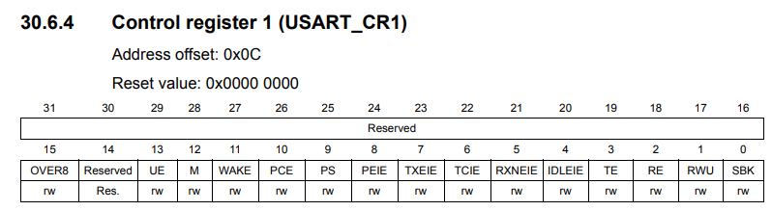
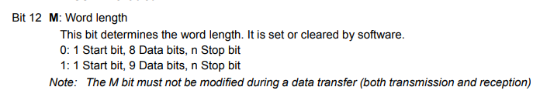
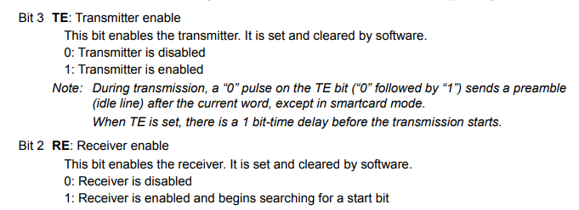
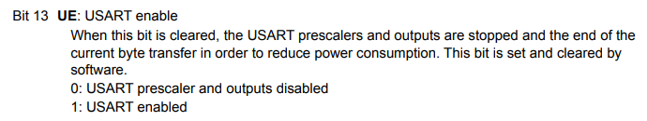
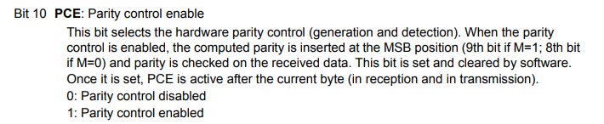
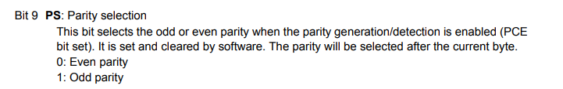

Slide 18
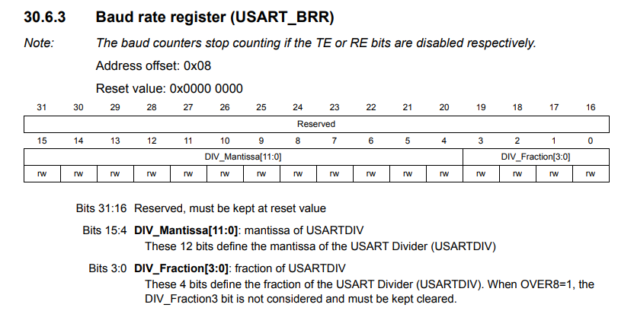

Slide 19
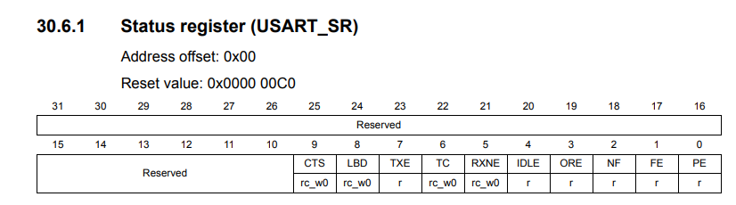
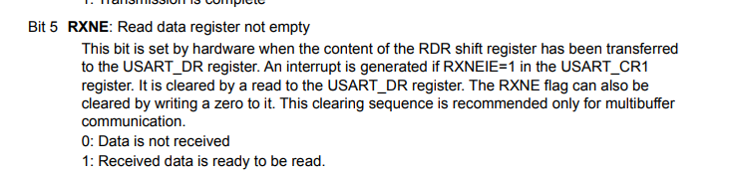
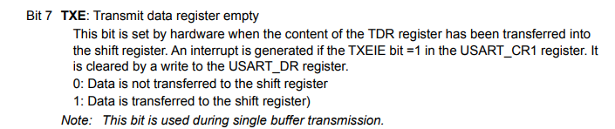
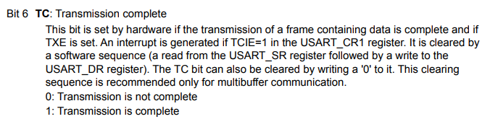

Slide 20
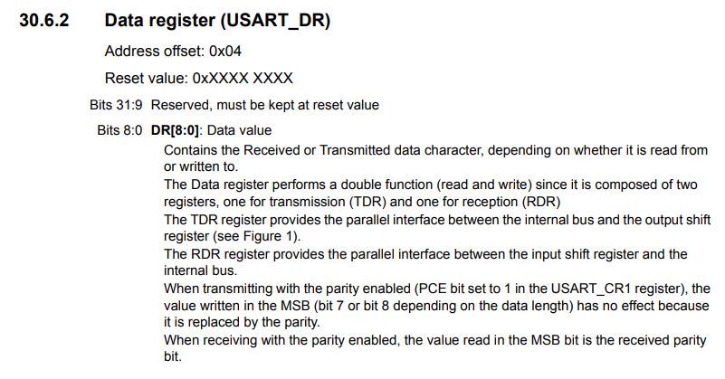

Slide 21
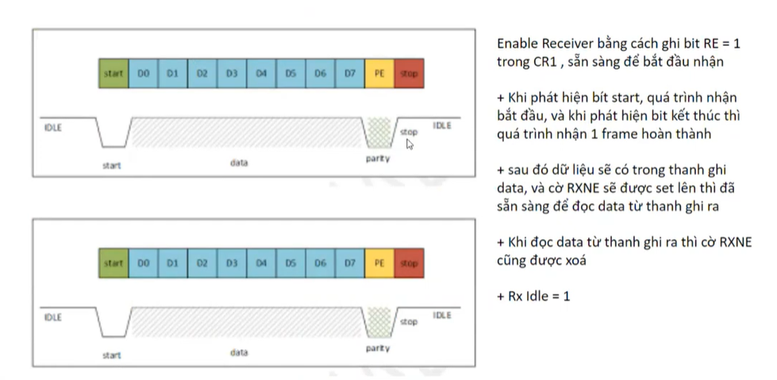

Slide 22
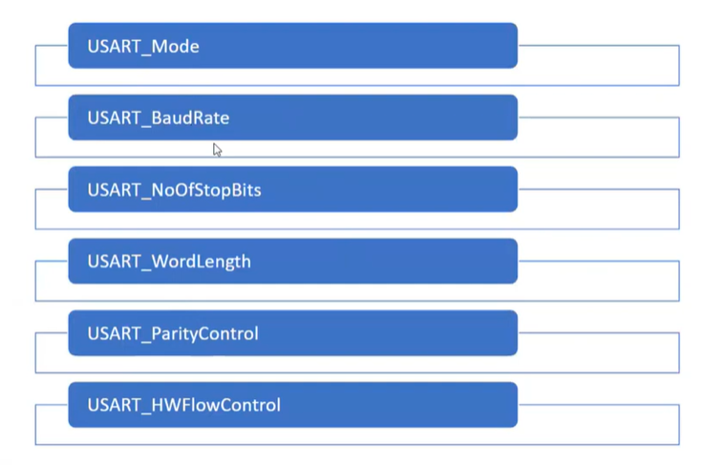

Slide 23
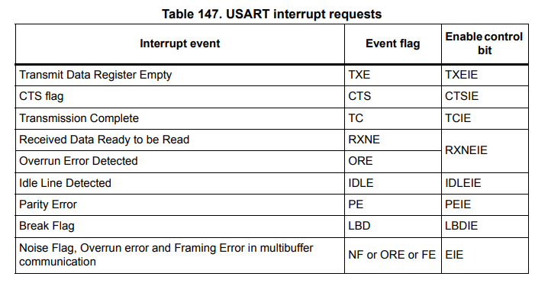
USART interrupts
The USART interrupt events are connected to the same interrupt vector
• During transmission: Transmission Complete, Clear to Send or Transmit Data Register empty interrupt.
While receiving: Idle Line detection, Overrun error, Receive Data register not empty, Parity error, LIN break detection, Noise Flag (only in multi buffer communication) and Framing Error (only in multi buffer communication).

Slide 24
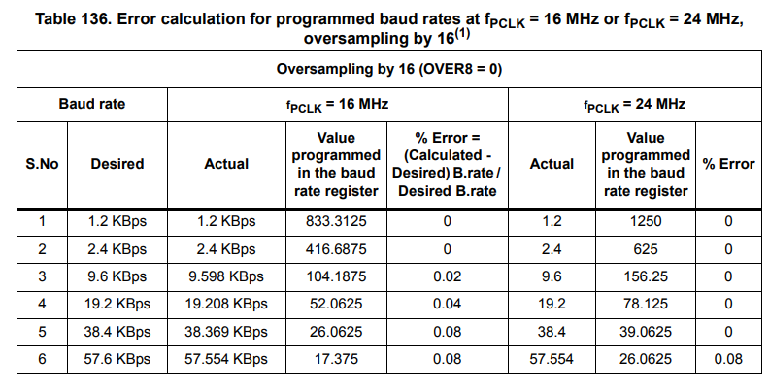
Baudrate

Slide 25


Slide 26
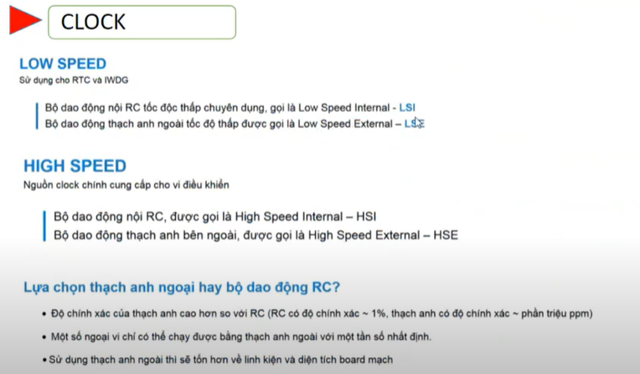

Slide 27
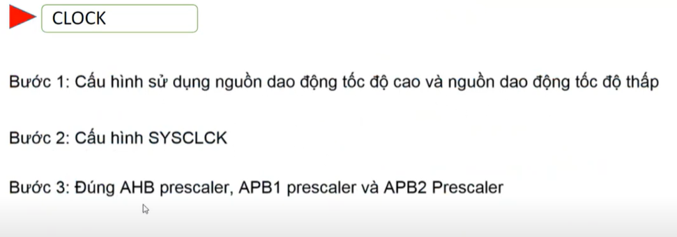

Slide 28
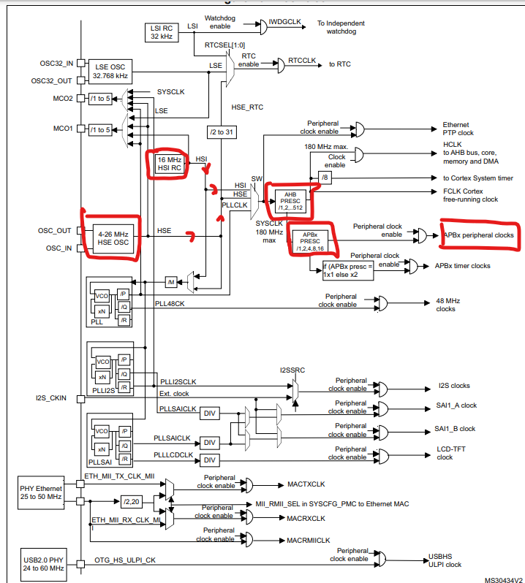
2
1
3

Slide 29
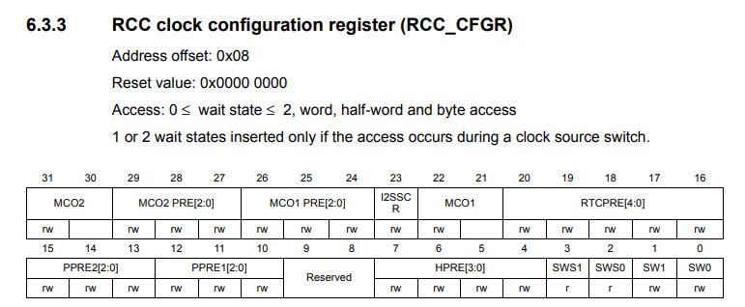
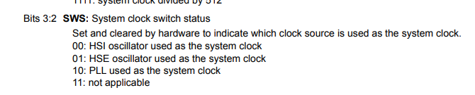
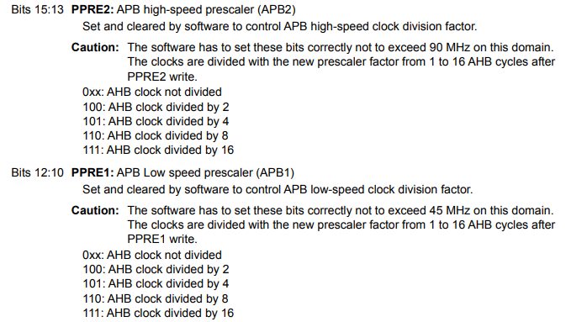
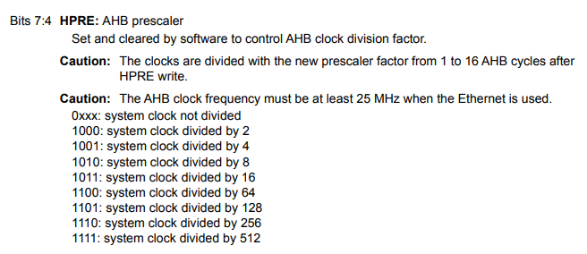

Slide 30
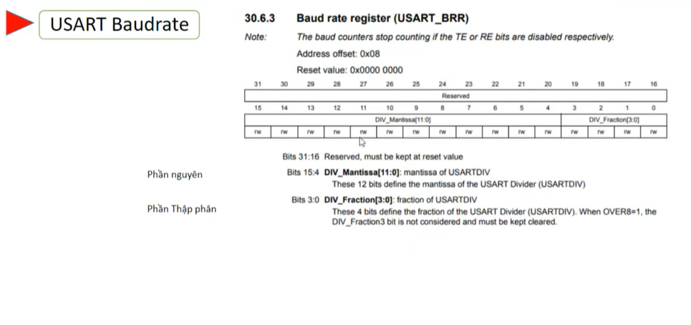

Slide 31
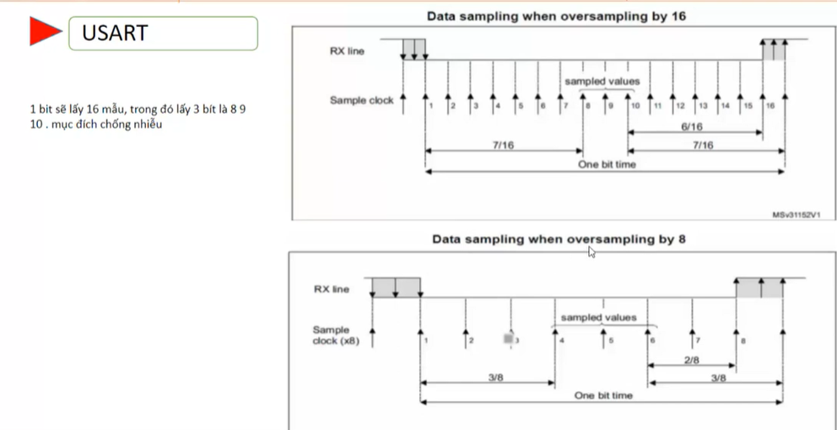

Slide 32
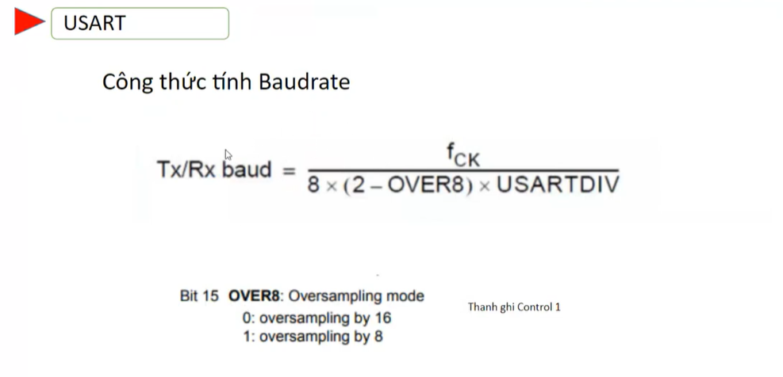
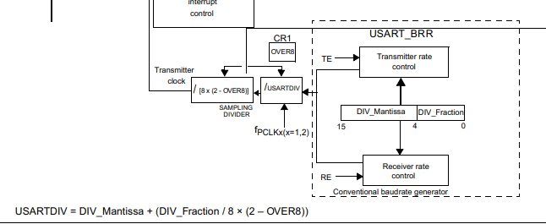

Slide 33
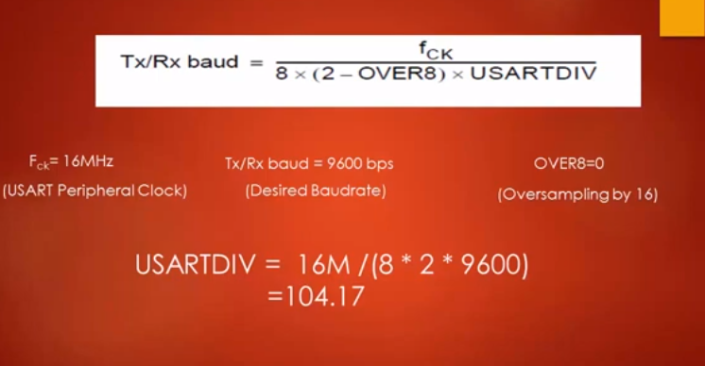
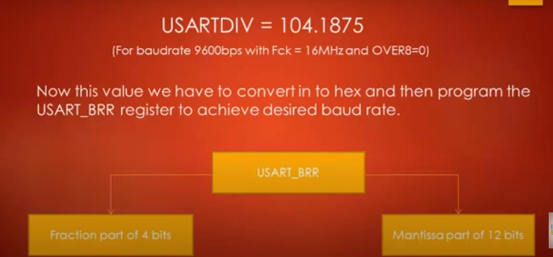

Slide 34
