Slide 1
How to create new module

Slide 2
The XDM format stores:
► Nodes (schema-nodes, data-nodes...)
► Node Attributes
The DataModel supports different kinds of nodes (for which different name spaces are defined):
generic nodes:
Nodes that are neither schema-nodes nor data-nodes. schema-nodes:
Schema-nodes define configuration parameters and the structure of configuration parameters. They define
type, structure and attribute defaults for data-nodes. data-nodes:
Data-nodes represent configuration parameters. A data node is bound to a schema-node that describes valid parameter ranges for the data-node.

Slide 3
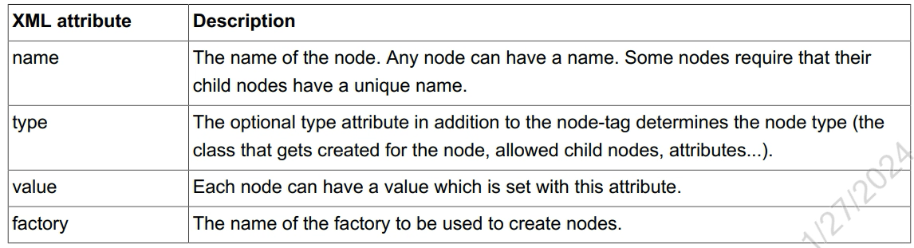
Nodes
Node tags are used to create nodes in the datamodel. There are various node tags available, one for each kind of node (container, list, variable).

Slide 4
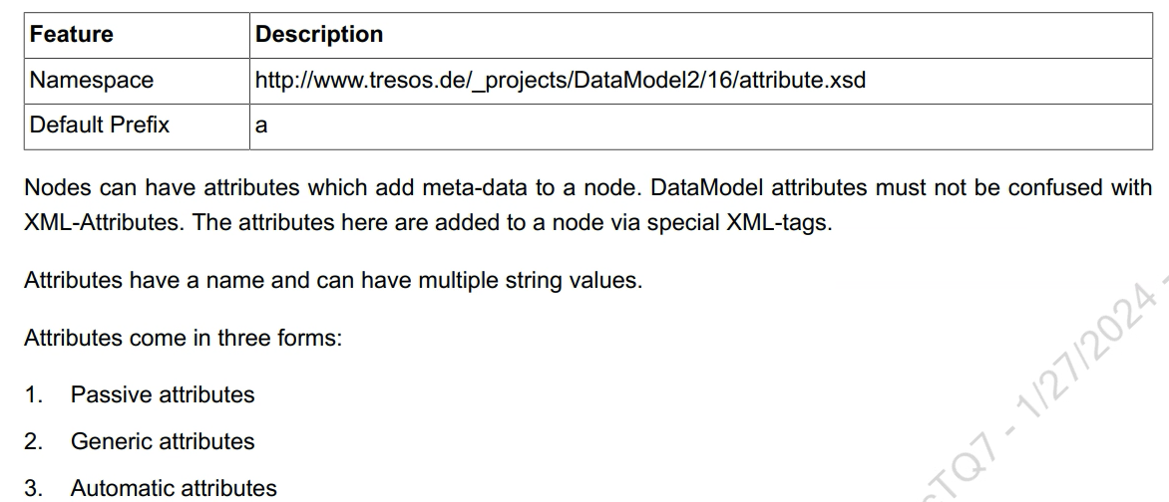
Attributes

Slide 5
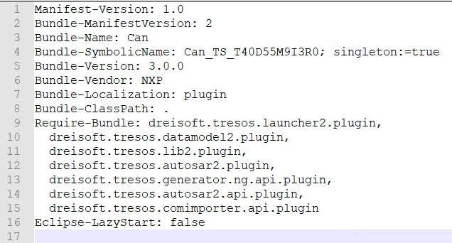
Adapting MANIFEST.MF
Bundle-Name:
Human-readable name for your plug-in.
Bundle-SymbolicName:
Unique name for your plug-in - a good practice is to use the directory-name of the plugin.
Bundle-Vendor:
The name of the vendor of the plugin

Slide 6
Adapting plugin.xml
Change the plugin.xml to your needs.
The plugin.xml is an XML file used to register resources with EB tresos Studio.
Registrations are grouped by so called extensions. For a first module setup adapting the three extensions defined in the TemplateGenerator_TS_T00D0M0I0R0 demo module is sufficient.
dreisoft.tresos.launcher2.plugin.module
The extension dreisoft.tresos.launcher2.plugin.module registers a new module
dreisoft.tresos.launcher2.plugin.configuration
The extension dreisoft.tresos.launcher2.plugin.configuration registers configuration specific resources for the module like the parameter definition, the provided editors, pre- and recommended configuration.
dreisoft.tresos.launcher2.plugin.generator
Via the generator extension a code generator can be registered for the module. A module can have any number of code generators. The generator extension supplies the tag generator as its single tag.

Slide 7
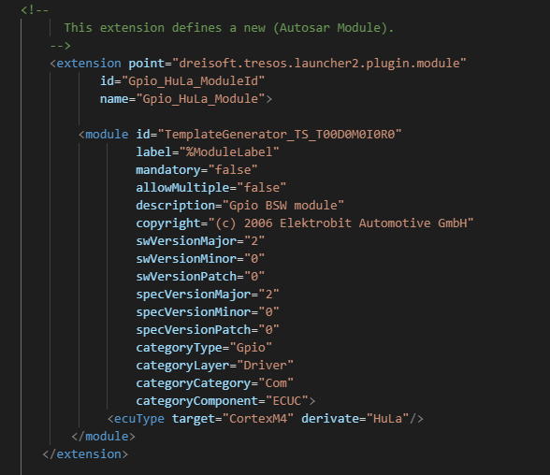
dreisoft.tresos.launcher2.plugin.module

Slide 8
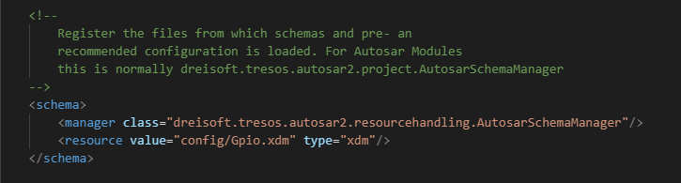
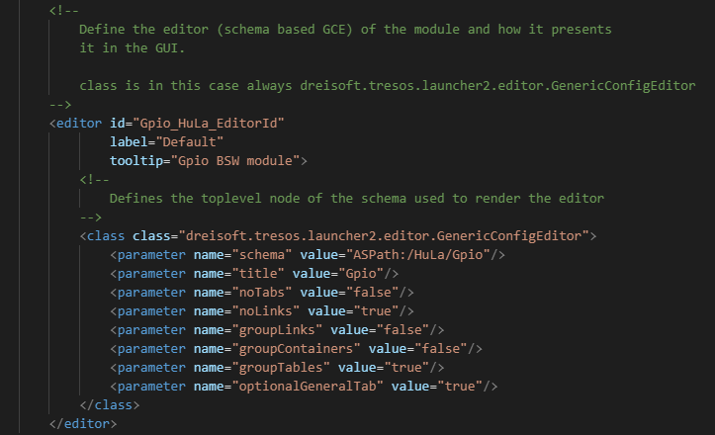
dreisoft.tresos.launcher2.plugin.configuration

Slide 9
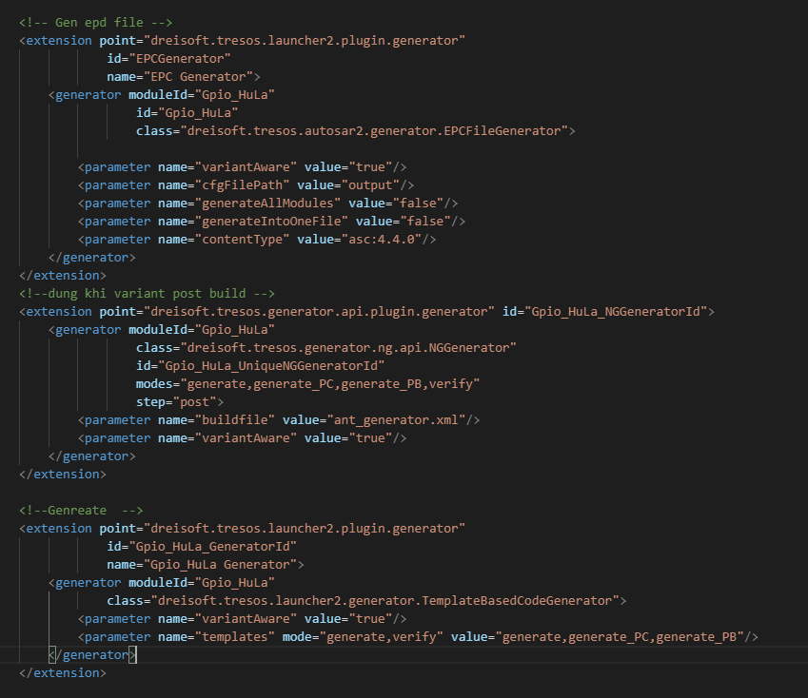
dreisoft.tresos.launcher2.plugin.generator
post: running after generate

Slide 10
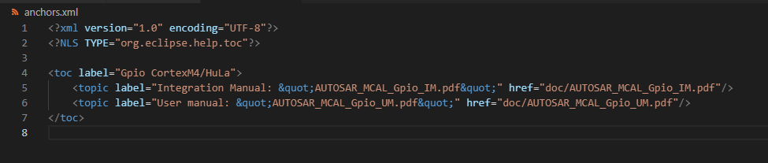
anchors.xml

Slide 11
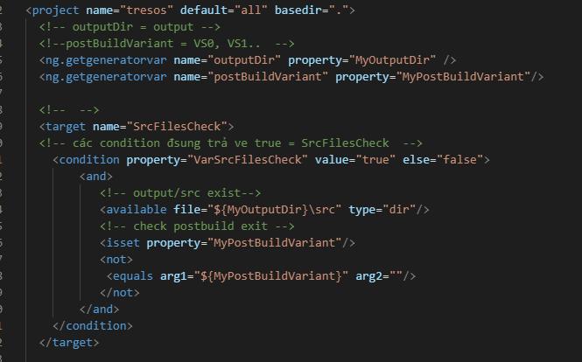
ant_generator.xml

Slide 12
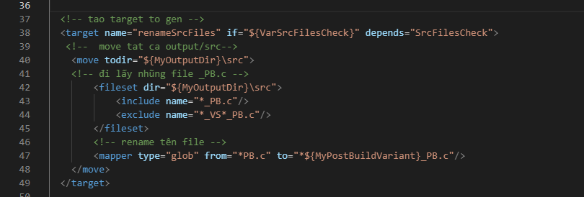

ant_generator.xml

