Slide 1
MAKEFILE
DUCTQ7

Slide 2
What is the makefile ?
A make file is a special file, containing shell commands, that you create and name makefile.
You need a file called a makefile to tell what to do. Most often, the makefile tells make how to compile and link a program.

Slide 3
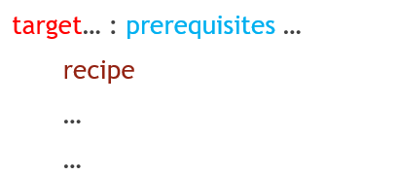
What a Rule Looks Like
A simple makefile consists of “rule” with the following shape:
A target is usually the name of the file that is generated by the program. A target can also be the name of an action to carry out.
A prerequisite(/priːˈrekwəzət/) is a file that is used as input to create the target. A target often depends on several files.
A recipe is an action that makes carried out. A recipe may have more than one command, either on the same line or each on its own line.
Please note: You need to put a “tab” character at the beginning of every recipe line!

Slide 4
Demo1
target
prerequisite
build : main.c
gcc –o app main.c
tab
recipe

Slide 5
Phony Target
A phony target is one that is not really the name of file, rather it is just a name for a recipe to be executed when you make an explicit request.
There two reasons to use a phony target:
+ to avoid a conflict with a file of the same name.
+ to improve performance.
If you have two .mk file and Makefie in a folder. How to select a file do you want to execute?

Slide 6
Include other Makefile
The include directive tells makes to suspend reading the current makefile and read one or more other makefiles before continuing.
include filenames
filenames can contain shell file name patterns. If the file name is empty, nothing is included and no error is printed.

Slide 7
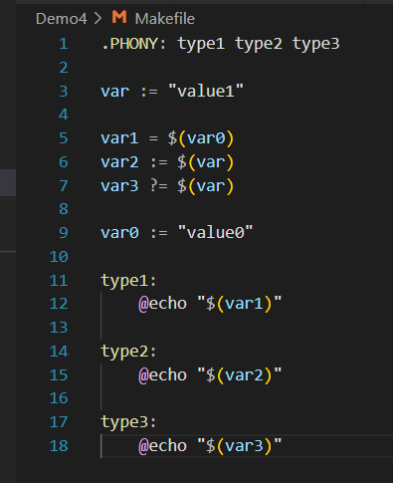
Basic of Variable Reference
Recursively Expanded Variable
Simply Expanded Variable
Condition Variable

Slide 8
Automatic Variable
$@
The file name of the target of the rule. If the target is an archive member, then “$@” is the name of the archive file.
$<
The name of the first prerequisite(/priːˈrekwəzət/). If the target got its recipe from an implicit rule, this will be the first prerequisite added by the implicit rule.
$^
The name of all prerequisites, with spaces between them.

Slide 9
Include in makefile
Specifies a directory dir to search for include makefiles. If several “-I” options are used to specify several directories, the directories are searched in the order specified.
Pattern Rule
%.o : %.c ; recipe…
A rule of the form specifies how to make a file n.o with another n.c as its prerequisite (/priːˈrekwəzət/), provided that n.c exists or can be made.

Slide 10
The vpath Directive
Allows you to specify a search path for a particular class of file name: those that match a particular pattern.
Wildcard funtion
$(wildcard pattern…)
List of names of exiting files that match one of the given file name patterns.
Foreach funtion
$(foreach var,list,text)
The foreach command will browse all files in multiple folders like a for loop in C
Notdir function
Notdir funtion it only get the file name not get path

Slide 11
THANK FOR ATTENTION

