Slide 1
Autonomous Trash/GARBAGE Collector Robot
Sayed MD Towaha
ID: 192-15-13126
Department of CSE
Daffodil International University
Fahad Faisal
Assistant Professor Department of CSE
Daffodil International University
Saturday 30 July 2014

Slide 2
TABLE OF CONTENTS
Introduction
Motivation
Objective
Related Work
How It Works
Flowchart
Limitation and Future Work
Impact on Society
Conclusion

Slide 3
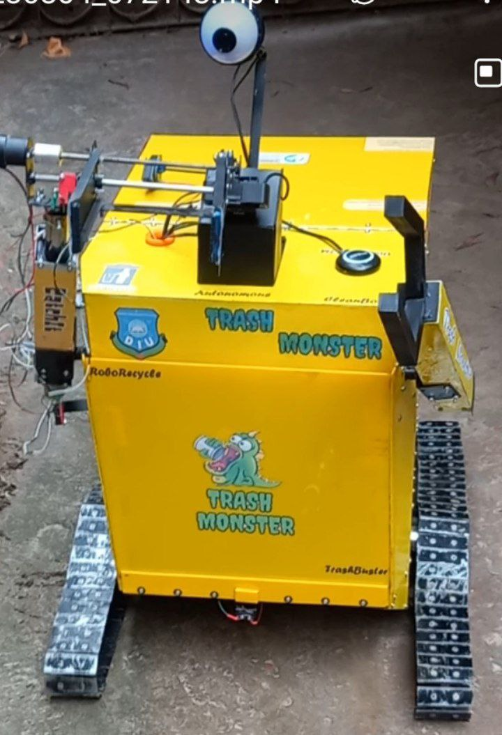
Introduction
What is an autonomous trash collection robot?
Why this robot?

Slide 4
Motivation
Simplify the waste collection process
Reduce manual labor and associated health risks
Enhance cleanliness in public spaces
Improve waste management practices
Contribute to a cleaner and greener environment
Create awareness among students

Slide 5
Objective
Develop an autonomous trash collection robot.
Efficiently collect and dispose of trash.
Streamline waste management processes.
Improve cleanliness in public spaces.

Slide 6
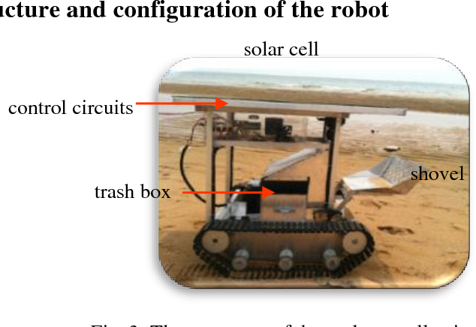
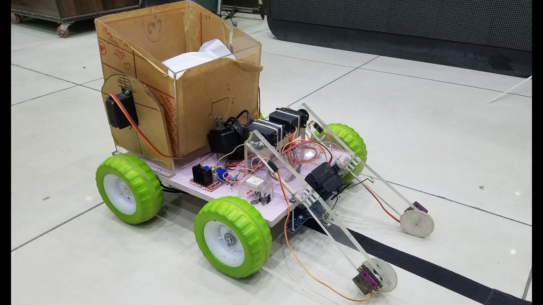
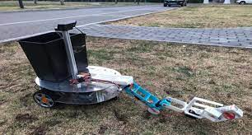
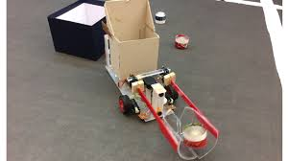
Related Work

Slide 7
How it works
GPS navigation system
Trash detection
Object Manipulation using a mechanical arm
Collection and Storage
Navigation and Disposal

Slide 8
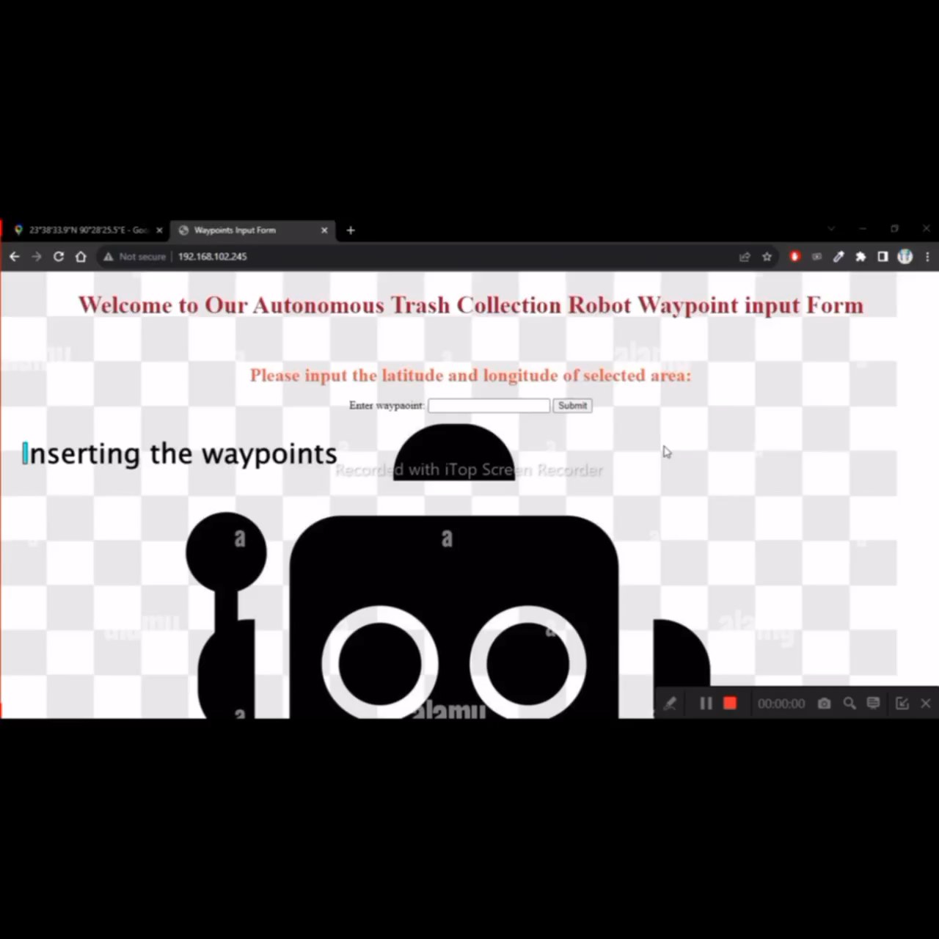

Slide 9
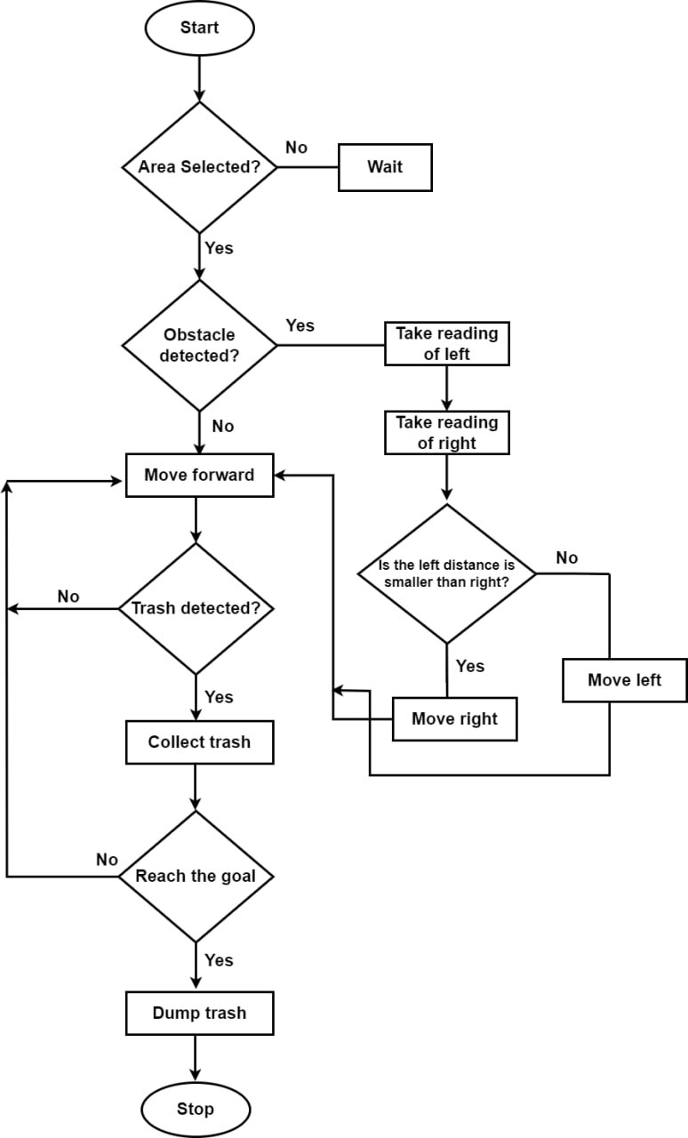
Flowchart

Slide 10
GPS navigation system
Input the waypoint
Calculate the distance using the Haversine distance formula
Navigate using satellite communication

Slide 11
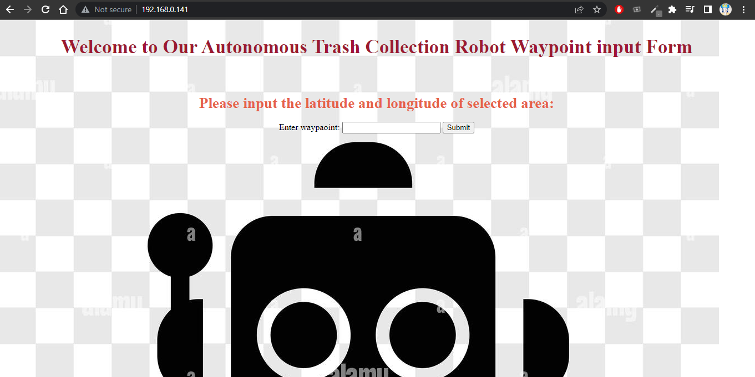
Input the waypoint

Slide 12
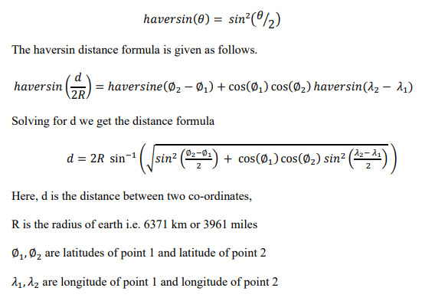
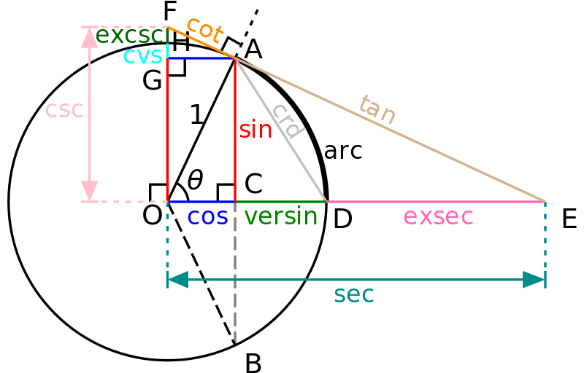
Calculate the distance using the Haversine distance formula

Slide 13

Navigate using satellite communication

Slide 14
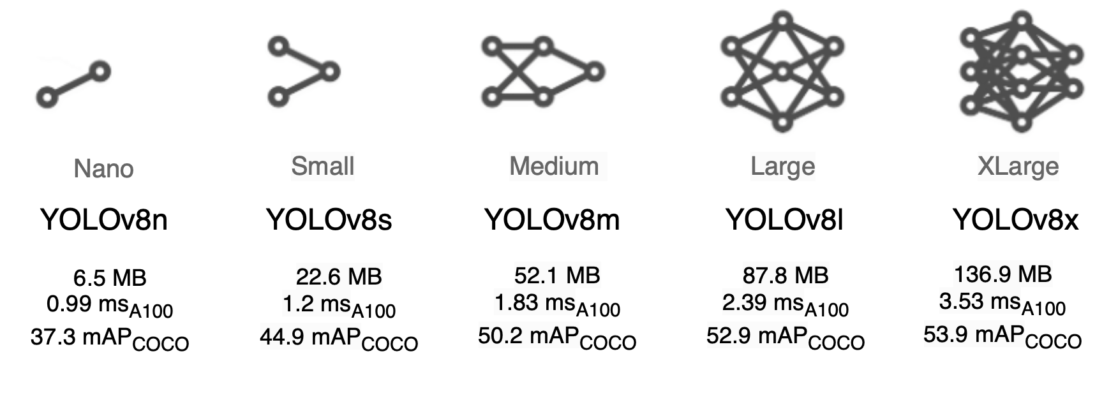
Trash detection

Slide 15
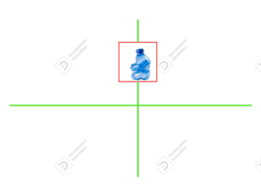
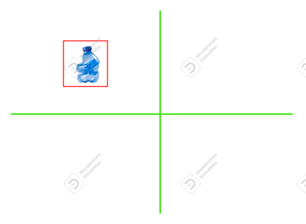
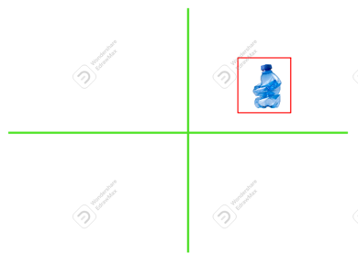
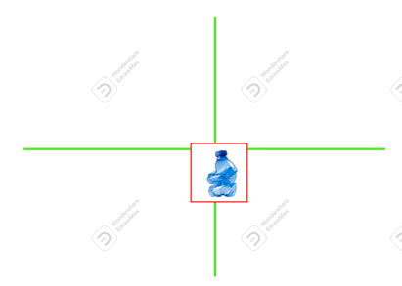
Object Manipulation using mechanical arm

Slide 16
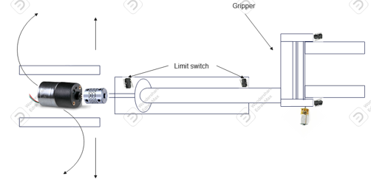
Object Manipulation using mechanical arm

Slide 17
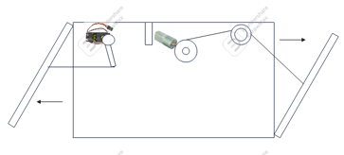
Collection and Storage

Slide 18
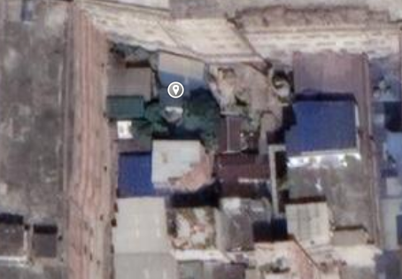
Navigation and Disposal

Slide 19
Limitation and Future Work
Limitation:
Limited capacity
Object detection accuracy
High power consumption
Not Waterproof
Speed very slow

Slide 20
Limitation and Future Work
Future work:
Increase the speed
Use a good power supplier
Train more trash
Change the wheel model
Add Voice Assistant

Slide 21
Impact on Society
Improved cleanliness
Reduced manual labor
Enhanced waste management practices
Public awareness and education
Inspiration for innovation
Economic benefits
Make a cleaner, healthier, and more sustainable environment

Slide 22
Conclusion
It simplifies the waste collection process
Enhances cleanliness in public spaces.
Reduces manual labor
Future work can focus on improving object detection accuracy and navigation algorithms.
Represents a promising solution for efficient and sustainable waste management.
Finally, it can be said it is important for any society.

Slide 23
Thank you

