Slide 1
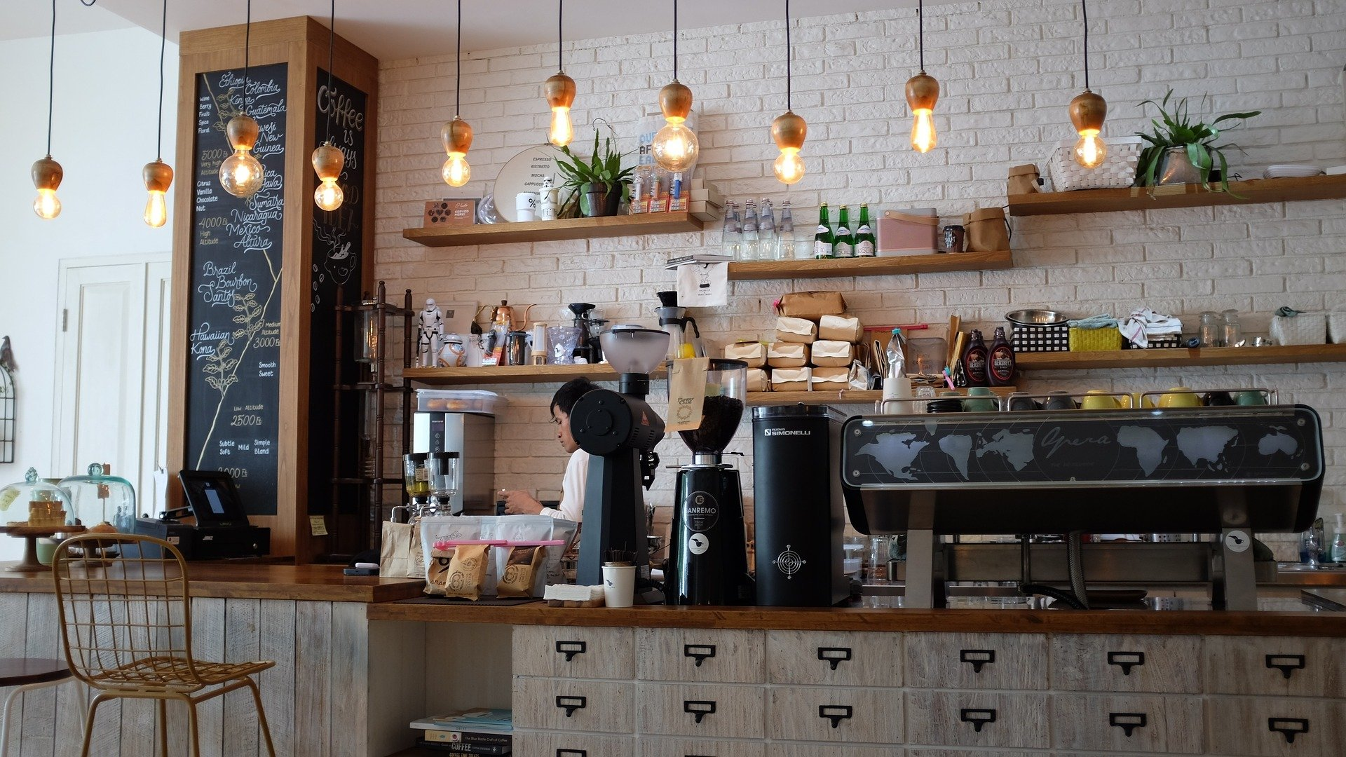

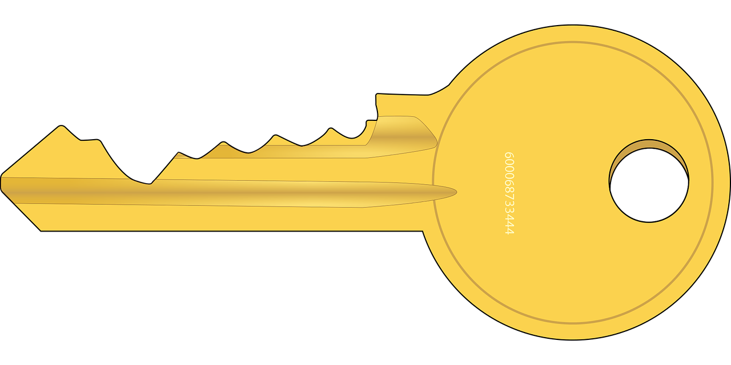

Slide 2
Semaphore: The Idea
Task A
Task B
Task C
Task D
Counting semaphore
3
semaphoreTake(semaphore)
2
1
0
1
0
3
Critical section
(manipulate shared resource)
semaphoreGive(semaphore)

Slide 3
Semaphore: In Practice
Task A
Task B
Producers
Counting semaphore
semaphoreGive(semaphore)
0
1
2
Shared resource
(e.g. buffer, linked list)
Value
Value
semaphoreTake(semaphore)
Task C
Task D
Consumers

Slide 4
Priority Inheritance!
Ownership!
Mutex
Semaphore
// Task 1
semaphoreTake(mutex)
// Use shared resource
semaphoreGive(mutex)
// Task 2
semaphoreTake(mutex)
// Use shared resource
semaphoreGive(mutex)
// Task 1 (producer)
// Add something to
// shared resource
semaphoreGive(semaphore)
// Task 2 (consumer)
semaphoreTake(mutex)
// Remove something from
// shared resource
Good for ISR!

Slide 5
FreeRTOS | POSIX
xSemaphoreTake() | sem_wait()
xSemaphoreGive() | sem_post()
uxSemaphoreGetCount() | sem_getvalue()

Slide 6
Semaphore: The Challenge
Task 0
Task 1
Task 2
Task 3
Task 4
Shared resource
(circular buffer)
Task A
Task B

Slide 7
Semaphore: The Idea
Task A
Task B
Task C
Task D
Counting semaphore
3
semaphoreTake(semaphore)
2
1
0
1
0
3
Critical section
(manipulate shared resource)
semaphoreGive(semaphore)

