Slide 1

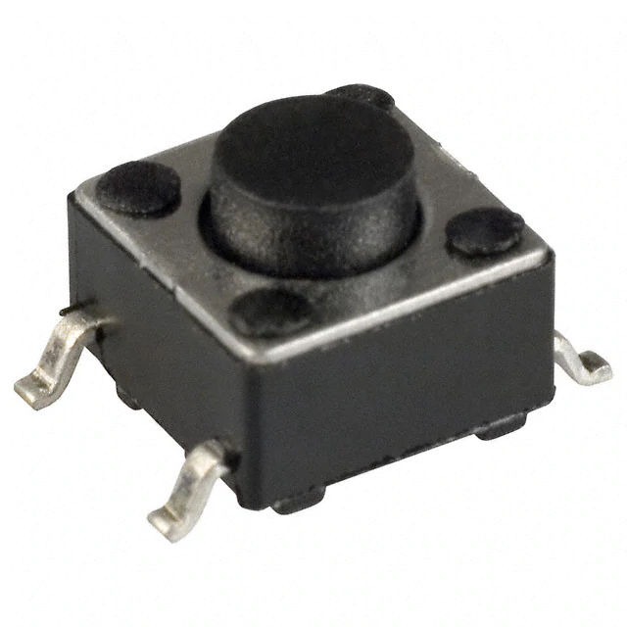

UART Comms
UART Buffer
CPU

Slide 2
What actually happens*
*assuming single-core processor
“preemptive scheduling”
Interrupt Service Routine (ISR)
ISR
(H/W)
Priority (S/W)
...
1
Task B
Task C
Task C
0
Task A
Task A
Task A
Task A
OS
Idle
“tick”
time
1 ms

Slide 3
Deferred Interrupt
ISR gives semaphore
Scheduler called to run newly unblocked task
Blocked waiting for semaphore
ISR
(H/W)
Priority (S/W)
...
2
B
1
Task A
Task A
Task A
Task A
Task A
Task A
OS
Idle
“tick”
time
1 ms

Slide 4
After 10 samples have been read, Task A will wake up and compute the average.
Double Buffer or Circular Buffer
Task A
Global:
Average (float)
Timer ISR
Samples from ADC (10 Hz)
Task B
Serial Terminal
> hello
> avg
Average: 59.2
> blah
>

