Slide 1

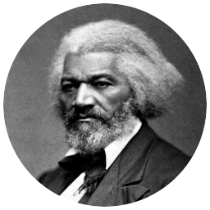
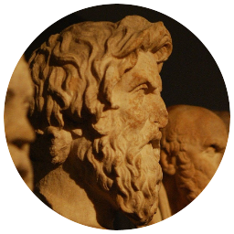
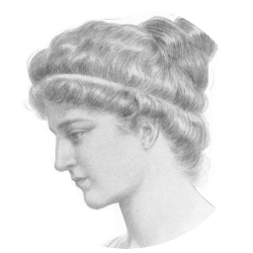


Slide 2
Thread
Shared resource
Mutex or semaphore

Slide 3
Priority 2
Priority 1
Priority 1
Priority 1
Starvation
Priority 2

Slide 4
Deferred Interrupt
ISR gives semaphore
Scheduler called to run newly unblocked task
Blocked waiting for semaphore
ISR
(H/W)
Priority (S/W)
...
2
B
1
Task A
Task A
Task A
Task A
Task A
Task A
OS
Idle
“tick”
time
1 ms

Slide 5
Aging
Task
Priority
...
Task A
4
3
2
Task B
1
0
Time

Slide 7
Deadlock

Slide 11
Livelock

Slide 12
1
5
2
4
3

Slide 13
1
5
2
4
3

Slide 14
1
5
2
4
3

Slide 15
1
Mutex
(arbitrator/waiter)

Slide 16
0
Mutex
(arbitrator/waiter)

Slide 17
0
Mutex
(arbitrator/waiter)

Slide 18
0
Mutex
(arbitrator/waiter)

Slide 19
1
Mutex
(arbitrator/waiter)

Slide 20
Priority 2
Priority 1
Priority 1
Priority 1
Starvation
Priority 2

Slide 21
Deadlock

