Slide 1
Smart Facility Digital Twin
Project 2 — Intelligent Ecosystem & Strategic Optimization
2 floors · 6 rooms · 11 interacting twins · 5 predicted failure modes
Extends the Project 1 single-room twin into a coordinated, self-monitoring facility.
Notes:
Project 2 report. Everything shown runs; nothing is mocked.

Slide 2
BRIEF
Objective & scope
• Extend one room twin into an intelligent, autonomous ecosystem.
• Integrate a predictive model for equipment failure.
• Coordinate multiple interacting twins across a smart facility.
• Address governance, ethics, ROI and a deployment roadmap.
Key task | Delivered by
Predictive Intelligence | 5-class fault model + physics guard, live per room
Ecosystem Integration | 11 twins, federated coordination, MQTT data flows
Governance & Ethics | Threat model, fairness audit, bounded autonomy
Strategic Roadmap | Measured ROI, 4-phase pilot-to-campus plan
Notes:
Four key tasks from the brief, and where each is answered.

Slide 3
WHAT CHANGED
From one room to a facility
 | Project 1 | Project 2
Scope | 1 room | 2 floors, 6 rooms, 11 twins
Coordination | None | Federated — rooms decide, supervisors advise
Occupancy | Per-room random walk | Headcount-conserving people flow
Equipment | Never degrades | 5 failure modes, AI4I-calibrated
Intelligence | PID control | PID + fault-type model + thermal guard
Remediation | AC on/off | 5 remedies, manual or model-dispatched
The Project-1 room survives as f1/lab-a with its calibrated constants intact — a test locks them as the regression guard.
Notes:
Project 1's room is still here, unchanged, as the regression guard for the whole refactor.

Slide 4
ECOSYSTEM INTEGRATION
Eleven twins, each with one job
Twin | Count | Owns | Loop
Room twin | 6 | Physics, PID, equipment health | 1 s
Floor twin | 2 | Aggregate; recommend setpoint nudges | 10 s
Building twin | 1 | kW allocation; maintenance work orders | 30 s
Occupancy twin | 1 | People flow between rooms | 1 s
Risk scorer | 1 | Fault probability per room | 30 s
Occupancy → energy → equipment wear → maintenance is a single causal chain.
A class leaving one room raises load in another, which accrues wear, which the model sees hours later.
Notes:
The brief asks for an energy twin interacting with an occupancy twin. That path is real: headcount is conserved, so people genuinely move between rooms and the thermal load follows them.

Slide 5
DELIVERABLE — COORDINATION STRATEGY
Centralised vs federated
 | Centralised | Federated (chosen)
A crash stops… | every room cooling | coordination only
Local disturbance | waits for the global loop | handled in the room's own 1 s loop
Occupancy data | leaves every room | stays room-local; aggregates only
Tuning | one loop for a 20 m² and a 70 m² room | per-room thermal mass
A supervisor bug | actuates every room | bounded advice, ≤ 1.5 °C
The 1.5 °C limit is enforced by the room, not by the supervisor sending the advice — so a spoofed or buggy advisory cannot make a room unsafe. Eight named tests back these claims.
Notes:
Federated with hierarchical supervision. Authority flows downward as advice and stops at a bound the recipient owns.

Slide 6
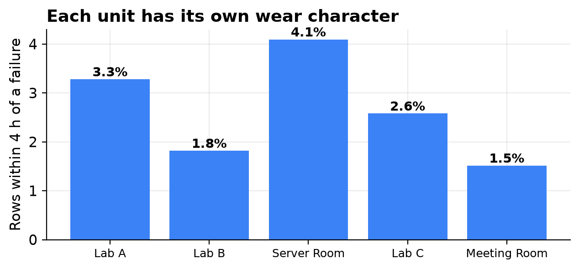
PREDICTIVE INTELLIGENCE
Five failure modes, one per unit character
Unit | Fails by
Wet lab A | Airflow
Dry lab B | Bearing
Server room | Overstrain
Teaching lab C | Heat dissipation
Meeting room | Power
Thresholds inherit from UCI AI4I 2020, whose published rules we verified reproduce exactly (115/115 rows).
Notes:
Real buildings do not contain six identical units. Each has its own wear character, which is what makes fault classification a real problem rather than one class with noise.

Slide 7
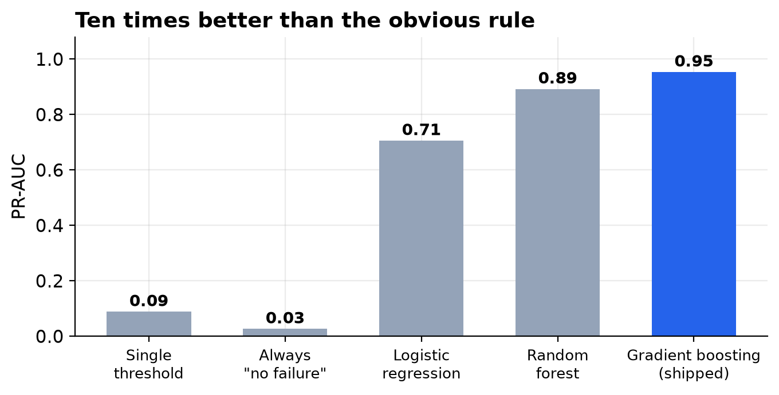
DELIVERABLE — PREDICTIVE MODEL OUTPUT
Model results
PR-AUC 0.953
Recall 0.974
Precision 0.734
Decision threshold 0.0153, chosen from a
cost curve — not left at 0.5.
Accuracy would be 97 % if we always
predicted "no failure". That is why
it is not the headline.
Notes:
Trained and evaluated with a temporal split and a held-out room. A random shuffle would inflate this to a meaningless 0.99.

Slide 8
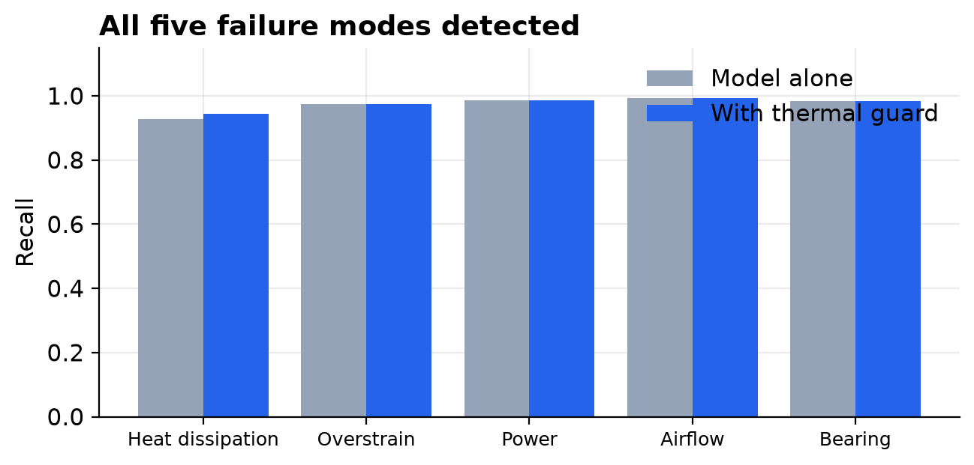
PREDICTIVE INTELLIGENCE
Every mode detected — after a correction
Heat dissipation:
0.00 → 0.93 recall
The first model was blind to that mode.
It had seen about two examples of it.
The cause was starvation, not tuning:
six identical units meant one mode
was 90 % of the data. Fixing the DATA
fixed the model.
A physics threshold still backs it up.
Notes:
A model that cannot see a failure mode is usually being starved of it, not badly tuned. Worth stating because it generalises.

Slide 9
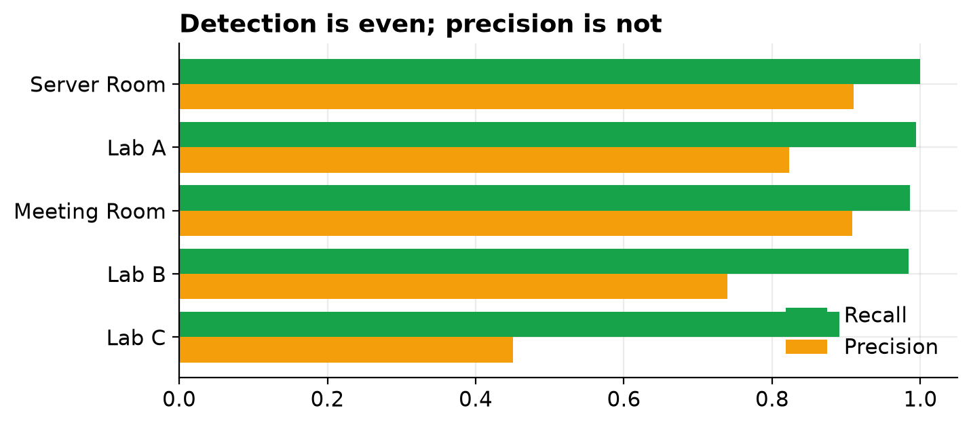
GOVERNANCE & ETHICS
Fairness audit
Recall 0.89–1.00
in every room
Room identity is excluded from the
features by construction, so the model
cannot learn a per-room prior.
Teaching Lab C stays weakest:
precision 0.45, and it misses about
one failure in nine.
The audit is repeated after every retrain.
Notes:
An earlier version had a 100 % false-negative rate on the wet lab — the room where an outage costs most. We publish both states.

Slide 10
ECOSYSTEM INTEGRATION
Closing the loop: one remedy per mode
Fault | Remedy | Reduces cooling?
Airflow | Replace filter | No
Bearing | Service motor | No
Overstrain | Service motor + occupant notice | No
Power | Electrical service | No
Heat dissipation | Thermal derate — cap fan duty | Yes, bounded
The derate is capped at 50 % duty, never zero, and releases itself once the winding cools —
what a thermal overload relay does. Easing a motor off is not the same act as switching cooling off.
Notes:
The system used to predict five faults and fix two. Three predictions had no action anyone could take.

Slide 11
GOVERNANCE & ETHICS
Security — the honest posture
• The pilot broker is anonymous and unencrypted. Fine on one machine.
• Unacceptable in a building that dispatches technicians to equipment.
Hardening | Why
mTLS + per-topic ACLs | a room twin can only speak for itself
Signed commands | no replay, no spoofed shutdown
Append-only audit log | every action attributable to a person
Network segmentation | not routable from the office LAN
Costed at €4,000 — a line item, not a backlog ticket.
Notes:
Stating the pilot is insecure is more useful than claiming otherwise. The threat model and checklist are in governance.md.

Slide 12
GOVERNANCE & ETHICS
Bounded autonomy, in one operator control
Level | Thermostat runs the AC | Model dispatches maintenance
Manual | No | No
Auto climate (default) | Yes | No — approval required
Full auto | Yes | Yes — preventive actions only
• Full auto is never the default — autonomy is opted into.
• Preventive actions only; at most one automatic service per unit per 24 h.
• Every dispatch is still published as an advisory, so the audit trail is identical.
• Shutting a unit down is forbidden at every level.
Notes:
There is no path from a model score to a physical action that does not pass through a person, or through these bounds.

Slide 13
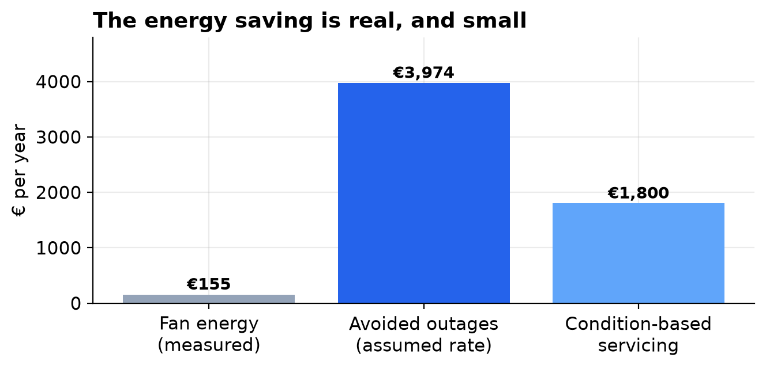
STRATEGIC ROADMAP
Where the value is — and is not
≈ €5,929 / year
Fan energy is measured: 620 kWh, €155.
Small. Anyone pitching predictive
maintenance on fan energy alone is
selling you something.
The value is in outages you don't have.
Notes:
Every figure is labelled measured or assumed. The cooling-capacity loss is probably larger and we do not claim it, because we did not measure it.

Slide 14
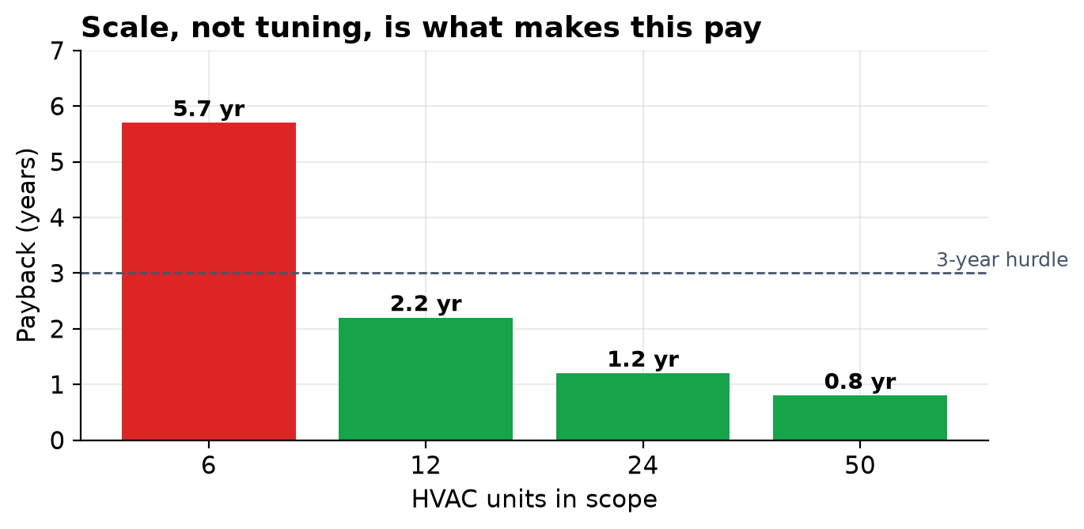
STRATEGIC ROADMAP
At six units it does not pay for itself
One-off | €17,000
Recurring | €2,900 / yr
Payback | 5.7 years
5-yr NPV @ 8 % | −€5,021
Integration cost is roughly fixed;
benefits scale with unit count.
Recommendation: pilot to prove the
model on real telemetry, then scale
to campus — not building by building.
Notes:
Reporting a negative NPV is the point. The conclusion is robust across the sensitivity table.

Slide 15
STRATEGIC ROADMAP
Pilot to campus
Phase | Scope | Exit criterion | Named risk
0 — Pilot (complete) | 6 simulated twins | Suite green; loop verified end to end | All results rest on simulated data
1 — Instrumented 3–6 months | 3 real units, observe-only | Model recalibrated on REAL telemetry | Real failures are rare; may see zero
2 — Full building 6–12 months | All units, live work orders | Measured drop in unplanned outages | Alert fatigue at 0.73 precision
3 — Campus 12–24 months | ≥ 24 units | Positive measured NPV | Models transfer poorly (PR-AUC 0.20)
Phase 4 — bounded autonomy — only after Phase 3, and never automatic shutdown.
Notes:
Each phase has an entry criterion, an exit criterion and a named risk with its mitigation.

Slide 16
REPRODUCIBILITY
Working prototype — how to run
docker compose up -d
dashboard http://localhost:8501
3D view http://localhost:8000/room3d/building3d.html
docker compose run --rm sim pytest -v
docker compose run --rm sim python simulator/dataset_generator.py
docker compose run --rm sim python ml/train.py
• Everything runs in Docker — no host Python needed.
• The dataset and both models regenerate from source, deterministically.
• Notebooks in ml/notebooks/ carry executed output.
Notes:
One command brings up the broker, simulator, dashboard and 3D view. The full suite runs in the same image.

Slide 17
CONCLUSION
Deliverables
Required deliverable | Where
Predictive model output — notebooks / results | ml/notebooks/*.ipynb · ml/models/model_card.md
Integrated ecosystem diagram — coordination strategy | docs/ecosystem.md (data flow, sequence, centralised vs federated)
Executive pitch — ROI, security, ethical safety | report/pitch/Digital_Twin_Project2_Executive_Pitch.pptx
Predictive intelligence (key task) | 5-class model + thermal guard, live per room
Ecosystem integration (key task) | 11 twins, federated coordination, MQTT topic map
Governance & ethics (key task) | docs/governance.md
Strategic roadmap (key task) | docs/roi_roadmap.md
All results are reproducible from a clean clone. The models are trained on simulated telemetry — recalibration on real data is Phase 1.
Notes:
Closing slide: every required deliverable and where to find it, with the standing caveat about simulated data.

