Slide 1
Smart Facility Digital Twin
Predictive maintenance for building HVAC
6 rooms · 2 floors · 11 interacting twins · 1 machine-learning model
Notes:
This is a working system, not a concept. Everything shown runs.

Slide 2
THE PROBLEM
We find HVAC failures when someone complains
• In a wet lab, that means temperature-sensitive samples are already at risk.
• Maintenance runs on a calendar: we service units that don't need it…
• …and miss units that do.
• No visibility into equipment condition between visits.
The question isn't whether to maintain.
It's whether we maintain on a calendar or on evidence.
Notes:
The question isn't whether to maintain. It's whether we maintain on a calendar or on evidence.

Slide 3
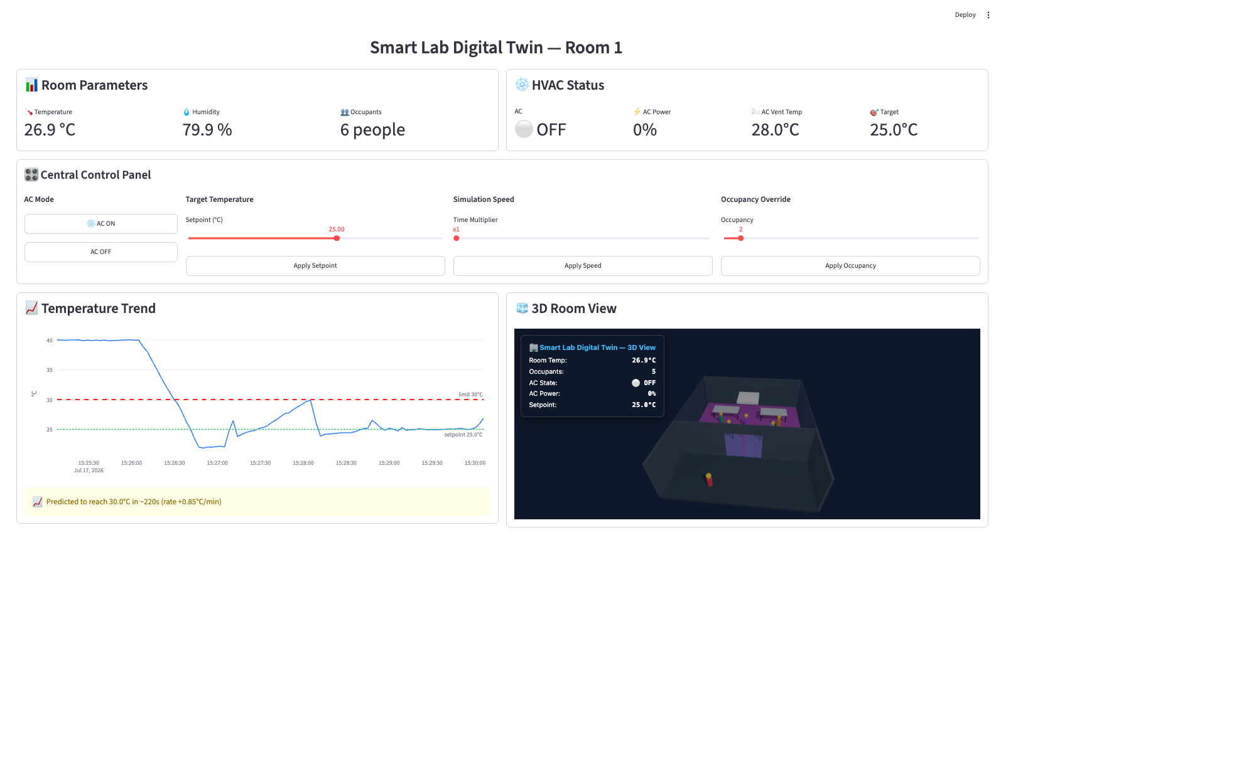
WHAT WE BUILT
A digital twin for every room
• Physics, control and equipment health simulated per room, live over MQTT.
• Floor and building twins coordinate a 15 kW electrical budget.
• An occupancy twin moves people between rooms — conserving headcount.
• Dashboard, 3D building view, and machine-learning risk scoring.
Notes:
Each room runs its own control loop. Supervisors advise; they never take over. If the coordination layer dies, every room keeps cooling.

Slide 4
ARCHITECTURE
Rooms decide. Supervisors advise.
 | Centralised | Federated (chosen)
A crash stops… | every room cooling | coordination only
Occupancy data | leaves every room | stays room-local
Tuning | one loop for all rooms | per-room thermal mass
A supervisor bug | actuates every room | bounded advice, ≤1.5 °C
The 1.5 °C limit is enforced by the room, not by the supervisor sending the advice.
Notes:
One crash in a centralised design stops every room. And occupancy data would have to leave the room it came from — this is a privacy choice as much as a resilience one.

Slide 5
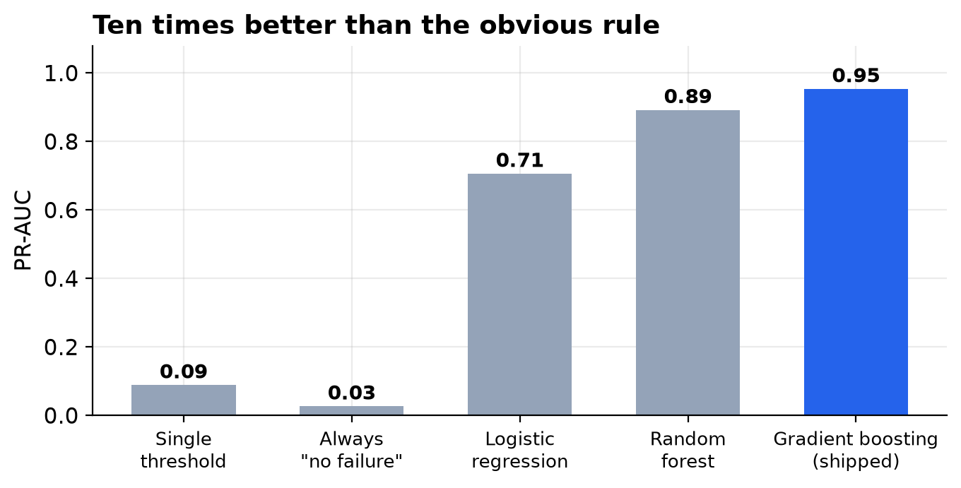
THE INTELLIGENCE
Four hours of warning before a failure
PR-AUC 0.95
Recall 0.97
Precision 0.73
Accuracy would be 98 % if we always predicted
"no failure". That is why we don't quote it.
Notes:
Accuracy would be 98% if we simply predicted 'no failure' every time — that's why we don't quote accuracy. The model is six times better than the obvious rule.

Slide 6
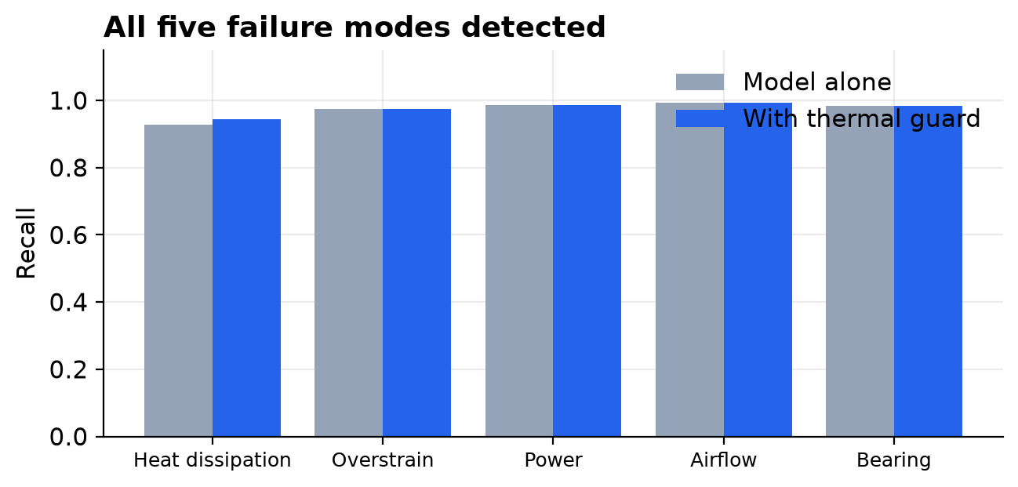
WHAT WENT WRONG FIRST
One failure mode was invisible — and why
Heat-dissipation recall:
0.00 → 0.95
The first model missed that mode entirely.
It had seen about two examples of it.
The fix was to the DATA, not the model:
six identical units were replaced by six
with realistic, different wear characters.
A physics threshold still backs it up.
Notes:
This is the slide I'd want to see if I were buying. Our first model was blind to one failure mode. The cause was starvation, not tuning — it had two examples. A model that cannot see something is usually being starved of it. We fixed the data, and we keep the physics threshold as an independent backstop.

Slide 7
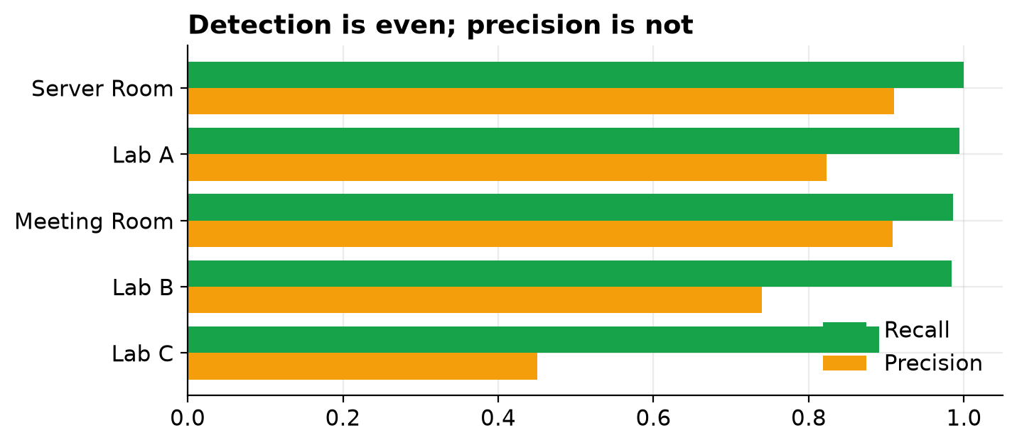
FAIRNESS AUDIT
Detection is even — precision is not
Recall 0.95–1.00
in every room
Room identity is excluded from the model
by construction, so it cannot learn a
per-room prior.
Teaching Lab C remains weakest:
precision 0.46 — about half its work
orders are unnecessary.
We re-run this audit after every retrain.
Notes:
An earlier version had a 100% false-negative rate on the wet lab — the room where an outage costs most. We found it, fixed its actual cause, and publish both states. What remains is a precision gap in the teaching lab, which is disruptive rather than dangerous. That placement is luck, not design, which is why the audit repeats.

Slide 8
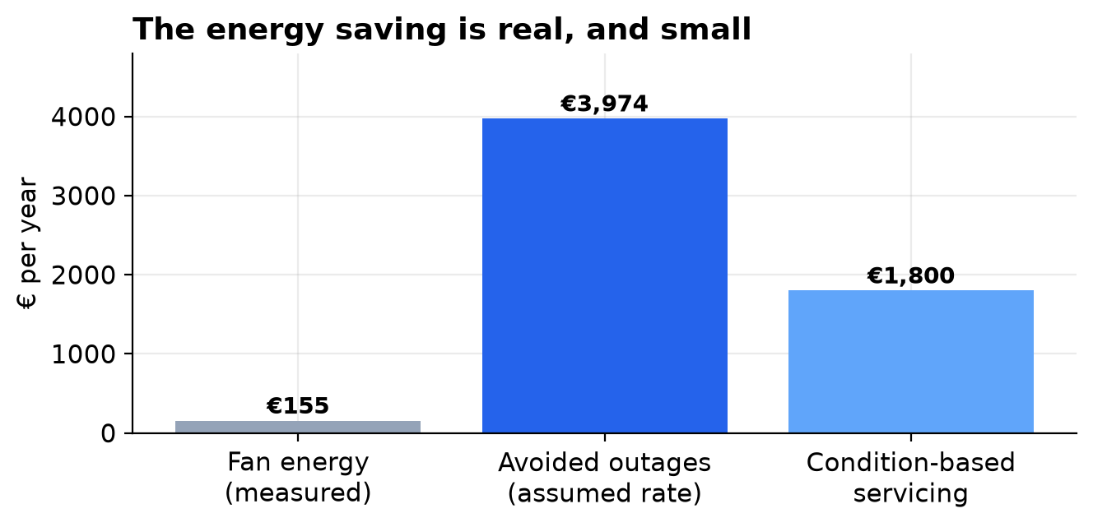
BUSINESS CASE
Where the value actually is
≈ €5,800 / year
Anyone pitching predictive maintenance
on fan energy alone is selling you
something. The value is in outages
you don't have.
Notes:
The energy saving is real but small — €155. The value is in outages you don't have.

Slide 9
THE UNCOMFORTABLE NUMBER
At six units, it does not pay for itself
One-off investment | €17,000
Recurring | €2,900 / year
Net benefit | €3,000 / year
Payback | 5.7 years
5-year NPV @ 8 % | −€5,021
Integration cost is roughly fixed.
Benefits scale with unit count.
This is a question of scale —
not of whether the technology works.
Notes:
On this building alone, it does not pay for itself. Integration cost is roughly fixed; benefits scale with unit count.

Slide 10
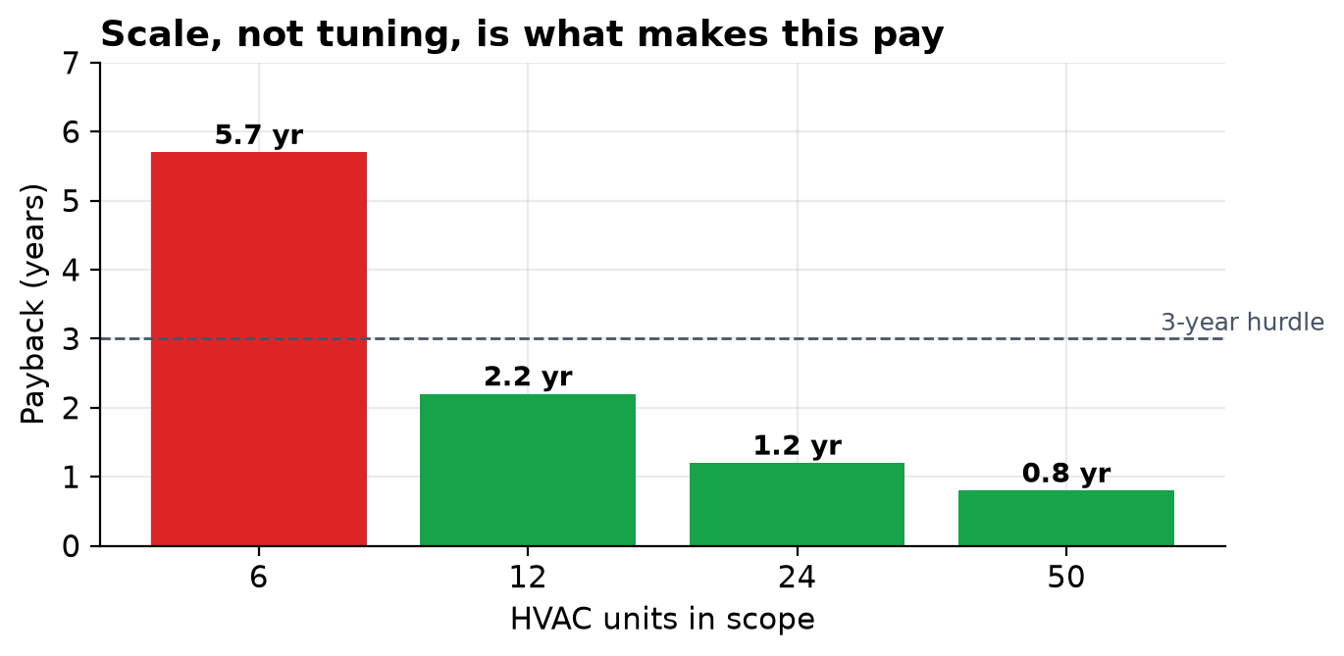
RECOMMENDATION
Where it does pay
Pilot to prove the model
on real telemetry.
Then scale to campus.
Not a building-by-building rollout.
Notes:
The recommendation is a pilot to prove the model on real telemetry, then campus scale. Not a building-by-building rollout.

Slide 11
SECURITY
The pilot is not secure — and that is costed
• Today: anonymous broker, no encryption. Fine on one machine.
• Unacceptable in a building that dispatches technicians.
Hardening | Why
mTLS + per-topic ACLs | a room twin can only speak for itself
Signed commands | no replay, no spoofed shutdown
Audit log | every action attributable to a person
Network segmentation | not routable from the office LAN
€4,000 — a line item, not a backlog ticket.
Notes:
A system that dispatches technicians to physical equipment needs every command attributable to a person. That's in the budget, not the backlog.

Slide 12
ETHICS AND OVERSIGHT
The model opens tickets. It never switches anything off.
• Every advisory carries requires_human_approval.
• Supervisory autonomy is bounded at 1.5 °C — enforced by the room.
• Occupancy is counted, never identified, and stays in the room that produced it.
• Known limitations are shown in the dashboard, not just in the appendix.
There is no path from a model score to a physical action
that does not pass through a person.
Notes:
There is no path from a model score to a physical action that doesn't pass through a person.

Slide 13
THE ASK
Phase 1: instrumented pilot
Scope | 3 units, one floor, observe-only
Duration | 3–6 months
Exit criterion | model recalibrated on REAL telemetry; fairness audit repeated
Named risk | real failures are rare — may see zero events; run in shadow mode
Approve Phase 1, and the €4,000 security hardening up front.
Everything today is built on simulated data. The failure physics is calibrated against a published
industrial dataset, but no number in this business case is trustworthy until it has been seen on
this building. Phase 1 exists to find that out cheaply.
Notes:
Everything today is built on simulated data. Phase 1 exists to find out cheaply whether it holds on this building.

