Slide 1
Timeline
DATE | TOPICS | RELATED TOPIC
05/5/2025 – 09/5/2025 | Basic transformations: Negative, Power Law, Log, Piecewise Linear stretching, Thresholding. Histogram analysis: Histogram Equalization, Histogram Matching, Contrast Local Adaptive Histogram Equalization. | Basic transformations & Histogram analysis
12/5/2025 - 16/5/2025 | Correlation and Convolution, Box filter, Gaussian Filter, Median filter. Resize images, Nearest Neighbor Interpolation, Linear Interpolation, Bilinear Interpolation. | Fundamentals of Spatial filtering
19/5/2025 – 21/5/2025 22/5/2025 – 23/5/2025 | Sobel filter: Derivative in detecting edge, Gradient, Sensitivity of derivatives to noise, Sobel Filter Program Bilateral filter: Compare Bilateral Filter and Gaussian Filter, My implementation program | Sobel filter Bilateral filter
26/5/2025 – 28/5/2025 29/5/2025 – 30/5/2025 | Canny edge detecting: Gradient, Non-Maximum Suppression, Hysteresis threshold, My implementation program Morphological Image Processing: Dilation, Erosion, Opening, Closing | Canny edge detecting, Morphological Image Processing
02/6/2025 – 04/6/2025 04/6/2025 – 06/06/2025 | Morphological Image Processing: Hit or miss transform, Boundary Extraction, Thinning, Skeleton. Thresholding | Morphological Image Processing Thresholding
09/6/2025 – 11/6/2025 12/6/2025 – 13/06/2025 | Template Matching Hough Transform: HoughLines, HoughCircle | Template Matching Hough Transform

Slide 2
Timeline
DATE | TOPICS | RELATED TOPIC
16/6/2025 – 20/6/2025 | Geometric Transfrom | Geometric Transfrom

Slide 3
GEOMETRIC TRANSFORM

Slide 4
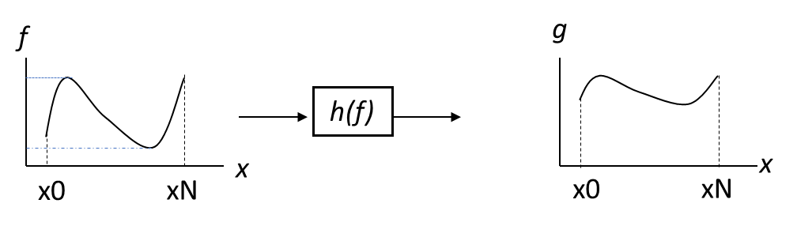
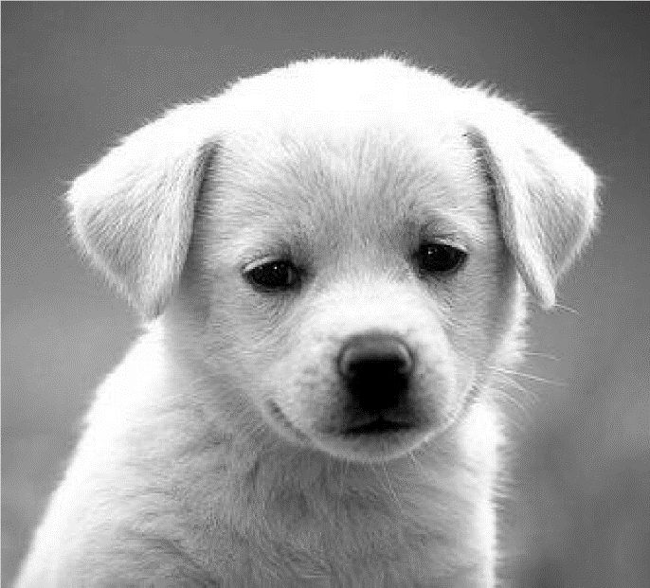

Image filtering
Image filtering: change the intensity range of image by considering its pixel value f(x) or neighboring pixel values to g(x).
g(x) = h(f(x))
h(f)
h(f)
Original Image
Result Image

Slide 5
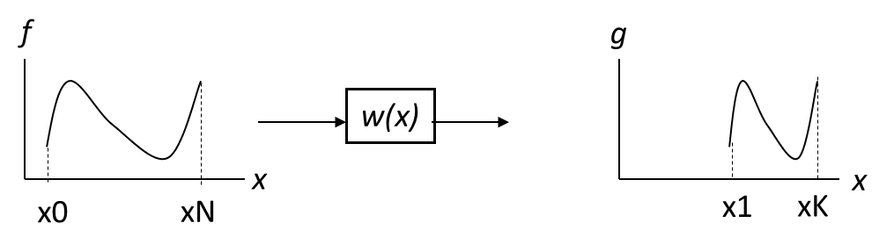
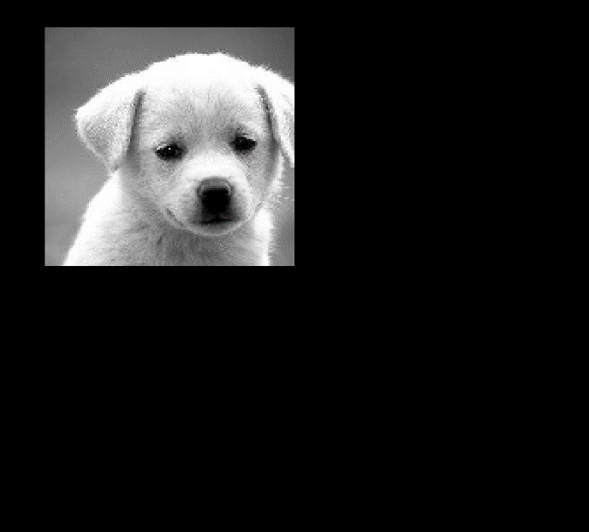
Geometric Mapping
Geometric Mapping : change domain of image coordinate, x by new coordinate w(x) by g(x) = f(w(x)).
g(x, y) = f(w(x, y))
w(x)
w(x, y)
Original Image
Result Image

Slide 6
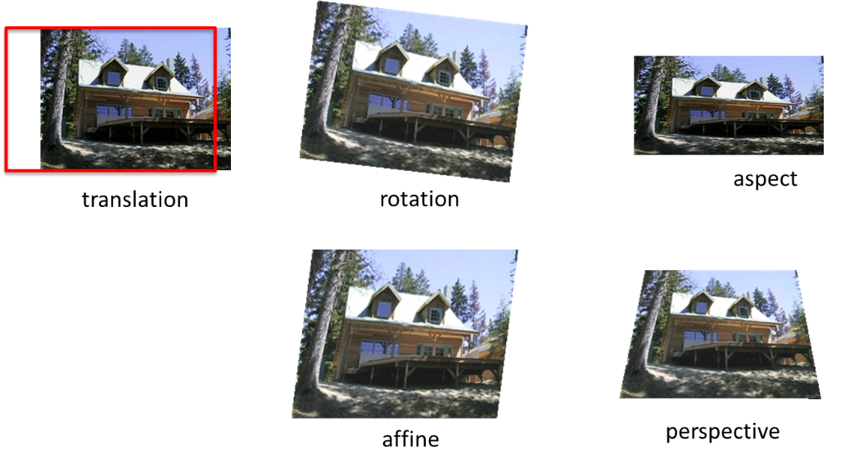
Example of Geometric warping

Slide 7
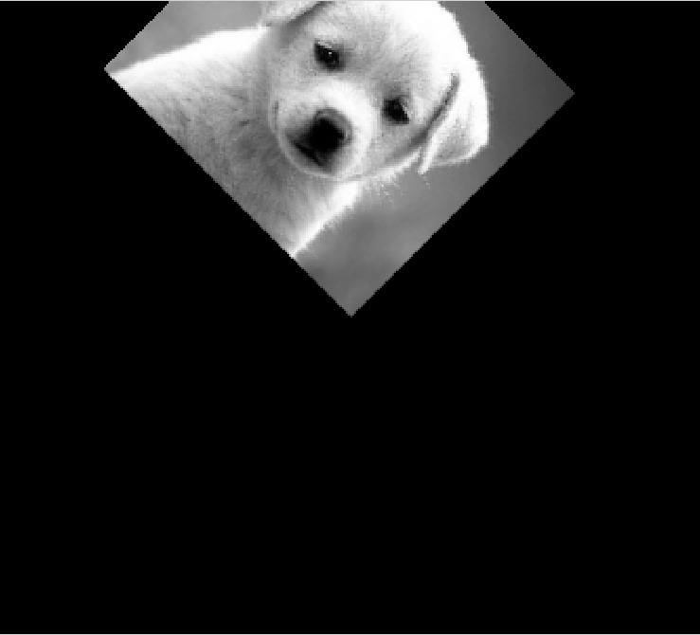
2x2 Linear Transformations
T(x, y)
T can represented by a matrix

Slide 8
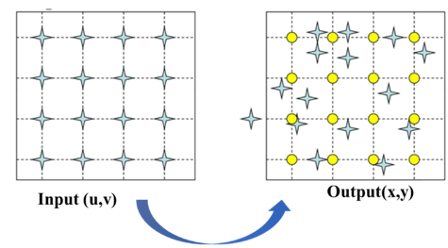
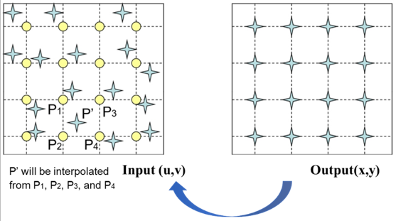
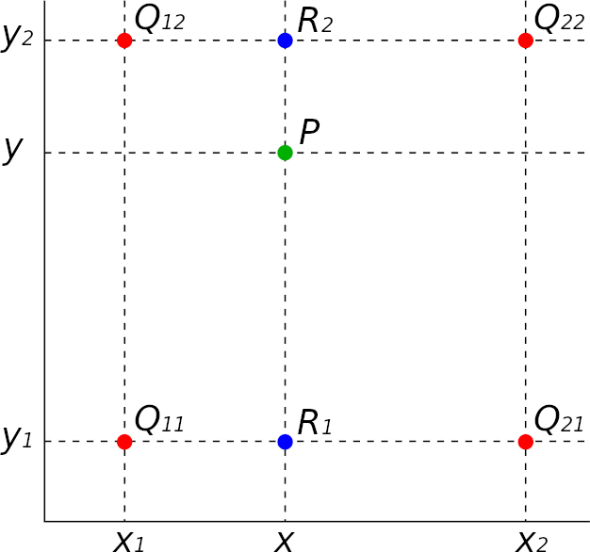

Forward mapping
Inverse mapping
Pixel are missed
T(u, v)
$T^{−1}$(x, y)
Map each source pixel to a new position in the destination image
Map each destination pixel back to the corresponding point in source
(x, y) often non-integer → Rounding to nearest pixel
(u, v) often non-integer → Need Interpolation in original image
Bilinear Interpolation
R₁(x, y) = Q₁₁ · (x₂ – x) / (x₂ – x₁) + Q₂₁ · (x – x₁) / (x₂ – x₁)
R₂(x, y) = Q₁₂ · (x₂ – x) / (x₂ – x₁) + Q₂₂ · (x – x₁) / (x₂ – x₁)
P(x, y) = R₁ · (y₂ – y) / (y₂ – y₁) + R₂ · (y – y₁) / (y₂ – y₁)
May leave holes in destination image - Some pixels are missed
More complete and higher-quality result

Slide 9



Scaling (Stretching or Squishing)
S(u, v)
$S^{−1}$(x, y)
Forward:
Inverse:

Slide 10
Rotation

Slide 11

Rotation
R(u, v)
$R^{−1}$(x, y)
Forward:
Inverse:

Slide 12

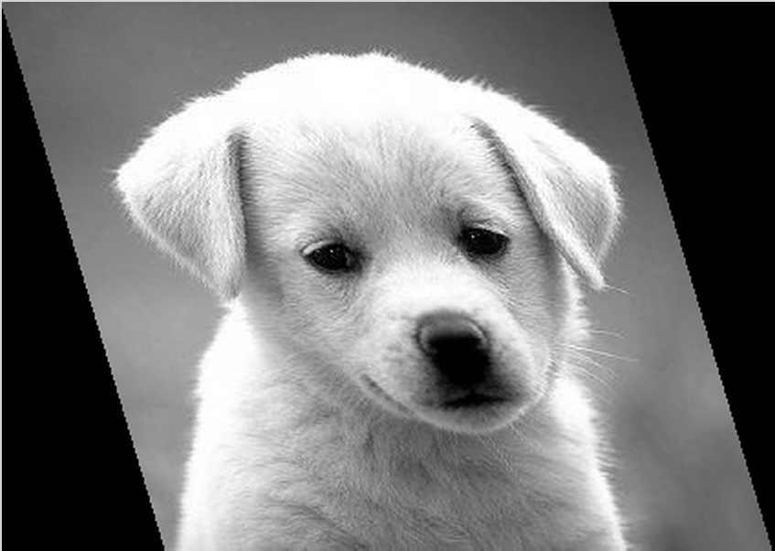
Skewing
Original Image
Horizontal Skew
Vertical Skew

Slide 13
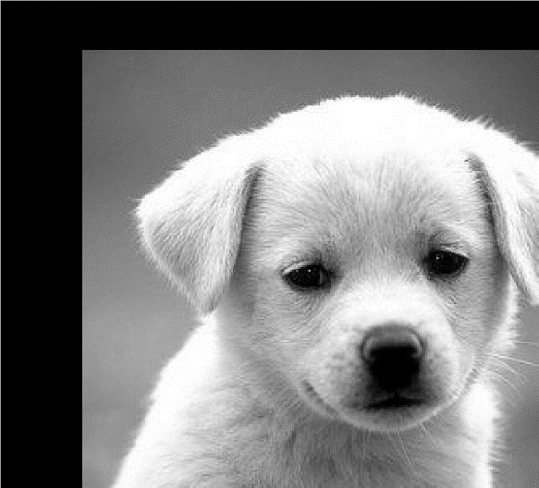

Translation
T(u, v)
$T^{−1}$(x, y)
Forward:
Inverse:
Problem: Translation can’t be expressed as 2x2 matrix

Slide 14
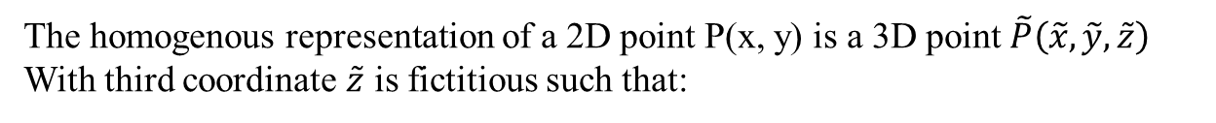

Homogenous Coordinates
The homogenous representation of a 2D point P(x, y) is a 3D point $\tilde{P}\left(\tilde{x}, \tilde{y}, \tilde{z}\right)$
With third coordinate $\tilde{z}$ is fictitious such that:
Find P from $\tilde{P}$:
(With $\tilde{z}$ $≠0)$

Slide 15

Translation
T(u, v)
$T^{−1}$(x, y)
Forward:
Inverse:

Slide 16
Scaling, Rotation
Forward:
Inverse:
Scaling
Rotation

