Slide 1
CANNY EDGE DETECTING
Notes:
Today I’ll be presenting on FUNDAMENTALS OF SPACTIAL FILLTERING
– a fundamental technique used to enhance image quality before deeper analysis.

Slide 5
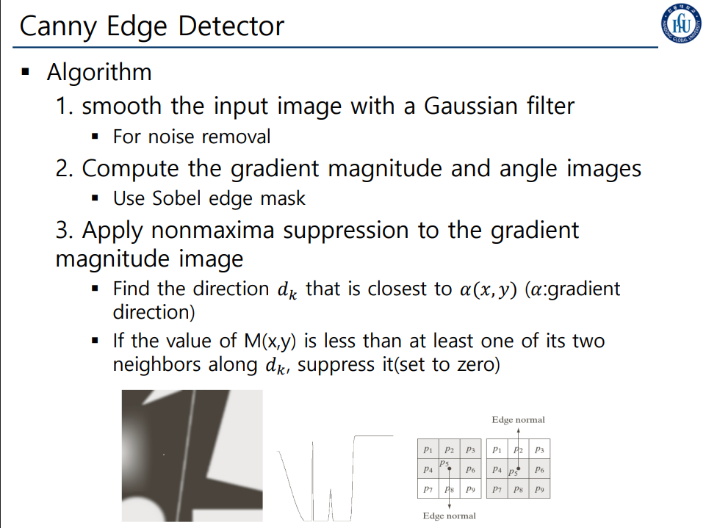

Slide 6
