Slide 1
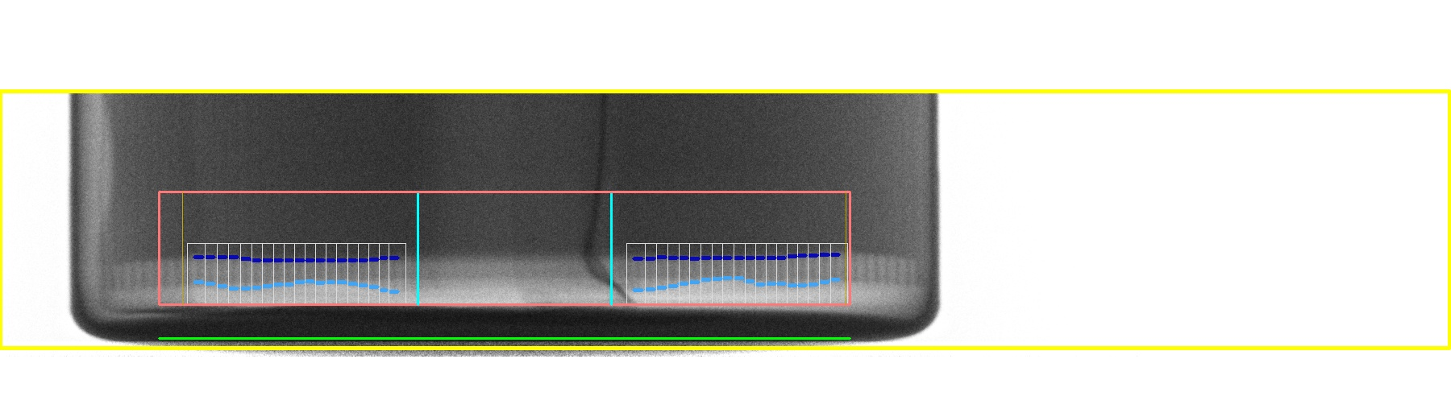
2. Pole Leaning
Pole Leaning Issue
Center of battery case
Pole Leaning detected position
d1=d2
Current Leaning ROI is the region between the two border padding line. So when user setting the border padding to big (dash line) to remove some boundary poles, there are no leaning information. So the algorithm worked incorrectly.
It also caused wrong center estimation (Green line). Neglect center region
Offset from the border padding line (pink line) by the distance d.
d1
d2
Neglect Center region
Border padding
Wrong Leaning Position

Slide 2
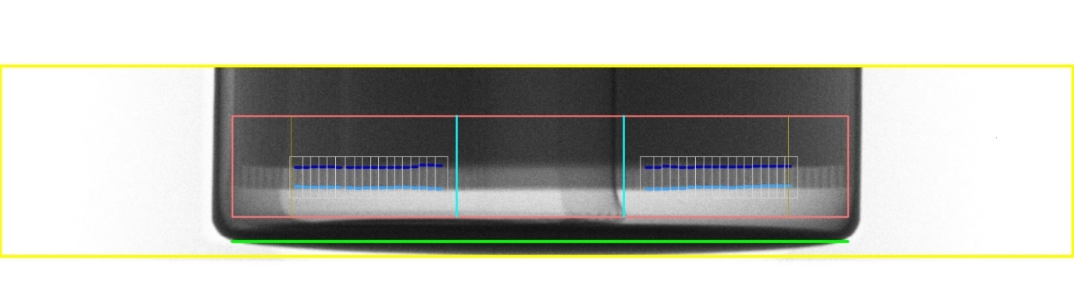
2. Pole Leaning
2. Pole Leaning Improvement
Pole Leaning detected position
Center of battery case
Update:
Pole Leaning ROI is the region between two red lines. Red line is offset from the border of the battery to 0.012* battery width.
After finding the Pole Leaning position. Adjust the affective range (battery center/neglect region) to the new value.
Border padding to remove unwanted pole will be calculated from the pole leaning detected positions (orange lines) then remove the poles in the setting range.
d1=d2
d1
d2
Affective range
Neglect Center region
Border padding

Slide 3
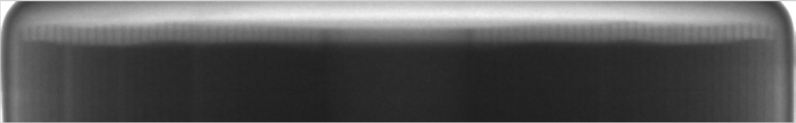
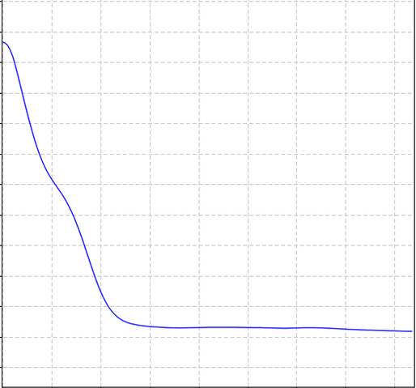
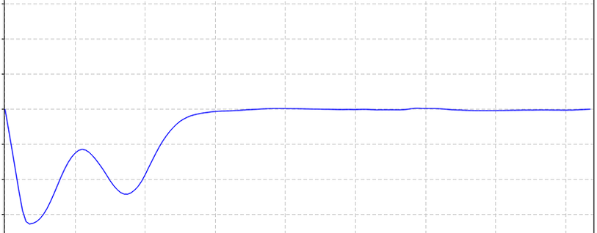
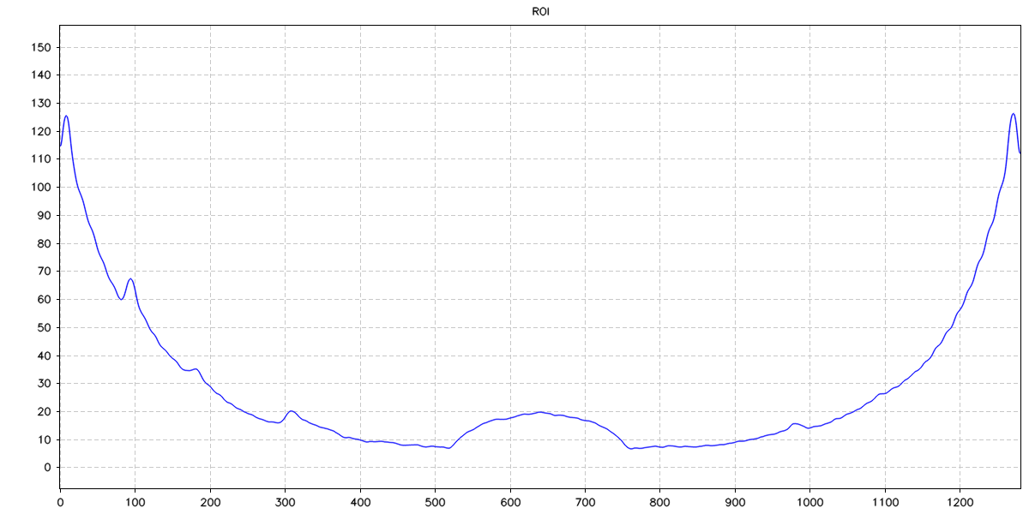
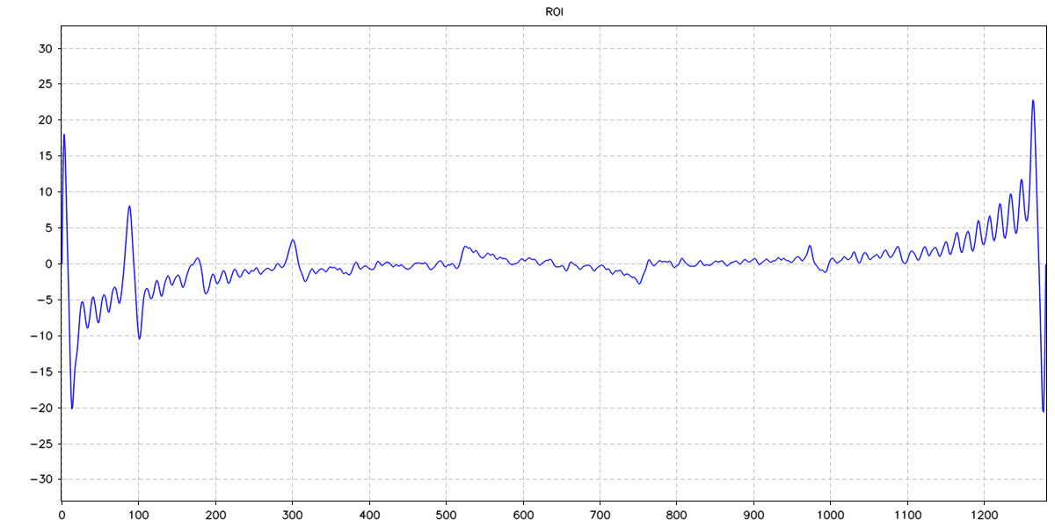
Step 4: Finding Leaning position(Auto)
ROI1
Definition ROI: Define ROI1 and ROI2 based on the specifications provided in Tables 1 and 2, respectively.
Horizontal Projection of ROI2: Horizontal projection across ROI2 to detect intensity variations.
Valley Detection and Selection: Identify valleys within ROI2. Select the first valley encountered while scanning from bottom to top that satisfies the condition "prominence > 0.5.“
ROI3 Creation: Based on the position of the chosen valley, establish a new ROI3.
Vertical projection and Sobel Operator: Perform a vertical scan of ROI3. Employ the Sobel operator to detect discrepancies in pixel intensity within ROI3.
Image Segmentation: Divide the entire image into twelve equal sections. Determine the leftmost and rightmost boundaries for each section (typically visualized as red dashed lines).
Check condition leaning:
if: index < limLeft && value < -15 : valley is leaning line
if: index > limRight && value > 15 : peak is leaning line
ROI2
ROI3
Horizontal
Projection of
ROI2
The difference
y axis
y axis
value
value
Vertical projection of ROI3
limLeft
limRight
Peak
(Leaning
position)
15
The difference(sobel)
Padding = battery width * 0.012
ROI1
x1 | batteryROI.x
y1 | A2.y + JR ROI Y
width1 | batteryROI.width
height1 | Pole region height
ROI2
x2 | x1 + padding
y2 | y1 + 2*padding
width2 | width1 – 2*padding
height2 | height1 – y2
-15
Valley(leaning position)

Slide 4
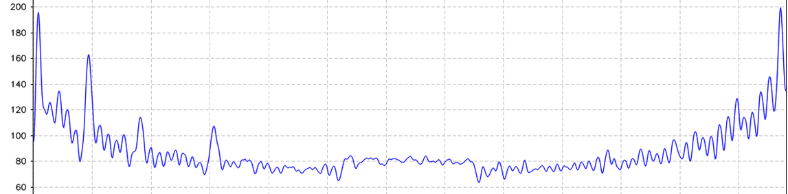
Step 4: Finding Leaning position(Manual)
If Threshold to Determine Pole Leaning > 0 && < 255 : check leaning by Manual
ROI1
Refined ROI3 Definition: Create a new Region of Interest (ROI3) by extracting two-thirds of the area from ROI2.
CLAHE and Vertical Projection: Apply CLAHE (Contrast Limited Adaptive Histogram Equalization) to the refined ROI3. Subsequently, perform vertical projection on the processed ROI3 to extract relevant information.
ROI3 Segmentation: Divide the refined ROI3 into twelve sections of equal size.
Check condition leaning:
Intensity previous column > thd & Intensity next column < thd : left leaning
Intensity previous column <thd & Intensity next column > thd : right leaning
ROI2
ROI3
LimLeft
LimRight
ROI3
Leaning position
Thd
Padding = battery width * 0.012
ROI1
x1 | batteryROI.x
y1 | A2.y + JR ROI Y
width1 | batteryROI.width
height1 | Pole region height
ROI2
x2 | x1 + padding
y2 | y1 + 2*padding
width2 | width1 – 2*padding
height2 | height1 – y2
Vertical projection of ROI3

