Slide 1
Timeline
DATE | TOPICS | RELATED TOPIC
05/5/2025 – 09/5/2025 | Basic transformations: Negative, Power Law, Log, Piecewise Linear stretching, Thresholding. Histogram analysis: Histogram Equalization, Histogram Matching, Contrast Local Adaptive Histogram Equalization. | Basic transformations & Histogram analysis
12/5/2025 - 16/5/2025 | Correlation and Convolution, Box filter, Gaussian Filter, Median filter. Resize images, Nearest Neighbor Interpolation, Linear Interpolation, Bilinear Interpolation. | Fundamentals of Spatial filtering
19/5/2025 – 21/5/2025 22/5/2025 – 23/5/2025 | Sobel filter: Derivative in detecting edge, Gradient, Sensitivity of derivatives to noise, Sobel Filter Program Bilateral filter: Compare Bilateral Filter and Gaussian Filter, My implementation program | Sobel filter Bilateral filter
26/5/2025 – 28/5/2025 29/5/2025 – 30/5/2025 | Canny edge detecting: Gradient, Non-Maximum Suppression, Hysteresis threshold, My implementation program Morphological Image Processing: Dilation, Erosion, Opening, Closing | Canny edge detecting, Morphological Image Processing
02/6/2025 – 04/6/2025 | Morphological Image Processing: Hit or miss transform, Boundary Extraction, Thinning, Skeleton. | Morphological Image Processing
04/6/2025 – 06/06/2025 | Thresholding | Thresholding
09/6/2025 – 11/6/2025 | Template Matching | Template Matching

Slide 2
TEMPLATE MATCHING

Slide 3
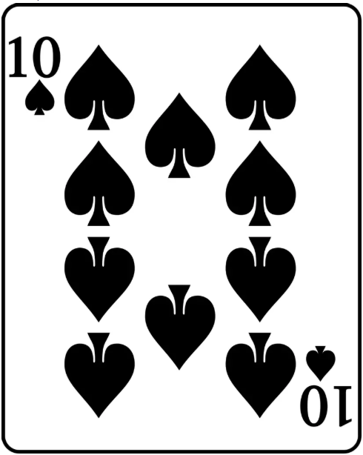

Introduction
Template matching
Definition: A technique in image processing to locate a smaller image (template) within a larger image by comparing pixel intensities.
Goal: Identify the position of the template in the source image with the highest similarity or lowest difference.
Applications:
Object detection (e.g., logos, faces).
Feature extraction in computer vision.
Motion tracking in video sequences.
Image
Template
Result of
Template Matching
Notes:
Là một kỹ thuật phân đoạn ảnh (image segmentation) đơn giản nhưng rất hiệu quả, dùng để phân chia ảnh mức xám thành các vùng dựa trên giá trị độ sáng (intensity).

Slide 4
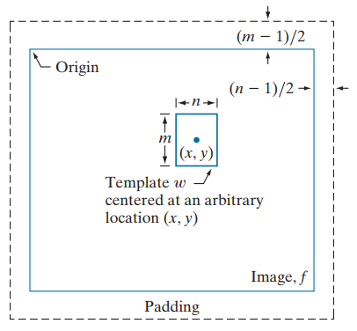
Core Principle
Template: A small image (e.g., a logo or object) to be matched.
Source Image: A larger image where the template is expected to appear.
Process:
Slide the template over the source image pixel by pixel. (Similar to correlation 2D)
At each position, compute a similarity or difference metric.
Identify the position with the best match
Method in OpenCV to compute a similarity or difference metric:
Sum of Squared Differences (TM_SQDIFF)
Normalized Sum of Squared Differences (TM_SQDIFF_NORMED)
Cross-Correlation (TM_CCORR)
Normalized Cross-Correlation (TM_CCORR_NORMED)
Correlation Coefficient(TM_CCOEFF)
Normalized Correlation Coefficient (TM_CCOEFF_NORMED)

Slide 5

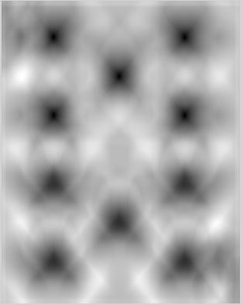

Sum of Squared Differences (TM_SQDIFF)
Measures the sum of squared pixel intensity differences between template and image region.
T: Template pixel intensity
I: Image pixel intensity.
Lower values indicate better matches (perfect match = 0).
Pros: Simple, fast for small templates.
Cons: Sensitive to noise
Image
Template
Result of
Template Matching
Notes:
In noisy environments, it is highly sensitive because noise alters pixel intensities, leading to incorrect matching. As a result, the accuracy of object detection may be low in many practical scenarios.

Slide 6

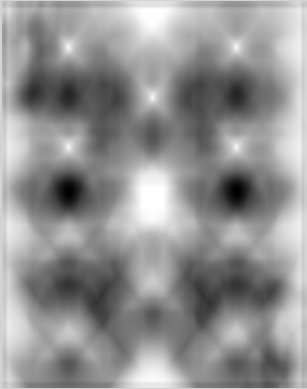
Cross-Correlation (TM_CCORR)
Measures the correlation between template and image region by multiplying intensities. This method relies more on the degree of pixel-wise matching (dot-product) rather than just the difference in brightness levels.
T: Template pixel intensity
I: Image pixel intensity.
Correlation has its highest value(s) in the region(s) where I and T are equal or nearly equal.
Higher values indicate better matches.
Pros: Simple, sensitive to pattern similarity.
Cons: Highly sensitive to brightness changes
Image
Template
Result of
Template Matching

Slide 7
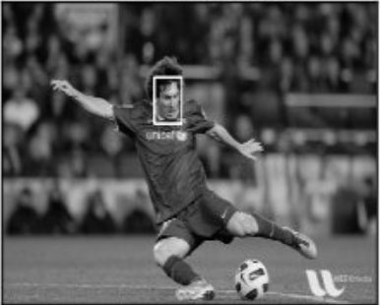

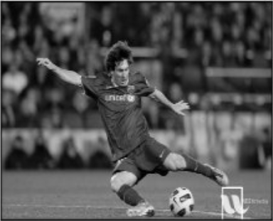
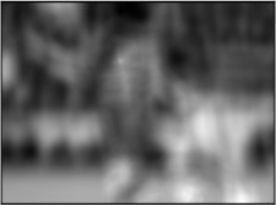



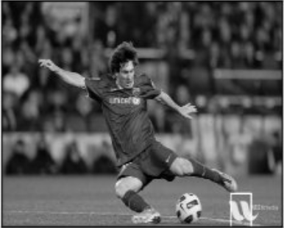
Limit of Cross-Correlation method
Expected point
Expected result
Image
Template
Detected wrong place point
Result
Notes:
It does NOT subtract the mean intensity from either the template or the image patch.
Because of this, if the overall brightness of the image region or template changes uniformly (e.g., brighter or darker lighting), the correlation value will be affected accordingly.
If the image region is brighter than the template, the correlation will increase even if the actual pattern doesn't match well.
If the image region is darker, the correlation decreases, potentially lowering matching accuracy.
Therefore, TM_CCORR is not suitable when the lighting conditions differ between the template and the target image.

Slide 8

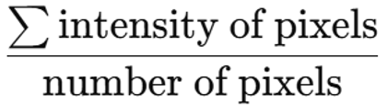
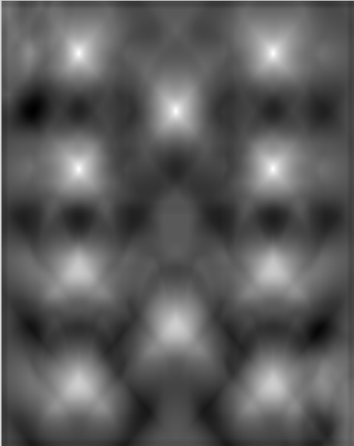
Correlation Coefficient(TM_CCOEFF)
Measures correlation after subtracting mean intensities of template and image region.
T: Template pixel intensity
I: Image pixel intensity.
Mean intensity =
Higher values indicate better matches.
Pros: Less sensitive to linear intensity shifts
than TM_CCORR.
Image
Template
Result of
Template Matching

Slide 9
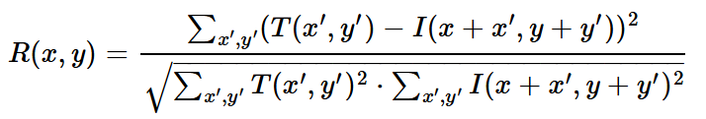
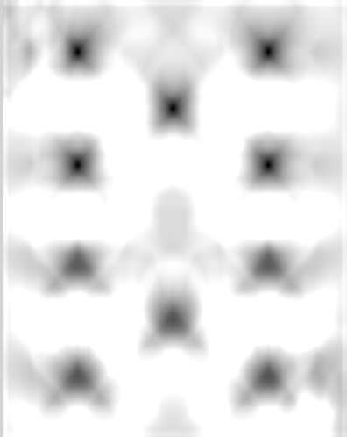
Normalized Sum of Squared Differences (TM_SQDIFF_NORMED)
Normalization reduces the influence of changes in brightness or contrast by scaling the values to a standard form.
This methid Normalizes Sum of Squared Differences to account for intensity variations:
T: Template pixel intensity
I: Image pixel intensity.
The result values range between 0 (perfect match) and 1 (worst match).
Brightness or contrast changes have less impact.
Image
Template
Result of
Template Matching

Slide 10
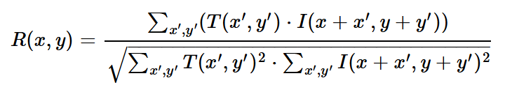
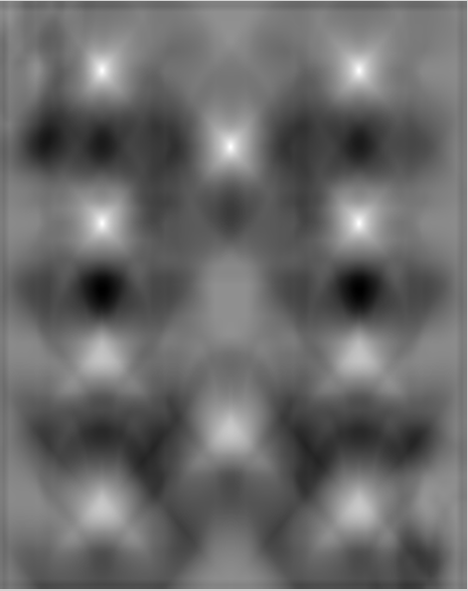
Normalized Cross-Correlation (TM_CCORR_NORMED)
Normalizes cross-correlation to reduce sensitivity to intensity variations
T: Template pixel intensity
I: Image pixel intensity.
Output range: [-1, 1] (1 = perfect match).
Robust to linear brightness and contrast changes.
Image
Template
Result of
Template Matching

Slide 11
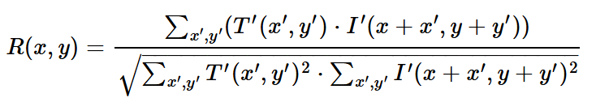
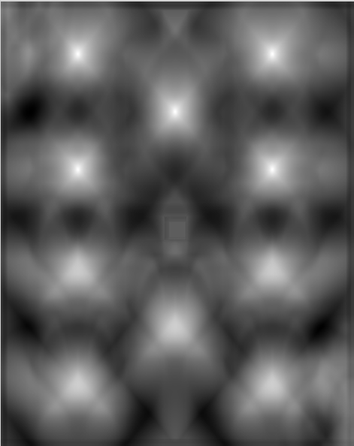
Normalized Correlation Coefficient (TM_CCOEFF_NORMED)
Normalizes the correlation coefficient for robustness to intensity variations.
T: Template pixel intensity
I: Image pixel intensity.
Mean intensity =
Output range: [-1, 1] (1 = perfect match).
Highly robust to linear brightness/contrast changes.
Image
Template
Result of
Template Matching

Slide 12
Comparing the Methods
No. | Enumerator | Characteristic | Match | Complexity | Accuracy
1 | TM_SQDIFF | Fast, sensitive to lighting | min value | Very Low (Fast) | Medium
2 | TM_SQDIFF_NORMED | Normalized, better for lighting changes | min value | Low–Medium | Fair
3 | TM_CCORR | Fast, sensitive to brightness | max value | Low | Medium
4 | TM_CCORR_NORMED | Robust to lighting | max value | Medium | Good
5 | TM_CCOEFF | Handles intensity shifts | max value | Medium–High | Good
6 | TM_CCOEFF_NORMED | Most robust | max value | High | Best
Note: All 6 methods do not support rotation or scale changes.

Slide 13
Recommendations by Use Case
Use Case | Recommended Method
Highest accuracy and lighting robustness | TM_CCOEFF_NORMED
Fastest computation | TM_SQDIFF, TM_CCORR
Handles lighting variation | TM_CCOEFF_NORMED, TM_CCORR_NORMED
Some noise in the image | TM_CCOEFF_NORMED, TM_SQDIFF_NORMED
Very simple or low-texture template | Avoid TM_CCOEFF, prefer TM_CCORR_NORMED

Slide 14
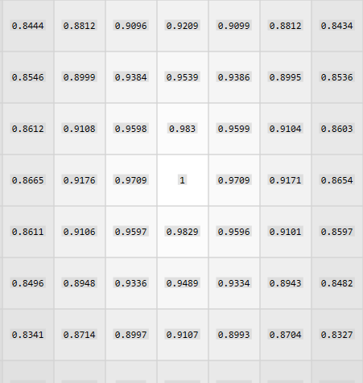

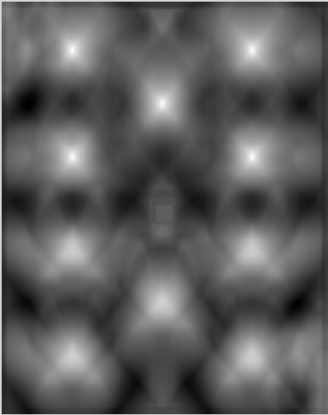
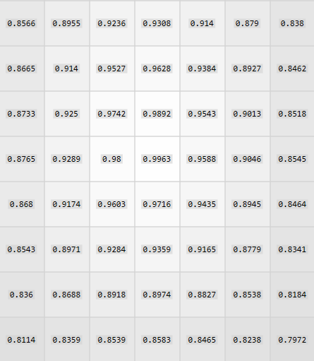
Program
Step 1: Load Image and Template in grayscale mode
Step 2: Choose a template matching method: TM_SQDIFF_NORMED, TM_SQDIFF_NORMED, TM_CCORR, …
Step 3: Slide the template over the image:
Perform template matching to generate a result matrix, which contains similarity scores at each location. (using the formula corresponding to each method)
Perfect match
location with the template
High similarity location with the template
Image
Template
Result matrix

Slide 15
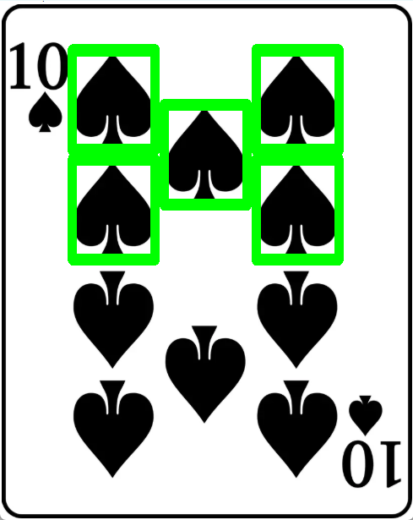
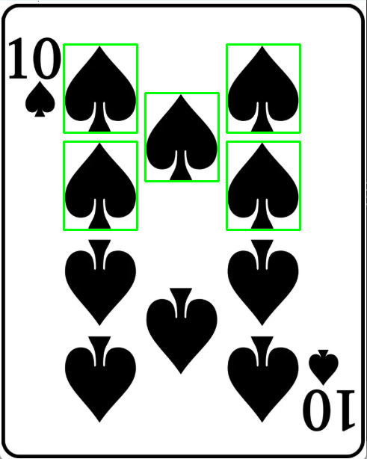
Program
Step 4: Apply thresholding:
Set a threshold value to filter out low-confidence matches.
Extract coordinates where similarity values are above the threshold.
Step 5: Apply Non-Maximum Suppression (NMS):
Eliminate overlapping matches by:
Identifying overlapping regions based on coordinates and template size.
Keeping only the match with the highest similarity score in each overlapping region.
Step6: Process the final results:
Draw bounding boxes around the final matched regions on the source image.
Results without using NMS
Results when using NMS
Notes:
Lý do có nhiều các đường bao dày lên như vậy là do có nhiều bounding box bị vẽ đè lên nhau. Để loại bỏ bớt các bạn có thể sử dụng thuật toán như Non Maximum Suppression.

Slide 16
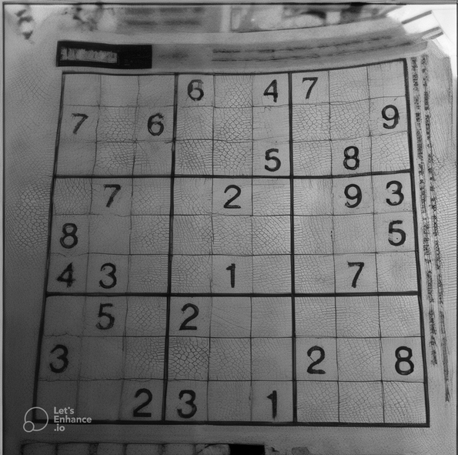
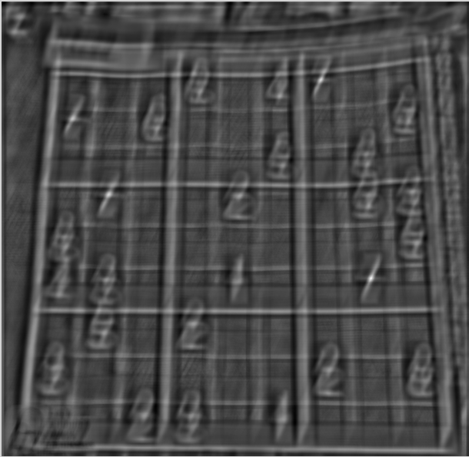
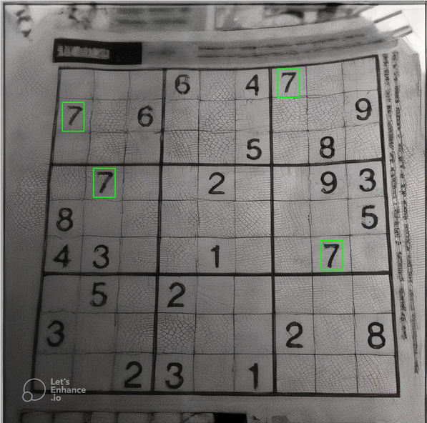
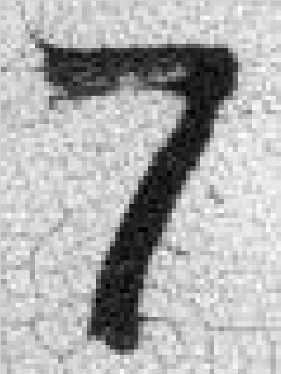
Example
Image
Template
scaled
Result matrix
TM_CCOEFF_NORMED
Result image
Threshold = 0.6

Slide 17
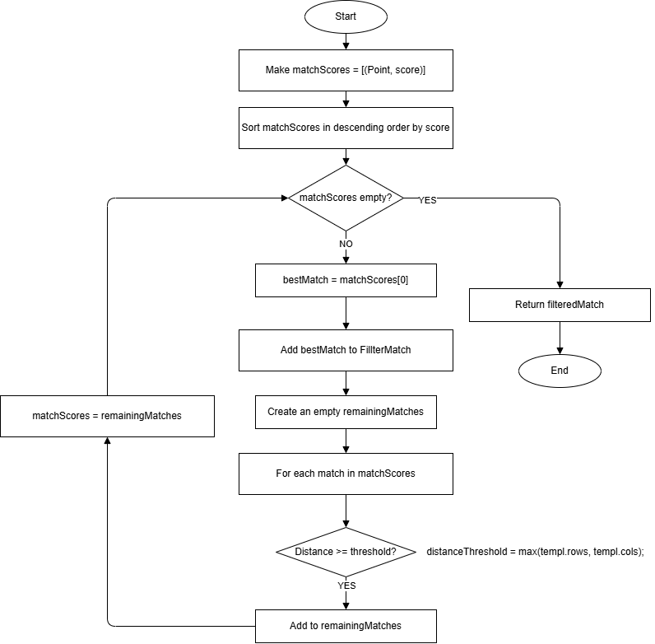
Non – Maximum Suppression

