Slide 1
Timeline
DATE | TOPICS | RELATED TOPIC
05/5/2025 – 09/5/2025 | Basic transformations: Negative, Power Law, Log, Piecewise Linear stretching, Thresholding. Histogram analysis: Histogram Equalization, Histogram Matching, Contrast Local Adaptive Histogram Equalization. | Basic transformations & Histogram analysis
12/5/2025 - 16/5/2025 | Correlation and Convolution, Box filter, Gaussian Filter, Median filter. Resize images, Nearest Neighbor Interpolation, Linear Interpolation, Bilinear Interpolation. | Fundamentals of Spatial filtering
19/5/2025 – 21/5/2025 22/5/2025 – 23/5/2025 | Sobel filter: Derivative in detecting edge, Gradient, Sensitivity of derivatives to noise, Sobel Filter Program Bilateral filter: Compare Bilateral Filter and Gaussian Filter, My implementation program | Sobel filter Bilateral filter
26/5/2025 – 28/5/2025 29/5/2025 – 30/5/2025 | Canny edge detecting: Gradient, Non-Maximum Suppression, Hysteresis threshold, My implementation program Morphological Image Processing: Dilation, Erosion, Opening, Closing | Canny edge detecting, Morphological Image Processing
02/6/2025 – 04/6/2025 | Morphological Image Processing: Hit or miss transform, Boundary Extraction, Thinning, Skeleton. | Morphological Image Processing
04/6/2025 – 06/06/2025 | Thresholding | Thresholding
09/6/2025 – 11/6/2025 12/6/2025 – 13/06/2025 | Template Matching Hough Transform | Template Matching Hough Transform

Slide 2
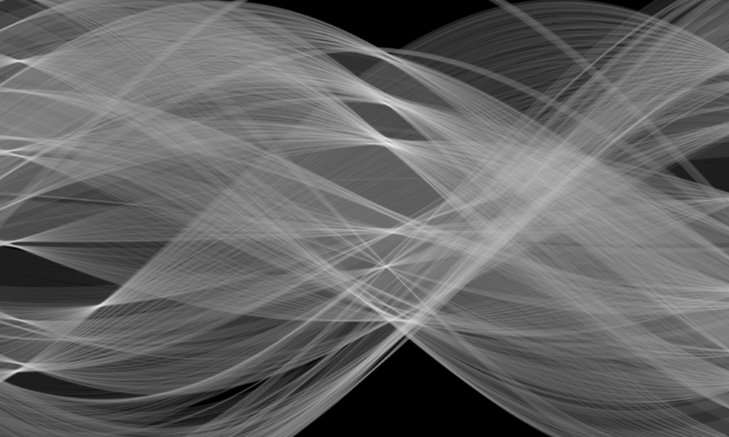
HOUGH TRANSFORM

Slide 3
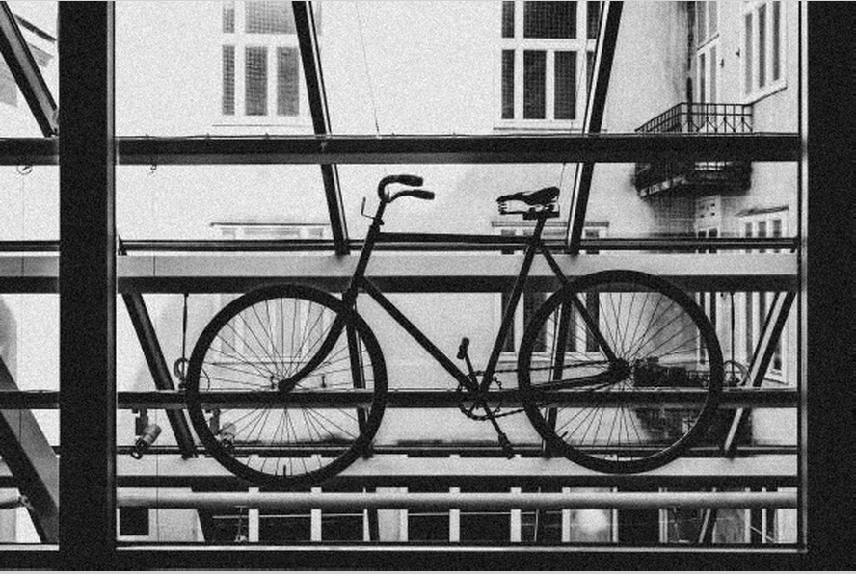
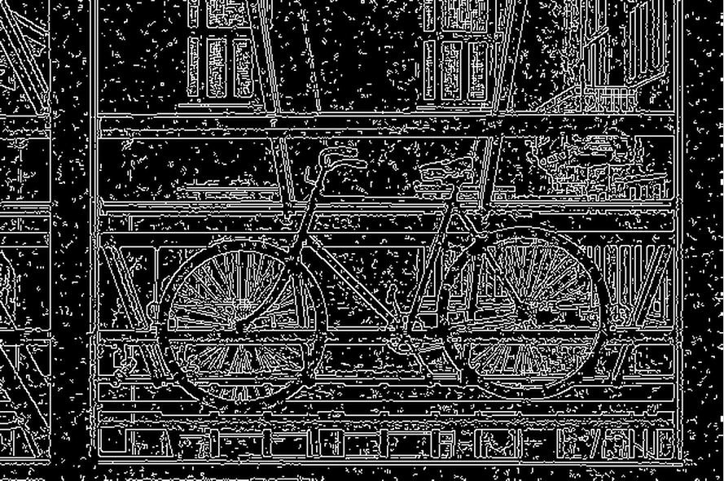
Introduction
Objective: find the two wheels of the bicycle, which can be described as circles
Image
Result of Canny Edge detection
T1 = 50, T2 = 150
Challenge:
Extraneous data: Which point to fit to the circle
Incomplete data: Only part of the model is visible
Noise
Solution: Hough Transform
Notes:
We can see the circles in the edge map, but we also see lots of other stuff
In the case of the bicycle, not all edges on the two wheels have been detected, creating some large gaps between the detected edges
Finally, we have noise — some of the edges on the wheel may be detected away from the wheel, and there may be other edges close to the wheel that do not correspond to the wheel
The Hough transform, gives us a powerful way to deal with these three problems in one shot. It works very well for simple shapes that can be described using a small number of parameters

Slide 4
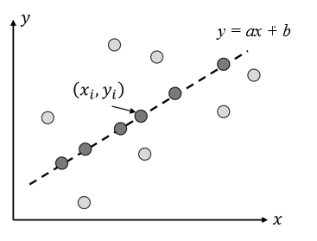

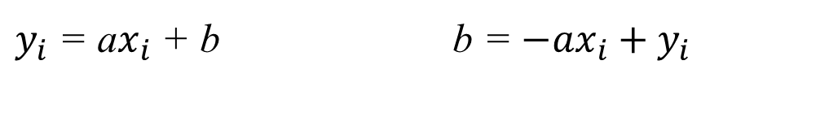
Line detection
Task: Detect line
y = ax + b
a: slope
b: y-intercept
Consider point ($x_{i}$, $y_{i})$
$y_{i}$ = a$x_{i}$ + b b = ${−{ax}_{i}+y}_{i}$
x-y space
Notes:
Let us take a look at how the Hough transform works for the simplest of all shapes: the straight line
This allows us to consider the problem in 2 spaces

Slide 5





Hough Transform concept
Image space
Parameter space
($x_{j}$, $y_{j})$
($a$, b$)$
($x_{i}$, $y_{i})$
$y_{i}$ = a$x_{i}$ + b
b = ${−{ax}_{i}+y}_{i}$
Point
Line
Line
Point
Notes:
So it is very interesting how there thing work out in image space and the parameter space
A point in image space maps to a line in parameter space, while a line in image space ends up as a point in parameter space. Based on this observation, we can create an algorithm to detect straight lines

Slide 6
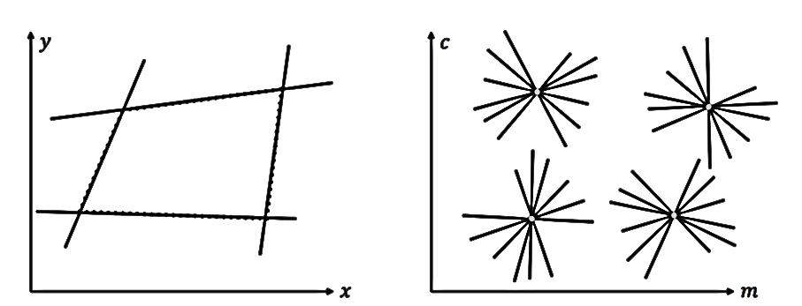
Multiple line detection
Image space
Parameter space

Slide 7
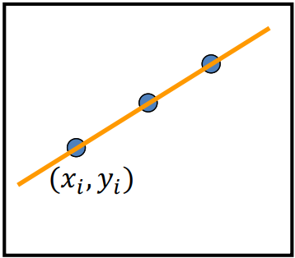

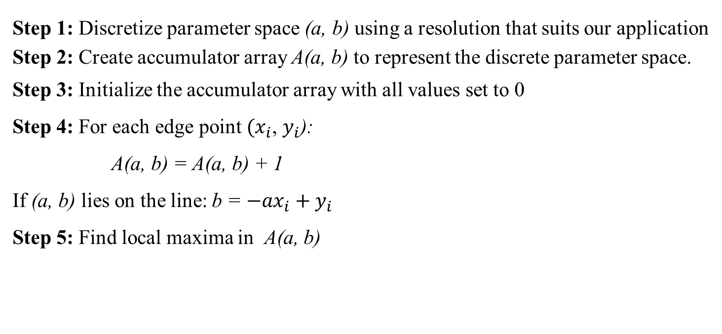

Line Detection Algorithm
Step 1: Discretize parameter space (a, b) using a resolution that suits our application
Step 2: Create accumulator array A(a, b) to represent the discrete parameter space.
Step 3: Initialize the accumulator array with all values set to 0
Step 4: For each edge point $(x_{i}$, $y_{i}$):
A(a, b) = A(a, b) + 1
If (a, b) lies on the line: b = ${−{ax}_{i}+y}_{i}$
Step 5: Find local maxima in A(a, b)
Image
$$A(a, b)$$
a
0
1
0
0
0
0
1
0
0
1
0
0
0
1
1
1
3
1
1
0
0
0
1
0
0
2
0
0
0
0
1
0
1
0
0
0
0
0
1
1
$$b$$
Accumulator array
Notes:
Consider all discrete values of a. For each value of a, a corresponding value of b that satisfies the equation b=−axi+yib = -a x_i + y_ib=−axi​+yi​ will be obtained. After finding the value of b corresponding to the value of a, increment the cell at coordinates (a, b) by 1.
The result obtained, as we can see, is a straight line in the parameter space. Where the two lines in parameter space intersect, we will get a 2 in the accumulator array If we have multiple lines in the image, we will get several local maxima in the accumulator array.

Slide 8
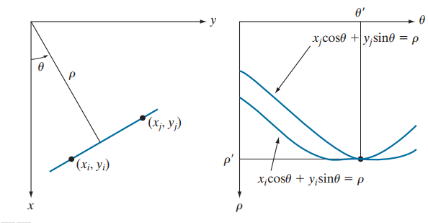
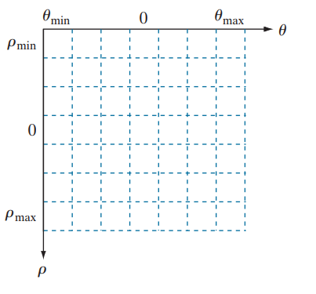
Problem with the hough transform
y = ax + b
Issue:
Slope of the line -∞ ≤ a ≤ ∞. As the line becomes vertical, the slope approaches infinity. (a = tan(θ))
Large Accumulator
More memory and computation
Solution:
Use other representation of a line:
ρ: the perpendicular distance from the origin to the line. → Distance ρ$≤S$ize of the image
θ: is the angle of the normal to the line with respect to the x-axis. → Orientation θ is finite: -$π$ ≤ θ <$π$
Image space
(x-y space)
Parameter space
(ρ-θ space)
Division of the ρ-θ-plane
into accumulator cells.

Slide 9
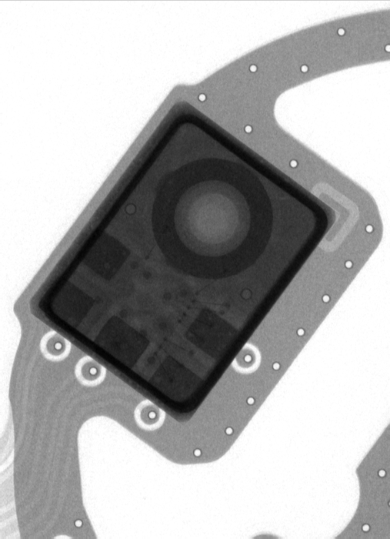
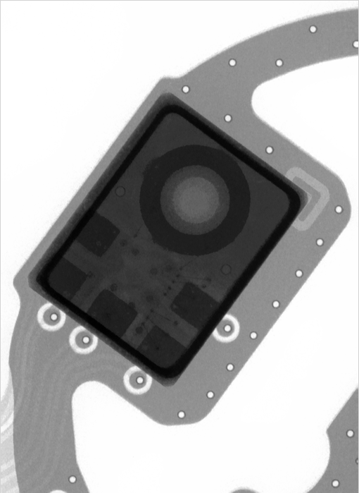
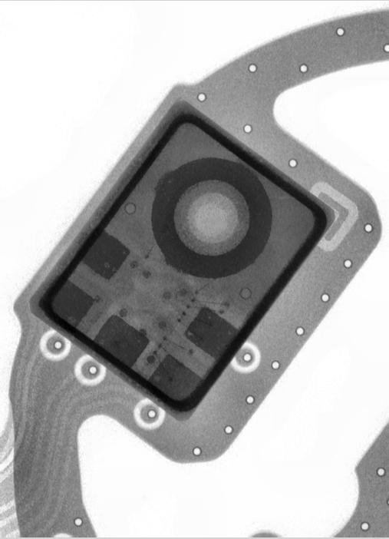
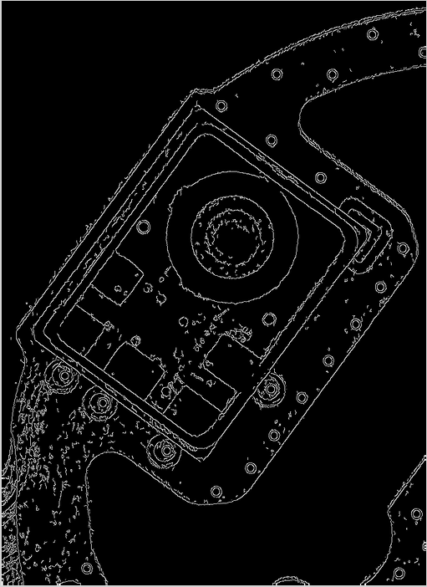
Result
Bilateral
Filter
CLAHE
Canny
Original Image

Slide 10

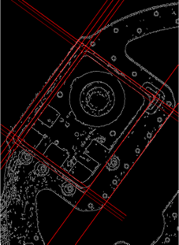
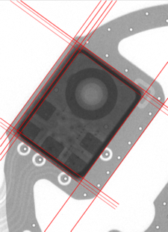
Result
Drawing result on canny edge image
Drawing result on original image
Result of Hough Transform with:
Distance resolution of the accumulator in pixels = 1
Angle resolution of the accumulator in radians = 180 (1 degree)
Threshold (Minimum number of votes (intersections in Hough accumulator) to consider a line) = 160

Slide 11

Hough Transform: Circle Detection
y
r
b
a
x
Equation of circle:
${(x_{i}−a)}^{2}+ {(y_{i}−b)}^{2}$ = $r^{2}$

Slide 12






Hough Transform: Circle Detection
If radius r is know
Image space
Parameter space
y
$$b$$
$(x_{i}$, $y_{i}$)
$(x_{i}$, $y_{i}$)
x
$$a$$
${(x_{i}−a)}^{2}+ {(y_{i}−b)}^{2}$ = $r^{2}$
${({a−x}_{i})}^{2}+ {({b−y}_{i})}^{2}$ = $r^{2}$

Slide 13

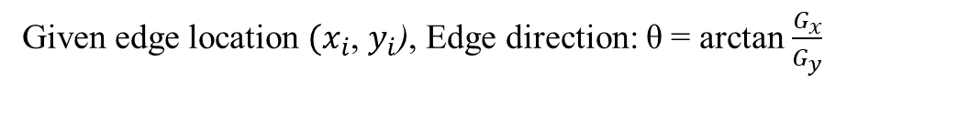

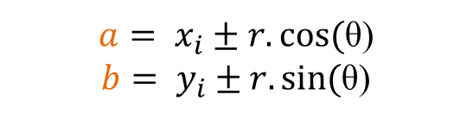


Using Gradient Information
Given edge location $(x_{i}$, $y_{i}$), Edge direction: θ = arctan $\frac{G_{x}}{G_{y}}$
Image space
Parameter space
y
$$b$$
$$r$$
θ
$$y_{i}$$
$$r$$
$(x_{i}$, $y_{i}$)
x
$$x_{i}$$
$$a$$
${(x_{i}−a)}^{2}+ {(y_{i}−b)}^{2}$ = $r^{2}$
$a= x_{i}±r.cos⁡($θ)
$b= y_{i}±r.sin⁡($θ)

Slide 15
