Slide 1
Timeline
DATE | TOPICS | RELATED TOPIC
05/5/2025 – 09/5/2025 | Basic transformations: Negative, Power Law, Log, Piecewise Linear stretching, Thresholding. Histogram analysis: Histogram Equalization, Histogram Matching, Contrast Local Adaptive Histogram Equalization. | Basic transformations & Histogram analysis
12/5/2025 - 16/5/2025 | Correlation and Convolution, Box filter, Gaussian Filter, Median filter. Resize images, Nearest Neighbor Interpolation, Linear Interpolation, Bilinear Interpolation. | Fundamentals of Spatial filtering
19/5/2025 – 21/5/2025 22/5/2025 – 23/5/2025 | Sobel filter: Derivative in detecting edge, Gradient, Sensitivity of derivatives to noise, Sobel Filter Program Bilateral filter: Compare Bilateral Filter and Gaussian Filter, My implementation program | Sobel filter Bilateral filter
26/5/2025 – 28/5/2025 29/5/2025 – 30/5/2025 | Canny edge detecting: Gradient, Non-Maximum Suppression, Hysteresis threshold, My implementation program Morphological Image Processing: Dilation, Erosion, Opening, Closing | Canny edge detecting, Morphological Image Processing

Slide 2
MORPHOLOGICAL IMAGE PROCESSING

Slide 3

Introduction
The word morphology commonly denotes a branch of biology that deals with the form and structure of animals and plants
We use the same word here in the context of mathematical morphology as a tool for extracting image components that are useful in the representation and description of region shape, such as
Boundaries extraction
Skeletons
Convex hull.
Morphological filtering
Thinning
Pruning
The operation are particularly useful for the analysis of binary images
Notes:
Morphology in image processing is a tool for extracting image components that are useful in the representation and description of region shape, such as boundaries and skeletons.
•Furthermore, the morphological operations can be used for filtering, thinning and pruning.

Slide 4
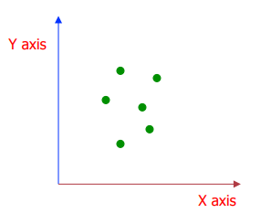
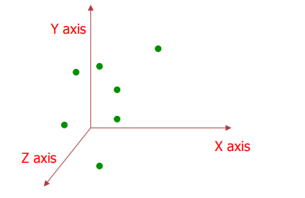


Representing Objects by sets
The language of mathematical morphology is set theory Objects in an image are represented by sets in mathematical morphology.
Binary image: the element of the set is the coordinates (x, y) of pixel belong to the object $Z^{2}$
Gray-scaled image: the element of the set is the coordinates (x, y) of pixel belong to the object and the gray levels $Z^{3}$
$$Z^{2}$$
$$Z^{3}$$
Notes:
The language of mathematical morphology is set theory. As such, morphology offers a unified and powerful approach to numerous image processing problems. When working with images, sets in mathematical morphology represent objects in those images. In binary images, the sets in question are members of the 2-D integer space Z2, where each element of a set is a tuple (2-D vector) whose coordinates are the coordinates of an object (typically foreground) pixel in the image. Grayscale digital images can be represented as sets whose components are in Z3. In this case, two components of each element of the set refer to the coordinates of a pixel, and the third corresponds to its discrete intensity value. Sets in higher dimensional spaces can contain other image attributes, such as color and time-varying components.

Slide 5
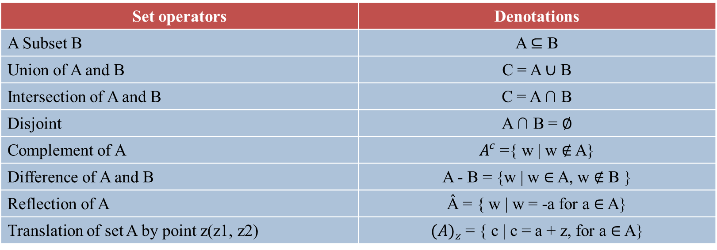
Representing Objects by sets
Basic Set Operators
Set operators | Denotations
A Subset B | A ⊆ B
Union of A and B | C = A ∪ B
Intersection of A and B | C = A ∩ B
Disjoint | A ∩ B = ∅
Complement of A | $A^{c}$ ={ w | w ∉ A}
Difference of A and B | A - B = {w | w ∈ A, w ∉ B }
Reflection of A | Â = { w | w = -a for a ∈ A}
Translation of set A by point z(z1, z2) | ${(A)}_{z}$= { c | c = a + z, for a ∈ A}
Notes:
The language of mathematical morphology is set theory. As such, morphology offers a unified and powerful approach to numerous image processing problems. When working with images, sets in mathematical morphology represent objects in those images. In binary images, the sets in question are members of the 2-D integer space Z2, where each element of a set is a tuple (2-D vector) whose coordinates are the coordinates of an object (typically foreground) pixel in the image. Grayscale digital images can be represented as sets whose components are in Z3. In this case, two components of each element of the set refer to the coordinates of a pixel, and the third corresponds to its discrete intensity value. Sets in higher dimensional spaces can contain other image attributes, such as color and time-varying components.

Slide 6

Basic Set Theory
A
A
A
A ∪ B
A ∩ B
B
B
B
Union of A and B
Intersection of A and B
A Subset B
B
A
A
A
A – B
B
$A^{c}$
A Subset B
Complement of A
Difference of A and B

Slide 7



Translation and Reflection
Translation of set A by point z($z_{1}$, $z_{2}$)
${(A)}_{z}$= { c | c = a + z, for a ∈ A}
Reflection of A (rotation by 180° about the origin
Â = { w | w = -a for a ∈ A}
$$z_{2}$$
$$z_{1}$$
Â
A
Reference point

Slide 8
Logic Operations
p | q | AND p . q | OR p + q | NOT p
0 | 0 | 0 | 0 | 1
0 | 1 | 0 | 1 | 1
1 | 0 | 0 | 1 | 0
1 | 1 | 1 | 1 | 0

Slide 9
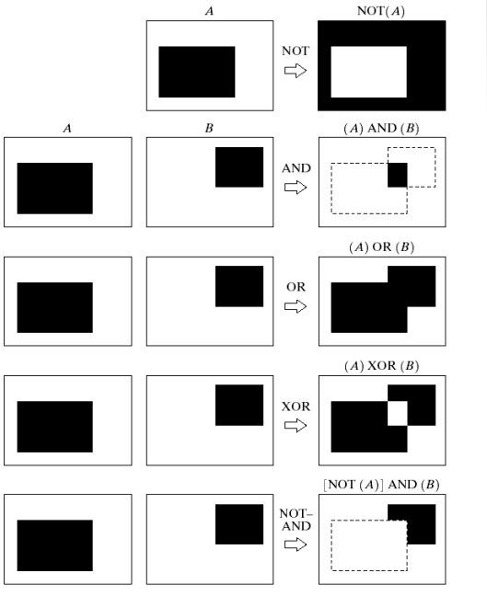
Logic Operations

Slide 10
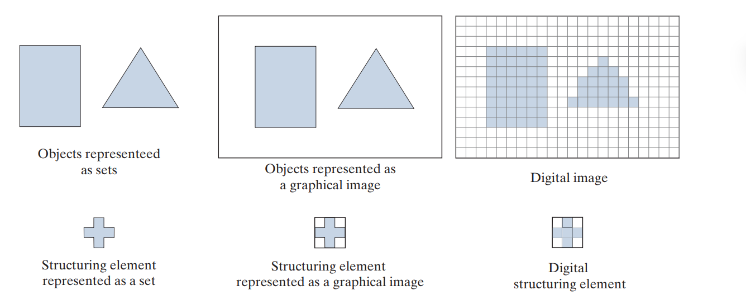
Structuring element
In image processing, we use morphology with two types of sets of pixels:
objects
structuring elements (SE’s).
Background
Image
Foreground
Foreground
Structuring element
Structuring elements are used in a form similar to spatial convolution kernels The image border just described is similar to the padding we discussed in Spatial filtering.
The Spatial filter operations are different in morphology, but the padding and sliding operations are the same as in convolution.
Notes:
There is an important difference between the way we represent digital images and digital structuring elements. Observe on the top right that there is a border of background pixels surrounding the objects, while there is none in the SE.

Slide 11

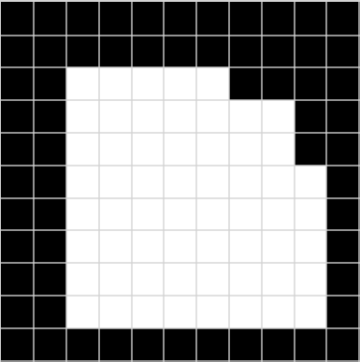
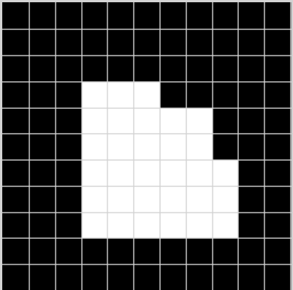

Erosion
Erosion is a fundamental morphological operation used to shrink the foreground. The erosion of A by B is the set of all points z such that B, translated by z, is contained in A.
A is a set of foreground pixels
B is a structuring element
Erosion "shrinks" white (foreground) regions.
It removes boundary pixels of objects.
Useful for eliminating small white noises and separating touching objects.
Origin
SE
Input Image
Output Image
Notes:
Hiểu đơn giản là khi ta di chuyển structuring element(SE) qua từng pixel trong ảnh. Pixel ở trung tâm của SE chỉ được giữ lại nếu toàn bộ các pixel trong vùng SE nằm trong vùng đối tượngNếu SE không hoàn toàn nằm trong vùng đối tượng, pixel trung tâm sẽ bị biến thành nền (background). (foreground).

Slide 12
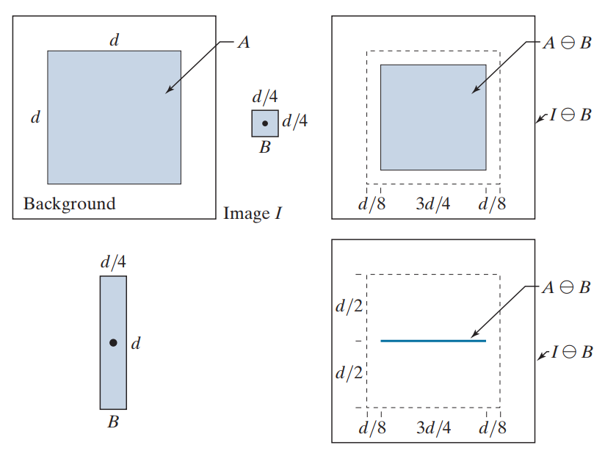
Erosion
Square SE, B (the dot is the origin).
Elongated SE.
Notes:
The dotted border is the boundary of A, shown for reference.

Slide 13




Using erosion to remove image components.
486x486 binary image
Image eroded using
square SE size 11x11
Image eroded using
square SE size 15x15
Image eroded using
square SE size 45x45

Slide 14



Dilation
Dilation is a fundamental morphological operation used to expand the foreground. The dilation of image A by structuring element B is the set of all points z such that the translated structuring element ${(B)}_{z}$overlaps with at least one foreground pixel in A.
A is a set of foreground pixels
B is a structuring element
Enlarges bright objects in binary images.
Connects broken parts
Fills small holes or gaps.
Origin
SE
Input Image
Output Image

Slide 15
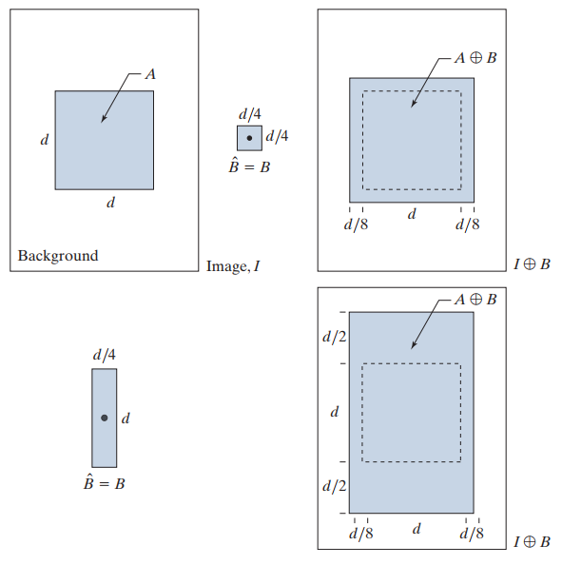
Dilation
Square SE, B (the dot is the origin).
Elongated SE.

Slide 16
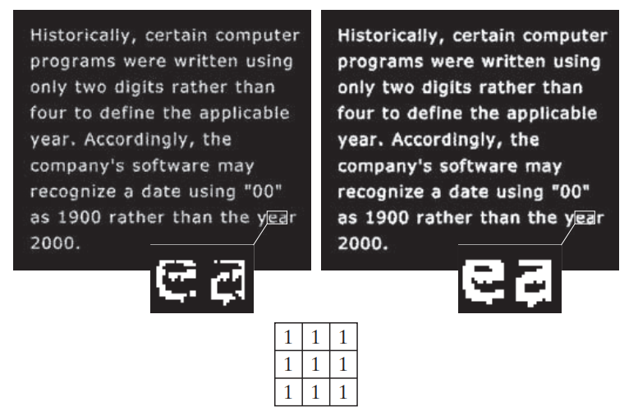
Dilation

Slide 17

Thanks
주식회사 자비스
XAVIS Co,.Ltd.
Tel:031-740-3800 Fax: 031-740-3802
Email: xavis@xavis.co.kr URL: www.xavis.co.kr

