Slide 1
CANNY EDGE DETECTING
Notes:
Today I’ll be presenting on FUNDAMENTALS OF SPACTIAL FILLTERING
– a fundamental technique used to enhance image quality before deeper analysis.

Slide 2

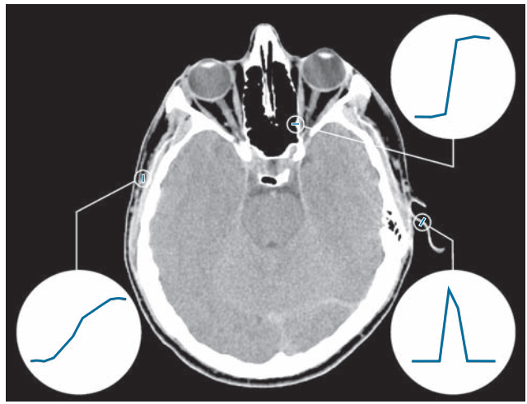
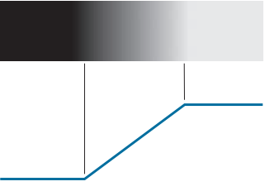

EDGE DETECTION
What is Edge?
An edge is a boundary or a significant change in intensity between adjacent pixcel
Type of Edge:
Step Edge:
Ramp Edge:
Roof Edge:
Notes:
In image processing and computer vision, an edge is a boundary or a significant change in intensity (brightness or color) between adjacent pixels. Edges often represent object boundaries, texture changes, or surface orientation changes, and they are critical for analyzing the structure and shapes in an image.
Edges can be classified based on the intensity profile—how the brightness changes across the edge. The common types are:
Step edge: Sudden and consistent change in intensity. Appears as a sharp transition.
Ramp Edge: Gradual change in intensity over a wider area. In real situations, edges are more closely modeled as having an intensity ramp profile
Intensity rises to a peak and falls back. Often seen in thin lines or textures. Roof edges are models of lines through a region,

Slide 3
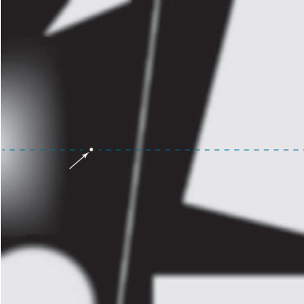

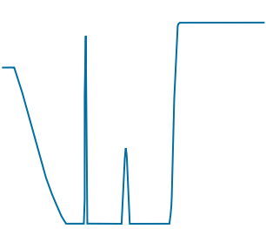
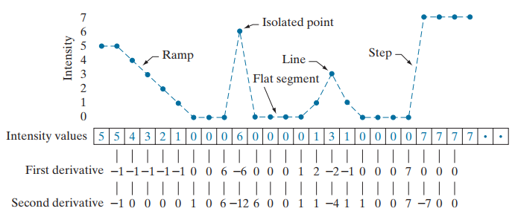
Using derivative in detecting edge
In image processing, the derivative is approximated by the difference between neighboring pixels.
Example in 1D, first-order derivative:
If pixel values don't change → derivative is close to 0.
If pixel values change suddenly → derivative is large → likely an edge.
Notes:
edges are locations in an image where the intensity changes rapidly, and the derivative illustrates how fast a value changes. It measures exactly that

Slide 4
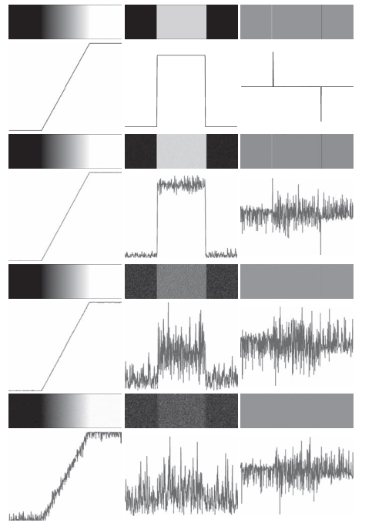



Sensitivity of derivatives to noise
Standard deviations of 0.0
Standard deviations of 0.1
Standard deviations of 1.0
Standard deviations of 10.0
$$\text{R}\text{amp} \text{edge}$$
$$1^{st} Derivative$$
$$2^{nd} Derivative$$
Notes:
These examples are illustrations of the sensitivity of derivatives to noise.
First column: 8-bit images with values in the range [0, 255], and intensity profiles of a ramp edge corrupted by Gaussian noise of zero mean and standard deviations of 0.0 0.1 1.0, and 10.0 intensity levels, respectively. Second column: First-derivative images and intensity profiles. Third column: Second-derivative images and intensity profiles.
The noise is almost visually undetectable in the images on the left column.
As we move down the center column, the derivatives become increasingly different from the noiseless case.
In fact, it would be difficult to associate the last profile in the center column with the first derivative of a ramp edge. As expected, the second derivative is even more sensitive to noise. The only noisy second derivative image that barely resembles the noiseless case corresponds to noise with a standard deviation of 0.1. The remaining second-derivative images and profiles clearly illustrate that it would be difficult indeed to detect their positive and negative components.
We need to reduce the noise if we want to detect the edge by using derivative

Slide 5
Steps for Canny Edge Detection
Step 1: Smooth the image with a Gaussian filter with spread σ.
Step 2: Compute gradient magnitude and direction at each pixel of the smoothed image.
Step 3: Zero out any pixel response less than or equal to the two neighboring pixels on either side of it, along the direction of the gradient (non-maxima suppression).
Step 4: Track high-magnitude contours using thresholding (hysteresis thresholding).
Step 5: Keep only pixels along these contours, so weak little segments go away.
Notes:
First, we smooth the input image using a Gaussian filter with a standard deviation sigma. This helps reduce image noise and small irrelevant details that could cause false edges.
Next, we compute the gradient magnitude and direction at each pixel of the smoothed image, typically using Sobel operators. This tells us how strong the edge is and in which direction it points.
Now we perform non-maximum suppression. For each pixel, we look along the gradient direction and suppress it (set to zero) if it's not a local maximum compared to its neighbors. This step thins out the edges.
We then apply hysteresis thresholding with two thresholds: a high and a low. Strong edge pixels above the high threshold are kept, and weak ones between the two thresholds are only kept if they are connected to strong edges.
Finally, we keep only the pixels that belong to the strong edges traced through the hysteresis step. This removes small, isolated segments and retains meaningful contours.

Slide 6
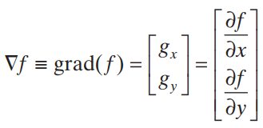
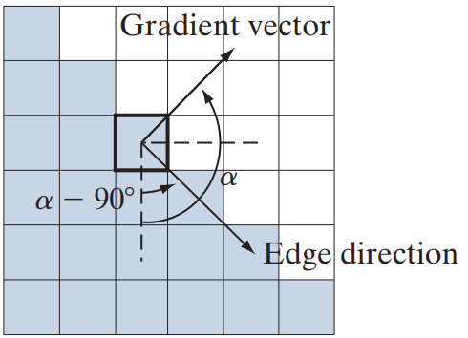

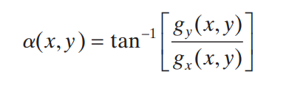
Gradient
In 2-D, First derivatives in image processing are implemented using the magnitude of the gradient. The gradient of an image f at coordinates (x , y) is a vector which defined as the two - dimensional column vector
Gradient vector
The partial derivative to the horizontal direction 𝑥.
The partial derivative to the vertical direction y.
Base on the formula, we evaluate the magnitude and the direction of gradient vector
The magnitude of the gradient shows how strong the change is
$$g_{y}$$
grad(f)
The direction shows where the change is happening fastest.
α
$$g_{x}$$

Slide 7
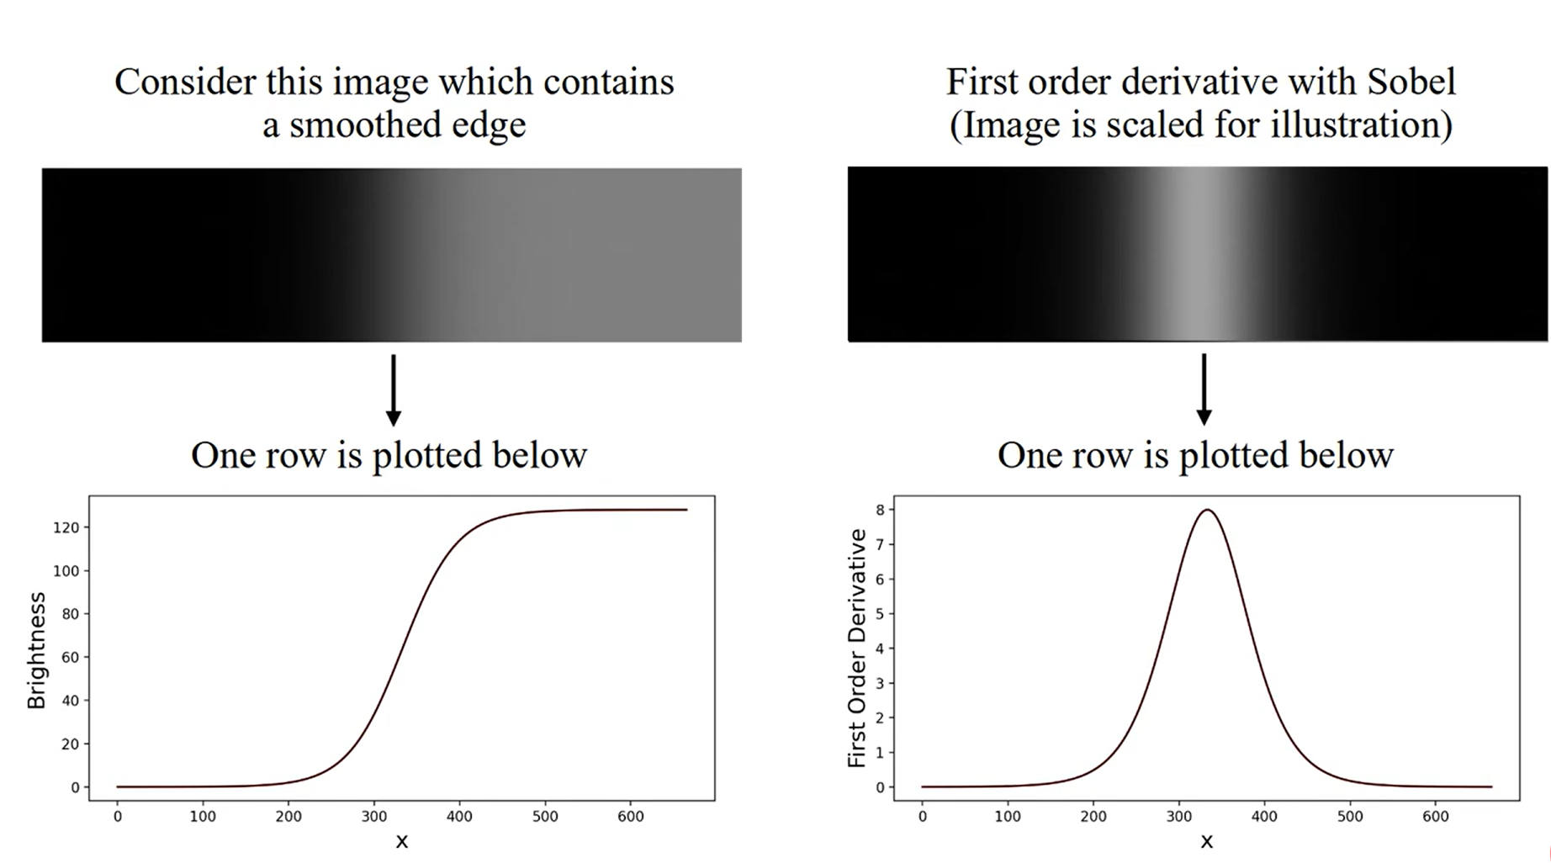
Non-Maximum Suppression
Maximum
Notes:
Gradient image f x y s( , ) typically contains wide ridges around local maxima.
The next step is to thin those ridges. One approach is to use nonmaxima suppression On the left, we see two curves. The gray dashed line represents a sharp step edge, where the intensity jumps suddenly from 0 to 1. The curve shows the result of applying a Gaussian filter to this edge. Notice how the transition becomes smooth and gradual, instead of abrupt. This simulates how real-world images often behave after noise reduction.
On the right plot, we show the gradient of the smoothed edge – which is the first derivative of intensity. The red curve peaks at the center of the edge, where the intensity changes most rapidly. This peak indicates the position of the strongest edge and is used in edge detection algorithms to identify edge locations.

Slide 8
Edge Neighbor
Edge
Edge Neighbor
Edge
Edge Neighbor
Edge Neighbor
?
Edge normal
(gradient vector)
X
?
X
?
?
Edge normal
(gradient vector)
Notes:
Và chúng ta muốn tìm điểm maximum trên 1 derivative. Làm thế nào chúng ta có thể xác định được một điểm có phải điểm maximum không? Ta phải so sánh giá trị của điểm đó với neightbor của nó theo hướng của gradient
This example shows the situation for the two possible orientations of an edge.

Slide 9
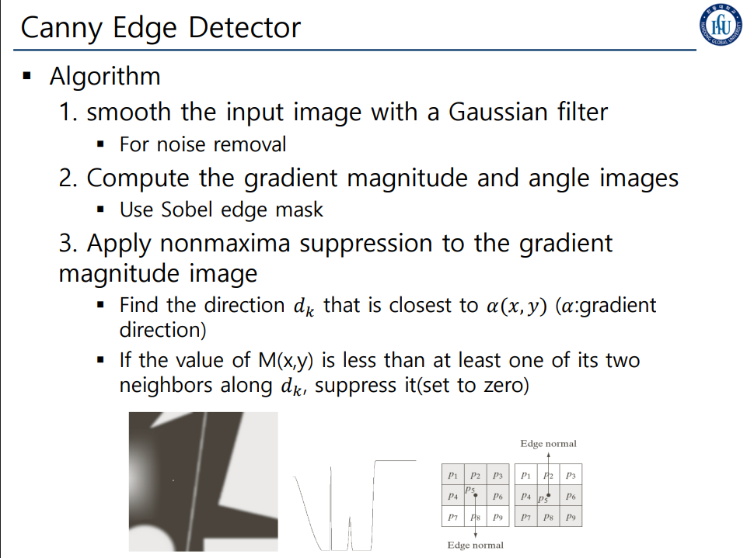

Slide 10
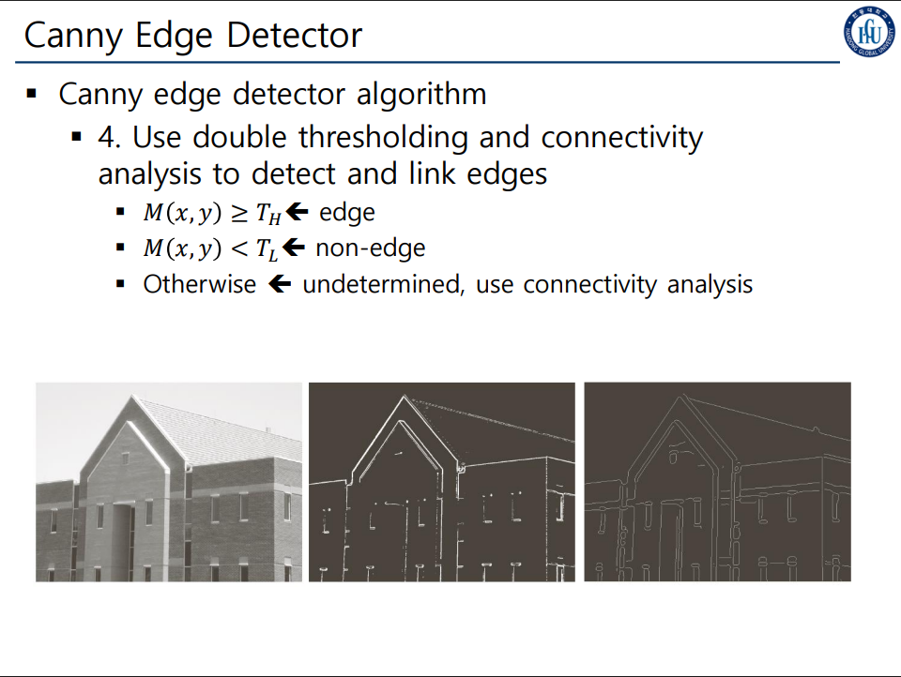

Slide 11
