Slide 1
CANNY EDGE DETECTING
Notes:
Today I’ll be presenting on FUNDAMENTALS OF SPACTIAL FILLTERING
– a fundamental technique used to enhance image quality before deeper analysis.

Slide 2

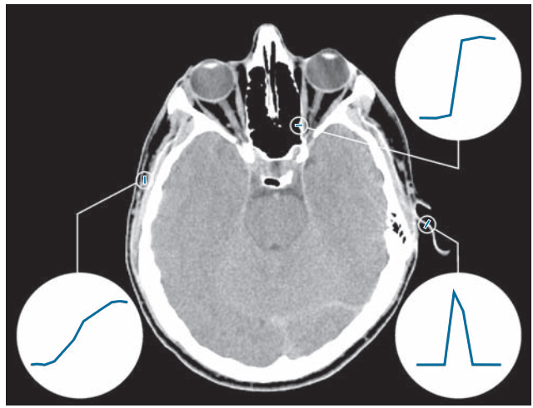
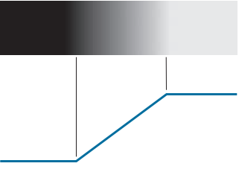

EDGE DETECTION
What is Edge?
An edge is a boundary or a significant change in intensity between adjacent pixcel
Type of Edge:
Step Edge:
Ramp Edge:
Roof Edge:
Notes:
In image processing and computer vision, an edge is a boundary or a significant change in intensity (brightness or color) between adjacent pixels. Edges often represent object boundaries, texture changes, or surface orientation changes, and they are critical for analyzing the structure and shapes in an image.
Edges can be classified based on the intensity profile—how the brightness changes across the edge. The common types are:
Step edge: Sudden and consistent change in intensity. Appears as a sharp transition.
Ramp Edge: Gradual change in intensity over a wider area. In real situations, edges are more closely modeled as having an intensity ramp profile
Intensity rises to a peak and falls back. Often seen in thin lines or textures. Roof edges are models of lines through a region,

Slide 3
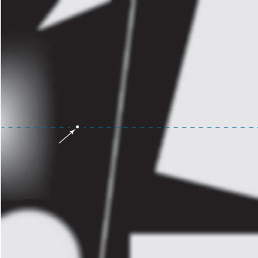

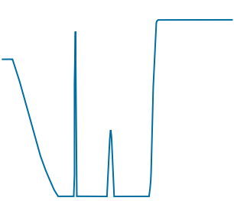
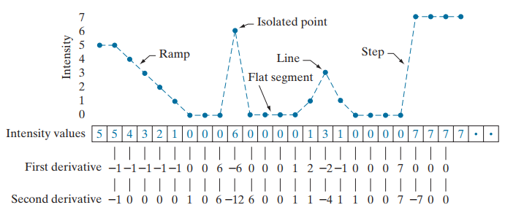
Using derivative in detecting edge
In image processing, the derivative is approximated by the difference between neighboring pixels.
Example in 1D, first-order derivative:
If pixel values don't change → derivative is close to 0.
If pixel values change suddenly → derivative is large → likely an edge.
Notes:
edges are locations in an image where the intensity changes rapidly, and the derivative illustrates how fast a value changes. It measures exactly that

Slide 4
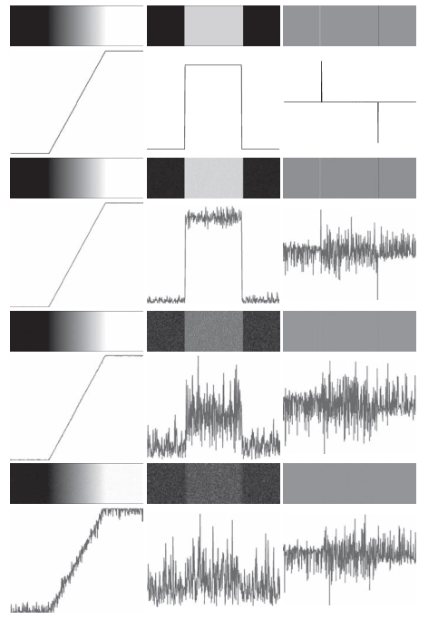



Sensitivity of derivatives to noise
Standard deviations of 0.0
Standard deviations of 0.1
Standard deviations of 1.0
Standard deviations of 10.0
$$\text{R}\text{amp} \text{edge}$$
$$1^{st} Derivative$$
$$2^{nd} Derivative$$
Notes:
These examples are illustrations of the sensitivity of derivatives to noise.
First column: 8-bit images with values in the range [0, 255], and intensity profiles of a ramp edge corrupted by Gaussian noise of zero mean and standard deviations of 0.0 0.1 1.0, and 10.0 intensity levels, respectively. Second column: First-derivative images and intensity profiles. Third column: Second-derivative images and intensity profiles.
The noise is almost visually undetectable in the images on the left column.
As we move down the center column, the derivatives become increasingly different from the noiseless case.
In fact, it would be difficult to associate the last profile in the center column with the first derivative of a ramp edge. As expected, the second derivative is even more sensitive to noise. The only noisy second derivative image that barely resembles the noiseless case corresponds to noise with a standard deviation of 0.1. The remaining second-derivative images and profiles clearly illustrate that it would be difficult indeed to detect their positive and negative components.
We need to reduce the noise if we want to detect the edge by using derivative

Slide 5
Steps for Canny Edge Detection
Step 1: Smooth the image with a Gaussian filter with spread σ.
Step 2: Compute gradient magnitude and direction at each pixel of the smoothed image.
Step 3: Zero out any pixel response less than or equal to the two neighboring pixels on either side of it, along the direction of the gradient (non-maxima suppression).
Step 4: Track high-magnitude contours using thresholding (hysteresis thresholding).
Step 5: Keep only pixels along these contours, so weak little segments go away.
Notes:
First, we smooth the input image using a Gaussian filter with a standard deviation sigma. This helps reduce image noise and small irrelevant details that could cause false edges.
Next, we compute the gradient magnitude and direction at each pixel of the smoothed image, typically using Sobel operators. This tells us how strong the edge is and in which direction it points.
Now we perform non-maximum suppression. For each pixel, we look along the gradient direction and suppress it (set to zero) if it's not a local maximum compared to its neighbors. This step thins out the edges.
We then apply hysteresis thresholding with two thresholds: a high and a low. Strong edge pixels above the high threshold are kept, and weak ones between the two thresholds are only kept if they are connected to strong edges.
Finally, we keep only the pixels that belong to the strong edges traced through the hysteresis step. This removes small, isolated segments and retains meaningful contours.

Slide 6
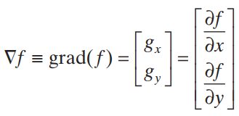
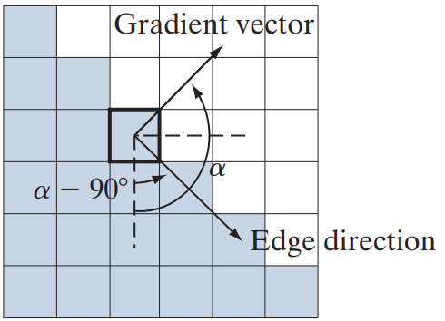

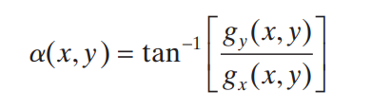
Gradient
In 2-D, First derivatives in image processing are implemented using the magnitude of the gradient. The gradient of an image f at coordinates (x , y) is a vector which defined as the two - dimensional column vector
Gradient vector
The partial derivative to the horizontal direction 𝑥.
The partial derivative to the vertical direction y.
Base on the formula, we evaluate the magnitude and the direction of gradient vector
The magnitude of the gradient shows how strong the change is
$$g_{y}$$
grad(f)
The direction shows where the change is happening fastest.
α
$$g_{x}$$

Slide 7
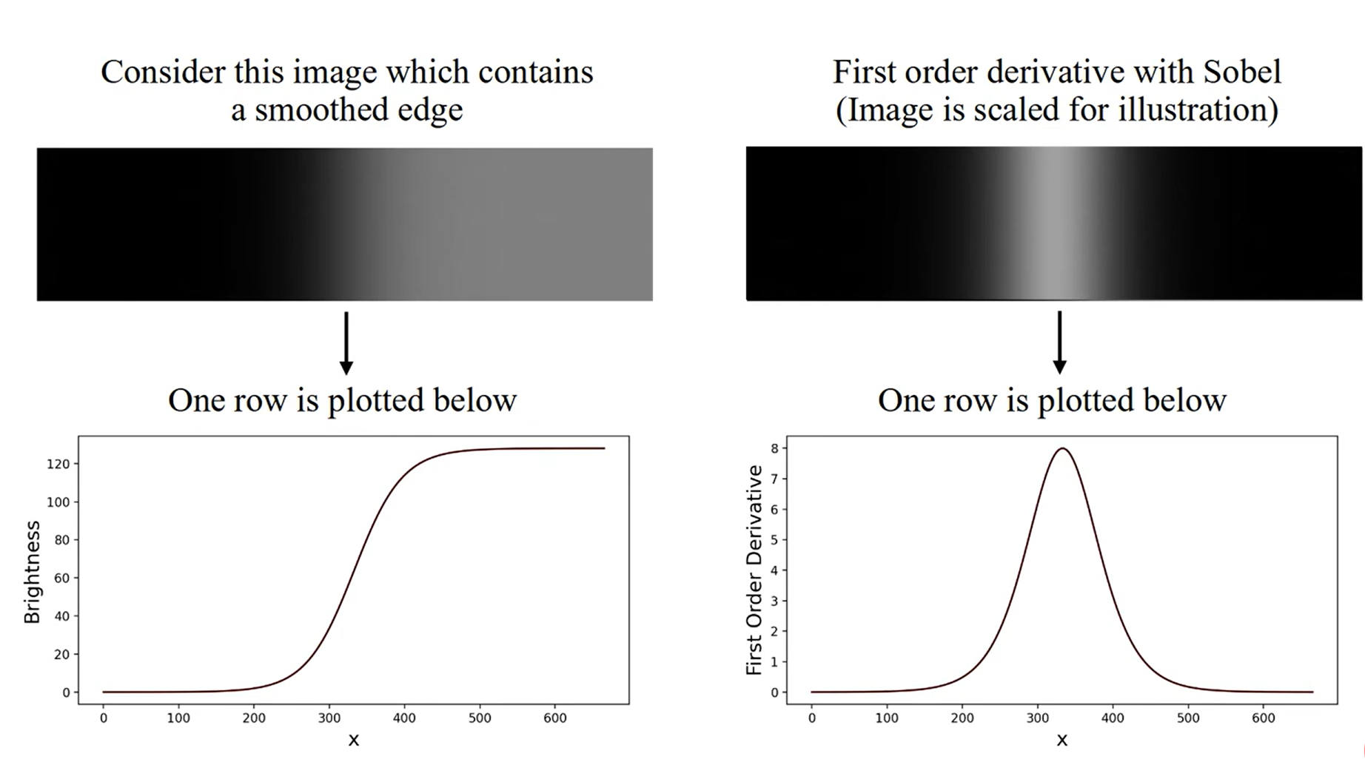
Non-Maximum Suppression
Maximum
Notes:
Gradient image f x y s( , ) typically contains wide ridges around local maxima.
The next step is to thin those ridges. One approach is to use nonmaximum suppression On the left, we see two curves. The gray dashed line represents a sharp step edge, where the intensity jumps suddenly from 0 to 1. The curve shows the result of applying a Gaussian filter to this edge. Notice how the transition becomes smooth and gradual, instead of abrupt. This simulates how real-world images often behave after noise reduction.
On the right plot, we show the gradient of the smoothed edge – which is the first derivative of intensity. The curve peaks at the center of the edge, where the intensity changes most rapidly. This peak indicates the position of the strongest edge and is used in edge detection algorithms to identify edge locations.
"Non-maximum suppression determines this point and suppresses its neighbors to obtain a thin edge that is 1 pixel wide.“
To determine whether a pixel represents a local maximum, it must be compared with its two neighboring pixels along the gradient direction.

Slide 8
Non-Maximum Suppression
Edge Neighbor
Edge
Edge Neighbor
Edge
Edge Neighbor
Edge Neighbor
?
Edge normal
(gradient vector)
X
?
X
?
?
Edge normal
(gradient vector)
Notes:
This example shows the situation for the two possible orientations of an edge.

Slide 9
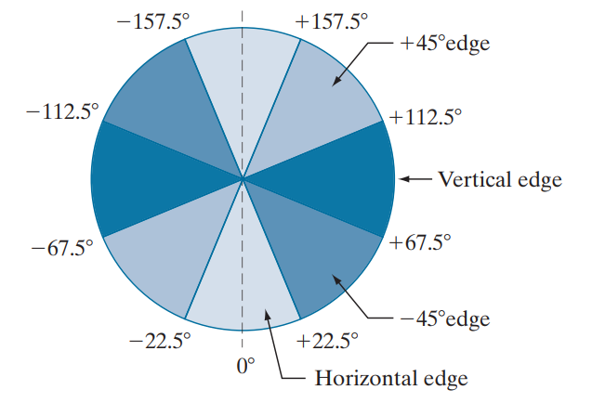
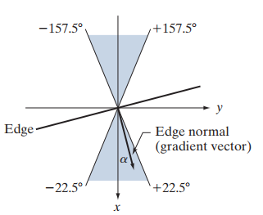









Non-Maximum Suppression
$$w_{1}$$
$$w_{2}$$
$$w_{3}$$
$$w_{4}$$
$$w_{5}$$
$$w_{6}$$
$$w_{7}$$
$$w_{8}$$
$$w_{9}$$
Notes:
Each pixel in the image is surrounded by a 3×3 matrix. The central pixel of this matrix is w5, which is the pixel we want to examine. The surrounding pixels, from w1 to w4 and from w6 to w9, are the neighbors of w5. The diagram in the middle illustrates the relationship between an edge in the image and the edge normal, or gradient vector. The angle α represents the direction of this gradient vector. α is calculated using a specific formula.
However, in practical digital image processing, handling infinitely continuous gradient directions is inefficient. Therefore, we need to quantize (round off) these gradient directions. The circular diagram divides 360 degrees into 8 segments corresponding to the 8 neighboring pixels around w5. In this way, any gradient direction at pixel w5 is rounded to one of these 8 standard directions (or grouped into 4 main categories).
Once we have the quantized gradient direction of pixel w5, we return to the 3×3 matrix to perform the final comparison step. Non-Maximum Suppression (NMS) will compare the gradient magnitude of the central pixel w5 with the gradient magnitudes of the two neighboring pixels that lie exactly on the line in the gradient direction.
Finally, if the gradient magnitude of w5 is the greatest among the three, w5 is retained and considered a valid edge pixel. Otherwise, it is suppressed. This process is repeated for every pixel in the image, ensuring that the edges detected by the Canny algorithm are only one pixel wide, sharp, and clearly defined.

Slide 10
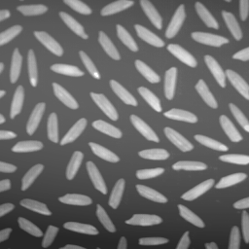
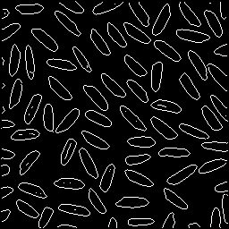
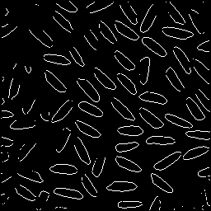
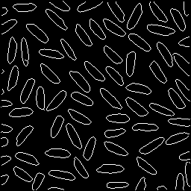
Hysteresis threshold
Original image
Low threshold
High threshold
Hysteresis threshold
(high and low threshold)
Notes:
After Non-Maximum Suppression, we obtain a map of 'potential edges' with varying strengths. However, we still cannot definitively distinguish true edges from noise. Thresholding helps address this issue. Using a single threshold is challenging, as a value too low may accept excessive noise, while a value too high risks breaking important but weaker edges. Hysteresis Thresholding employs two different intensity thresholds, a high and a low threshold, to resolve this.

Slide 11
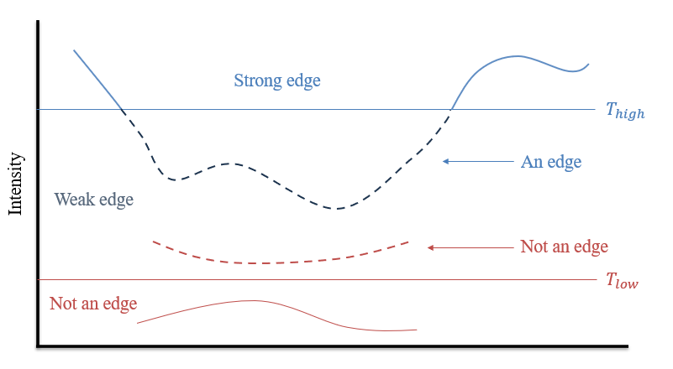
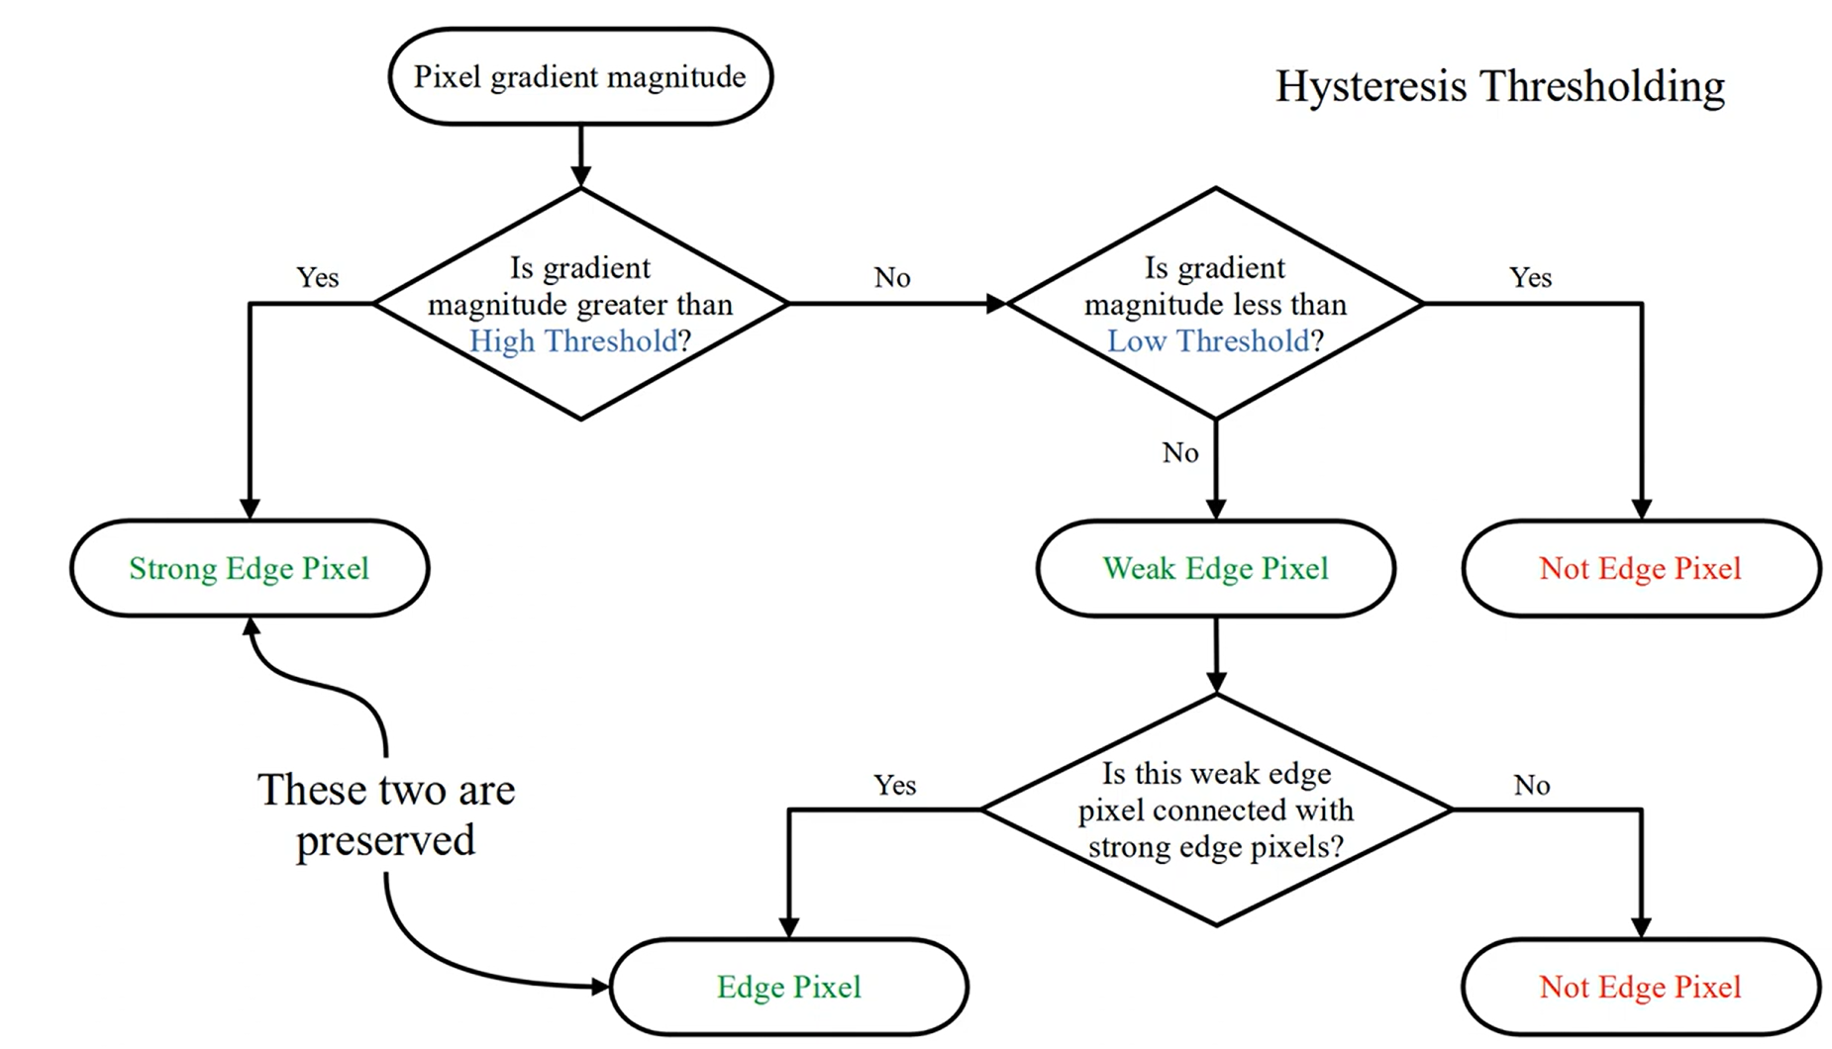
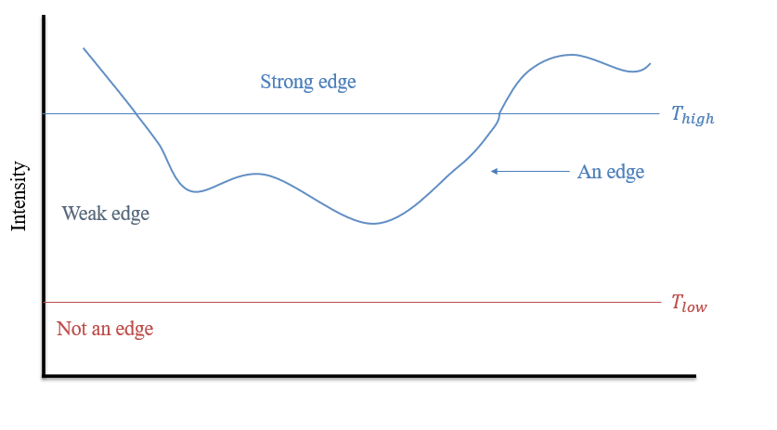
Hysteresis threshold
Notes:
"Now let’s talk about Hysteresis Thresholding, which is the fourth step in the Canny Edge Detection algorithm.
Its main goal is to accurately separate true edges from noise. It does this by using two thresholds: a high threshold, called T-high, and a low threshold, called T-low.
First, for each pixel, we check the gradient magnitude:
If it's greater than T-high, we classify it as a Strong Edge Pixel – it’s definitely part of a real edge.
If it’s less than T-low, it’s considered not an edge, and we discard it.
If it lies between T-low and T-high, we marked it a Weak Edge Pixel – this needs further checking.
In the next step, we perform weak edge linking. For every Weak Edge Pixel, we check whether it's connected to any Strong Edge Pixel using 8-connected neighbors.
If it is connected, we keep it as part of the edge.
If it’s not connected, it’s likely caused by noise, so we discard it
Finally, only the Strong Edge Pixels and the connected Weak Edge Pixels are kept in the final edge map. This process helps ensure that real edges are continuous and smooth, while noise and false edges are removed."

Slide 12


Strong edge
$$T_{high}$$
An edge
Intensity
Weak edge
Not an edge
$$T_{low}$$
Not an edge

Slide 13
Strong edge
$$T_{high}$$
An edge
Intensity
Weak edge
$$T_{low}$$
Not an edge

Slide 14
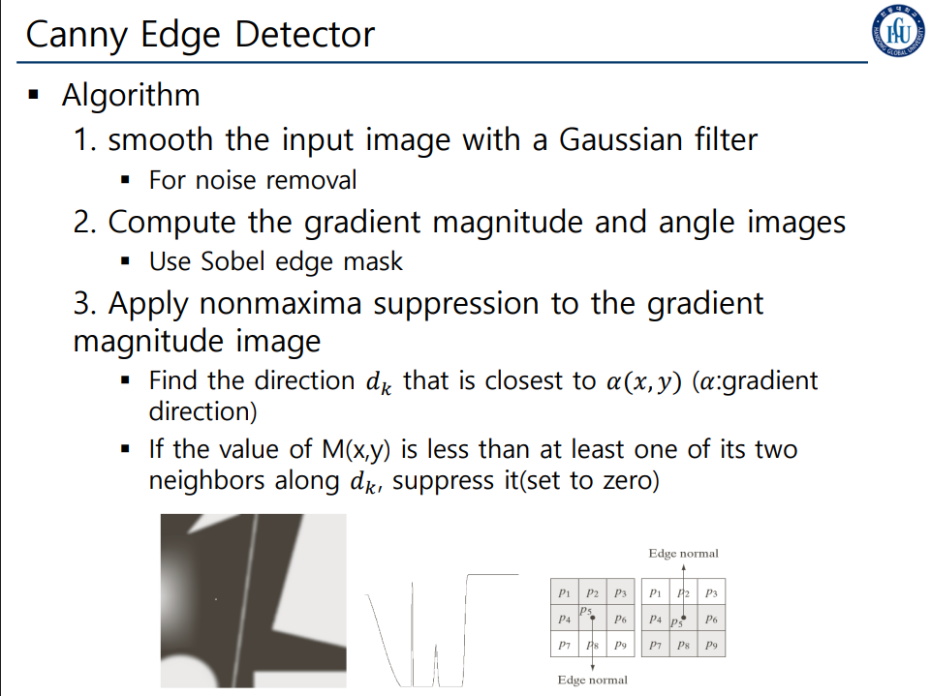

Slide 15
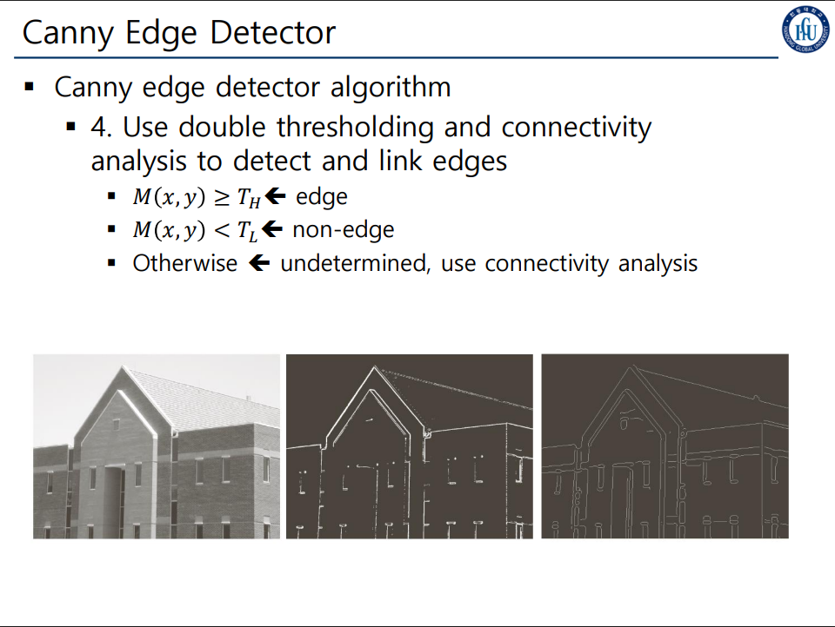

Slide 16
