Slide 1
Histogram & Transformation function
Date: May 9, 2025
Name: Nguyen Tien An

Slide 2
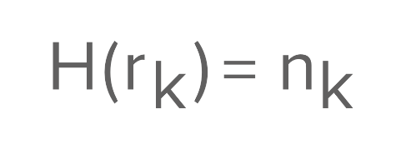
Histogram
It describes the distribution of pixel intensities in an image.
The histogram of a digital image with gray levels in the range [0, L-1] is a discrete function.
Unnormalized histogram:
For k = 0, 1, 2,…, L-1
Histogram value at intensity level r_k
K-th intensity level
Number of pixels that has intensity level r_k

Slide 3

Histogram
Normalized histogram:
We mostly work with this type of histogram => Image histogram
Probability of intensity level r_k
Number of pixels that has intensity level r_k
Image rows and columns

Slide 4
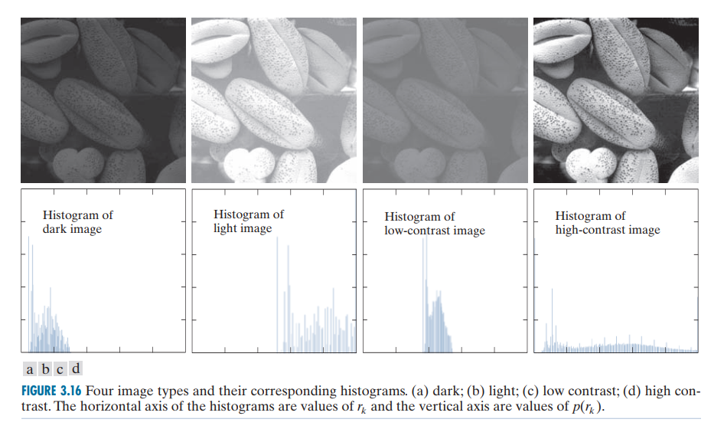
Histogram

Slide 5
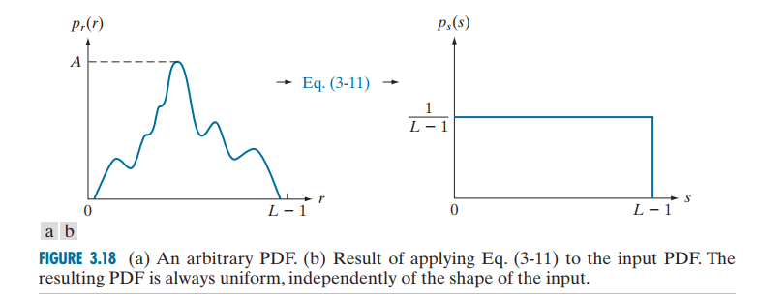
Histogram equalization
Purpose: To transform the original image intensity values 𝑟 into new values 𝑠, such that:
The histogram (probability density function - pdf) becomes uniform (evenly distributed)
The contrast of image is improved by using the full intensity range [0, L-1]

Slide 6

Histogram equalization
For continuous value equalization, we use Cumulative Distribution Function (CDF).
CDF of pixel intensity r:
Transformation function:

Slide 7


Histogram equalization
For discrete value equalization, we work with probabilities and summations.
Probability of occurrence of intensity level r_{k} :
The target intensity level s_{k} can be calculated using this function:

Slide 8
Histogram equalization
Code implementation manualEqualizeHist(const Mat& input)
Mat output = input.clone();
int hist[256] = { 0 };
int lut[256] = { 0 }; // Look-up table
int total = input.rows * input.cols;
int L = 256; // Intensity levels
// Step 1: Calculate histogram
for (int y = 0; y < input.rows; y++) {
for (int x = 0; x < input.cols; x++) {
hist[input.at<uchar>(y, x)]++;
}
}
// Step 2: Compute Look up Table based on Histogram Equalization formula
int cummulated_hist = 0;
for (int k = 0; k < 256; k++) {
cummulated_hist += hist[k];
lut[k] = cvRound(((float)(L - 1) / total) * cummulated_hist); // T(r_k)
}
// Step 3: Apply LUT to get equalized image
for (int y = 0; y < input.rows; y++) {
for (int x = 0; x < input.cols; x++) {
output.at<uchar>(y, x) = lut[input.at<uchar>(y, x)];
}
}

Slide 9
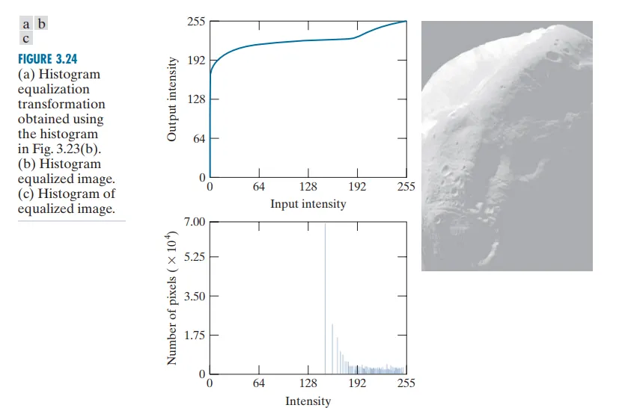
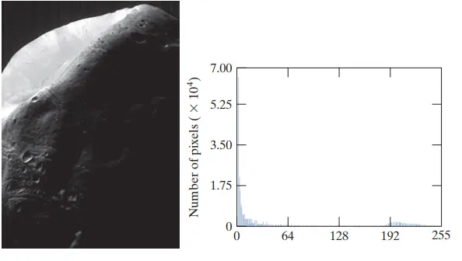
Histogram specification
When an image has large concentration of pixels in one end of the gray scale, applying histogram equalization transformation may not be optimal.
Reason: When this transformation is applied to the levels of the input image to obtain a histogram-equalized result, the net effect is to map a very narrow interval of dark pixels into the upper end of the gray scale of the output image.

Slide 10
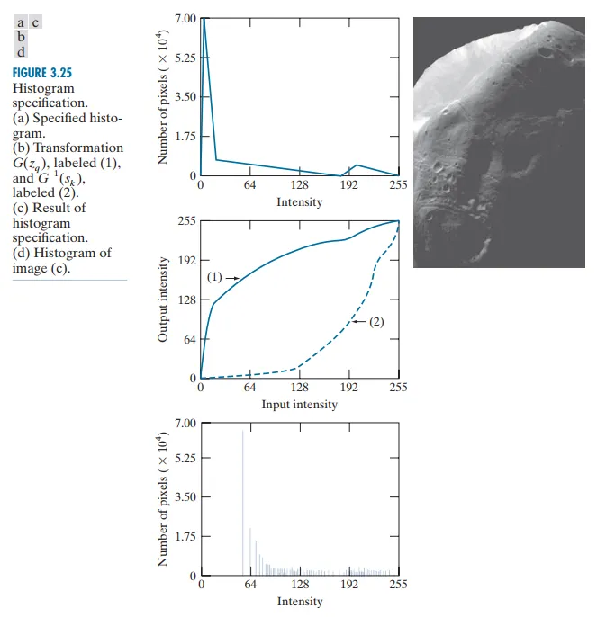
Histogram specification
Solution:
Modify the histogram, so that it preserves the general shape of the original histogram, but has a smoother transition of levels in the dark region of the gray scale.

Slide 11
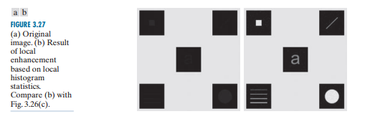
Local Histogram Equalization
Global equalization uses the histogram of the entire image, which may not enhance small features in low-contrast regions.
Local equalization improves contrast locally, making hidden details in dark or bright regions more visible.
General steps:
Divide the image into equal blocks
Apply histogram equalization to each block
Merge result

Slide 12
Local Histogram Equalization
LHE Methods:
 | Blockwise LHE | Sliding Window LHE
Description | Divide the entire image into non-overlapping tiles. Apply histogram equalization independently to each tile. Merge the tiles into the final output. | Use a sliding M×N window. Move the window pixel-by-pixel (or by patches) Apply histogram equalization to the local window, then assign the center pixel/patch to the output. Continue across the image.
Pros | Fast, Simple | Better local contrast. Reduce visible boundaries.
Cons | Causes visible blocky artifacts at tile boundaries. | Slower than blockwise equalization.

Slide 13
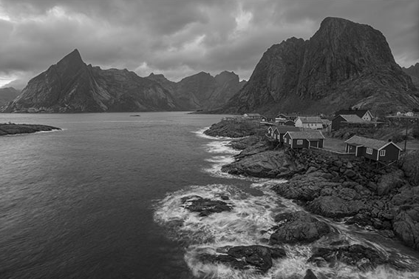
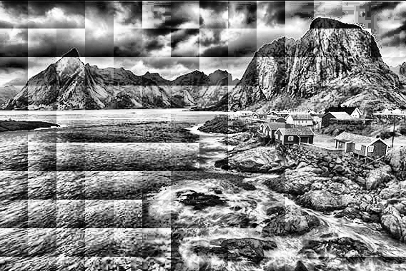
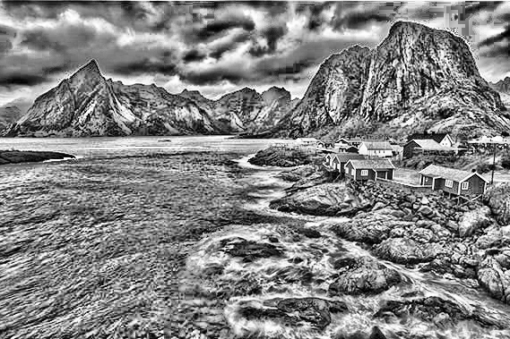
Local Histogram Equalization
Input
Enhanced block-wise LHE
Enhanced pixel-wise LHE
For both LHE methods, there is blocky effect. To reduce this effect, we need to apply interpolation to the edge area.

Slide 14
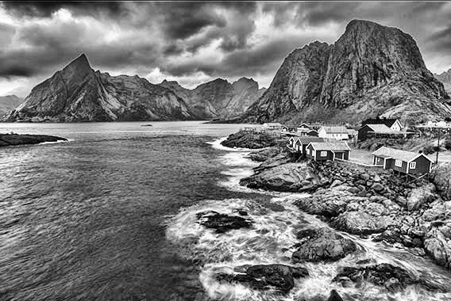
Contrast Limited Adaptive Histogram Equalization (CLAHE)
Improve image contrast while avoiding over amplification of noise and preserving image details.
CLAHE involves two main steps:
Contrast enhancement: local Histogram Equalization is applied to each small region (tileGridSize) of image.
Limiting contrast: the contrast of the image is limited by a parameter called clipLimit - determines the maximum amount of contrast amplification that can be performed in each region before the contrast is limited.
Input
Enhanced CLAHE output

Slide 15

Transformation functions
Image Negative
Reverse the intensity of image:
Purpose: enhancing white or gray detail embedded in dark regions of an image, especially when the black area are dominant in size.

Slide 16

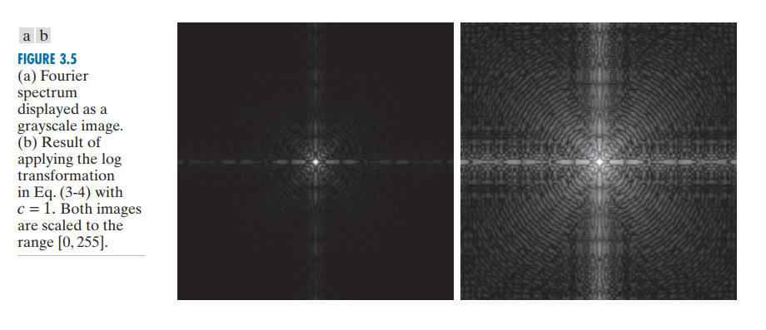
Transformation functions
Log transformation
Replacing all pixel values, present in the image, with its logarithmic values.
Log transformation is used for image enhancement as it expands dark pixels of the image as compared to higher pixel values.

Slide 17




Transformation functions
Gamma transformation
Power-law (Gamma) transformation have the form of:
Gamma correction is important for displaying images on a screen correctly, to prevent bleaching or darkening of images when viewed from different types of monitors with different display settings.
Input
Gamma = 0.5
Gamma = 2.2

Slide 18

Thanks
주식회사 자비스
XAVIS Co,.Ltd.
Tel:031-740-3800 Fax: 031-740-3802
Email: xavis@xavis.co.kr URL: www.xavis.co.kr

