Slide 2

PRESENTATION TITLE
SUBTITLE. SUBTITLE. SUBTITLE.
SUBTITLE. SUBTITLE.

Slide 3
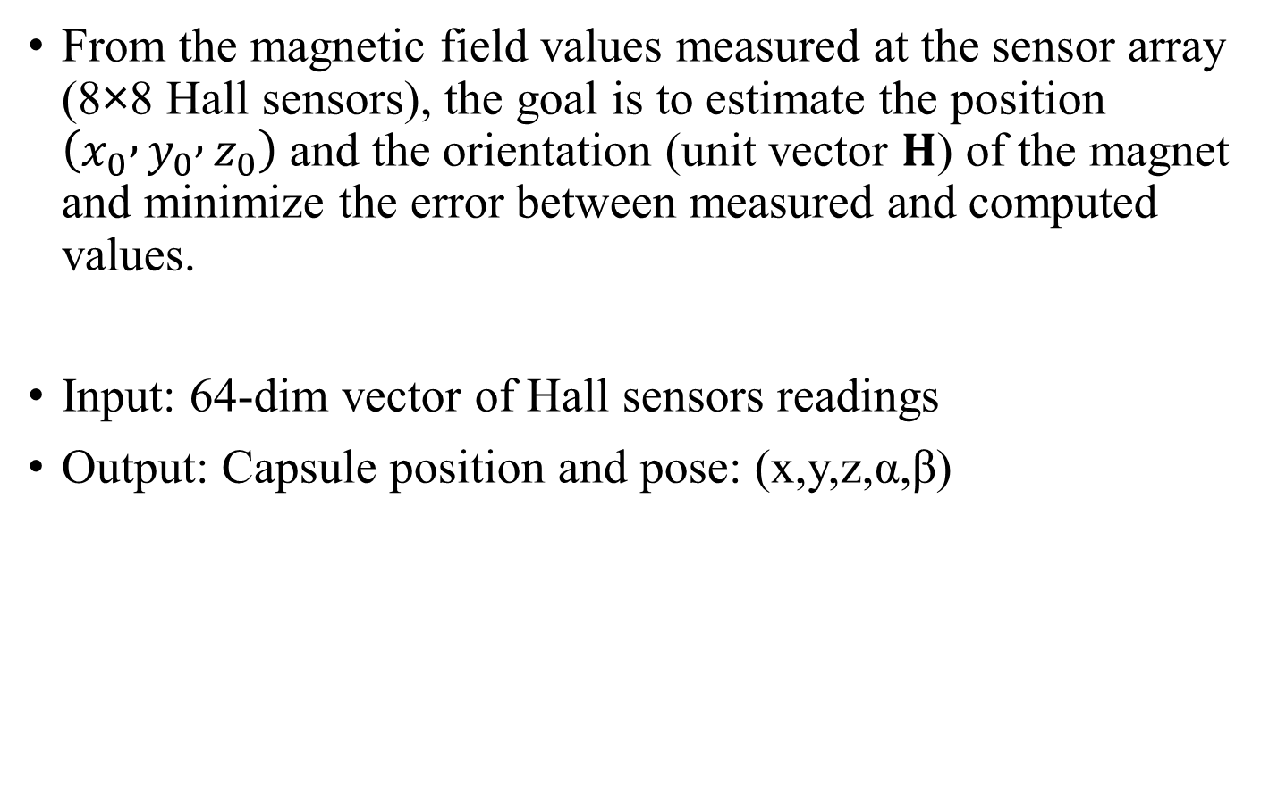
Problem
From the magnetic field values measured at the sensor array (8×8 Hall sensors), the goal is to estimate the position $\left(x_{0} , y_{0} , z_{0}\right)$and the orientation (unit vector $H$) of the magnet and minimize the error between measured and computed values.
Input: 64-dim vector of Hall sensors readings
Output: Capsule position and pose: (x,y,z,α,β)

Slide 4
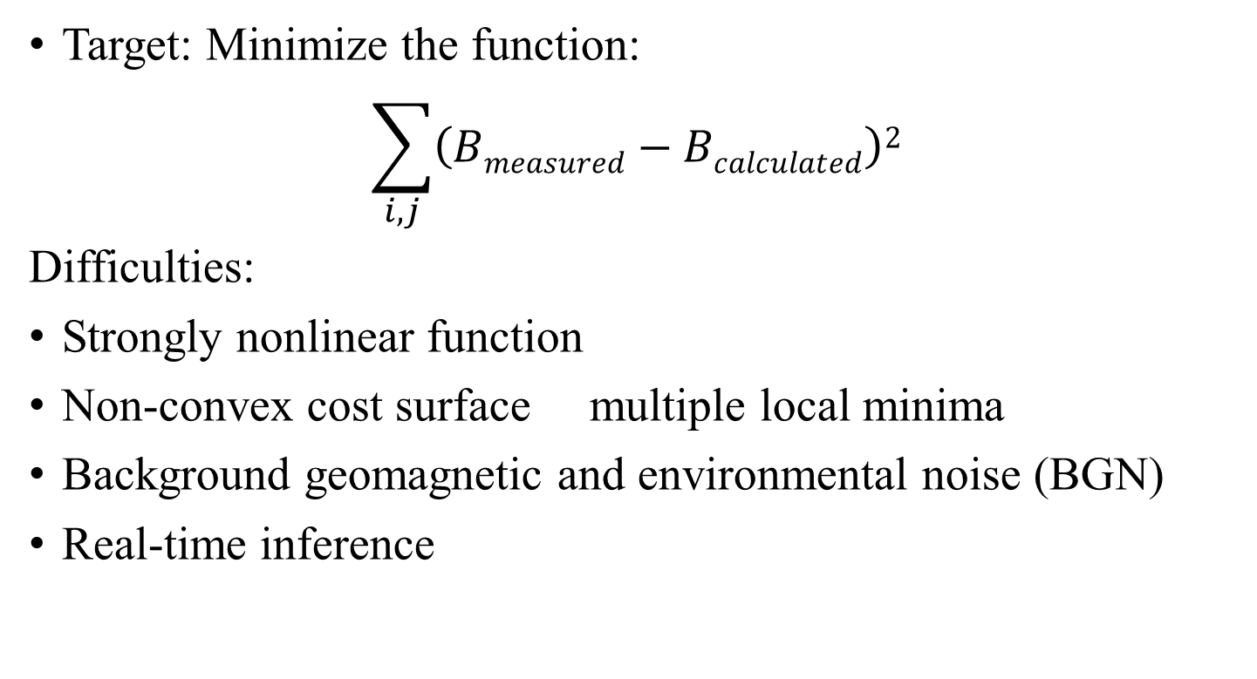
Optimization Problem
Target: Minimize the function:
$$\sum_{i,j}{\left(Bmeasured−Bcalculated\right)2}$$
Difficulties:
Strongly nonlinear function
Non-convex cost surface multiple local minima
Background geomagnetic and environmental noise (BGN)
Real-time inference

Slide 5
Proposed approach
Fully Convolutional Network (FCN)
FCN for 8x8 sensor hall: Convolutions preserve local spatial structure.
Parameter sharing reduces learnable weights vs. dense layers.
Efficient interference & regularization.

Slide 6
Proposed Approach
Spatial Attention
Spatial Attention helps the network focus on informative sensor locations in the 8×8 magnetic field map.
It learns a weighting mask highlighting important spatial regions, enabling the network to suppress noisy or low-information sensors.

Slide 7
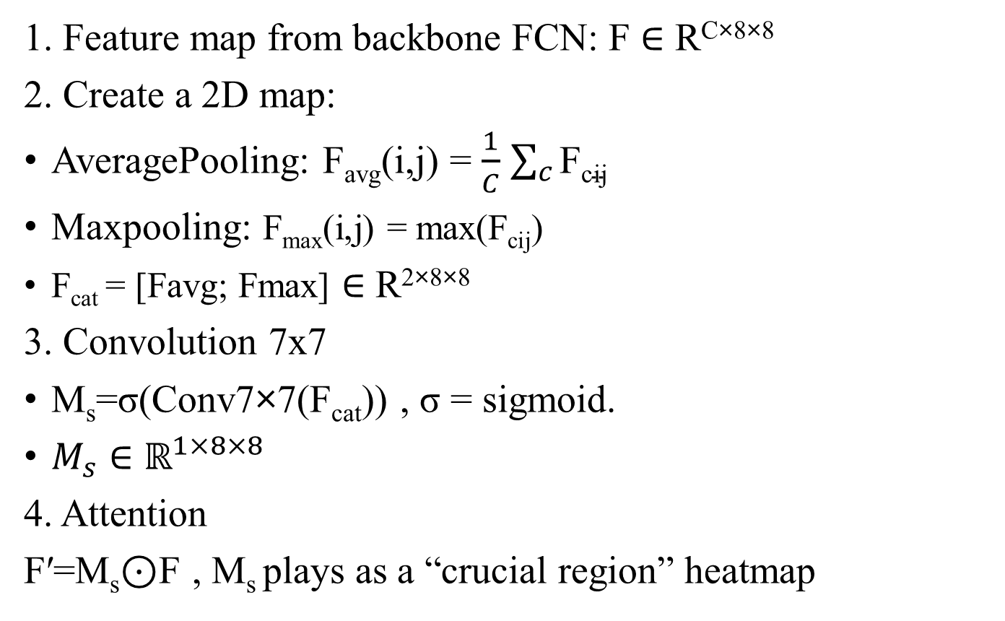
Introduce to Convolution Block Attention Module (CBAM):
1. Feature map from backbone FCN: F ∈ R^{C×8×8}
2. Create a 2D map:
AveragePooling: F_{avg}​(i,j) = $\frac{1}{C}$ $\sum_{c}{\text{F}\text{cij}}$
Maxpooling: F_{max}​(i,j) = max​(F_{cij}​)
F_{cat} = [Favg; Fmax] ∈ R^{2×8×8}
3. Convolution 7x7
M_{s}​=σ(Conv7×7​(F_{cat}​)) , σ = sigmoid.
$M_{s}∈ℝ^{1×8×8}$
4. Attention
F′=M_{s}​⊙F , M_{s} plays as a “crucial region” heatmap

Slide 13
THANK YOU !

