Slide 1
Improve Predictive Model Calibration for
Safety-Critical Domains
Group 9

Slide 2
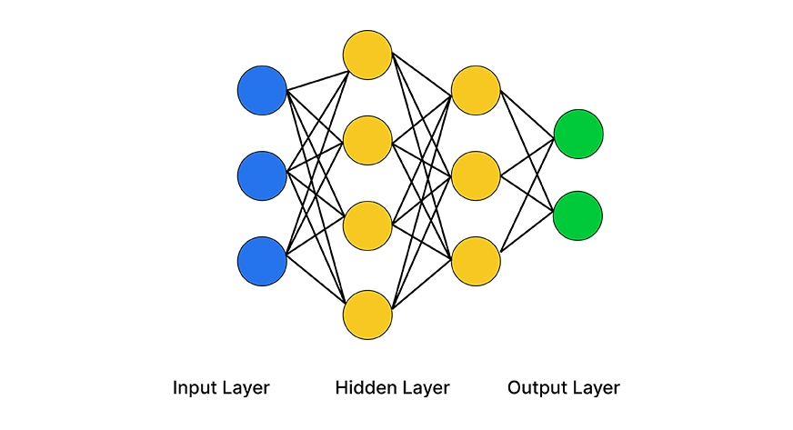
Introduction
Modern neural networks have achieved numerous successes in prediction tasks
Extend the usage of neural network into safety-critical domains

Slide 3
Motivations
Deep neural networks tend to be overconfident
Safety domains required not just raw accuracy, but predictive reliability

