Slide 1


illustrative
KT Vietnam health examination system construction project
performance plan
20XX. XX.XX

Slide 2
Contents
1. | Construction direction
2. | performing organization
3. | Role by Performing Organization
4. | schedule
5. | Scope of performance
6. | target system
7. | architecture
8. | Education / reference material work
9. | Test execution plan
10. | Business conversion and stabilization
11. | Project Management Approach Overview
12. | Schedule and progress management
13. | Quality and output management
14. | Scope and change management
15. | Issue and risk management
16. | Communication and reporting management
17. | People and organization management
18. | security management
19. | deliverables step by step
20. | Maintenance plan

Slide 3

Construction direction
1. Project Overview
One.
illustrative
We aim to build a system for user convenience and customer service enhancement .
Pain Point
Promotion and improvement direction
Closed and not standardized
system structure
direction 1
Health examination center specialized integrated solution
direction 4
Sales Management Mobile
Medical examination / medical information integrated management
Integrated system-based process standardization
Maximize estimating work efficiency
Real-time provision of sales information
ONE Stop composite screen limit
internal / external system linkage
direction 2
smart health examination system
direction 5
Advanced integrated PACS
Absence of sales system
Inspection equipment and internal / external system linkage
Real-time provision of customer movement and inspection results
Smooth exchange of examinee image information between centers
Provides user-friendly features
Difficulty in identifying revenue due to dual
Lack of data continuity due to the use of a dual system
direction 3
Homepage / Examiner's Mobile
direction 6
Advancement of new technology integration infrastructure
Homepage improvement and examinee mobile system establishment
Customer Convenience and increase manager efficiency
Building cloud infrastructure using new technology
uninterrupted infrastructure environment
Handwritten report and human error
Unable to secure operational stability
Notes:
Group ERP plays an inciting role

Slide 4
performing organization
2. Promotion organization / role and schedule
2.
Based on a clear understanding of this project through experience in similar projects, medical IT technical personnel and a systematic project management organization are organized to carry out the project .
general business
KT Computer Advancement Project Promotion Team
Steering Committee
KT | ISOFH
Development Supervisor
Operations Supervision
Power User Group
Project manager
PMO
Technical support organization ( Quality , Performance , Security , AA, DBA , etc. )
Development team
Integrated health check system
Education / reference materials
Examiner Mobile / Homepage
Sales Management Mobile
interlocking development
migration
building infrastructure
Building

Slide 5
Role by Performing Organization
2. Promotion organization / role and schedule
3.
Prompt decision-making on major project issues , coordination of opinions among stakeholders on major issues , power Define roles and responsibilities for each target organization, including requesting active participation by user groups .
target organization | Roles and Responsibilities | KT | attendant
Steering Committee | Decision-making on Giving organizational members a sense of purpose and providing direction | ● | ●
Project manager | Project management ( scope , budget , schedule , resources ) and execution responsibility Resolving major issues arising from the project , managing risks | ● | ●
PMO and Business PL | Project contract and project management Project management processes , methodologies and management tools spread education Project planning and progress monitoring Technical Support Project staffing / budget management Control and collection of various project outputs Support for communication and standardization activities between field TF and development team |  | ●
Power User Group | / confirmation of requirements for each area / confirm various outputs by stage Leading and participating in integrated test / user test in each area System function evaluation / approval | ●
development team | Promotion of practical work for individual parts by work area Resolving issues and conducting communication in the responsible business part Participation in project practice and development Participation in continuous change management and system improvement activities |  | ●
Technical support organization | AA (Application Architecture) DA (Data Architecture) TA (Technical Architecture) Quality / performance / security ( simulation hacking , web diagnosis , source , setting , server diagnosis ) OS/MW (OS and WEB/WAS, DB tuning support ) |  | ●

Slide 6
Promotion Schedule – Attendant (1/2)
2. Promotion organization / role and schedule
4.
division |  | February _ |  | March _ |  | april _ |  | may _ |  | june _ |  | july _ |  | august _ |  | september _ |  | October _ |  | november _ |  | december _ |  | '21 january _ |  | February _ |  | March _ |  | april _
TASK
PMO | KT DS
education
reference data
solution Development
examinee mobile / Homepage
business management mobile
detailed design
system development
testing and training
Diffusion and Stabilization
launch report
1st interim report
2nd interim report
Main office open
spread open
Representative user training
/ Schedule testing
unit test
( Establish scenario and training schedule plan )
integrated
test
rehearsal
Practice REMIND
education
Integration Test / Scenario
work
representative user
education
business user
education
rehearsal
reference data
List
Reference material training
Establishment of reference data
Field REMIND training
detailed design
package reflect
integrated
test
rehearsal
In situ stabilization
stabilization
package
installation
run unit tests
rehearsal
technology
Escalation
analyze
design
avatar
test
rehearsal
In situ stabilization
education
rehearsal
analyze
design
UI
design
avatar
( non-resident )
test
rehearsal
In situ stabilization
education
rehearsal

Slide 7
Promotion Schedule – Attendant (2/2)
2. Promotion organization / role and schedule
4.
division |  | February _ |  | March _ |  | april _ |  | may _ |  | june _ |  | july _ |  | august _ |  | september _ |  | October _ |  | november _ |  | december _ |  | '21 january _ |  | February _ |  | March _ |  | april _
TASK
PMO | KT DS
CDIS
RFID
data migration
infra
detailed design
system development
testing and training
Diffusion and Stabilization
launch report
1st interim report
2nd interim report
Main office open
spread open
detailed design
Program design / development
Gwanghwamun
Yeouido
interlocking test
Suwon
Gangnam / Gwangju
interlocking test
daegu
busan
interlocking test
integrated
test
rehearsal
center spread
stabilization
infra
installation
system
build
unit
test
integrated
test
rehearsal
stabilization
Operation process
analyze
AS-IS and TO-BE
analyze
TO-BE
transition design
Conversion verification and script supplementation
main conversion
germinal
stabilization
conversion target selection
Conversion script development
Perform center transition
center
stabilization
design
equipment order
operating equipment
Preparation ( upper side )
Operating infrastructure
( Network , power supply, etc. )
wearing operating equipment
build ( install )
Infrastructure Integration
Test ( all centers )
infrastructure stabilization
Establishment of development environment
spread support and
stabilization

Slide 8
3. Project implementation plan
5.
Scope of performance
Implementation plan including features and requests of existing solutions
Core function implementation plan (1/20)
division | work | function | explanation | implementation plan
knife jin sen place Special fury container bout brush roo sean | health check management | health care business Overall | ( by year ) sales policy management Daily cost management Management Excellent Customer Management | Package code management / Inquiry document / Inquiry management By Sales Representative Implementation of application rate details / health check list inquiry Implementation of daily cost management promotional expenses Payment rate management / sales promotion cost calculation details inquiry Misreceived occurrence status / realization of receipt Implementation of best customer management
 |  | health checkup support Overall | Management of the workplace certificate Partner hospital management | It is possible to search Implementation of
 |  | Sales management | business sales dry sales Medical revenue management | Estimated sales management / Nationwide center sales sales status can be viewed National Center Sales Sales Status / Sales Status by Center viewable Medical revenue management and inquiry available
 |  | business support | Corporation guidelines management Translation management Management of attracting foreign patients fee management Healthcare company sales management Outsourcing inspection agency management Reservation management Personal customer management Reservation confirmation management Reference data management Meal ticket management | Implement Implementation Implementation of Implementation of Healthcare company management avatar Inquiry of list of confirmed cases avatar Implementation of Implementation of Implementation of Detailed business site management / implementation of Implementation

Slide 9
3. Project implementation plan
5.
Scope of performance
Core function implementation plan (2/20)
division | work | function | explanation | implementation plan
knife jin sen place Special fury container bout brush roo sean | reception / claim | reception / storage management | Consent form and ID management dry storage External site input management | Implementation of consent and ID management Realization of integrated storage function for treatment / medical examination Implementation of qualification inquiry
 |  | progress management | Movement management Medical Accident / Complaint Management Treatment management before dispatch | Implementation of examinee movement line inquiry Management through patient top information display of health examination / medical treatment integrated result inquiry
 |  | Result management | Equipment result management Questionnaire input management Endoscopy result management ( record sheet ) | Implementation of result management Implementation of paperweight code management integrated record inquiry / integrated record inquiry classification management
 |  | hospital management | Outpatient reception outpatient | Outpatient registration / medical support management of selected doctors Patient basic information management / foreign patient registration Implementation of foreign patient management Outpatient payment / confirmation of medical expenses details Daily payment deadline / Implementation of outpatient payment inquiry
 |  | Issuance management | Certification Management ( Issuance ) copy management CD Issuance ( Issue ) Issuance of slides ( Issuance ) | my proof / Implementation of certificate issuance Copy issuance details inquiry / implementation of copy issuance Radiology CD Management of slide loan registration / loan return status patient inquiry

Slide 10
3. Project implementation plan
5.
Scope of performance
Core function implementation plan (3/20)
division | work | function | explanation | implementation plan
knife jin sen place Special fury container bout brush roo sean | reception / claim | outpatient billing | outpatient billing Create | Outpatient claim creation / outpatient follow-up review / objection implementation SAM FILE creation implementation
 |  | reference data | EDI code management Insurance type management fee management semen generation management Consignment contract management Prescription management | Provides standard data management screen such as
 |  | management of patients | advance payment management | card , cash, etc. Implementation Cash receipt approval details can be viewed
 |  | management | Personal Accounts Receipt Management Management of unaccompanied patients | Personal attempt list search available SMS transmission function Accounts receivable payment notice can be printed Implementation of non-received patient management
 |  | receipt / storage management | Result Consultation Reservation | Details can be viewed by Implementation of checking and managing

Slide 11
3. Project implementation plan
5.
Scope of performance
Core function implementation plan (4/20)
division | work | function | explanation | implementation plan
knife jin sen place Special fury container bout brush roo sean | special examination | special examination | Reviewer notification and reporting other tasks Health agency / work environment measurement Estimation and reservation for special medical examination Ministry of Labor and Korea Occupational Safety and Health Agency result report Estimation and reservation for special medical examination Special medical examination result processing and output Health agency / work environment measurement other tasks Estimation and reservation for special medical examination Quality control and institutional evaluation Health agency / work environment measurement Special medical examination result processing and output | 2 Implementation of the list of patients subject to medical examination Implementation of provisional upload Management of sending official documents / implementation of cerebrovascular test result status Health Agency WorkList / Implementation of basic management of health agency workplaces Receipt of health agency / Realization of billing statement for health agency Implementation of health agency claim generation Implementation Sanan report data creation avatar Selection of special medical examination items / implementation Reservation and reception status avatar Realization of Business trip review plan / business trip review program implementation Settlement of special health checkup / realization of Special medical examination report / Special medical certificate avatar Quality control of special medical examination ( hearing / pneumoconiosis ) / realization of implementation of Implementation of
 | health checkup support | health checkup support | reservation calculate health check result order report | CTI Callback Management / Waitlist Management Text message sending management / sending management Advance reception / Reservation schedule management Integrated reservation management, billing management / bill registration health check result Suspicion result / Health examination result Healthcare company results Order report management

Slide 12
3. Project implementation plan
6.
target system
health care , medical and PACS , etc. It aims to build an integrated KT SMART health examination
system .
customer service
management information
external institution
ONE
Health status
Sales Status
information analysis
dashboard
Industrial Safety Corporation
home page
Ministry of Employment and Labor
integration
SMS
National Health Insurance
email
Standard information management
business management
Reservation management
health check management
customer management
LIS
Review and Assessment Service
Common information management
Geonjin Sales Management
Reservation information
industrial complex
Reservation Consultation
inspection management
CTI
Business site information management
Account management
Reservation status
special examination
result consultation
quality control
entrusted institution
Inspection information management
Estimation management
bulk reservation
Comprehensive medical examination
Vigilance
equipment interlocking
Food and Drug Administration ( narcotics )
mobile app
Receipt / Billing
statistics management
OCS/EMR
Customer Relationship Management
Result management
card company
storage management
Data collection / analysis
diagnosis
receipt
record
revenue
Consultation chatbot
health check result
Corporation claims management
Indicator management
Endoscope
inoculation
claim
acceptance
Result sheet management
Billing / Accounts Receivable Management
predictive management
video
Imaging EMR
drugs
pathology
External examination office
PACS
Basic inspection
function test
electronic signature
Directions
ERP
groupware
Overall opinion
coercion
key
intraocular pressure
EKG
Prescription signature
RFID
Accounts receivable
advance payment
Electronic payment
examination findings
image
weight
…
Breath
…
inspection signature
Waitlist management
personal deposit
group claim
Messenger
IT infrastructure
server
network
storage
security equipment
System S/W
new introduction
system connection
improvement

Slide 13
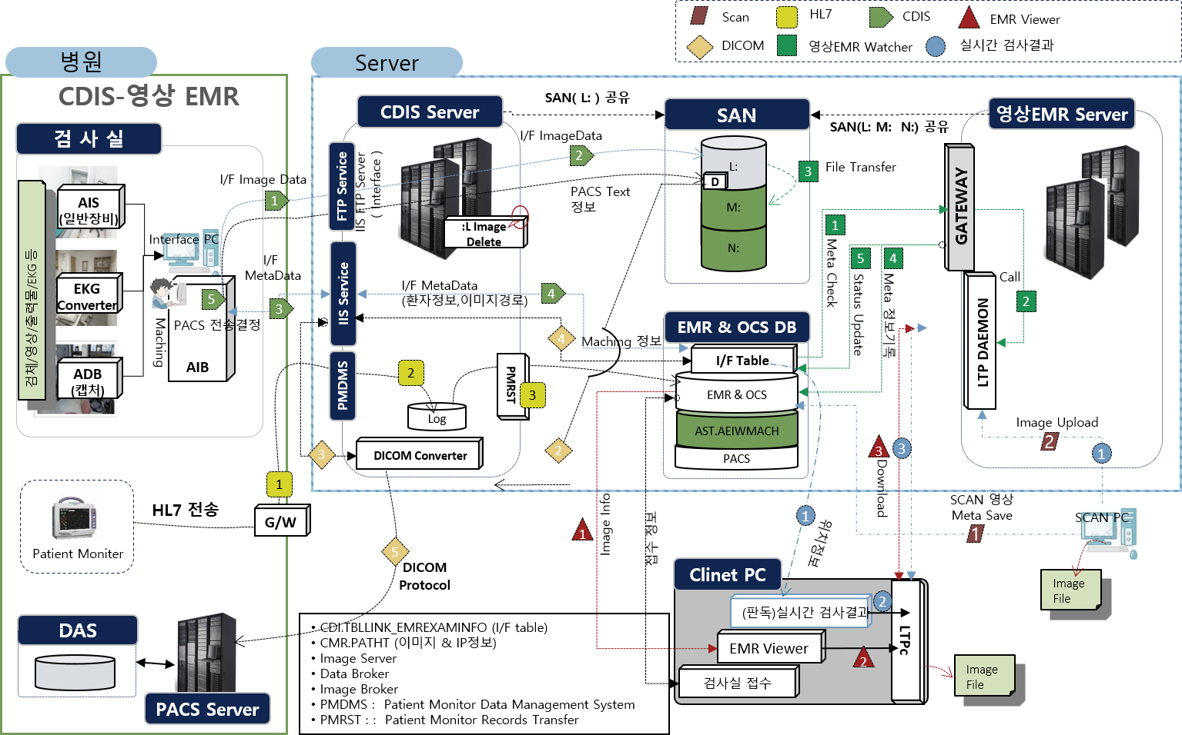
3. Project implementation plan
7.
Architecture - Application
By providing various agents , through protocol communication with DDC , data to be analyzed is collected , The architecture is composed of a structure that stores statistical analysis results by applying an algorithm .
Write if the architecture is performed together

Slide 14

3. Project implementation plan
7.
Architecture – Live framework
It is composed of MVC model based on Live Framework .
Business Common Services
Platform Dependent Services ( PDS )
TCS (Testing Common Services)
BDS (Business Dependent Services)
Business Specific Services ( BSS )
Insurance
Defense
Public
Providing services commonly required in business operations
/ specialization possible according to business contents
postal code search , calendar , common code management, etc.
Unit Testing
Health Care
Banking
Manufacturing
Business Common Services ( BCS )
…
Common
Code
Zip Code
Calendar
Application common service
Stress Testing
Provide services commonly used by applications
/ specialization or setting during application development
Batch processing , webmapper service , logging service , DAO, interceptor , etc.
Business Independent Services ( BIS )
Application Common Services (ACS)
Batch
DAO
Message
Transaction
…
DataSource
Logging
IdGeneration
Web Mapper
ASI (Application Service Infrastructure)
AOP
WebActionDispatcher/WebAction
Application service infrastructure
UI Testing
Service Container
infrastructure
Composed of Service Container , which is an IoC Container , and AOP and Web MVC Framework
ACC (Application Core Components)
EJBizDelegator
DataSource
LiveException
Utility
…
Code
Coverage
Testing
ServiceLocator
ValueObject
Query
Resource
Transaction
application core components
JavaEE Platform
Java -based web application development and application common service development
client request processing , DB access , data transfer between components , component lookup , resource management , various utility components, etc.
Plug-ins
Tools
PIS (Platform Independent Services)
PCS (Project Common Services)
Methodology Common Services ( MCS )
Version Manager
Build Manager
Bulletin Board
Tutorials
Deliverable Templates
Examples
Tailoring Guides

Slide 15







3. Project implementation plan
7.
Architecture – Cloud Infrastructure.
Separate Zones by area based on Private Cloud Securing business continuity through redundancy in preparation for major server failures , and when expanding services Provides flexible scalability through virtual machine (VM) expansion .
WAN
Out internet section
WAN
VPN
VPN
SD-WAN
VPN
SD-WAN
VPN
IDC internal network
network inside the center
Integrated backup
integrated
storage
OCS/EMR
DB server
Integrated AP server
(IDC)
PACS Server
( Center )
PACS
storage
(DAS)
DMZ
system
operation management
AP/WAS
DB
PACS
OCS/EMR WEB #1
OCS/EMR WEB #2
virtualization
manager
Vaccine management
OCS/EMR AP #1
OCS/EMR AP #2
LIS #1
LIS #2
CDIS #1
CDIS #2
Video EMR #1
Video EMR #2
home page
DB
Gwanghwamun
PACS #One
Gwanghwamun
PACS #2
Gangnam
PACS #One
Gangnam
PACS #2
Yeouido
PACS #One
integrated log
DB
access control
DUR #1
DUR#2
PACS
Broker
PACS
back up
RFID
RFID
Broker
interior
DNS
Internet
proof
Yeouido
PACS #2
Suwon
PACS #One
Suwon
PACS #2
gwangju
PACS #One
gwangju
PACS #2
home page
WEB #1
home page
WEB #2
RFID
DB
integrated control
mobile
WAS #1
mobile
WAS #2
former
agreement
road name
address
Homepage WAS #1
home page
WAS #2
daegu
PACS #One
daegu
PACS #2
busan
PACS #One
busan
PACS #2
security management
mobile
WEB #1
mobile
WEB #2
Development
Testing / Quality / Training
mobile
Development
DUR development
OCS/EMR development
LIS development
PACS
Development
CDIS development
Imaging EMR
Development
configuration management
Distribution management
mobile
test
DUR
test
OCS/EMR
test
LIS
test
PACS
test
CDIS
test
Imaging EMR
test

Slide 16
3. Project implementation plan
7.
Architecture – Cloud Infrastructure.
server history
No | Role | algebra (EA) | CPU (Core) | MEM (Gb) | Local Disk (Gb) | sheath Disk | OS | DB | MW | duplication | note
One | OCS/EMR WEB | 2 | 2 | 4 | 300 | - | Linux |  |  | O
2 | Homepage WEB | 2 | 2 | 4 | 300 | - | Linux |  |  | O
3 | Mobile WEB | 2 | 2 | 4 | 300 | - | Linux |  |  | O
4 | OCS/EMR AP | 2 | 6 | 32 | 500 |  | Linux |  | Jeus | O
5 | LIS | 2 | 6 | 32 | 500 |  | Windows server |  |  | O
6 | CDIS | 2 | 6 | 32 | 500 |  | Windows server |  |  | O
7 | Imaging EMR | 2 | 6 | 32 | 500 |  | Windows server |  |  | O
8 | DUR | 2 | 4 | 8 | 500 |  | Windows server |  |  | O
9 | PACS Broker | One | 4 | 8 | 500 |  | Windows server |  |  | O
10 | PACS Backup | One | 4 | 8 | 500 |  | Windows server |  |  | O
11 | RFID | One | 4 | 8 | 500 |  | Windows server |  |  | O
12 | RFID Broker | One | 4 | 8 | 500 |  | Windows server |  |  | O
13 | Internal DNS | One | 4 | 8 | 500 |  | Windows server |  |  | O
14 | Internet proof | One | 4 | 8 | 500 |  | Windows server |  |  | O

Slide 17







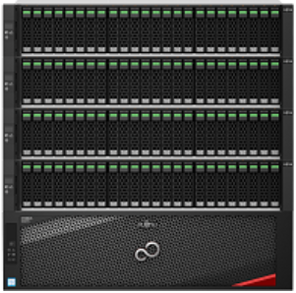

3. Project implementation plan
7.
Architecture - Network
entire A redundant network is formed, and IDC builds IPS and Ant-DDoS for external service operation, and installs wireless APs for center work efficiency . The IDC and the center communicate using SD-WAN and VPN networks .
WAN
Out internet section
WAN
VPN
VPN
SD-WAN
VPN
SD-WAN
VPN
L3 switch
L3 switch
internal network
(10G)
IPS/IDS
Ant- ddos
internal network
(1G)
firewall
firewall
L4
backbone
network controller
( wireless , wired )
L4
backbone
L4
center
Center L2
IDC L2
IDC
PACS Server
center
storage
(DAS)
PoE L2
back up
storage
(Network)
main
storage
(SAN)
main cloud
server
OCS/EMR
DB server
wireless AP
May be deleted depending on the timing of PACS integration
SAN

Slide 18
3. Project implementation plan
7.
Architecture – Software
OCS/EMR WEB | OCS/EMR APs | OSC/EMR DB | LIS | CDIS | Imaging EMR | DUR
WEBTOBE | JEUS | Oracle E/E 12c | LIS S/W | CDIS S/W | Video EMR S/W | DUR S/W
SSL | Reexpert Tool | Vormetric Agent ( Reuse ) | Obics APM Agent | Obics APM Agent | Obics APM Agent | Obics APM Agent
PKI | L.Hospital S/W | combat agent ( reuse ) | combat agent ( reuse ) | combat agent ( reuse ) | combat agent ( reuse ) | combat agent ( reuse )
combat agent ( reuse ) | Obics APM Agent | Obics SMS Agent | Obics SMS Agent | Obics SMS Agent | Obics SMS Agent | Obics SMS Agent
Obics SMS Agent | combat agent ( reuse ) | DB safer agent ( reuse ) | Node safer agent ( reuse ) | Node safer agent ( reuse ) | Node safer agent ( reuse ) | Node safer agent ( reuse )
Node safer agent ( reuse ) | Obics SMS Agent | Oracle Linux | V3 Agent ( Reuse ) | V3 Agent ( Reuse ) | V3 Agent ( Reuse ) | V3 Agent ( Reuse )
Redhat 7.x | Node safer agent ( reuse ) |  | windows server 2019 | windows server 2019 | windows server 2019 | windows server 2019
 | Redhat 7.x
Homepage WEB | Homepage WAS | Mobile WEB | Mobile WAS | Homepage / Mobile DB | Internal DNS | electronic agreement
Apache | Tomcat | Apache | Tomcat | Oracle E/E 12c | Obics APM Agent | Electronic Agreement S/W
SSL | Obics APM Agent | SSL | Obics APM Agent | Vormetric Agent ( Reuse ) | combat agent ( reuse ) | combat agent ( reuse )
PKI | combat agent ( reuse ) | PKI | combat agent ( reuse ) | combat agent ( reuse ) | Obics SMS Agent | Obics SMS Agent
combat agent ( reuse ) | Obics SMS Agent | combat agent ( reuse ) | Obics SMS Agent | Obics SMS Agent | Node safer agent ( reuse ) | Node safer agent ( reuse )
Obics SMS Agent | Node safer agent ( reuse ) | Obics SMS Agent | Node safer agent ( reuse ) | DB safer agent ( reuse ) | CentOS 7.x | windows server 2019
Node safer agent ( reuse ) | CentOS 7.x | Node safer agent ( reuse ) | CentOS 7.x | Oracle Linux
CentOS 7.x |  | CentOS 7.x
Street name address | internet proof | RFID | RFID Broker | RFID DB | PACS Backup | PACS Broker
Road Name Address S/W | Internet verification S/W | RFID S/W | combat agent ( reuse ) | Oracle E/E 12c | combat agent ( reuse ) | combat agent ( reuse )
combat agent ( reuse ) | combat agent ( reuse ) | combat agent ( reuse ) | Obics SMS Agent | Vormetric Agent ( Reuse ) | Obics SMS Agent | Obics SMS Agent
Obics SMS Agent | Obics SMS Agent | Obics SMS Agent | Node safer agent ( reuse ) | combat agent ( reuse ) | Node safer agent ( reuse ) | Node safer agent ( reuse )
Node safer agent ( reuse ) | Node safer agent ( reuse ) | Node safer agent ( reuse ) | windows server 2019 | Obics SMS Agent | windows server 2019 | windows server 2019
windows server 2019 | windows server 2019 | windows server 2019 |  | DB safer agent ( reuse )
 |  |  |  | Oracle Linux

Slide 19
3. Project implementation plan
7.
Architecture – Software
OCS/EMR development | LIS development | CDIS development | Visual EMR development | DUR development | Homepage / Mobile Development | PACS development
WEBTOBE | LIS S/W | CDIS S/W | Video EMR S/W | DUR S/W | Apache | PACS S/W
JEUS | windows server 2019 | windows server 2019 | windows server 2019 | windows server 2019 | Tomcat | windows server 2019
SSL |  |  |  |  | CentOS 7.x
PKI
Reexpert Tool
L.Hospital S/W
Redhat 7.x
OCS/EMR test | LIS test | CDIS test | Imaging EMR test | DUR test | Homepage / Mobile Test | PACS test
WEBTOBE | LIS S/W | CDIS S/W | Video EMR S/W | DUR S/W | Apache | PACS S/W
JEUS | windows server 2019 | windows server 2019 | windows server 2019 | windows server 2019 | Tomcat | windows server 2019
SSL |  |  |  |  | CentOS 7.x
PKI
Reexpert Tool
L.Hospital S/W
Redhat 7.x

Slide 20
3. Project implementation plan
8.
Education / Reference data work
the KT Vietnam health examination system, training for representative and field users is conducted , and standardization of reference data is simultaneously performed .
Training and Baseline Procedures |  | performance details
 | detailed design | training schedule establish Selection of trainees , confirmation of training schedule and scope user education Representative user training Spread education by center ( representative user -> field TF) support Preparing training data Writing educational materials Writing training materials for each part and job
 | build and stabilization
 |  | Reference material training 4 major masters and standard data for each task Confirmation and standardization of reference data range Establishment of standard data training schedule and training Establishment of reference data Reference data 7 center standardization Establishment of reference data operation process Standard data correction and supplementation Modification and supplementation of standard data based on the results obtained during testing
user education
Reference data work
representative user
Establish training schedule
Reference material training
(4 major masters )
Package education ( representative user )
master screen
analysis and design
Establish training schedule ( representative & field user )
master screen
correction
Writing educational materials
Establishment of reference data
Representative user training
Standard data correction and supplementation
On-the-job user training
( Diffusion education )
Field REMIND training

Slide 21

3. Project implementation plan
9.
Test execution plan
Establish an efficient test environment based on pre-validated procedures and a dedicated organization , strengthen user / collaboration-oriented (TF) tests , and conduct tests according to the quality assurance system
test step by step
Verification and Verification
high-risk areas
Early Verification
high quality
guarantee
unit test
unit test
Screen unit function verification
(TF) unit test
integration test
integration test
Test relationships at each step by process
Customer (TF)/ developer-based verification
Rehearsal _
line Test verification in an environment equivalent to system open
Verification of overall application and base technology
Rehearsal
rehearsal

Slide 22
3. Project implementation plan
9.
Test execution plan
unit tests , integration tests , and rehearsals , system functions are verified according to requirements and design results. avatar verify that it has been done .
Execution Task | Activity
One. Establish a test strategy | Establishment of schedule and resource plan for full functional test execution , sharing and confirmation by relevant team The step-by-step test data preparation schedule is in the test strategy establishment stage. Confirmed in consultation with each related part .
2. Establish test goals | Establishment of test performance goals for each stage of testing
3. Step-by-step features test detailed plan establish | ( scope ), test execution procedure , distribution / release procedure, etc. for
 | Establishment of a step-by-step detailed plan for
4. Step-by-step testing write a statement and test environment build | unit test case writing
 | Creating business scenarios / cases /test data for
 | Batch /Interface test case writing
 | Establishment of system environment for
 | Migration tables required for integration testing are determined
5. perform tests and Organize the results | Unit tests are performed by the program developer and designer / leader , and the results of the tests are recorded.
 | The 1st integrated test is supervised by the performing company , and the test is conducted under the participation of KT TF and the results are managed.
 | In the 2nd integrated test, the customer conducts joint tests and manages the results.
6. Defect identification and action | Cause analysis, action , tracking management
7. Step-by-step testing report results | Create a report on the results of each stage of the test (( defect detection and action result statistics ) Review results and decide whether to proceed to the next step

Slide 23
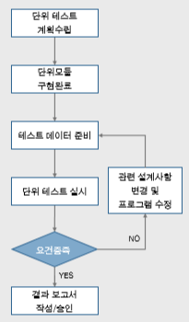
3. Project implementation plan
9.
Test Execution Plan _ Unit Test (1/2)
This is the process of testing to verify whether the functions of unit modules and programs conform to the functions of the specifications , review whether the coding phase is written according to project standards , and check whether the necessary functions within each program are properly performed .
Unit test execution plan
illustrative
test method
test procedure
Test history
• Data consistency test for each program by inputting sample data for testing for the program created by the application system developer
• Functions in the program , execution path , and error handling tests
• Unit test subjects : KT TF
• Establish unit test scheduling ( test order , timetable )
• New / Fixed Program Unit / Test Specifications
• Prerequisites
- Test item , test data , screen and item description
Test checklist
• Conduct tests to check functionality
• Modify test cases when design documents are changed.
• log errors, even minor ones, to the unit test error list
• Normal operation of unit program function
Whether
• Compliance with program standardization
• Omission of function of unit program
• Test results are reflected in components
• Completed programs are stored in a separate library after being checked by the head of the unit business team.
Outputs
unit test specification

Slide 24
3. Project implementation plan
9.
Test Execution Plan _ Unit Test (2/2)
This is the process of testing to verify whether the functions of unit modules and programs conform to the functions of the specification , review whether the coding phase has been written in accordance with project standards , and check whether the necessary functions within each program are properly performed .
Procedure for conducting unit tests
Development Team
illustrative
unit
test
case
Specification
write
development / modification
enforcement
development completed
test request
education /
Standard Data Team
N
N
unit
test
case
write results
test run
Requirements
verification
Y
test
request
Requirements
verification
Y
complete
customer
Field TF
unit
test
case
write result
test run

Slide 25
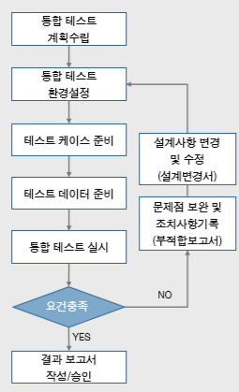
3. Project implementation plan
9.
Test implementation plan _ integration test ( application )
Test and evaluate the interaction between components between internal systems and hardware components, and verify smooth information linkage and data consistency between internal and external systems .
How to conduct integration testing
illustrative
test method
test procedure
Test history
• Functional inspection by task
• Inspection of interface accuracy between internal / external systems ( equipment tests are performed during rehearsals depending on circumstances )
• Integration test subject : KT TF
• Writing integration test specifications
- Purpose and scope , method , test case classification , test data acquisition , test schedule planning , test promotion organization , test scenario writing
• Test group classification
• Deriving test cases
• Setting test items
• Obtain test data
Test checklist
• Prerequisites
- Test item , test data , screen and item description
• Conduct testing
• Write test data for each test item to conduct integration test , record test specification processing
• Whether or not the function of the program group works normally ( function test )
• Internal / external system interface
Test ( Reservation -> Reception -> Examination -> Claim )
Outputs
integration test specification

Slide 26
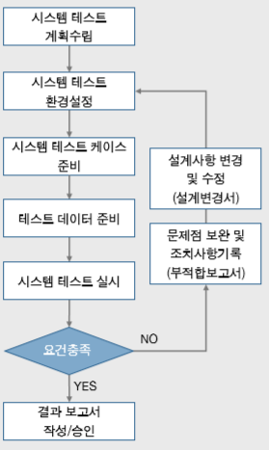
3. Project implementation plan
9.
Test Execution Plan_ Integration Test ( Performance Test )
This is a test that measures the performance of the system in an environment composed of test data implemented in actual operation for the entire system and equipment to be actually operated, and additional resource expansion factors can be removed after the system is opened in the future .
How to perform integration test ( performance )
illustrative
test method
test procedure
Test history
• Performance test under single and multiple loads
• Check for abnormal errors such as
• System test subject : Organization specializing in testing of proposed companies
• Deriving test cases
- System performance , overload test , security
• Setting test items
• Obtain test data
• Write system test plan
purpose and scope , method , test case classification , test data acquisition , test schedule planning , test organization
Test checklist
• Prerequisites
Test item , test data , screen and item description
• Setting performance metrics
• Stress test
Whether the normal operation of the expected maximum number of cases is possible
• Volume test
• Optimization test
- Hardware / software parameter adjustment , lock occurrence monitoring
• Performance test
- By transaction TPS, average response time
• Load test
- Identification of bottlenecks in each section , response time ,
• Stability test
- Long-term (10-24 h) testing
Outputs
Performance Test Plan / Result

Slide 27
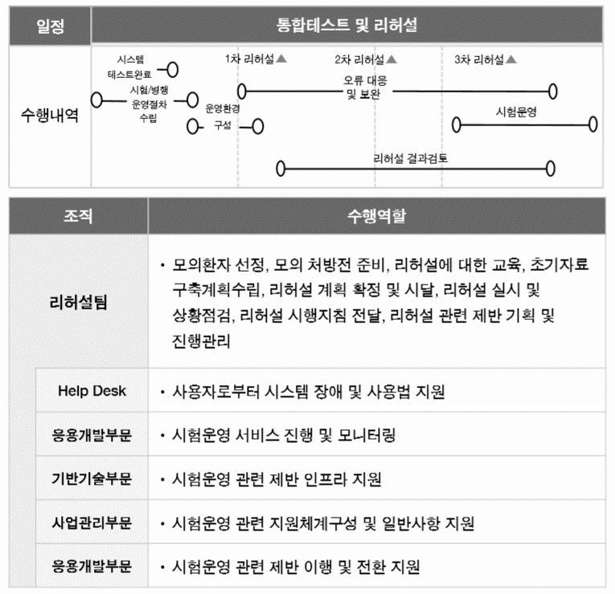
3. Project implementation plan
9.
Test implementation plan _ Rehearsal (1/2)
The user directly participates in the test according to the predefined test plan to see whether the built system guarantees user requirements and appropriate functions ( performance ) .
Rehearsal preparations and schedule
illustrative
Preparations
Establishment of work response plan during rehearsal
• Unit and integration tests completed
• Check hardware and network environment
• Organization of rehearsals
• Composition of emergency preparedness experts ( hardware , software , application system )
• Establishment of handling plan in case of program change
• Establishment of work-specific handling plans in case of system failure
• Establish a backup plan
• Establishment of application system source version management plan
System Prerequisites
• Main System, Database, Network, Other System S/W Entire Set Up Confirmation , Tuning and Test Run
Inspection of client equipment and related application software ( automatic distribution of final application )
• Final conversion of data to be applied to the new system among past data , accuracy test, and confirmation of results
Composition of support personnel for each KT task and adjustment of work schedule ( day / night work support , telephone response , program error correction , data supplementation, etc. )

Slide 28
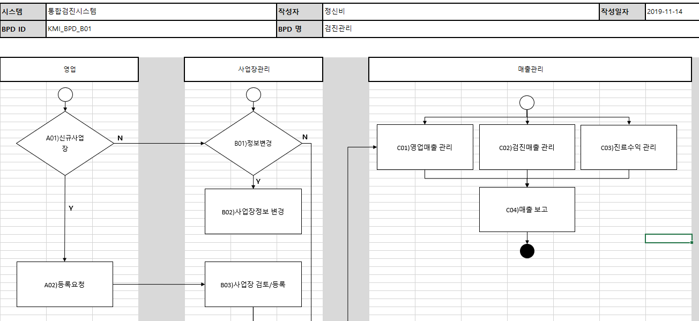
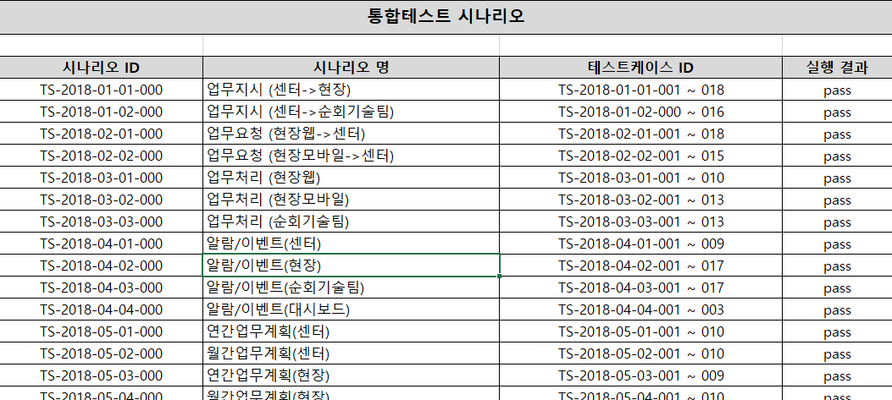
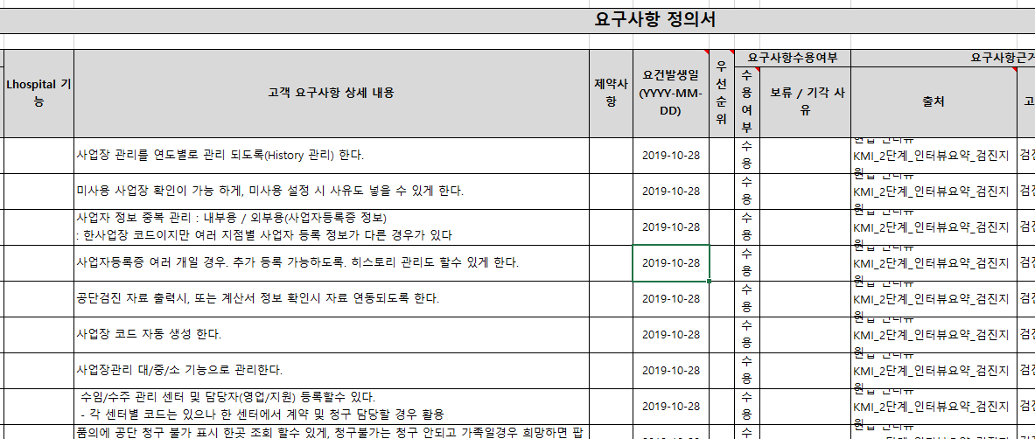

3. Project implementation plan
9.
Test implementation plan _ Rehearsal (2/2)
The rehearsal is carried out with the Comprehensive linkage and practice to CDIS and internal and external interfaces The purpose is to test even the movement line check for simulated customers / patients .
Pre-rehearsal plan
Example progress scenario
rehearsal content
rehearsal test case
classification
division
Main detailed function
BPD
integration test
base
system
H/W
• Preliminary identification of improvement points through monitoring
- CPU and DISK usage test , Physical Memory usage test , Disk I /O test
data
Base
• Analysis of function , performance and adequacy of DB settings
- DB performance management , suitability of DB structure
etc
System SW
• Tuning for optimal performance - Optimal parameter setting according to the number of
requirements statement
work
system
Performance
• Verification of system performance and data retrieval performance when multiple users access
• Verification of system load
• Verification of response time for frequently used formal queries
Filling out a paperweight
receipt
site
S
handwriting
notes
Dried
Functional
• Verification of implementation of customer requirements
• Reliability verification of stored data
• Verification of consistency of prescription data
simulated patient
N
Out
mobile writing
scanning
Out
equipment
“Integrative test and rehearsal specification based on BPD and requirements definition : Derivation ”
Ease of use
• Verification of user convenience of input screen
• Verification of user convenience of various inquiry screens
• Verification of ease of creation and utilization of various reports
key checklist
• Connection test with external equipment (CDIS, PACS, LIS, Douzone )
• Identification / resolving
• Identification / resolution

Slide 29
3. Project implementation plan
9.
Test implementation plan _ Security test
The security test verifies access rights to login / menu, security functions implemented in the system , and tests and identifies system vulnerabilities .
division | test Target | test detail
system vulnerability (OS) | All servers (WEB/WAS/DB/AP) | script diagnosis
system vulnerability (DBMS) | DB server | Confirm compliance with
web vulnerabilities (Web Application) | WEB/WAS server | Web Vulnerability Scan Diagnosis ( Utilization of Vulnerability Diagnosis System )
Privacy common | Personal information management server | Personal information protection level diagnosis
access right | Web/Application server | Check access rights by

Slide 30
3. Project implementation plan
10.
Business conversion and stabilization
Open and spread the optimized service through a stabilization period after thorough pre-function testing and data verification .
division
December 2020 to April 2021 _ _ _
january _
February _
March _
april _
Go-Live
diffusion
M11
M12
M13
ITO/SM
One
3
user testing
and rehearsal phase
Opened Gwanghwamun headquarters
and stabilization phase
Stabilization of Gwanghwamun Headquarters
and preparing for the opening of 6 centers
2
6 centers open
and stabilization phase
4
❶ Go-Live Pre-Check: Function check
❷ Gwanghwamun headquarters opening and stabilization phase
Go-Live Check
- Integration test and rehearsal 3 months before
- Verification of interlocked external data consistency
- Operation server source distribution and operation environment SETUP
Help-Desk operation
Parallel implementation of the
- Parallel implementation of tests requested by each center ( temporary until spread )
- Implementation of LIS Interface redundancy ( the center transmits results to the previous system )
❸ Stabilization of Gwanghwamun headquarters and preparation for opening of 6 centers
❹ IT Service transfer
Go-Live Check ( prepare for opening of 6 centers )
- Verification of interlocked external data consistency
- Operation server source distribution and operation environment SETUP
- Check each center interface
transfer of operation
system monitoring
- DB, Application Server Monitoring and Alert
User Perspective Monitoring
- Major Transaction Monitoring and Alerts

Slide 31








3. Project implementation plan
10.
Business Transition and Stabilization _ Help Desk
During the stabilization period, a help desk will be formed to promptly resolve issues that arise in the early stages of system operation .
Help Desk Operation Plan
Help Desk Purpose
HelpDesk operating system
Convenience for system users - Prompt solution in case of inexperienced usage or system failure - User inquiries and problem solving - Identification of user additional training requirements and training
System issues and troubleshooting - Prompt resolution of problems at the beginning of operation - Promote early stabilization of the system
System stabilization and improvement - Early settlement and stabilization of the system - Derivation of additional improvement requirements
problem occurs _
Receive a problem
problem solving
notice of resolution
problem analysis
Unification of communication channels
Rapid issue resolution and system operation stabilization
business issue
infrastructure issues
system issue
user
communication channel
Communication channels operated by customers
project team
Developer / Operator
integrated control
mobile
control point management
cloud

Slide 32
Project Management Approach Overview
4. Project management plan
11.
In project progress, schedule management , quality management , scope management , issue and risk management , communication management , and manpower management processes are managed in an integrated manner .
Project progress management area
project management area
project progress management
project progress management
Schedule and progress management
project schedule , progress status , output progress , major routes and interrelated matters
schedule and progress management
quality and output management
range and configuration ( change ) management
Quality and output management
Identify stakeholder expectations and needs . Establishment of plans accordingly and inspection of project progress including outputs
Scope and change ( geometry ) management
Track major scope changes from initial scope definition . Continuous tracking and management of changes to baselines/ products that have a large impact
Issue and risk management
Communication and reporting management
People and organization management
Issue and risk management
Periodically inspect the status of issues and risks that occur during project execution . Management by priority and utilization of appropriate techniques
Communication and reporting management
Establishment of internal and inter-project communication channels, such as exchanging project progress and key information
Change and training management
security management
Development and production environment management
People and organization management
Review the adequacy of the manpower input plan for all project participants and monitor actual manpower input based on the plan

Slide 33
Schedule and progress management (1/2)
4. Project management plan
12.
schedule delays / changes due to additional volume , etc., we establish management standards, index progress management by stages , and perform progress management based on linkage with the management system .
range of propulsion
Main Content
schedule / progress management standards
schedule / change and progress management procedures
task progress and output derivation , but prevent situations in which required outputs are omitted after the schedule has elapsed
WBS creation / change , development / test quantity registration / change , progress monitoring, and establishment of delay action procedures
Automatic monitoring and aggregation of progress rate against development / test target volume , report data calculation
WBS writing criteria
a WBS , concrete plans and guidelines are presented to divide work into units that can be realistically calculated by reflecting the characteristics of the work.
Establishment of criteria for calculating progress rate by stage
Considering the schedule difference by project task stage progress rate Calculation standard presented
- step progress management index
Based on real-time linkage Automated progress management
project management tool linkage
Reinforcement of development output progress management reliability
Development Performance Aggregation Method apply
the development / unit test phase
Simultaneous use of
Intensive management plan for development output and test progress and improvement of effectiveness / efficiency

Slide 34
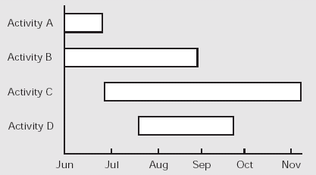
4. Project management plan
12.
Schedule and progress management (2/2)
PMO- centered systematic communication, various communication channels such as regular and irregular reports, meetings , workshops , and briefings are utilized .
Schedule and progress management plan
Establish project schedule
Weekly progress management
Establishing a schedule considering the nature of work by area and interrelationships
Reflect changes to plans / schedules and manage baselines at the same time
Identify the weekly progress of each part on the Project Plan and identify the integrated progress rate
Identification of issues through impact analysis of related projects due to inconsistency between plan and progress
Since the completion or initiation of a task is the same as the completion or drafting of the corresponding output, it is performed by linking the output creation and management with progress management
Active progress management in the form of intensive management of tasks that are expected to be delayed in advance
progress check
Progress management process
Critical path in job performance is inspected on a daily basis to sensitively monitor progress
Aggregation of weekly progress rate and output status by team
Progress tracking and integration
Identification of issues and analysis of impact on overall schedule
Coordination among relevant stakeholders
Team progress chart
Output completion status table by team
Overall project performance management status chart ( cumulative performance against plan)
Current status of project deliverables
Issue Log (Update) → Plan adjustments and changes if necessary
Today

Slide 35
4. Project management plan
13.
Quality and Output Management (1/2)
business In order to secure requirements , development quality , and test quality, we establish a quality plan that meets project goals , conduct quality control , and implement a monitoring system for activities .
Quality and deliverables management overview
promotion goal
Definition of quality standards and quality levels that align with project objectives
Establish a reasonable system for project quality control
Provision of procedures and criteria for quality verification
Biz Requirement Traceability Quality
Analysis of business department requirements from an integrated perspective , reflection of design , development , and testing, and quality assurance
Core management direction
step by step Securing development quality
/ progress management utilization plan
Code smell removal through
Securing quality that can pass company-wide security standards and standardization standards
based on customer needs
Establishment of quality plan
of quality requirements and various standards , rules , guidelines , policies , and procedures
Securing TEST- based execution coverage quality
quality assurance and
Perform quality control
User Acceptance level For quality, test scenario / case coverage, interface consistency secure
Securing
Support for various resources necessary for the implementation of the quality plan
Identification of quality complaints and cooperation with resolution activities
Quality Management Theme
of the results of quality control activities
Establish feedback system
Confirmation of achievement of quality requirements and suggestions for improvement
Clarification of feedback system for quality activity results
T raceability
C overage
Visibility _
Security & standard _

Slide 36
4. Project management plan
13.
Quality and Output Management (2/2)
In order to secure project quality, we operate quality management priority goals , activities and target scopes , implementation plans and management system for each stage and project .
range of propulsion
Main Content
Define the scope of quality control
Define the scope of activities and targets - the main design for each stage of implementation Deliverables Log - Source Code Quality Activities (Code Inspection , etc. ) - Biz perspective Scenario / Case Quality Check , test plan , test Defects , test results quality activities
output quality
Code quality
Test quality
Definition of quality control practices
Plan _
Definition of action plans - Definition of quality control procedures : Plan (Plan) → Review (Do) → Action / Report (See) can be - Define quality management roles : Designate government / governmental QA personnel for each performing team and additionally define the roles of supporting organizations (CM, TA , etc. )
Definition of quality control procedures
Define quality control roles
Review (Do)
 | QA |  | work | support
 | affection | wealth
part | - | - | - | -
part | - | - | - | -
Action / Report (See)
Definition of Quality Activity Criteria
Define management activities - Define evaluation indicators for detailed quality management at each stage - Measure evaluation and feedback activities based on
Derivation of quality index (Quality Index)
Definition of Quality Criteria (Check Point & Check List)
Measurement and Feedback (Quality Feedback)

Slide 37
4. Project management plan
14.
Scope and Change Management (1/2)
project When performing, it plays the role of executive and detailed scope change management .
Scope and change management overview
range of propulsion
Clear definition and control of the scope of tasks that should and should not be included in the project
Establish an appropriate project execution plan that reflects the impact of scope changes
, activities and schedule , baseline, etc. for project change management activities
Confirmed Baseline Management
Baseline management method definition
Determined baseline management using tools
Core management direction
Establishment of scope change management process
Establishment of linkage procedures
scope of work
clear definition
When establishing the initial schedule , it is necessary to clearly define and share additional requirements / reflection time and target tasks
Use of management support system
Establishment of consultative body operation plan
Operate
of scope changes
active control
and documented
Perform change history monitoring with explicit agreement and preparation of grounds for scope change
Excluding the possibility of future controversy due to the level of understanding among stakeholders on the scope change agreement
Operation of the Scope Change Management Consultative Body (CCB)
Scope change process
Clarification and Compliance
Stakeholders’ clear understanding of the scope change management process
Minimize additional requirements that cause overall schedule delays through a clear scope change management process
Requirements Freezing
planning
of step-by-step requirement freezing plan
After freezing , establishment of reflection plan

Slide 38
4. Project management plan
14.
Scope and Change Management (2/2)
Change management helps maintain consistency of initial business goals by identifying the impact and risk of all changes that occur after the baseline is confirmed .
Scope and Change Management Plan
Change Management Key Points
Change management process
Subject to change management
1) Scope 2) Plan 3) Manpower 4) Cost 5) Output 6) Others
detailed procedure
Considerations
- Changes handled according to the change management procedure are those that have a significant impact on the scope and plan of the project ( issues that can be resolved internally by the team are resolved on their own )
- If the action plan for the raised issue is agreed upon as a change, the issue will follow the change management procedure.
- Documents related to change management can serve as evidence and confirmation data in the event of a change in the contract signed with the customer
requester *
Implementation Team PM/PMO
Steering Committee
Change review and management
request for change
For changes that occur after the scope and plan of the project are finalized, a communication memo and a draft of the change request form are prepared and requested.
request for change
Impact assessment and decision making
Change Management Log
Change review and deployment
The PMO reviews the contents of the change request and determines whether the change is necessary by considering whether the change affects the scope , plan , personnel, etc. of the project . Escalation of change request according to the case
check and
delivery of results
Reflection of changes and notification of results
Reflect the change result
According to the conclusion of consultation, acceptance of change and revision of scope were agreed upon . If a conclusion cannot be reached, it is passed to each management as a decision-making matter and the decision-making result of the management is accepted.
Related form
Requirements change request

Slide 39
4. Project management plan
15.
Issue and Risk Management (1/3)
Through risk and issue management, problem factors that may affect the progress of the project are identified in advance , and issues are promptly dealt with through intensive management through regular monitoring .
Issue and Risk Management Overview
range of propulsion
Minimize problems by identifying risks in advance and establishing mitigation measures
Facilitate project execution through timely management of issues through regular monitoring of identified issues
Establishment of systematic management foundation for risks and issues
Preliminary research and workshops
risk investigation by area and conducting workshops
Identification of risks in advance through review of performance plans
Biz risk
Identification of business risks
Core management direction
proactive risk management
risk through
minimize occurrence
Pre-identification and management of initial risk before issue occurs , presentation of risk deduction guide
Eliminate risks through active mitigation of initial risks
Risk / Issue Integrated
Management and 24/7 monitoring
laying the groundwork
/ issues for intensive management of possible risks
PM and issue manager’s periodic or issue elimination activities
Analysis of correlation between tasks and E2E verification
Schedule and Task Risk Analysis
Task analysis
Analyzing the precedence relationship of outputs
Verification based on
Process verification for each major task
Check the result of thorough action
and feedback through the complainant after implementation
Risks / issues addressed in the document match practical application
Raising and resolving the same issues repeatedly through timely feedback

Slide 40
4. Project management plan
15.
Issue and Risk Management (2/3)
handles and monitors issues raised through standardization of the issue management process and a structured decision-making structure for issue resolution .
Issue management plan
activity | explanation | role
raise an issue | The issue raiser should immediately raise an issue if an issue that may cause a disruption to the project plan arises. The issuer prepares an issue report, submits it to the person in charge of each PMO team, and discusses it. → Issues are regularly reported during the weekly report, but can be raised on an ongoing basis. | Issuer
Issue logging and analysis | PMO person in charge reviews the issue report, analyzes the issue together with the issuer or other related parties, and records it in the issue management log . Other members of the project can also participate in the issue analysis stage , where a draft response strategy with related actions , responsibilities , and deadlines is derived. the action, the issue can be escalated and presented to a higher level meeting body . | PMO
Establish a response plan | Persons involved in the issue establish a response plan for the issue and decide who is in charge of handling the issue | Issue related person
Resolve and check result | The person in charge of issue action performs actions (actions) according to the issue response plan and reports them to the person in charge of each PMO team , and the person in charge of each PMO team monitors the action taken and records and manages it in the issue management log PMO team reviews the issue resolution results with the relevant person, determines whether or not the issue has been resolved, and closes the completed issues . | Person in charge of handling issues PMO
report an issue | The issue raiser reports the issues raised at the weekly meeting body of each organization and the results and progress of each action. The weekly meeting body reviews the issues reported during the weekly meeting and proposes solutions or decides whether to present them to the higher level organization. | PM/ PMO
Issue Management Process
Issuer
Stakeholders ( Meeting )
Implementation Team PM/PMO
weekly meeting
raising issues and
report
Issue logging and analysis
Establish countermeasures and resolve issues
Issue resolution and result confirmation
report an issue
Status Review
change management
Issues can be raised by all project members including PM/PMO
If changes are necessary among the results of resolving issues, follow the change management procedure.
Related form
OBICs Orchestra issue registration

Slide 41
4. Project management plan
15.
Issue and Risk Management (3/3)
In order to prevent and manage unexpected risks that occur during project execution, continuous risk management activities are performed from the planning stage to the end of the project .
Risk management plan
activity | explanation | role
Risk Factor Definition | The person in charge of risk identification ( team leader , person in charge of each PMO team ) must constantly identify risk potential If the risk poser is a team leader, the team leader identifies risk factors, prepares a risk definition, and submits it to the person in charge of each PMO team. PMO team writes a risk management log based on the risk statement and reviews the possibility and severity of risk occurrence | PMO area leader
Establishment of countermeasures | Risk posers and PMO managers establish countermeasures through consultation with key stakeholders and team leaders for each risk factor in the risk management log . Establish an action plan to address and mitigate risks | PMO area leader
Risk monitoring and control | According to the action plan, the person in charge of risk action takes action on risk factors, and the person in charge of PMO monitors the action situation and registers it in the risk management log for management. Identify the results of measures against risk factors , and check changes in risk status accordingly factor has already become visible and has become an issue through monitoring of the risk factor / confirmation of action results , or the risk factor has disappeared through appropriate countermeasures, it will be closed. | PMO area leader Hazard Officer
Risk management process
risk factors
related person
team leader
PM/PMO
weekly meeting
risk factor definition
Risk factor definition and review
Establishment of countermeasures
Request for establishment of countermeasures
Response plan and action plan
establish
Risk monitoring and control
take action and
report results
Risk assessment and action result confirmation
Risk Status Report / Closure
Risk Status Review
Related form
OBICs Orchestra issue registration

Slide 42
4. Project management plan
16.
Communication and report management _ major reports , consultative body
Reports / meetings are held regularly to monitor project progress , control project schedules, and control risk factors in advance through project change management .
report division |  | to give | report content | method | report to
progress report | launch report (Kick-off Meeting) | 1 time | Project overview , business scope , schedule , Promotion of project management measures, etc. plan report | Presentation | project related person
 | interim report | twice _ | Report on | meeting / document | project related person
 | report completion | 1 time | Project overview , progress , system configuration , business transition , etc. Report on construction results | Presentation | project related person
regular report | weekly business report | every week | Weekly process progress rate , performance against work plan , Current status of issues , other notices ( executive attendance every other week ) | meeting / document | project related person
issue consultative body | report from time to time | If necessary | Summarize the contents of the report by case | meeting / document | depending on the case decision
steering committee ( Steering Committee) |  | If necessary | Decision-making on key issues | meeting | sponsor / project related person

Slide 43

4. Project management plan
17.
People and organization management
It enables each person to mutually understand the work contents , work progress status, and problems that occur during work progress , and promptly responds when personnel changes inevitably occur .
Risk minimization plan according to input manpower change
Causes of Workforce Fluctuation
Countermeasures in case of change in input manpower
Impact on other processes
If it is determined that there is a risk of significantly delaying the work process compared to other processes and thus affecting the progress of other processes
Preliminary suppression of workforce fluctuations through self-education
excessive workload
In case of an excessive increase in workload during task execution compared to the initial analysis
Provides a sense of purpose for the project of the input personnel and various motivational measures
PM 's judgment
If the project manager determines that a change in the duties of the person in charge is necessary
In case of unavoidable replacement , the customer is notified in advance of the replacement of manpower and replacement is made according to the procedure.
Customer's replacement request
If there is a request for replacement of the attendant from the customer
When a job change is necessary, it is determined through joint review with the client company , and in the case of additional staff, it is put in after examining the qualification standards for the staff.
resignation , accident , work adjustment
In the event of a vacancy due to the resignation of a project team member or an accident, or a vacancy due to work adjustment
In the case of excessive work, it is decided whether to change manpower by evaluating the appropriate amount of work.

Slide 44
4. Project management plan
18 .
Security Management (1/2)
Establish and implement an information protection system to prevent risk of project information leakage in advance .
Establishment of information protection organization and training
Building an information protection environment
purpose of performance
Assignment of compulsion and importance to responsibilities and obligations for information protection
Continuously maintain awareness of information protection during the project period
personal PC information and fundamentally block information leakage
Establishment of measures to prevent illegal access on the network
Main work contents
Establishment of information security education plan
regular and non-regular information security training sessions
Installation of antivirus programs and firewall programs used throughout the company on personal PCs of all project members
Set the security status (high) of the basic security program provided on the operating system
Establishment of computer information leakage prevention plan
Considerations
Define roles and responsibilities for each project member
customer information protection policies, processes , and security programs

Slide 45
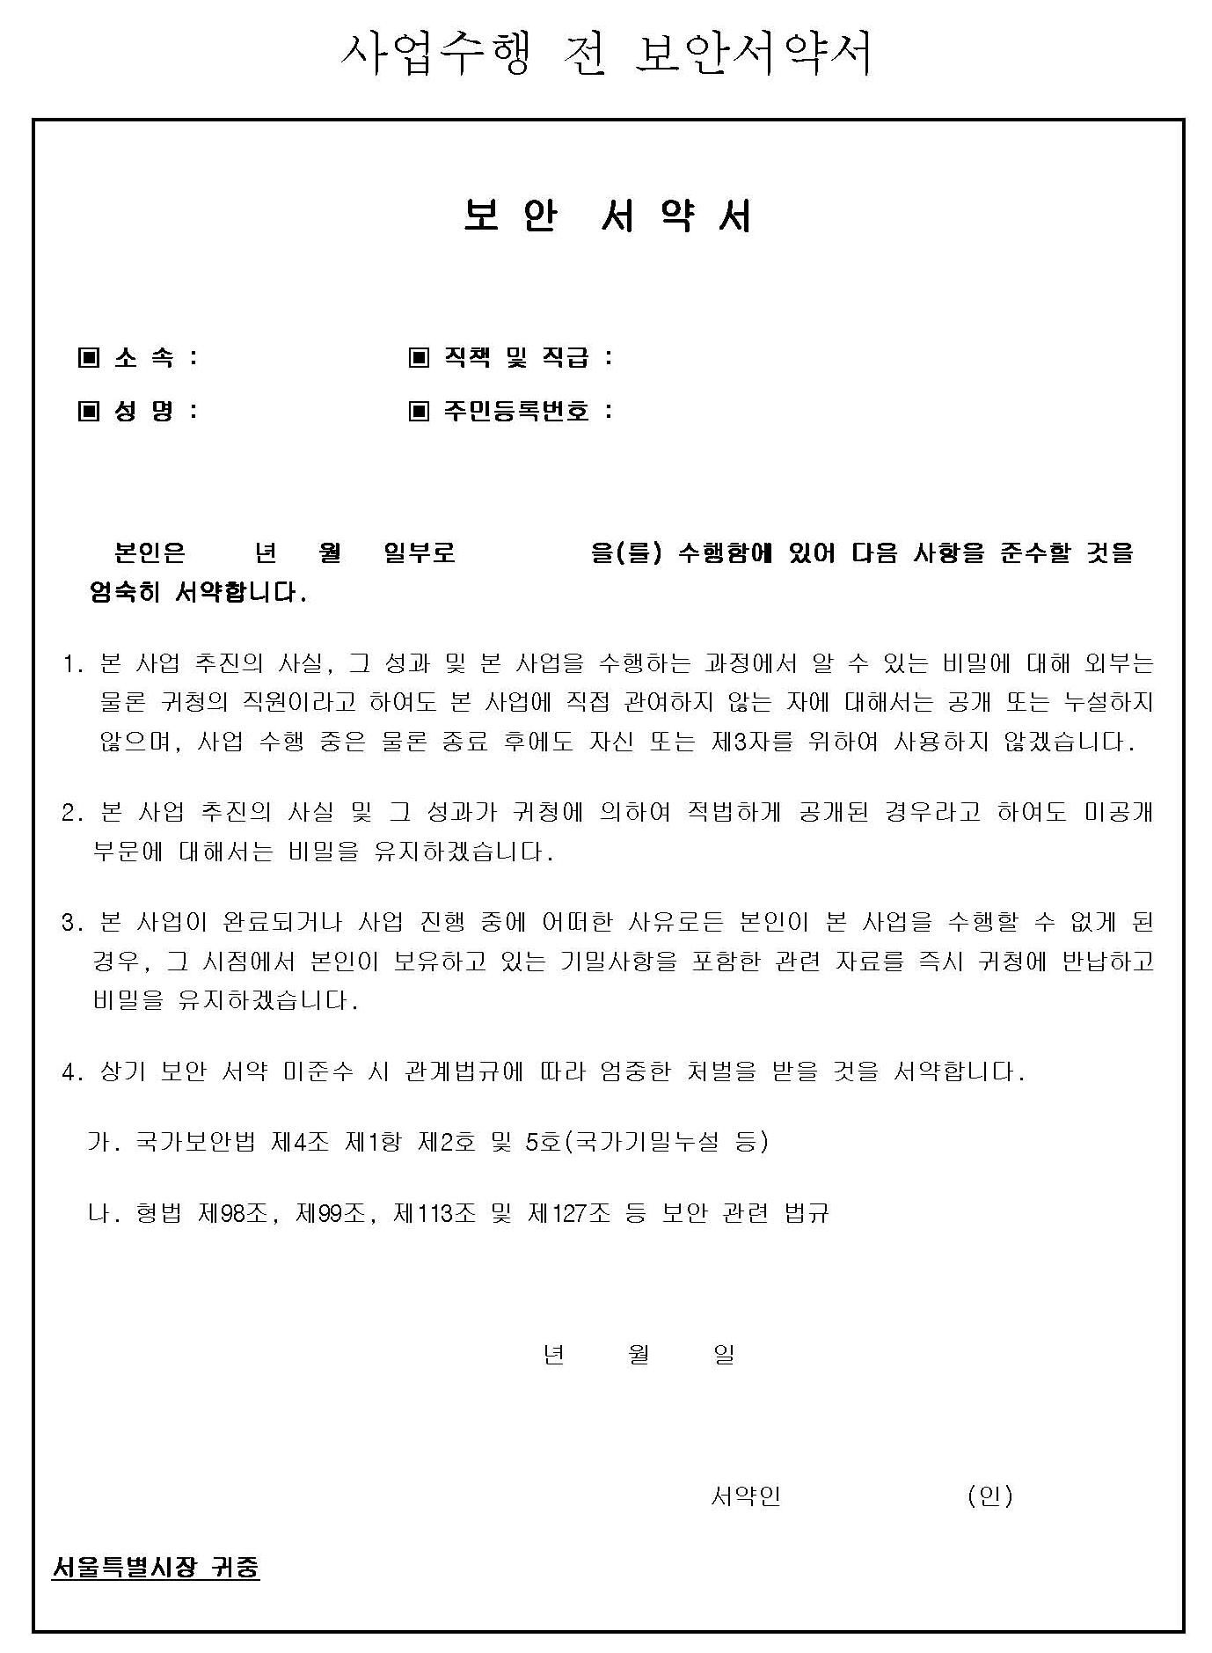
4. Project management plan
18.
Security Management (2/2)
Confidentiality is protected for all data acquired or learned during the business process , and security controls are applied in the areas of office access control / data management /PC and file server management .
Risk minimization plan according to input manpower change
Inside Information Confidential Security
Submission of Security Pledge
division | Compliance
office access control | Visiting hours of visitors are limited to normal working hours and are allowed only in designated places. Recovery of security authority such as pass issued when project execution personnel moved out When a transfer attendant visits, the same access as regular visitors
data management | All acquired data is managed in accordance with confidentiality , and access is controlled except for the relevant person. Personal possession of business data is prohibited , and is stored in a place with a lock attached . Obtained data are copied and discarded under the approval of the person in charge of security
PC and File server management | OA devices, including PCs , are managed by appointing a manager ( government / government ) The person in charge of managing the PC is responsible for maintaining the security of the data inside the PC , data designated as confidential should not be stored on shared PCs or file servers .
Target | Data management measures
Withdrawal ( turnover ) personnel | Turnover is personally viewed as the end of the business, so it is treated the same as security measures. When submitting a resignation letter, simultaneously submit a security confirmation memorandum to the security officer in the execution team
handling material | Immediate deletion of all access rights by data The security officer in the team confirms whether or not any business-related data collection measures have been taken. Make sure to return important and confidential data
handling equipment | Instant deletion of all access rights including access IDs for each device The security officer in the team checks whether all equipment has been returned and whether there are any abnormalities.
※ The form of the above security pledge can be changed according to the form requested by the customer.

Slide 46
4. Project management plan
19.
deliverables step by step
Inspection stage | Execution step | product name
start | start | initiation report WBS business plan
detailed design | analyze | Requirements definition ( supplement ) Requirements Tracking Matrix ( Supplemental ) business function Flow Chart -BPD ( Supplemental )
 | design | System Architecture Definition ( Supplementary ) ERD ( logical / physical ) table definition UI blueprint System interface list / design document Program list ( supplement ), program specification menu structure Data Migration Items / Data Migration Mapping Statement / Data Migration Plan test plan Master Data Definition
avatar | avatar | Unit test specification ( case / result / defect ) business transition plan educational plan
complete | test | Integrated Test Specification ( Scenario / Case / Result / Defect ) Performance Test Plan / Result Rehearsal Specification ( Scenario / Case / Result / Flaw ) Security Vulnerability Analysis and Results
 | implementation | user manual operator's manual Project completion report
ISOFH composable part
need justice

Slide 47
4. Project management plan
20.
Maintenance plan
illustrative
division | classification | The details | period | method
common | interface | Defect repair in case of Defect repair in case of linkage error with other systems | 1 year after system operation conversion | Remote and on-site response (07:00~16:00)
 | monitoring | Deployment Solution AP Monitoring | 1 year after system operation conversion | 24/7 monitoring (00:00~24:00)
HIS/EMR | system wide | Errors in Errors in digital Error in authentication operation | 1 year after system operation conversion | Remote and on-site response (07:00~16:00)
PACS | system wide | Errors in AI reading system linkage error | 1 year after system operation conversion | Remote and on-site response (07:00~16:00)
LIS | system wide | Errors in equipment interface error | 1 year after system operation conversion | Remote and on-site response (07:00~16:00)
mobile | system wide | mobile error in operation | 1 year after system operation conversion | Remote and on-site response (07:00~16:00)
CRM | system wide | Errors in | 1 year after system operation conversion | Remote and on-site response (07:00~16:00)
I-VISITOR | system wide | Errors in | 1 year after system operation conversion | Remote and on-site response (07:00~16:00)
… | … | … | … | …

Slide 48



