Slide 2
Current work Jun-29
Read some papers in “stock price prediction” field
Presentation Content
Paper “Deep neural networks, gradient-boosted trees, random forests: Statistical arbitrage on the S&P 500”
Author: Krauss, Christopher, Do Xuan Anh, Nicolas, Institute for Economics, Erlangen.
Summary of other papers listed in last week.

Slide 3
[*] Deep neural networks, gradient-boosted trees, random forests: Statistical arbitrage on the S&P 500
Purpose
To forecast a probability for each stock to outperform the cross-section median in period t+1.
Data and Methodology
Data: S&P 500 dataset.
Methodology: use Deep Neural Network, Gradient Boosted Tree, Random Forest and ensemble method which is combined 3 below methods.

Slide 4
Contributions of paper
Briefly reviews the relevant literature
Covers the data sample
Methodology
Results and discusses key findings in light of the existing literature
Concludes and provides directions for further research

Slide 5
Methodology
Their methodology consist of four steps:
First, they split their entire data in non-overlapping training and trading sets
Second, for each of these training-trading sets, they generate the feature space necessary for making predictions
Third, they train DNNs, GBTs, and RAFs on each of the training sets.
Fourth, they use these models and a simple ensemble to make out-of-sample predictions on the corresponding trading sets.
Stocks are ranked according to these predictions and traded accordingly.

Slide 6
Methodology
Generation of training and trading sets
Set the length of in-sample training window to 750 days and the length of out-of-sample trading window to 250 days.
Define a “study period” as a training-trading set, each study period consists of 1000 days. They have 23 study periods for entire dataset from 1990 until 2015 <26 years>
Number of stocks in the dataset are 500.
For example:
1990-1993
1st Study period
1991-1994
2nd Study period
…………………………..

Slide 7






Methodology
Feature generation
For each training-trading sets, they generate the feature space (input) and the response variable (output) as follows:
Input: Simple return for each stock s over m periods as:
Output: Construct a binary response variable . 1 if larger than the corresponding cross-sectional median return computed over all stocks, 0 if otherwise.
$$R_{t,m}^{s}$$
$R_{t,m}^{s}=\frac{P_{t}^{s}}{P_{t−m}^{s} }$ - 1
with $P_{t}^{s}$: the price process of stock s
$$m∈\left\{\left\{1,2,...,20\right\}∪\left\{40,60,...,240\right\}\right\}$$
$$Y_{t+1,1}^{s}∈\left\{0,1\right\}$$
$$R_{t+1,1}^{s}$$
<First focus on the returns of the first 20 days, corresponding to on trading month, then consider the multi-period returns corresponding to the subsequent 11 months>

Slide 8
Current work July-13
Propose DNN model following paper “Deep neural networks, gradient-boosted trees, random forests: Statistical arbitrage on the S&P 500”
Read section 4.3.4 – “Ensemble” and 4.4 – “ Forecasting, ranking and trading” in this paper

Slide 9





Methodology
Feature generation
Define return of each stock in each study period like below:
In each t, we calculate 31 returns for each stock following period time
and corresponding stock index of 500 companies.
$$R_{241,240}^{GG}$$
$$R_{241,10}^{GG}$$
Google Stock (GG)
t
1
231
241
……
750
10 days
240 days
$$R_{t,m}^{s}$$
$$m∈\left\{\left\{1,2,...,20\right\}∪\left\{40,60,...,240\right\}\right\}$$
$$s∈\left\{1,2,...,500\right\}$$

Slide 10
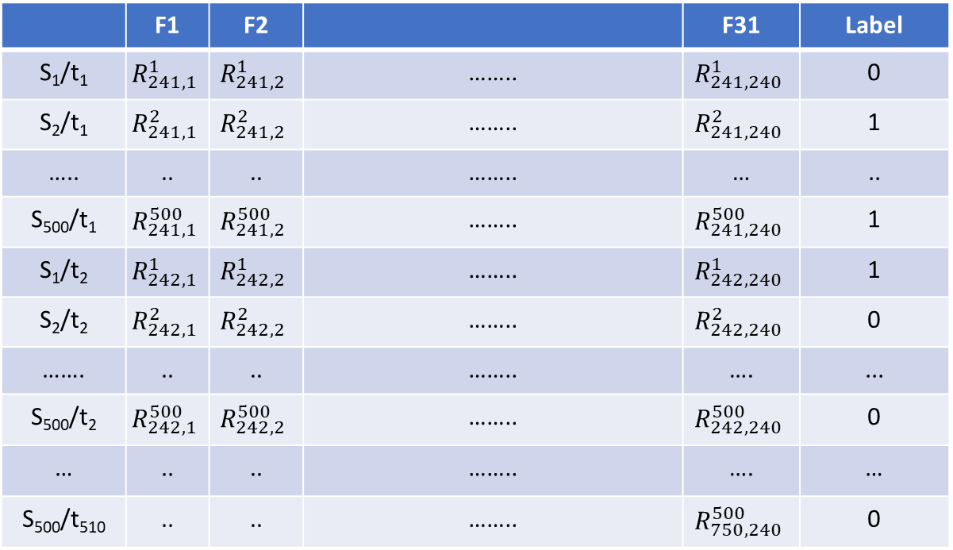
Methodology
Feature generation
This table describes features of each input example and label of model:
 | F1 | F2 |  | F31 | Label
S₁/t₁ | $$R_{241,1}^{1}$$ | $$R_{241,2}^{1}$$ | …….. | $$R_{241,240}^{1}$$ | 0
S₂/t₁ | $$R_{241,1}^{2}$$ | $$R_{241,2}^{2}$$ | …….. | $$R_{241,240}^{2}$$ | 1
….. | .. | .. | …….. | … | ..
S₅₀₀/t₁ | $$R_{241,1}^{500}$$ | $$R_{241,2}^{500}$$ | …….. | $$R_{241,240}^{500}$$ | 1
S₁/t₂ | $$R_{242,1}^{1}$$ | $$R_{242,2}^{1}$$ | …….. | $$R_{242,240}^{1}$$ | 1
S₂/t₂ | $$R_{242,1}^{2}$$ | $$R_{242,2}^{2}$$ | …….. | $$R_{242,240}^{2}$$ | 0
……. | .. | .. | …….. | …. | ...
S₅₀₀/t₂ | $$R_{242,1}^{500}$$ | $$R_{242,2}^{500}$$ | …….. | $$R_{242,240}^{500}$$ | 0
… | .. | .. | …….. | …. | …
S₅₀₀/t₅₁₀ | .. | .. | …….. | $$R_{750,240}^{500}$$ | 0
Used to calculate label

Slide 11
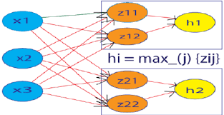

Methodology
Model Training
Deep Neural Network (DNN):
- Describe the topology of the network with the following code I-H1-H2-H3- O (31-31-10-5-2).
- Use a hidden dropout ratio of 0.5; input dropout ratio of 0.1
- Use L1 regularization with
- Training epoch is 400, and use ADADELTA optimization
- Use maxout activation function in hidden layer, and sigmoid in output layer
What is maxout activation function
$$λ=0.00001$$

Slide 12
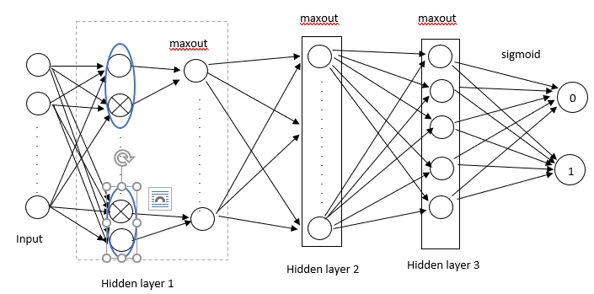
Methodology
Model training
Due to using maxout activation function, we have the number of weights: I-H1: 62x31, H1-H2: 20x31, H2-H3: 10x10, H3-O: 2x5

Slide 13
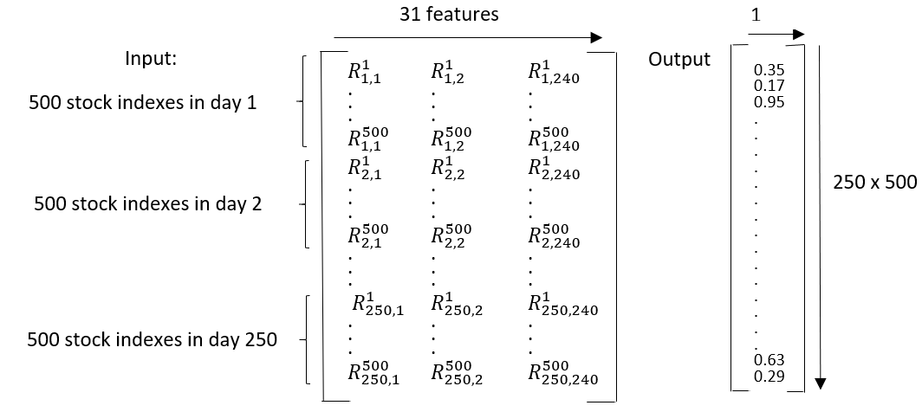
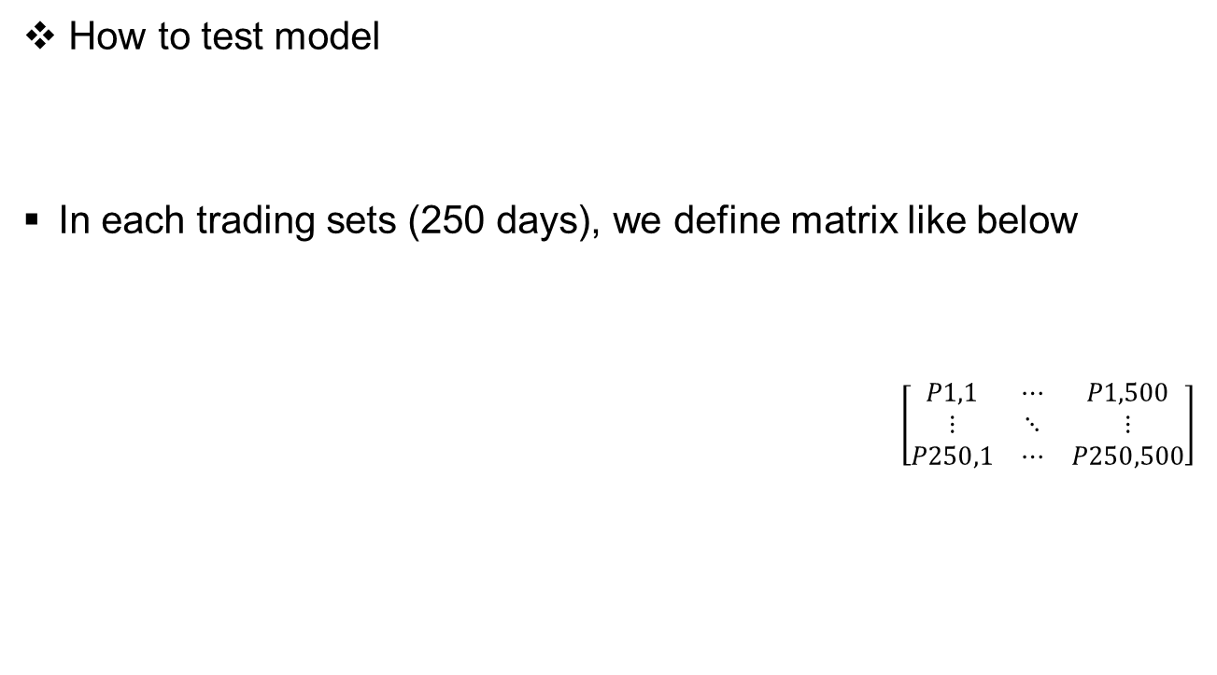
Methodology
How to test model
In each trading sets (250 days), we define matrix like below
$\left[\begin{matrix}P1,1 & ⋯ & P1,500 \\ ⋮ & ⋱ & ⋮ \\ P250,1 & ⋯ & P250,500\end{matrix}\right]$
input
P0
DNN model using sigmoid function in output layer
P1
reshape
Pi,j is the probability to outperform cross-sectional of stock j in day i.

Slide 14


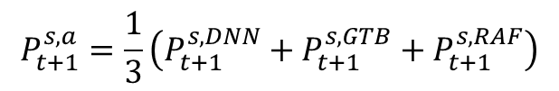
Section 4.3.4 - Ensemble
$$P_{t+1}^{s,a}$$
denote the probability forecast of a learning algorithm a that stock s outperforms its cross-sectional median in period t+1 with
:
$$a∈\left\{DNN,GBT,RAF,ENS\right\}$$
$$P_{t+1}^{s,a}=\frac{1}{3}\left(P_{t+1}^{s,DNN}+P_{t+1}^{s,GTB}+P_{t+1}^{s,RAF}\right)$$

Slide 15


Section 4.4 – Forecasting, ranking and trading
$$P_{t+1}^{s,a}$$
Forecasting: for each t+1, forecasting the probability for each stock s to outperform its cross-sectional median.
Ranking: Sorting the probability of all stocks to outperform the cross-section in descending order following 4 methods ( we have 4 rankings).
Trading
The highest k probabilities (k stocks in the top) are converted into long positions => should buy
The lowest k probabilities (k stocks in the bottom) are converted into short positions => should sell
with n = 500.
$$k∈\left\{1,2,...,\left[n/2\right]\right\}$$

Slide 16
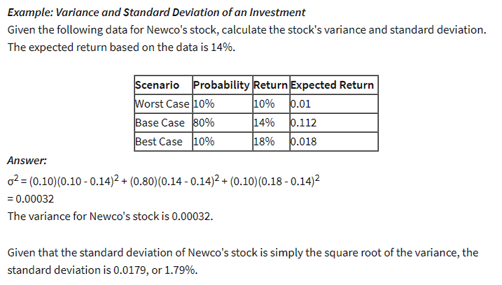

Result
Some concepts to evaluate model
Mean return: in securities analysis, is the expected value, of all the likely returns of investments comprising a portfolio => calculate benefit
Standard deviation: In finance, standard deviation is applied to the annual rate of return of an investment to measure the investment's volatility.
$$E=\sum_{i=1}^{n}{P_{i}×R_{i}}$$

Slide 17
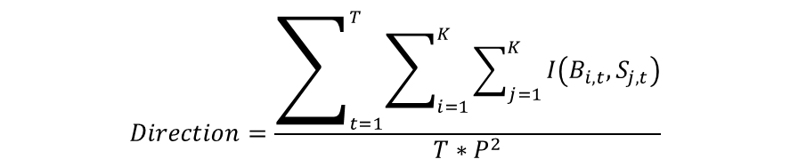
Result
Directional Accuracy
T: number of forecasting periods
K: number of pairs
B_{i,t}: the asset bought in ith position
S_{j,t}: the asset bought in jth position
I(.): indicative function, returns 1 if return of B_{i,t} is greater than return of S_{j,t} and 0 otherwise.
$$Direction=\frac{\sum_{t=1}^{T}{\sum_{i=1}^{K}{\sum_{j=1}^{K}{I\left(B_{i,t},S_{j,t}\right)}}}}{T∗P^{2}}$$

Slide 18
Next plan
Read paper continually ( section 5 – Result and section 6 – Conclusions).

Slide 19
Current work Jul-20
Read section 5 –”Result” and section 6 –”Conclusion” in paper “Deep neural networks, gradient-boosted trees, random forests: Statistical arbitrage on the S&P 500”
Reading second paper “Learning to Trade via Direct Reinforcement”
Trading System and Performance criteria
Learning to trade (using Reinforcement learning algorithms)
Empirical Results
Presentation
Summary of some important results in the first paper.

Slide 20

Summary of approach
S&P500 dataset
Model
(DNN,RAF,GBT,ESB)
output
Forecast probability of each stock to outperform cross section median
Sorting the probability in descending order
Choose K highest probability & K lowest probability.
Standard deviation
Mean return
Directional accuracy
Analyze the performance of the portfolios consisting top K pairs
General result
VaR
CVaR
Maximum drawdown
Sharpe/sortino radio
$$K∈\left\{10,50,100,150,200\right\}$$
Strategy performance/risk management

Slide 21
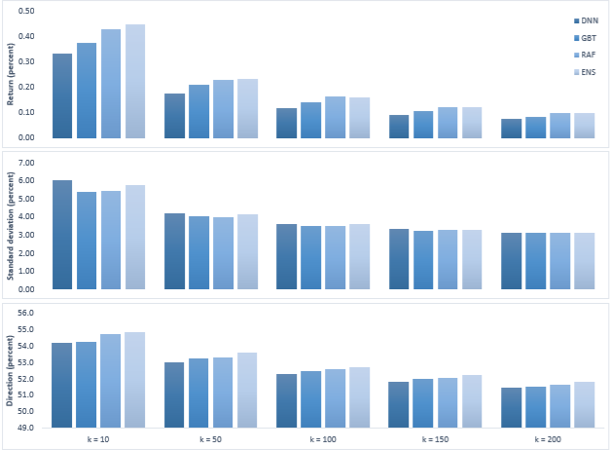
General Results
0.43
0.45
Evaluate benefit
0.33
0.37
Evaluate the investment’s volatility
When we forecast rise or drop, the performance of model must be examined using directional test.
Fig. Performance metrics for long-short portfolios of different size from 12/1992 to 10/2015

Slide 22
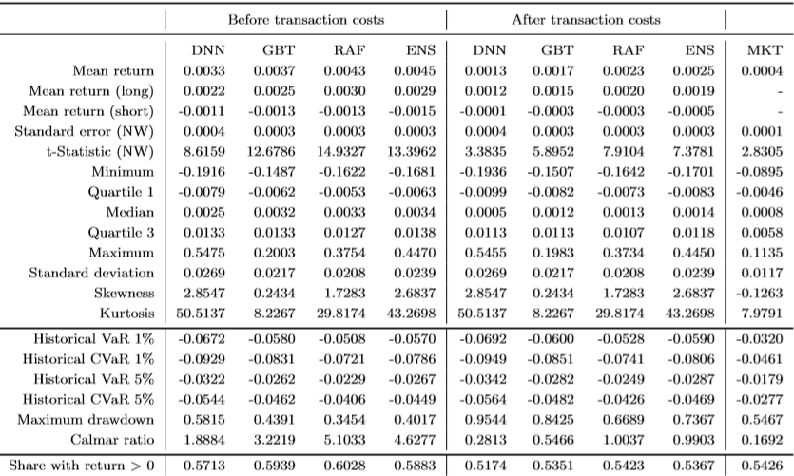
Strategy Performance
Criteria
Table. Daily return characteristics of k = 10 portfolio prior to and after transaction cost

Slide 23

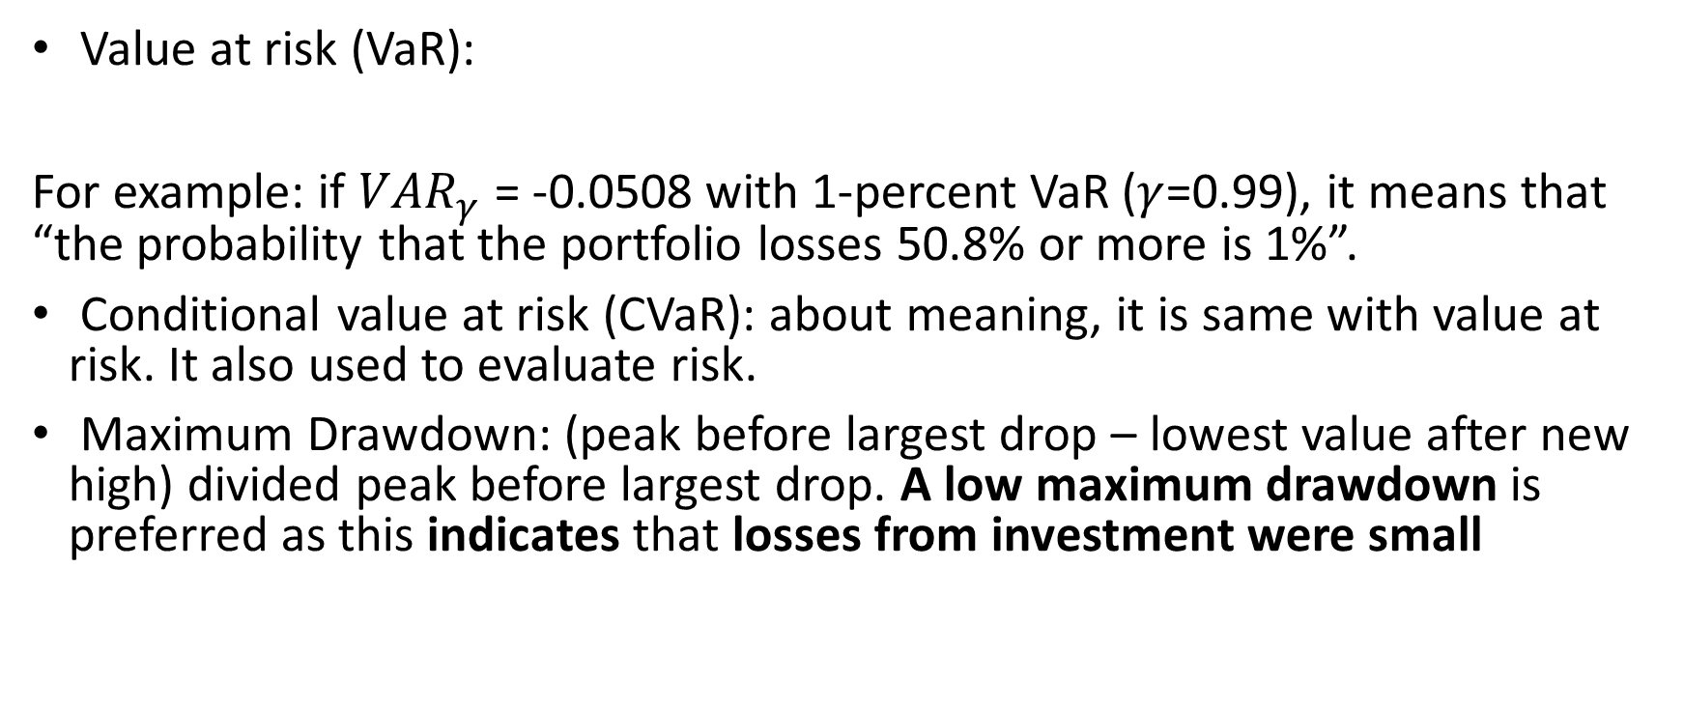
Strategy Performance
Value at risk (VaR):
For example: if $VAR_{γ}$= -0.0508 with 1-percent VaR ($γ$=0.99), it means that “the probability that the portfolio losses 50.8% or more is 1%”.
Conditional value at risk (CVaR): about meaning, it is same with value at risk. It also used to evaluate risk.
Maximum Drawdown: (peak before largest drop – lowest value after new high) divided peak before largest drop. A low maximum drawdown is preferred as this indicates that losses from investment were small
$$P\left[Loss≥VAR_{γ}\right]=1−γ$$

Slide 24
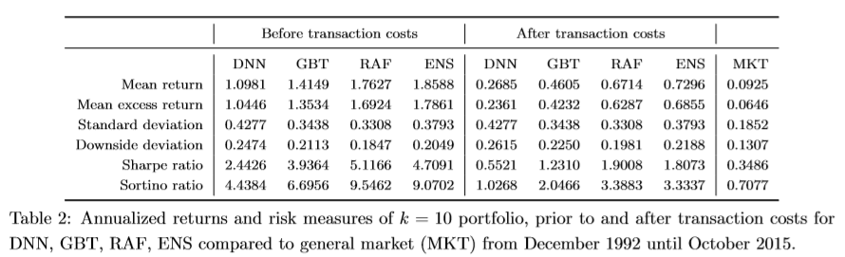
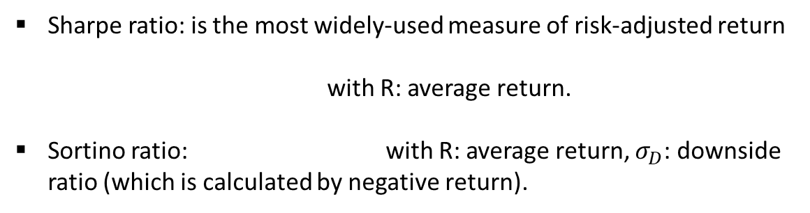


Strategy Performance
Sharpe ratio: is the most widely-used measure of risk-adjusted return
with R: average return.
Sortino ratio: with R: average return, $σ_{D}$: downside ratio (which is calculated by negative return).
$$S_{T}=\frac{R}{standard deviation}$$
$$SortinoRatio=\frac{R}{σ_{D}}$$

Slide 25
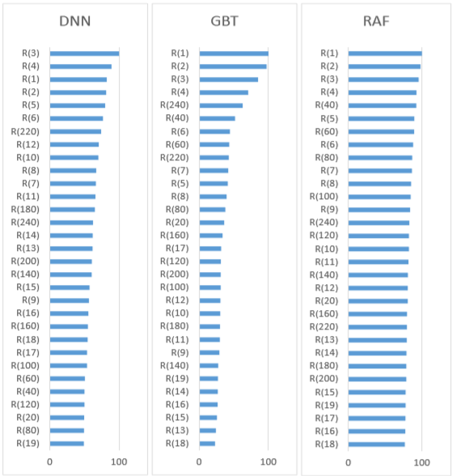

Further analyses
Variable importance:
The returns corresponding to the past 4 to 5 days have the highest relative importance, ending up at the top of the ranking.
The next group includes the multi-period returns roughly corresponding to the monthly resolution with
At the bottom of the ranking, we find returns between R(10) and R(20) in case of GBT.
$$m∈\left\{20,40,...,240\right\}$$

Slide 26
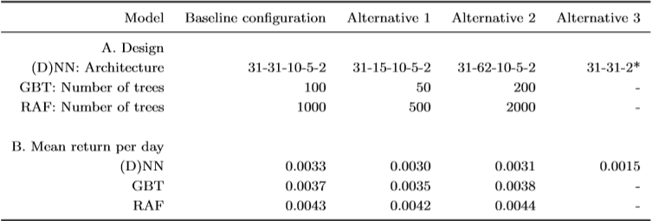
Further analyses
Compare with the difference hyperparameter of the model

Slide 27
Conclusion
They have developed a statistical arbitrage strategy based on DNN, GBT, RAF, ESB method and deployed it on the S&P 500 dataset.
Focuses on the different machine learning approaches: they find that random forests outperform to other methods in their application.
For the ESB method with K = 10, they fine statistically and economically significant returns of 0.25 percent per day after transaction costs.
Finally, the most recent returns corresponding to the prior five trading days have the highest explanatory value.

Slide 28
Next plan
Read second paper continually

