Slide 1
Struts 2 Introduction
WEB MVC FRAMEWORK

Slide 2
What is Struts 2?
Struts 2 is the Open source web application Framework which simplified the creation of Web Applications in in Java. It is based on the Model – View – Framework (MVC) architect

Slide 3
Struts 2 Features
Configurable MVC components
In struts 2 framework, we provide all the components (view components and action) information in struts.xml file. If we need to change any information, we can simply change it in the xml file.
POJO based actions
In struts 2, action class is POJO (Plain Old Java Object) i.e. a simple java class. Here, you are not forced to implement any interface or inherit any class.

Slide 4
Struts 2 Features
AJAX support
Struts 2 provides support to ajax technology. It is used to make asynchronous request i.e.
Integration Support
We can simply integrate the struts 2 application with hibernate, spring, tiles etc. frameworks.
Various Result Types
We can use JSP, freemarker, velocity etc. technologies as the result in struts 2.

Slide 5
Struts 2 Features
Various Tag support
Struts 2 provides various types of tags such as UI tags, Data tags, control tags etc to ease the development of struts 2 application.
Theme and Template support
Struts 2 provides three types of theme support: xhtml, simple and css_xhtml. The xhtml is default theme of struts 2. Themes and templates can be used for common look and feel.

Slide 6
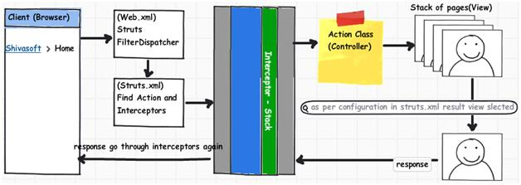
How does it work?

Slide 7
How does it work?
1. Request: Client makes the request.
2. Filter Dispatcher: As Boot Strap component is specified in Deployment Descriptor file. In Case of Struts 2, it is Servlet Filter (Filter Dispatcher). Filter Dispatcher looks the request and then as per the mapping of URL, request is forwarded to appropriate Action Class.
3. Interceptor Stacks: Before going to Action Class, request goes to Interceptor Stacks (Action class mapping found in configuration file, and from there, list of interceptors identified which must be processed before Action class) .

Slide 8
How does it work?
4. Action Class : Then the request object is passed to Action Class. Action Class then executes the code and after execution it returns the result code to the Controller. (either SUCCESS or INPUT or ERROR)
5. Result: On the basis of result code, Controller then selects View to be rendered as a result of Action.
6. Interceptors Stack: Before sending response back to client, again interceptors run.
7. Response returned to User.

Slide 9
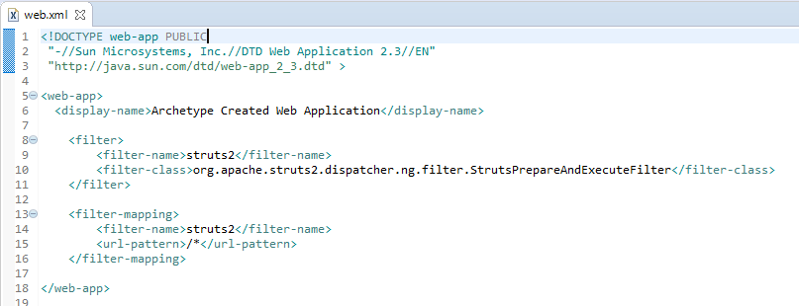
Get started – Simple website
In struts 2, StrutsPrepareAndExecuteFilter class works as the controller. As we know well, struts 2 uses filter for the controller. It is implicitly provided by the struts framework.

Slide 10
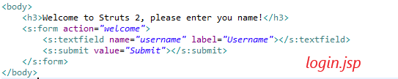

Get started – Simple website
Create view pages:

Slide 11
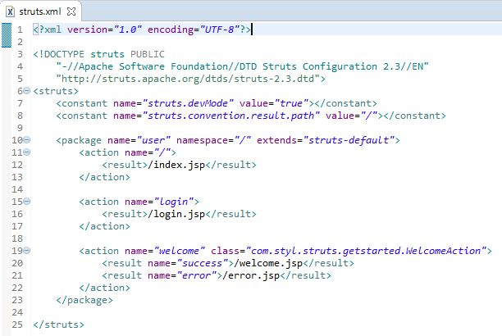
Get started – Simple website
Add struts.xml to Resources folder

Slide 12
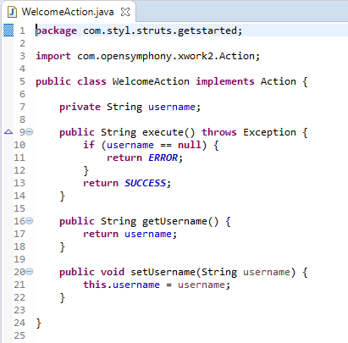
Get started – Simple website
Struts 2 actions don’t force you to implement any interface or extends class, it’s only required you to implement an execute() method that returns a string to indicate which result page should return.
When invoking the action, the default configuration (with default interceptor stack) maps the http parameters calling the setter
After the action execution, Struts2 will invoke getter to display result in view

Slide 13
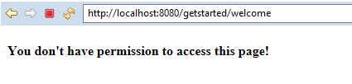
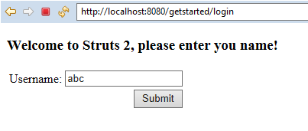

Error when try to access Welcome page without login
Try again, access to Login page

Slide 14
Sample Project
Build a RESTful & NonREST API with Struts 2
Dependence:
Spring Hibernate + MySQL
Struts 2 JSON Plugin
Struts 2 REST Plugin
Struts 2 Convention Plugin
Github:
https://github.com/tuandatqn95/struts2-sample-restful

Slide 15
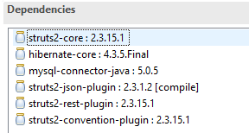
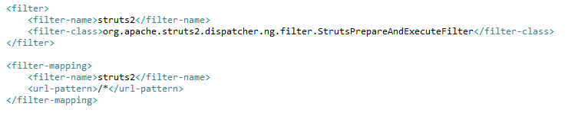
Sample Project
We need to add Struts2, Hibernate and MySQL maven dependencies in pom.xml file, final pom.xml file looks like below.
Add filter into web.xml

Slide 16
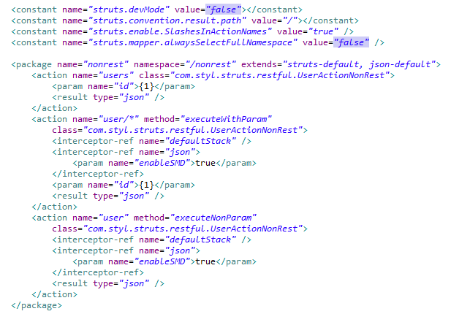
Sample Project
Configure for NonREST in struts.xml

Slide 17
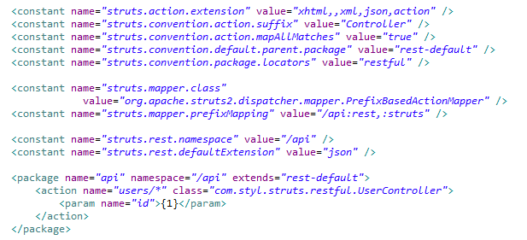
Sample Project
Configure for REST API in struts.xml

Slide 18
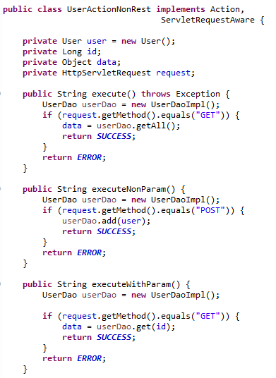
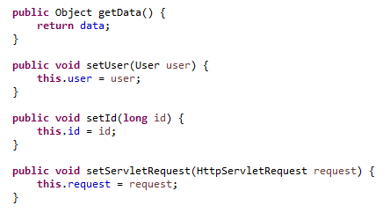
Sample Project
UserActionNonRest.java
getData(): return data to result.
getId(), setUser(): receive id or user from request

Slide 19
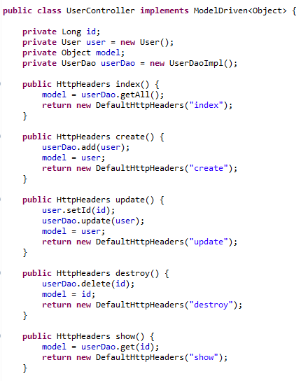
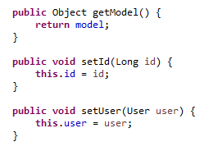
Sample Project
UserController.java
getData(): return data to result.
getId(), setUser(): receive id or user from request

Slide 20
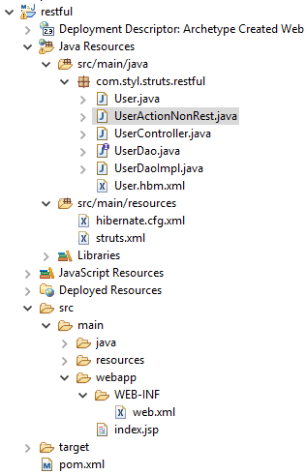
Sample Project
In addition, we need to configure hibernate, create and map domain classes to hibernate.
After that, we also need to implement DAO classes to handle database operation required.
Finally, run project on Tomcat Server

Slide 21
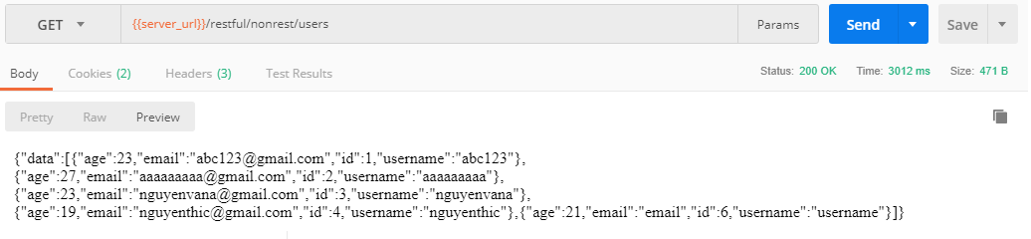
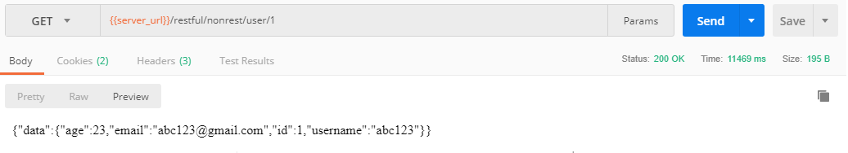
Sample Project
Result NonREST API

Slide 22
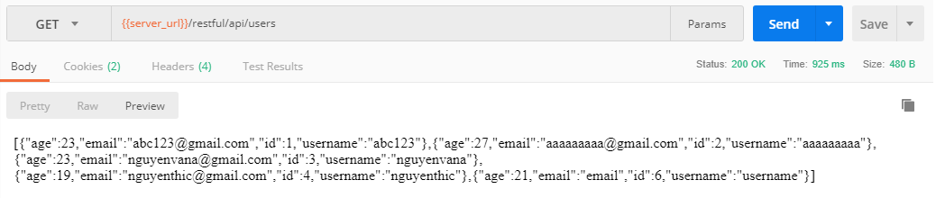
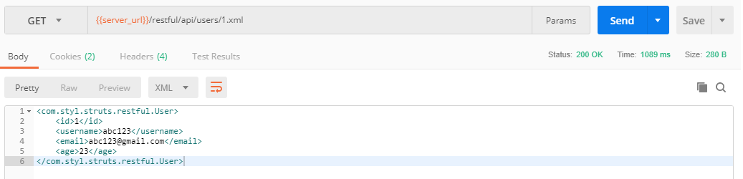
Sample Project
Result RESTful API
Rest plugin can extract data by XML

