Slide 1
Teaching simulated agents to perform complex spatial-temporal activities
AAAI Symposium 2018 on
Integrated Representation, Reasoning, Learning and Execution for Goal Directed Autonomy
Tuan Do, Nikhil Krishnaswamy, James Pustejovsky,
Brandeis University
AAAI-SS2018

Slide 2
Summary
Overview
Motivations
Details
Future direction
Contributions
Discussion
AAAI Symposium 2018 on
Integrated Representation, Reasoning, Learning and Execution for Goal Directed Autonomy
Submit to AAAI Symposium 2018 on
Integrated Representation, Reasoning, and Learning in Robotics

Slide 3
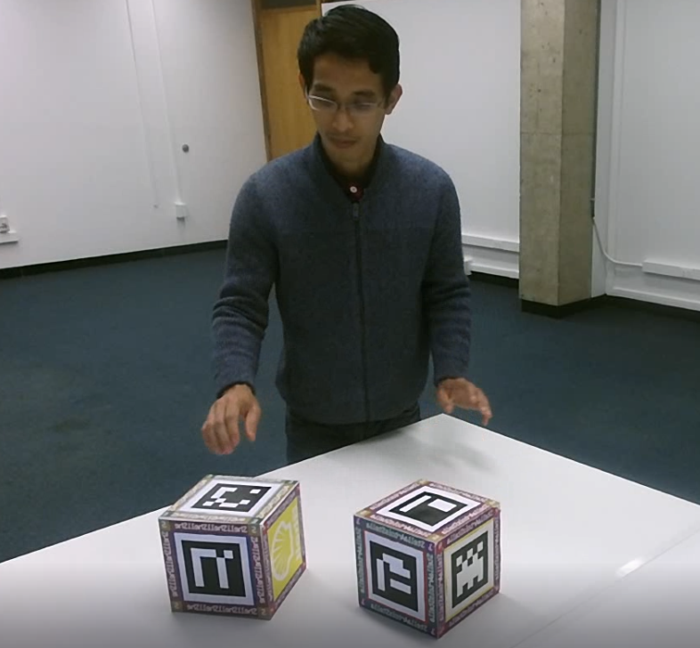
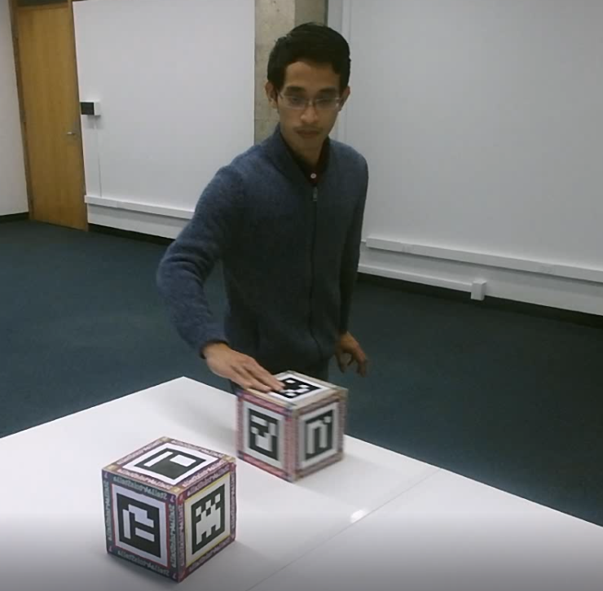
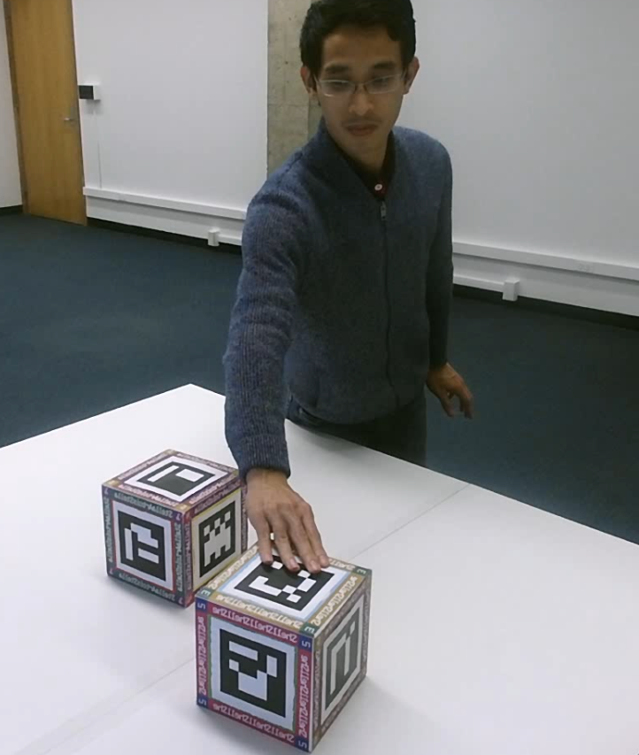
Overview
Learning for virtual agents to perform action from observing recorded human demonstrations, and from descriptions of actions.
Input
descriptions of actions
recorded human demonstrations
Slide Stella Artois around Shell
AAAI Symposium 2018 on
Integrated Representation, Reasoning, Learning and Execution for Goal Directed Autonomy
Submit to AAAI Symposium 2018 on
Integrated Representation, Reasoning, and Learning in Robotics
Qualitative reasoning Workshop, 2017

Slide 4
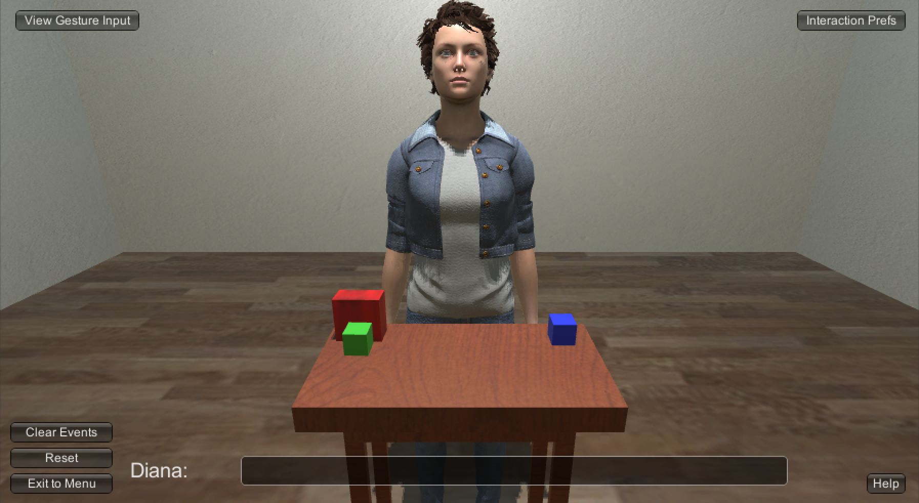
Overview
Learning for virtual agents to perform action from observing recorded human demonstrations, and from descriptions of the actions.
Output:
Perform action in a situated environment
AAAI Symposium 2018 on
Integrated Representation, Reasoning, Learning and Execution for Goal Directed Autonomy
Submit to AAAI Symposium 2018 on
Integrated Representation, Reasoning, and Learning in Robotics
Qualitative reasoning Workshop, 2017

Slide 5
Overview
Representation
Learning
QSRLIb-2D features extracted on frame-by-frame basis
Sequential model (LSTM)
to learn action completion. RL to learn best policy
AAAI Symposium 2018 on
Integrated Representation, Reasoning, Learning and Execution for Goal Directed Autonomy
Submit to AAAI Symposium 2018 on
Integrated Representation, Reasoning, and Learning in Robotics
Qualitative reasoning Workshop, 2017
Reasoning
Execution
(in progress)
from feature-based learning to symbolic reasoning
Plan generated from RL on simulator, evaluated by human annotators

Slide 6
Motivation
DARPA’s Communicating with Computers (CWC) main points:
A corpus or library of elementary ideas
Starting with action primitives
Algorithms for assembling complex ideas from elementary ones given language and context
AAAI Symposium 2018 on
Integrated Representation, Reasoning, Learning and Execution for Goal Directed Autonomy
Submit to AAAI Symposium 2018 on
Integrated Representation, Reasoning, and Learning in Robotics
Qualitative reasoning Workshop, 2017

Slide 7
Motivation
Directions of Blocks World subtask
Mapping between languages descriptions and various spatial configurations: directly northwest, bottom left corner should be almost touching upper right northeast etc. (Bisk et al 2017)
Natural Language Dialogue for Building and Learning Models and Structures (Perera et al 2017).
Mapping between languages descriptions and shape: Build a square of size 3. Then, construct a row of 4 blocks above the square. (Narayan-Chen et al 2017)
Understanding Gesture in Simulation Semantics: language, gesture, objects with rich semantic typing (Krishnaswamy et al 2017)
AAAI Symposium 2018 on
Integrated Representation, Reasoning, Learning and Execution for Goal Directed Autonomy
Submit to AAAI Symposium 2018 on
Integrated Representation, Reasoning, and Learning in Robotics
Qualitative reasoning Workshop, 2017

Slide 8
Motivation
Agents that can communicate with humans to execute tasks are a long sought goal of AI.
Agents need to translate from instruction to executable plan in a context-dependent manner.
Agents should also be able to learn new actionable predicates on the fly.
Agents should be able to learn after small number of training samples.
Actionable predicates could be of different types: Aktionsart classification of verbal predicates (achievements, activities, accomplishments) (Pustejovsky et al 2011)
AAAI Symposium 2018 on
Integrated Representation, Reasoning, Learning and Execution for Goal Directed Autonomy
Submit to AAAI Symposium 2018 on
Integrated Representation, Reasoning, and Learning in Robotics
Qualitative reasoning Workshop, 2017

Slide 9
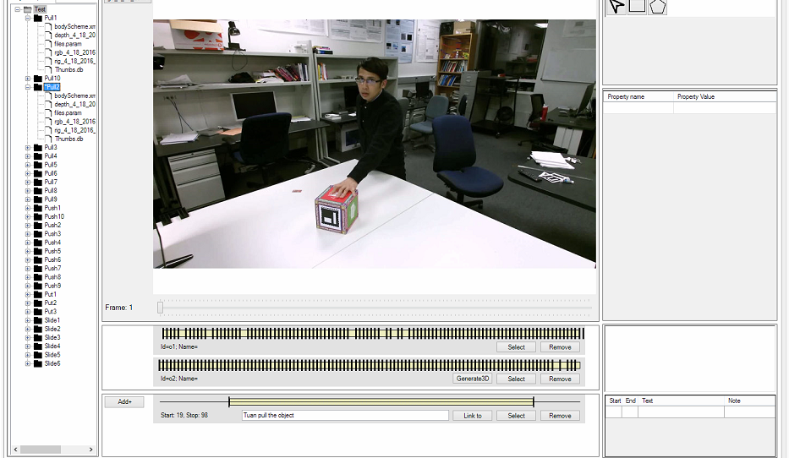
Details Representation
We capture 3-dimensional videos of human performers doing interaction with objects and annotating spans of events with textual description
AAAI Symposium 2018 on
Integrated Representation, Reasoning, Learning and Execution for Goal Directed Autonomy
Submit to AAAI Symposium 2018 on
Integrated Representation, Reasoning, and Learning in Robotics
Qualitative reasoning Workshop, 2017

Slide 10
Details Representation
Cardinal direction: measures compass relations between two objects into canonical directions such as North, North East etc. In total, this qualitative relation give 9 different values, including one where two locations are identical.
Qualitative Distance Calculus discretizes the distance between two moving points. Here I discretizes the distance between two centers of two squares.
Qualitative Trajectory Calculus (Double Cross) QTC_C is a representation of motions between two objects by considering them as two moving point objects (MPOs)
North
AAAI Symposium 2018 on
Integrated Representation, Reasoning, Learning and Execution for Goal Directed Autonomy
Submit to AAAI Symposium 2018 on
Integrated Representation, Reasoning, and Learning in Robotics
West
East
Qualitative reasoning Workshop, 2017
South

Slide 11
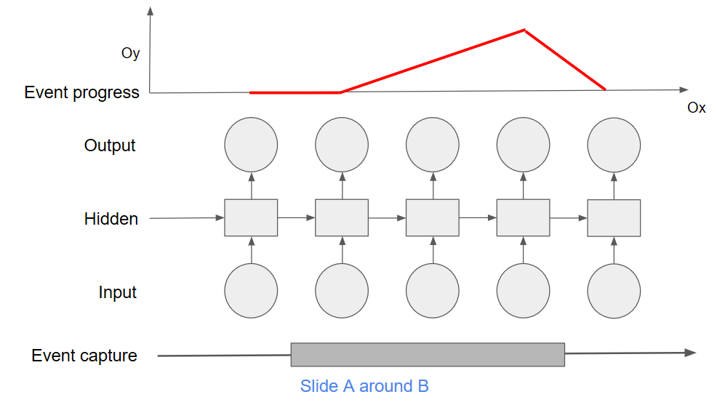
Details Learning
For each event class, we use sequential modeling (LSTM) to learn a function f that takes in a sequence of feature vectors and outputs an estimation of the event progress
AAAI Symposium 2018 on
Integrated Representation, Reasoning, Learning and Execution for Goal Directed Autonomy
Submit to AAAI Symposium 2018 on
Integrated Representation, Reasoning, and Learning in Robotics
Qualitative reasoning Workshop, 2017

Slide 12
Details Representation for Learning
Some observations:
Use of qualitative features, or in general, discretize feature space help in learning: improve accuracy of event progress function, speed up RL methods.
In this framework, we use LSTM to make comparison between raw features vs discretized features, but in general other sequential based models such as HMM could also be applied.
Qualitative feature translation implies bias on our ML methods, that helps to reduce number of training samples to about a dozen.
Discussion questions:
Can we assume more bias corresponding to human spatial perception bias to reduce even more samples?
AAAI Symposium 2018 on
Integrated Representation, Reasoning, Learning and Execution for Goal Directed Autonomy
Submit to AAAI Symposium 2018 on
Integrated Representation, Reasoning, and Learning in Robotics
Qualitative reasoning Workshop, 2017

Slide 13
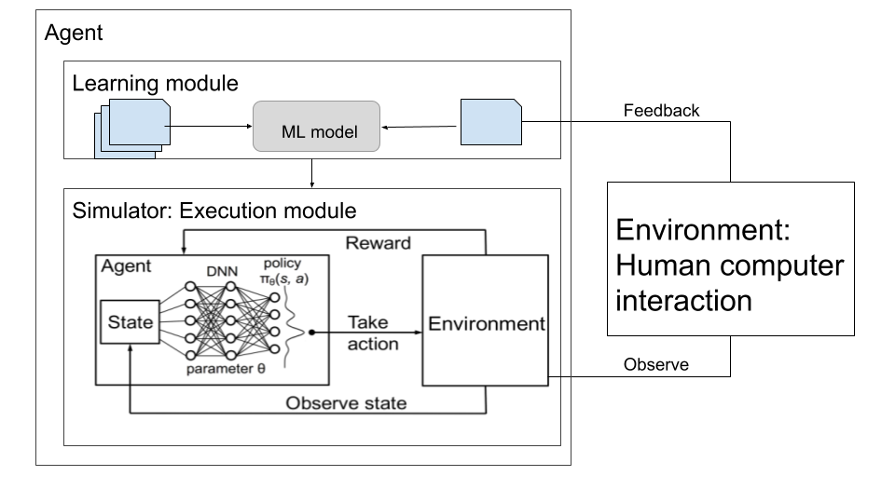
Details Execution
AAAI Symposium 2018 on
Integrated Representation, Reasoning, Learning and Execution for Goal Directed Autonomy
Submit to AAAI Symposium 2018 on
Integrated Representation, Reasoning, and Learning in Robotics
Qualitative reasoning Workshop, 2017

Slide 14
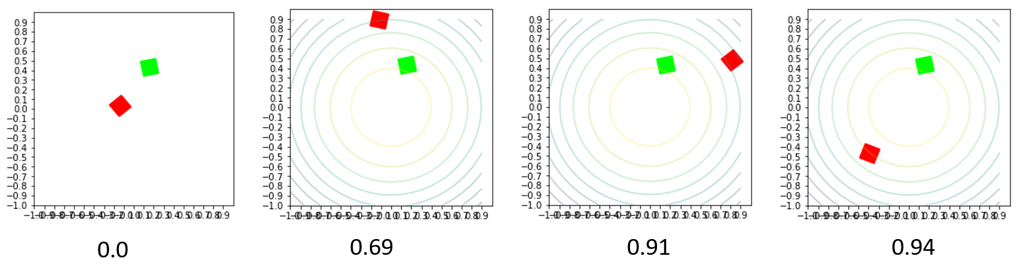
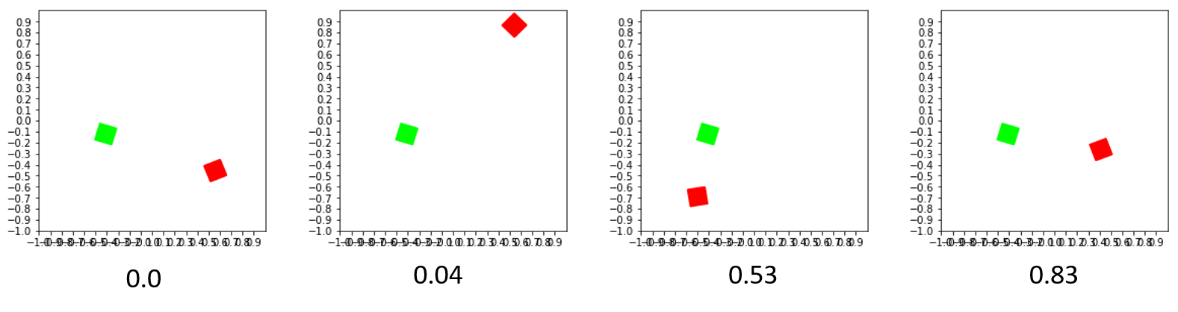
Details Execution
AAAI Symposium 2018 on
Integrated Representation, Reasoning, Learning and Execution for Goal Directed Autonomy
Good demonstration
Bad demonstration

Slide 15
Details Execution
Human evaluation of action executions (30 executions for each action).
Each execution is graded by two annotators. They are solicited for a grade from 0 to 10, with 0 being non-relevant at all. They are also asked to give a comments for each execution.
Evaluator disparity:
Absolute difference between annotators’ scores, averaged over executions
Action type | Average score | Disparity
Slide Closer | 5.4 | 1.57
Slide Away | 6.48 | 2.37
Slide Next To | 5.55 | 1.7
Slide Past | 6.38 | 1.9
Slide Around | 2.75 | 1.03
AAAI Symposium 2018 on
Integrated Representation, Reasoning, Learning and Execution for Goal Directed Autonomy

Slide 16
Details Execution
Using feedback:
Dividing 30 demonstrations from SlideAround into 2 groups, using ones that got high score (>=7) for positive samples, and ones that got low scores (<=2) for negative samples.
Retrain for one group, and re-generate for another group.
Re-evaluation: 2.75 -> 5.95 (evaluator disparity ~ 1).
Descriptive feedback from annotators:
For “Move closer”: First part of action looks good, but then the object moves away.
For “Move around”: The first part looks good, but at the end it doesn’t close the loop
Online feedback:
We can extend the offline method to investigate the effect of using feedback in an online manner.
AAAI Symposium 2018 on
Integrated Representation, Reasoning, Learning and Execution for Goal Directed Autonomy
Submit to AAAI Symposium 2018 on
Integrated Representation, Reasoning, and Learning in Robotics
Qualitative reasoning Workshop, 2017

Slide 17
Details Reasoning
A scenario:
We want to teach our agent the concept of “making a row from blocks”.
Some observations:
If the agent learns the movement of blocks and the final setup of blocks, it could still recognize that order of execution or manner of movement is not important, but it needs many more training samples.
We should give it a learning bias for the type of action. For example, in this case, we only focus on the final outcome.
Discussion questions:
Even with this assumption, we still don’t know how to abstract from featured-based representation to symbolic representation. How to represent row, zigzag etc.?
Feature-based representation could be used for learning with neural-based methods, but it is hard to be carried over to symbolic reasoning. What would be the appropriate method to handle that?
AAAI Symposium 2018 on
Integrated Representation, Reasoning, Learning and Execution for Goal Directed Autonomy
Submit to AAAI Symposium 2018 on
Integrated Representation, Reasoning, and Learning in Robotics
Qualitative reasoning Workshop, 2017
Notes:
Row: on the feature level, you want to capture: blocks are adjoined, blocks are aligned.

Slide 18
Future direction
Limitations:
Need to define the set of actions beforehand. Linguistic expressions are, therefore, hardcoded.
Resolution and tracking capability of our capturing framework limits extension to more complex actions.
Future directions:
Encode bias for objects and actions. For example, concept of repetition (bias of action), object composition and direction invariance (bias of objects) etc.
Learn actions on generic objects with varied shapes and affordances. For example, to learn the difference between “rolling a bottle” and “sliding a bottle”, the system needs to be equipped with object pose tracking.
Online learning
Learning action from simulated action demonstrations, and from descriptions of the instructions. (to be continue on next slide)
AAAI Symposium 2018 on
Integrated Representation, Reasoning, Learning and Execution for Goal Directed Autonomy

Slide 19
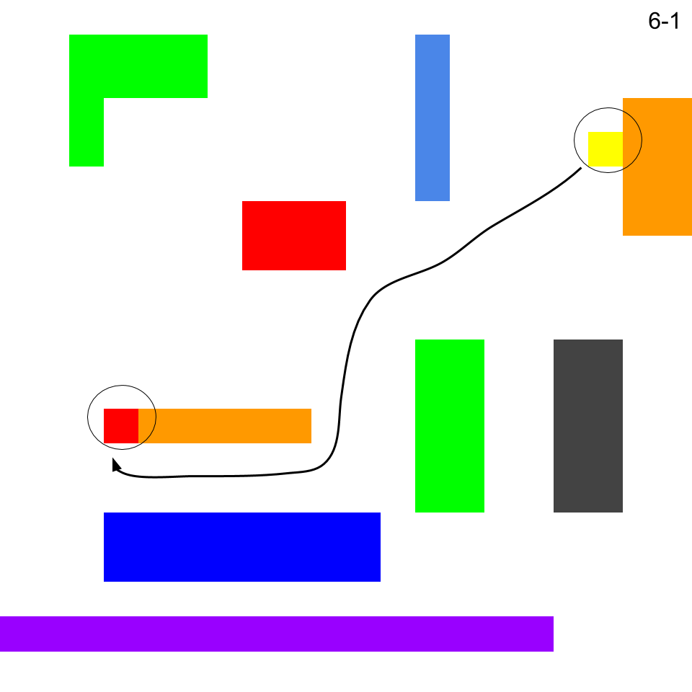
Future direction
Setup
Annotators are shown a maze traversal map.
They are asked to give instruction to move object from source to target.
Instruction samples:
Move the yellow block between the orange row and the blue row, to the left end of the orange row.
Sneak the yellow square between the orange and green shapes, then slide it beneath the orange toward its left end.
AAAI Symposium 2018 on
Integrated Representation, Reasoning, Learning and Execution for Goal Directed Autonomy

Slide 20
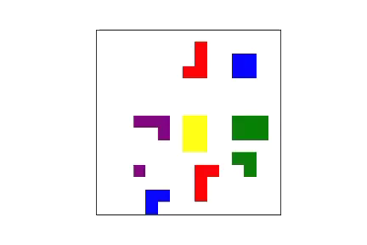
Future direction
AAAI Symposium 2018 on
Integrated Representation, Reasoning, Learning and Execution for Goal Directed Autonomy

Slide 21
Contributions
We provided an annotated dataset for learning action execution.
We proposed and tested an end-to-end system that allows virtual agents to learn actionable predicates by observing human demonstrations.
We showed that with limited data, virtual agents can learn to execute fairly complex actions.
We discussed some limitations, and directions to extend our framework.
AAAI Symposium 2018 on
Integrated Representation, Reasoning, Learning and Execution for Goal Directed Autonomy

Slide 22
Discussion
Can we assume more bias corresponding to human spatial perception bias to reduce even more samples? How do we make learning on the fly?
Feature-based representation could be used for learning with neural-based methods, but it is hard to be carried over to symbolic reasoning. What would be the appropriate method to do so?
Learning from demonstration in our framework is similar in nature to Robot programming from demonstration (Billard et al. 2008). To what extend the framework we have described so far can be applied for real robots?
AAAI Symposium 2018 on
Integrated Representation, Reasoning, Learning and Execution for Goal Directed Autonomy

Slide 23
References
Bisk, Y., Shih, K. J., Choi, Y., & Marcu, D. (2017). Learning Interpretable Spatial Operations in a Rich 3D Blocks World. arXiv preprint arXiv:1712.03463.
Perera, I. E., Allen, J. F., Galescu, L., Teng, C. M., Burstein, M. H., Friedman, S. E., ... & Rye, J. M. (2017). Natural Language Dialogue for Building and Learning Models and Structures. In AAAI (pp. 5103-5104).
Pustejovsky, J., & Moszkowicz, J. L. (2011). The qualitative spatial dynamics of motion in language. Spatial Cognition & Computation, 11(1), 15-44.
Krishnaswamy, N., Narayana, P., Wang, I., Rim, K., Bangar, R., P.atil, D, Mulay, G., Beveridge, R., Ruiz, J., Draper, B., & Pustejovsky, J. (2017). Communicating and acting: Understanding gesture in simulation semantics. In IWCS 2017—12th International Conference on Computational Semantics—Short papers.
Narayan-Chen, A., Graber, C., Das, M., Islam, M.R., Dan, S., Natarajan, S., Doppa, J.R., Hockenmaier, J., Palmer, M., & Roth, D. (2017). Towards Problem Solving Agents that Communicate and Learn. In Proceedings of the First Workshop on Language Grounding for Robotics (pp. 95-103).
Billard, A., Calinon, S., Dillmann, R., & Schaal, S. (2008). Robot programming by demonstration. In Springer handbook of robotics (pp. 1371-1394). Springer Berlin Heidelberg.
AAAI Symposium 2018 on
Integrated Representation, Reasoning, Learning and Execution for Goal Directed Autonomy
Submit to AAAI Symposium 2018 on
Integrated Representation, Reasoning, and Learning in Robotics
Qualitative reasoning Workshop, 2017
This work was supported by Contract W911NF-15-C-0238 with the US Defense Advanced Research Projects Agency (DARPA) and the Army Research Office (ARO).

