Slide 1
7
Start
3
4
End
5
75º
80º
0º
15º
90º
1.2
1.3
30º
1.5

Slide 2
Output
Notes
x
+
Neuron. tanh activation
C_{t-1}
C_{t}
tanh
σ
Neuron. sigma activation
x
tanh
x
F_{t}
I_{t}
G_{t}
O_{t}
Pair-wise multiplication
x
+
σ
σ
tanh
σ
Pair-wise sum
I
I
Concatena-tion
H_{t-1}
H_{t}
tanh
Element-wise tanh
X_{t}
Input

Slide 3
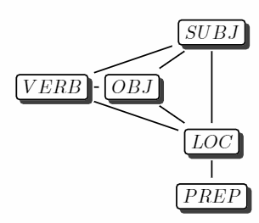
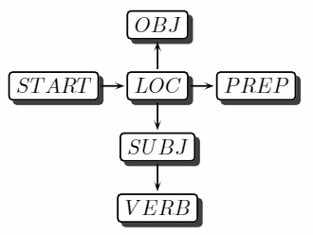

Slide 4
H_{t}
Last layer before output
Label constraint
Label 1
z₁
y₁
LSTM 1
SUBJ
Label 2
X_{t}
y₂
y₄
Input
……
Label 3
OBJ
VERB
H_{t}
Label 4
y₃
y₅
LSTM 5
Label 5
LOC
ADJU
z₅
X_{t}

Slide 5
SUBJ
SUBJ
OBJ
OBJ
VERB
LOC
VERB
LOC
ADJUN
ADJUN

Slide 6
…
…
L_{AB} | A₁ | A₂
B₁
B₂
+
[ z_{A1}, z_{A2} ]
A
collapse
A
[z_{A1-collapse-B,} z_{A2-collapse-B} ]
B
C
C
[ z_{B1}, z_{B2} ]
[ z_{C1}, Z_{C2} ]
[ z_{C1}, Z_{C2} ]

Slide 7
…
…
L_{AB} | A₁ | A₂
B₁
B₂
+
[ z_{A1}, z_{A2} ]
A
collapse
A
[z_{A1-collapse-update-B,} z_{A2-collapse-update-B} ]
B
C
B
C
[ z_{B1}, z_{B2} ]
[ z_{C1}, Z_{C2} ]
[ z_{C1}, Z_{C2} ]

Slide 8
…
…
L_{AB} | A₁ | A₂
B₁
B₂
+
[ z_{A1}, z_{A2} ]
A
collapse
A
[z_{A1-collapse-predict-B,} z_{A2-collapse-predict-B} ]
B
C
B
C
[ z_{B1}, z_{B2} ]
[ z_{C1}, z_{C2} ]
best: { A₁: B₂, A₂: B₁ }
[ z_{C1}, Z_{C2} ]

Slide 9
go
up
and
right
between
the
…
Encoder
Embedded Instruction
Decoder
up
up
right
right
right
<STOP>

Slide 10
Encoder
go
up
and
right
between
the
…
Ann
Ann
Ann
Ann
Ann
Ann
+
up
up
right
right
right
Decoder

Slide 11
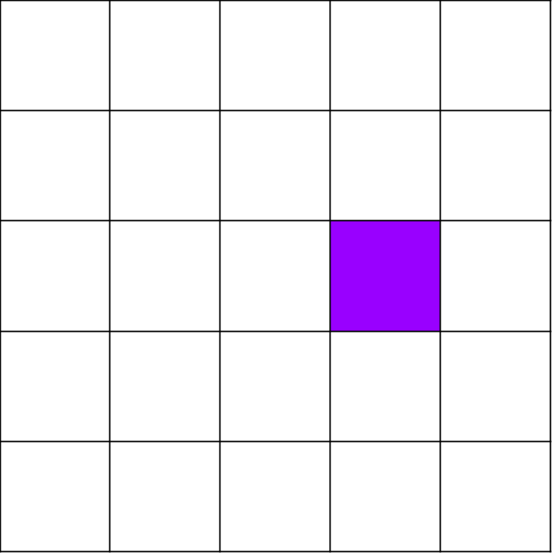
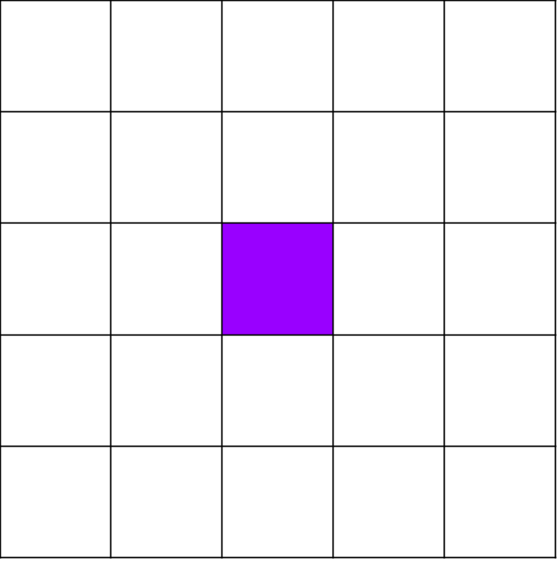
Encoder
Controller
go
up
and
right
between
the
…
Ann
Ann
Ann
Ann
Ann
Ann
+
+
Decoder
up
up
right
right
right

Slide 12
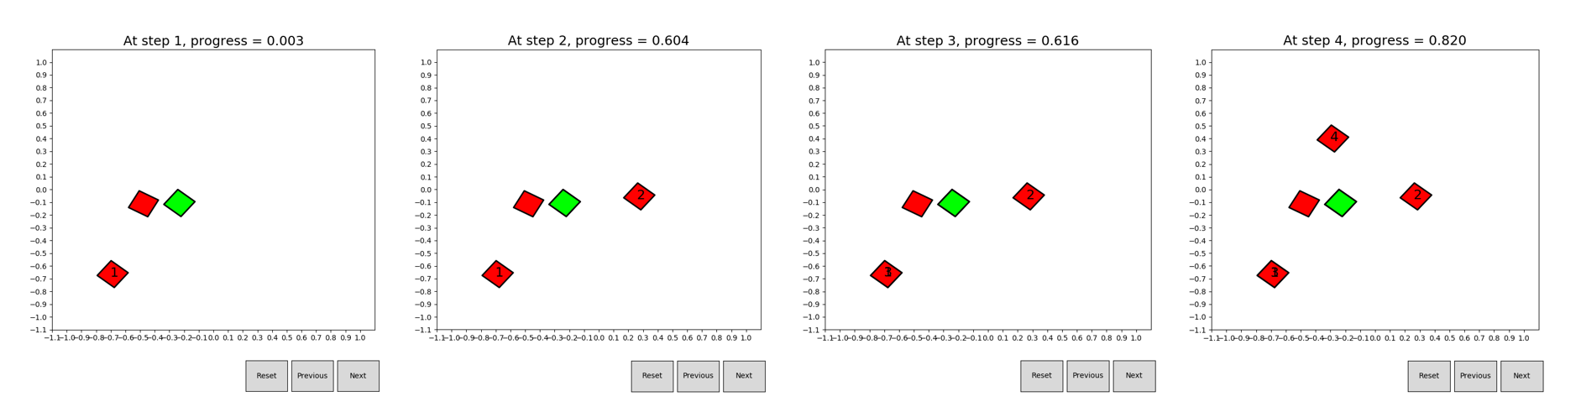
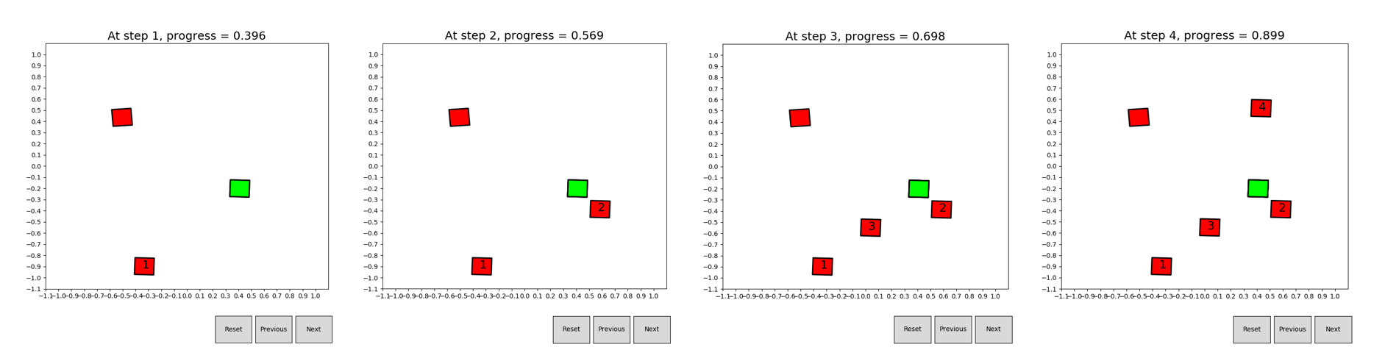

Slide 13
Result state
Trajectory
Other Skills
Actions
Path
Manner
Feature
Symbolic

Slide 14
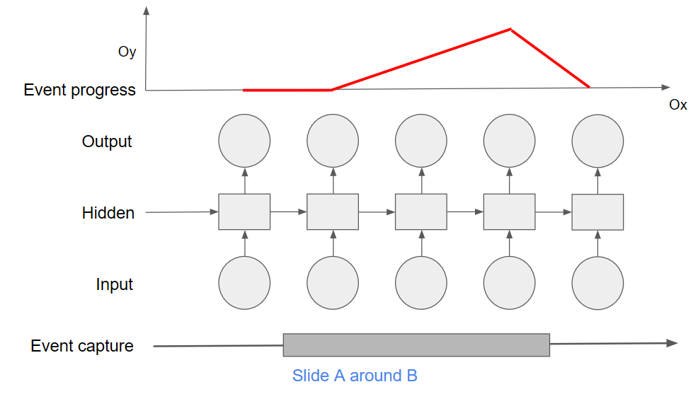
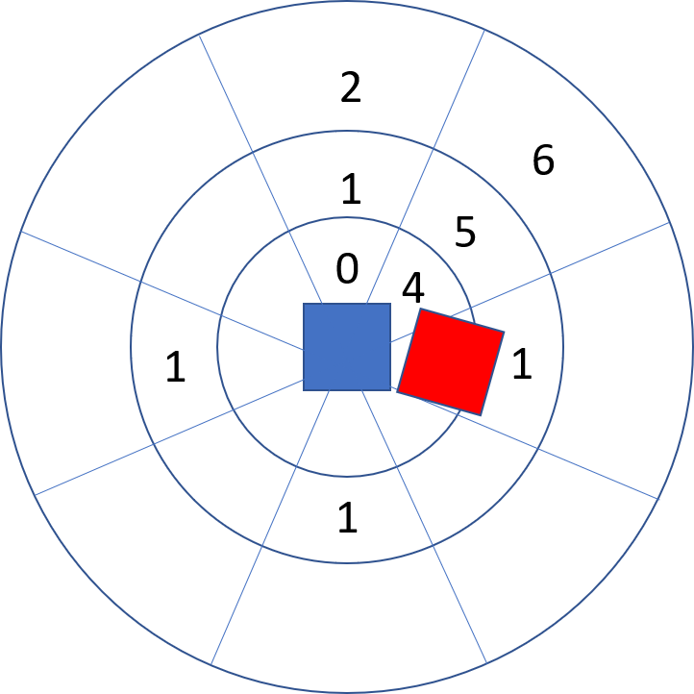

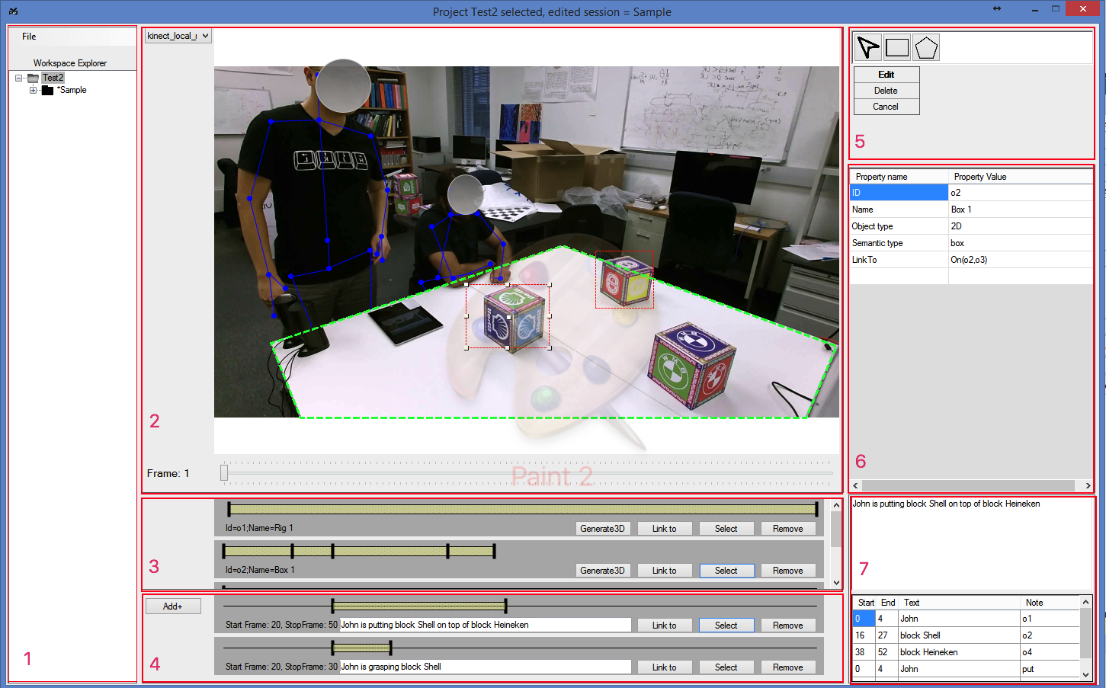
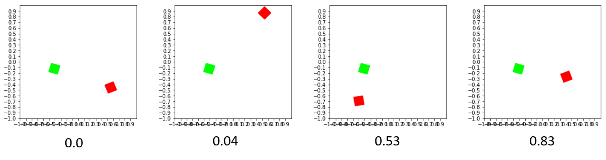
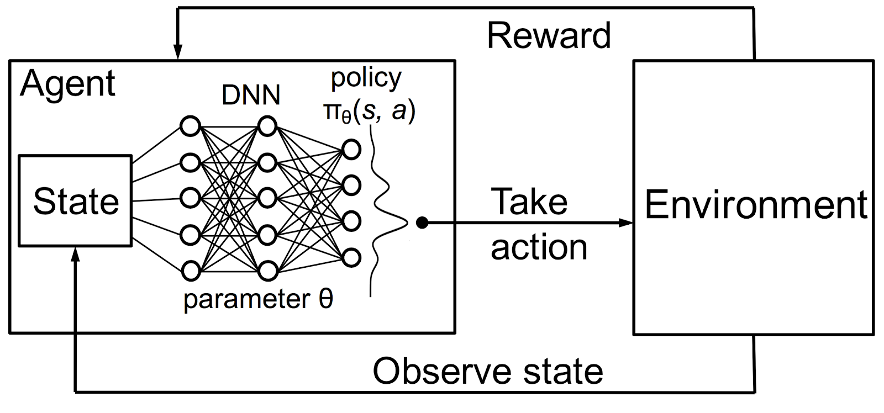
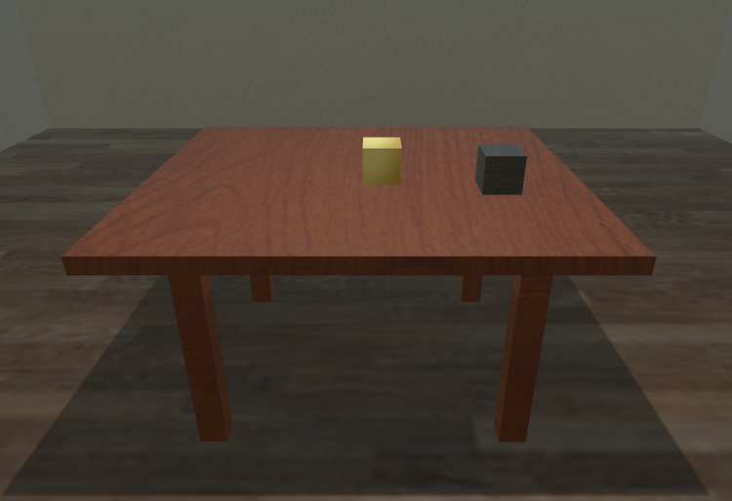
Progress learner
Interactive learner
Automatic Evaluator
Capture
Process data
2D Visualizer
RL algorithms
3D Visualizer

Slide 15
Capture
Process data
ML algorithms
Visualization,
Interaction and
Evaluation

Slide 16
ML algorithms
Capture and Process
Action understanding
Action performance
Visualization,
Interaction and
Evaluation

Slide 17
Visualization
Interactive learner
Automatic Evaluator
2D Visualizer
Capture and Process
ML algorithms
3D Visualizer

Slide 18
