Slide 1
7
Start
3
4
End
5
75º
80º
0º
15º
90º
1.2
1.3
30º
1.5

Slide 2
Output
Notes
x
+
Neuron. tanh activation
C_{t-1}
C_{t}
tanh
σ
Neuron. sigma activation
x
tanh
x
F_{t}
I_{t}
G_{t}
O_{t}
Pair-wise multiplication
x
+
σ
σ
tanh
σ
Pair-wise sum
I
I
Concatena-tion
H_{t-1}
H_{t}
tanh
Element-wise tanh
X_{t}
Input

Slide 3
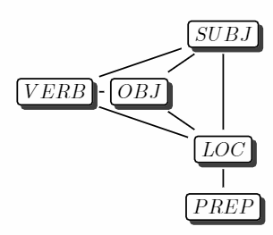
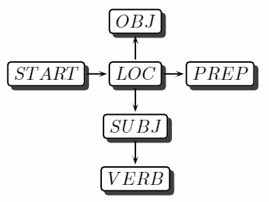

Slide 4
H_{t}
Last layer before output
Label constraint
Label 1
z₁
y₁
LSTM 1
SUBJ
Label 2
X_{t}
y₂
y₄
Input
……
Label 3
OBJ
VERB
H_{t}
Label 4
y₃
y₅
LSTM 5
Label 5
LOC
ADJU
z₅
X_{t}

Slide 5
SUBJ
SUBJ
OBJ
OBJ
VERB
LOC
VERB
LOC
ADJUN
ADJUN

Slide 6
…
…
L_{AB} | A₁ | A₂
B₁
B₂
+
[ z_{A1}, z_{A2} ]
A
collapse
A
[z_{A1-collapse-B,} z_{A2-collapse-B} ]
B
C
C
[ z_{B1}, z_{B2} ]
[ z_{C1}, Z_{C2} ]
[ z_{C1}, Z_{C2} ]

Slide 7
…
…
L_{AB} | A₁ | A₂
B₁
B₂
+
[ z_{A1}, z_{A2} ]
A
collapse
A
[z_{A1-collapse-update-B,} z_{A2-collapse-update-B} ]
B
C
B
C
[ z_{B1}, z_{B2} ]
[ z_{C1}, Z_{C2} ]
[ z_{C1}, Z_{C2} ]

Slide 8
…
…
L_{AB} | A₁ | A₂
B₁
B₂
+
[ z_{A1}, z_{A2} ]
A
collapse
A
[z_{A1-collapse-predict-B,} z_{A2-collapse-predict-B} ]
B
C
B
C
[ z_{B1}, z_{B2} ]
[ z_{C1}, z_{C2} ]
best: { A₁: B₂, A₂: B₁ }
[ z_{C1}, Z_{C2} ]

Slide 9
go
up
and
right
between
the
…
Encoder
Embedded Instruction
Decoder
up
up
right
right
right
<STOP>

Slide 10
Encoder
go
up
and
right
between
the
…
Ann
Ann
Ann
Ann
Ann
Ann
+
up
up
right
right
right
Decoder

Slide 11
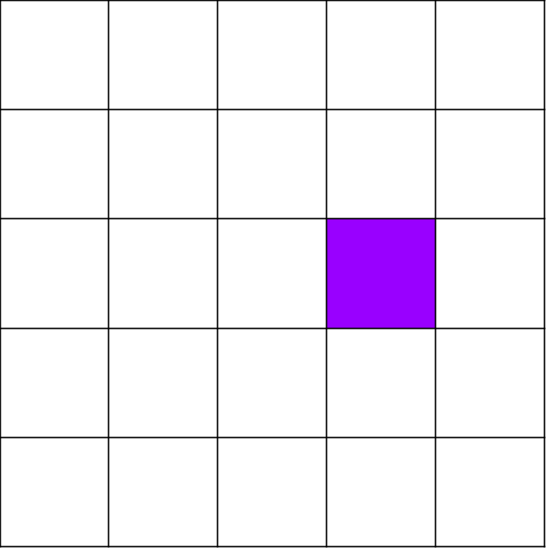
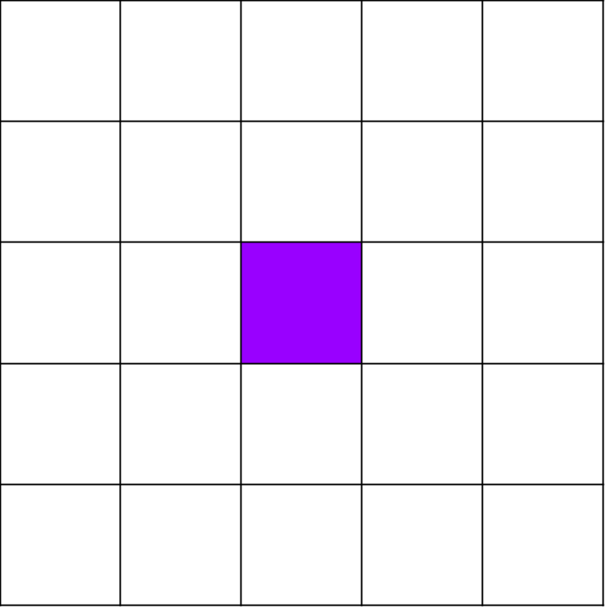
Encoder
Controller
go
up
and
right
between
the
…
Ann
Ann
Ann
Ann
Ann
Ann
+
+
Decoder
up
up
right
right
right

Slide 12
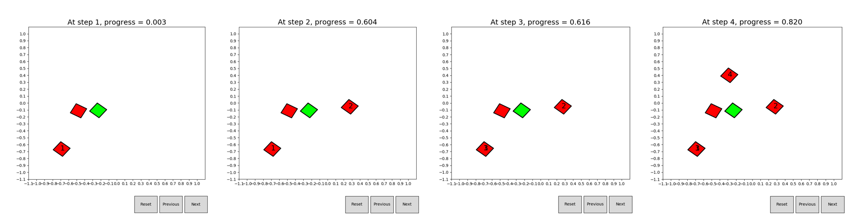
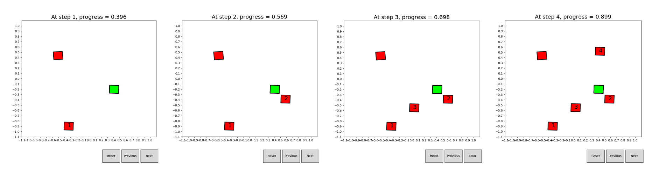

Slide 13
Goal
Mean
Other Skills
Actions
Path
Manner
Feature
Symbolic

