Slide 1
Music Genres Classification
Group 5

Slide 2
Members
Phạm Việt Thành - 20194454
Nguyễn Tuấn Dũng - 20194427
Đặng Vũ Hoàng Hiệp - 20194431

Slide 3
Project Proposal
Our task is the classification of 10 popular music genres: blues, classical, country, disco, hiphop, jazz, metal, pop, reggae and rock.
Algorithms used for this project:
Support Vector Machine
Dense Neural Network
Convolutional Neural Network

Slide 4
Dataset Introspection
The GTZAN Dataset: the most popular dataset for evaluation in machine learning research for music genre classification.
Contains 1000 tracks in total, with 10 genres, each class having 100 tracks. Each audio file lasts 30 seconds.
However, the dataset was published in 2002, so it contains music tracks of the previous generation. Thus, systems performing well on the dataset may not achieve similar results on recent music tracks.

Slide 5
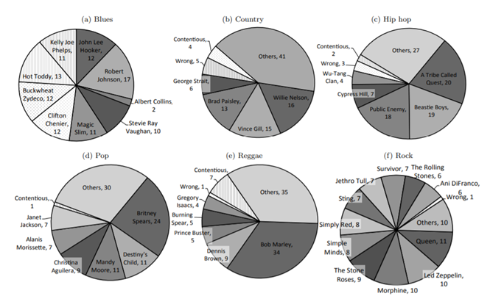
Dataset Introspection

Slide 6
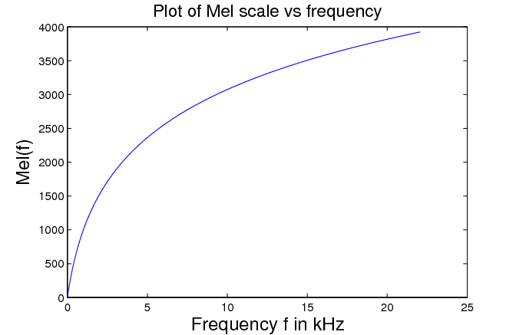

Features extraction: Mel-scale frequency
An audio signal is a combination of multiple sound waves of different frequencies, which are calculated in Hertz (Hz). However, humans do not perceive sound as linear.
Mel scale is a logarithmic transformation applied to a signal's frequency -> This is the frequency that human perceive.

Slide 7
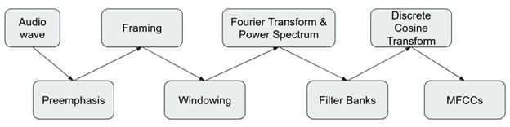
Features extraction: MFCC
We will not explain the detailed calculation of the process as it is out of scope for the project.
The output of the process is a vector of 40 dimensions for each sample. Commonly, we will use the first 13-20 coefficients although latter coefficients are also informative.

Slide 8
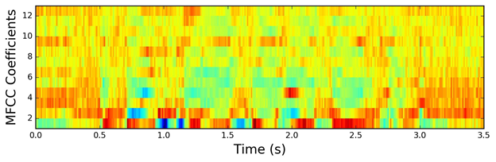
Features extraction: MFCC
Strategy to extract MFCC:
Extract 20 coefficients, then compute mean and variance of each coefficient -> We will have 40 features in total.
Each file is 30s long -> split 1 sample to 9 subsamples -> reduce time dependency -> better feature representation.

Slide 9
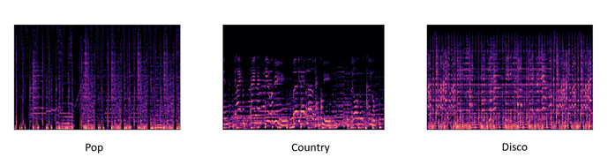
Features extraction: Mel Spectrogram
After extracting the spectrogram, we have observed different spectral patterns in the genres, which we hope the model can identify correctly.
The idea is that CNNs have the ability to extract different features from input tensors, so we expect them to learn some patterns in different music genres.

Slide 10
Dense Neural Network
Fully connected neural network:
Input layer: 40 neurons for 40 features extracted from each audio file.
3 hidden layers, with 512, 256, 32 nodes, respectively.
Final layers: 10 neurons for 10 different classes.
RELU activation function for all layers, except for the final layer.
Softmax function (a function for multi-class classification) for the final layer.

Slide 11
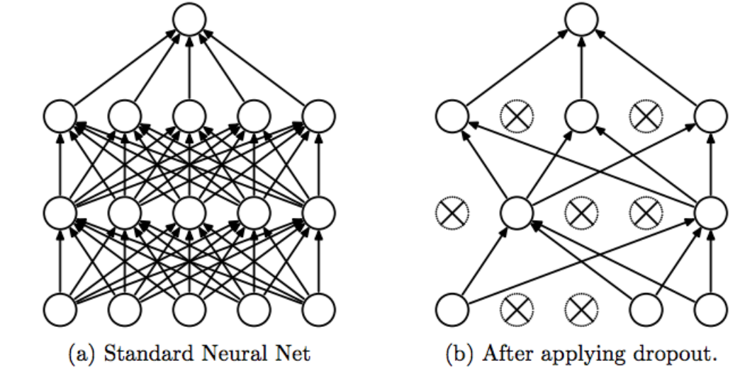
Dense Neural Network: Dropout
Apply Dropout regularization between layers to prevent overfitting:
Dropout: randomly eliminating that node off of our neural network with a probability p ( here, p = 0.5)

Slide 12
Support Vector Machine
Tuning hyperparameters + Kernel: The main function of the kernel is to transform the given dataset input data to the required form ( here, kernel is radial bias function ) + Penalty parameter - C: Represents misclassification or error term ( here, C=5 ) + Gamma: The parameter represents how exactly is the training dataset fitted ( here, gamma = 0.1 )
We use Grid Search algorithm to choose the most suitable kernel function and penalty parameter for this model.
Optimal choice: RBF Kernel with penalty C = 5

Slide 13
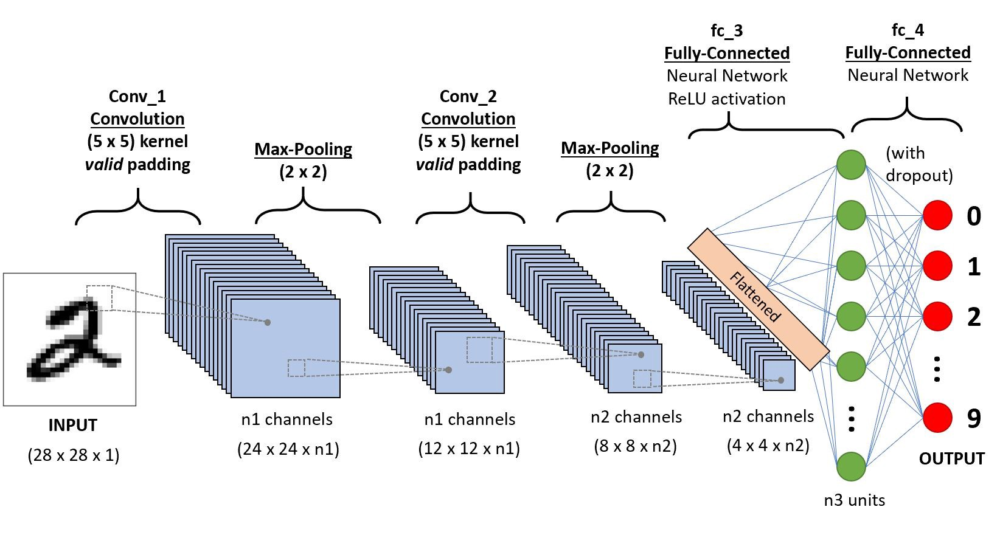
Convolutional Neural Network

Slide 14
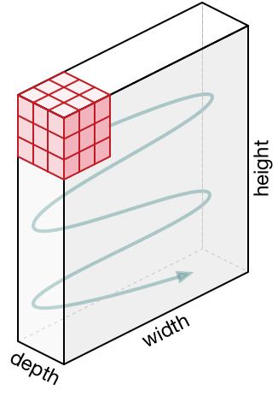
Convolutional Neural Network: Convolutional Layers

Slide 15
Convolutional Neural Network: Padding

Slide 16
Convolutional Neural Network: Convolutional Layers

Slide 17
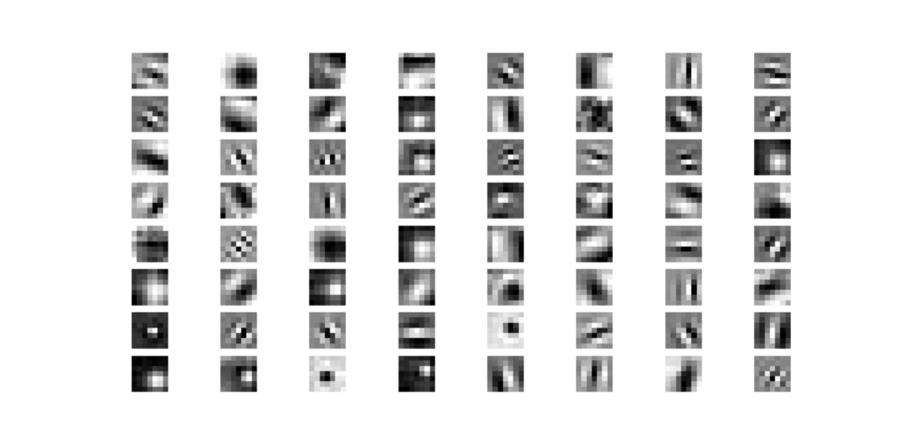
Convolutional Neural Network: Convolutional kernels

Slide 18
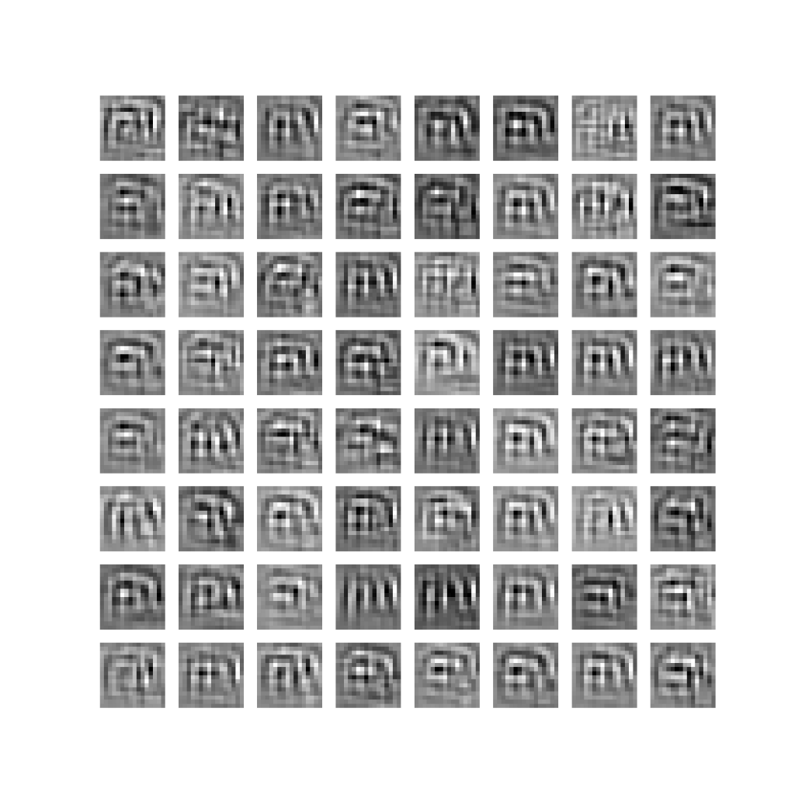
Convolutional Neural Network: Convolutional kernels

Slide 19
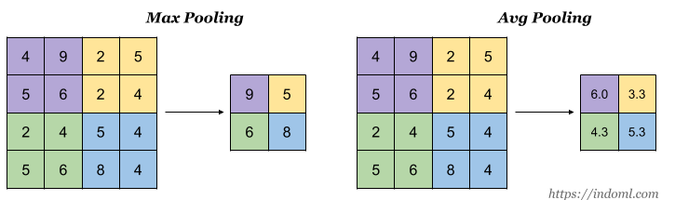
Convolutional Neural Network: Pooling Layers

Slide 20
Experiments: Training setups
Datasets used:
Dataset | Number of samples
GTZAN | 9000
Mixed (Youtube + GTZAN) | 15000
Mixed dataset information:
We crawled 50 music tracks from each genre playlist from Youtube, then we choose 33% of them to mix up with GTZAN.
Dataset preparation:
We splitted each sample into 9 subsamples, which will reduce the time dependency, as discussed before.

Slide 21
Experiments: Training setups
Test set:
To prepare test data, we crawled 11 more songs for each genre (we actually crawled 2 more songs for the reggae class, since we came across a few problems with audio file corruption and extracting, but this won’t have a lot of effects on our evaluation process).
We splitted each sample into 9 subsamples, just like we do to the training set. The reason is for CNN.

Slide 22
Experimental Results
Performance of the three models trained on original GTZAN Dataset.
Set | ANN | SVM | CNN
Training set | 87.81 | 84.37 | 77.69
Validation set | 86.00 | 87.79 | 72.52
Youtube test set | 25.10 | 20.14 | 29.13

Slide 23
Experimental Results
Performance of the three models trained on mixed Dataset.
Set | ANN | SVM | CNN
Training set | 80.46 | 77.16 | 73.94
Validation set | 74.09 | 76.31 | 68.67
Youtube test set | 36.71 | 40.48 | 48.19

Slide 24
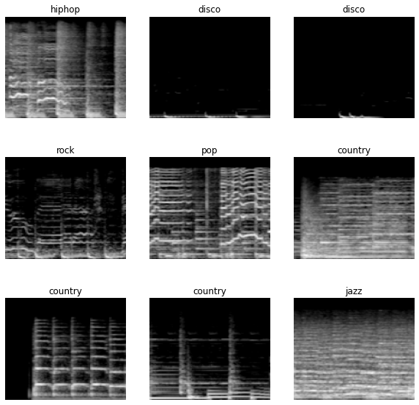
Experimental Results
Spectrograms in the mixed dataset are much more complicate, as there are many representations just for 1 genre, as shown on the left.

Slide 25
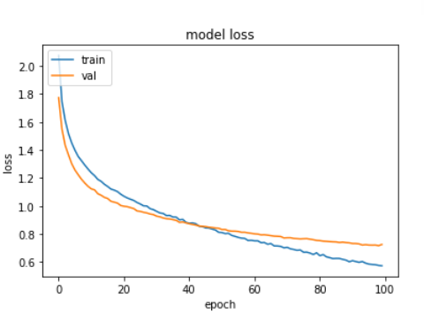
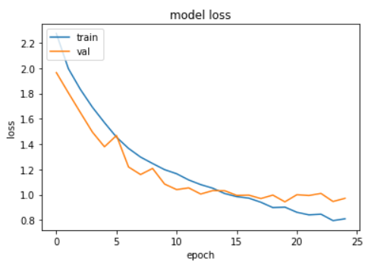
Experimental Results
CNN loss
DNN loss

Slide 26
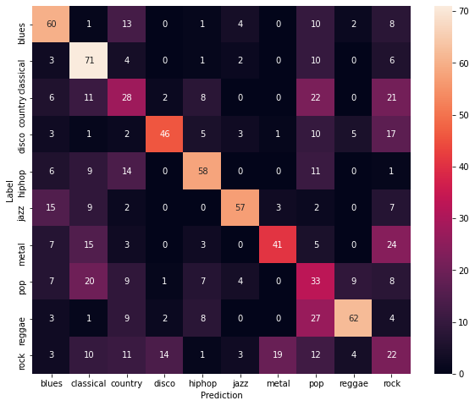
Discussion: Results Assessments
Confusion matrix of CNN performance
Classicals are the easiest to predict.
Rock are the hardest to predict.
Rock and metal are often misclassified.
Pop, rock, country are often misclassified.

Slide 27
Conclusions
Models training on GTZAN dataset may not perform very well on ‘real world’ data, even if we preprocess the test data carefully.
By mix up the GTZAN dataset and Youtube data, we are able to increase the accuracy of models by a large amount, in which CNN achieves the highest accuracy of 48.19%.
Despite the improvement, the models’ accuracy is still not quite good, since the sounds of many genres are hard to generalize, especially for diverse genres like pop, rock...

Slide 28
Future works
The simple CNN model easily gets overfit if trained with a large number of epochs. We will implement a data augmentation technique on spectrograms called SpecAugment.
We will try other audio features such as zero-crossing rate, spectral centroid to see if they are more appropriate for the task.
Using a sequence model on these datasets will likely have better performance, as the data is time series data. We will try models such as RNN and LSTM and hopefully achieve higher accuracy and better generalization.

Slide 29
Thank you!

