Slide 1
://
print("Hello world")
Transporting vehicles
with people and packages
{}
import numpy as np

Slide 2





Project overview
Project description
Approach methods
{table of contents}
Heuristic solution
Initial value
Main algorithm
MIP solution
Decision variables
Constraints
Objectives
Data & output
CP solution
Constraints
Objectives
Data & output
Final analyze
Testing with different data sets
Analyze pros and cons

Slide 3



group members
Phạm Đinh Gia Dũng
20194428
Nguyễn Tuấn Dũng
20194427
Nguyễn Huy Hoàng
20194433

Slide 4
Description
There are N passengers 1, 2, ..., N and M packages N + 1, N + 2, …, N + M. Any person/package i have a pick-up point i and the return point is i + N + M (i = 1,2,…, 2N + 2M).
Each package i has weight q (i = N+1,…,N+M)
There are K vehicles 1,…, K comes from point 0. Each vehicle can transport maximum of 1 passenger and maximum Qk weight of package at the same time (k = 1, ..., K)
We know that d (i, j) is the distance from point i to point j (I, j = 0,…, 2N + 2M)
Goals: Calculate the travel plan so that the total vehicle’s distance are shortest

Slide 5
1
2
3
We will use approaches
1. Heuristic
2. Mixed Integer Programming
3. Constraint programming

Slide 6
Overview
overview
overview
overview
overview
overview
overview
overview
overview

Slide 7

{algorithm overview}
Firstly, from the starting point 0, we iterate through each car [k] and choose the nearest pick-up point for vehicle [k] that hasn't been chosen. After this iteration, each car should go through a pick-up point.
After choosing each point, we should update the car's state(weight, does vehicle have people, latest position),and remove the point from the candidate list
And then, we continue to iterate through each car [k], choosing a nearest point to vehicle [k] that hasn't been taken and satisfies the problem's requirements, and update the car's current status and the candidate set after each point. We will repeat this iterating process until the candidate set is empty, and add the point 0 as the final point in path

Slide 8
{Initialized value}
current_weight: Weight inside vehicle while traveling
path: indicate Vehicle’s path
person_in_car: Decide whether vehicle have a person inside
near_distance: List of distance between all pick up points and point [0]
We initiate some variables which
will be used in the algorithm
current_weight = [0 for i in range(K+1)]
path = {} last_position = [0 for i in range(K+1)] person_in_car = [False for i in range(K+1)]
near_distance = list(d[0][1:N+M+1])
2. This line initiate the candidate list:
list of points that have not been chosen
candidate = [i for i in range(1,2*N+2*M+1)
3. we sort this list of candidates in
increasing order, since we want to
prioritize the one with closer distance
sorted_candidate = sorted(candidate, key=lambda x: d[last_position[k]][x])

Slide 9
algorithm
1
for k in range(1,K+1): min = 9999 for i in range(len(near_distances)): if near_distances[i] < min and i not in chosen_points : min = near_distances[i] last_position[k] = i+1
We iterate through each car, for each iterations we choose the shortest available pick-up point to the depot that hasn’t been chosen, and then we update the current position of the vehicles
2
Remove the point from candidate list and update vehicle’s state (Person and weight in vehicle)
candidate.remove(last_position[k])
if last_position[k] <= N: person_in_car[k] = True elif N+1<= last_position[k] <= N+M: current_weight[k] += q[last_position[k]-(N+1)]
After all vehicles have been assigned to a pick-up point, we continue to iterate through each car, choosing 1 nearest point to the last position that satisfies our demand at a time, and we will repeat this process until the candidate array is empty, which means all the points have been chosen
3
while len(candidate) > 0: for k in range(1, K + 1): sorted_candidate = sorted(candidate, key=lambda-
-x:d[last_position[k]][x]) if sorted_candidate == []: break

Slide 10
4
for cand in sorted_candidate: if cand <= N: if person_in_car[k] == False: person_in_car[k] = True path[k].append(cand) candidate.remove(cand) sorted_candidate.remove(cand) last_position[k] = cand
If the nearest point is a person pick-up points, check if there is a person on the vehicle or not. If not, update the vehicle’s state and remove visited point out of the candidate list
5
elif (N < cand <= N + M): if current_weight[k] + q[cand-(N+1)] <= capacity[k-1]: current_weight[k] += q[cand - (N + 1)] path[k].append(cand) candidate.remove(cand) sorted_candidate.remove(cand) last_position[k] = cand
We do the same thing if the nearest point is a package pick-up point, this time we will check if the vehicle can fit the package or not
6
elif (N+M+1 <= cand <= 2*N+M): if (cand-(N+M)) in path[k]: candidate.remove(cand)
sorted_candidate.remove(cand) person_in_car[k] = False path[k].append(cand) last_position[k] = cand
Or if the nearest point is a person-delivery point, we check if the vehicle had picked up the person or not
7
elif (2*N+M+1 <= cand <= 2*N+2*M): if (cand - (N+M)) in path[k]: candidate.remove(cand)
sorted_candidate.remove(cand) path[k].append(cand) current_weight[k] -= q[(cand-(N+M)) - (N+1)] last_position[k] = cand
And yes, it’s the same if it’s a package delivery point
We will repeat this process until all points have been picked up

Slide 11

8
def find_distance(k): global path,d distance = 0 for i in range(len(path[k]) - 1): distance += d[path[k][i]][path[k][i + 1]] return distance
Find the distance between 2 adjacent point in vehicles path
9
def Print_Sol(): global path,d for k in path.keys(): print('Path of vehicle number ' + str(k) + ' is:') for value in path[k][:len(path[k])-1]: print(str(value) + ' ==> ',end = ' ') print(path[k][-1]) print('The distance vehicle number '+ str(k) + ' travelled is: ',end= ' ') print() print(find_distance(k)) print() if __name__ == '__main__': print("The estimated optimized distance is: ", end=' ') print(Greedy_Sol()) print() Print_Sol() print( ) print('The time taken for the estimation is: ',end = ' ' ) print(time.time() - t0)
/
After the loop has ended we print out the solution

Slide 12


Slide 13
Constraints
Exactly one vehicle goes in to point [j]
Exactly one vehicle goes out of point [i]
If vehicle [k] passes through point [h] it has to go into point [h] first
All vehicles start and end at point [0]
Order of point [0] in all vehicles path is equal to 0
If vehicle k goes through pick up point [i], it have to go through the corresponding deliver point [i+N+M]
Vehicles must go through pick up point [i] before go through corresponding deliver point [i+M+N]
If vehicle [k] goes to a pickup point a human pick-up point [i], it has to go to the corresponding human delivery point [i+N+M] before going to another human pick-up point [j]
Order of point [j] in vehicle [k] path is equal to order of point [i] plus 1 if vehicle [k] go from point [i] to point [j]
Weight inside vehicle [k] after passing point [0] is 0
the current weight in vehicle k after passing through point j is equal to the weight passing through point i plus the weight at point , if x[k][i][j] == 1
Max (0, weight in point [i]) < Current weight in vehicle [k] after go through point [i] < Max (Vehicle package capacity, Vehicle package capacity – weight in point [i]

Slide 14

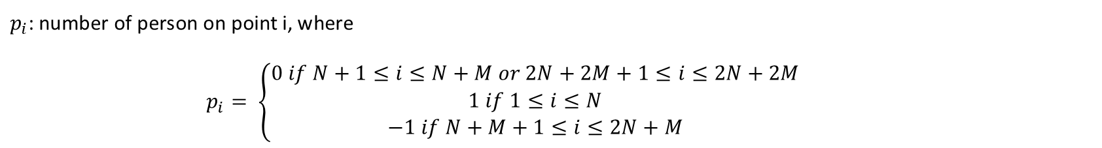
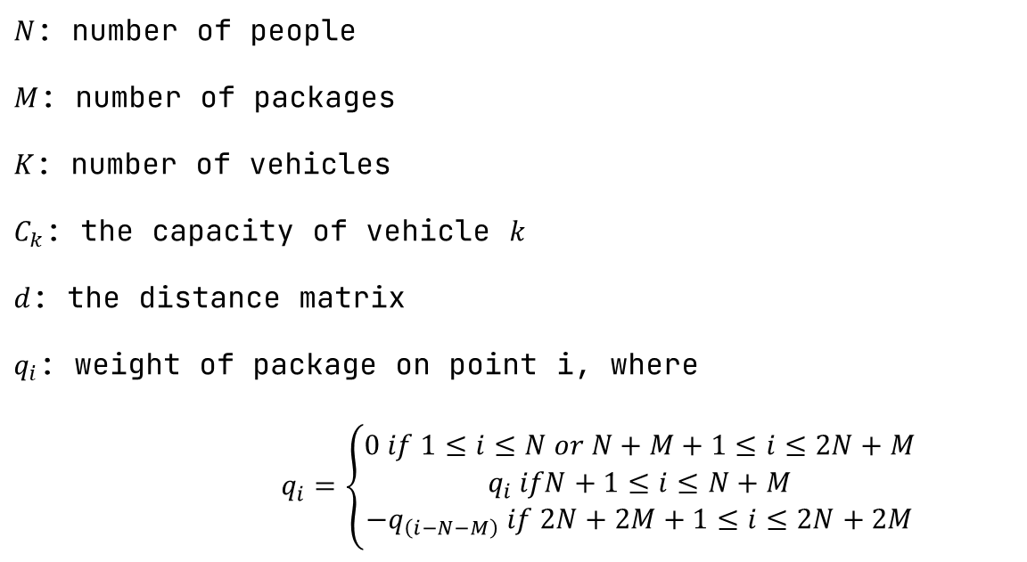
initialize data
$N$: number of people
$M$: number of packages
$K$: number of vehicles
$C_{k}$: the capacity of vehicle $k$
$d$: the distance matrix
$q_{i}$: weight of package on point i, where
$$q_{i}=\left\{\begin{aligned}0 if 1≤i≤N or N+M+1≤i≤2N+M \\ q_{i} ifN+1≤i≤N+M \\ −q_{\left(i−N−M\right)} if 2N+2M+1≤i≤2N+2M\end{aligned}\right.$$
$p_{i}$: number of person on point i, where
$$p_{i}= \left\{\begin{aligned}0 if N+1≤i≤N+M or 2N+2M+1≤i≤2N+2M \\ 1 if 1≤i≤N \\ −1 if N+M+1≤i≤2N+M\end{aligned}\right.$$

Slide 15
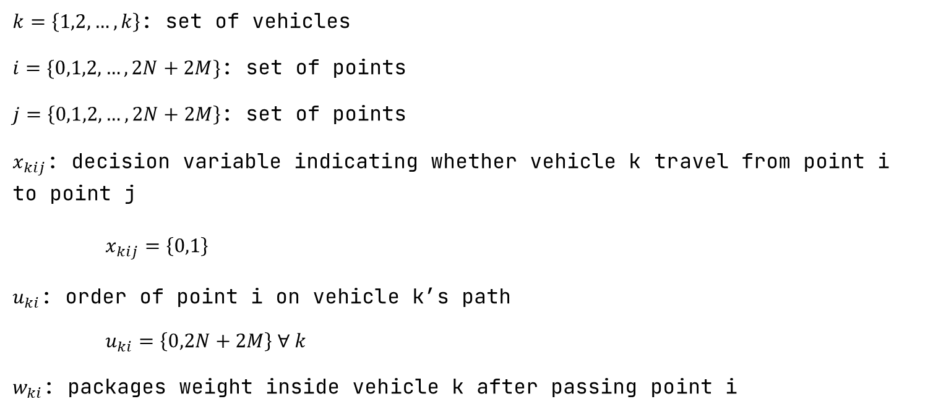
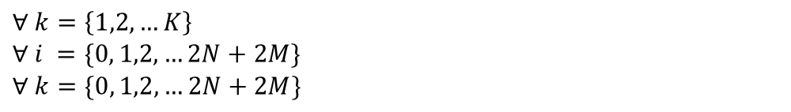
initialize data
$k=\left\{1,2,…,k\right\}$: set of vehicles
$i=\{0,1,2, …,2N+2M\}$: set of points
$j=\left\{0,1,2,…,2N+2M\right\}$: set of points
$x_{kij}$: decision variable indicating whether vehicle k travel from point i to point j
$$x_{kij}=\left\{0,1\right\}$$
$u_{ki}$: order of point i on vehicle k’s path
$u_{ki}=\left\{0,2N+2M\right\} ∀ k$
$w_{ki}$: packages weight inside vehicle k after passing point i
$$∀ k=\left\{1,2,…K\right\}$$
$$∀ i =\{0, 1,2,…2N+2M\}$$
$$∀ k=\{0, 1,2,…2N+2M\}$$

Slide 16
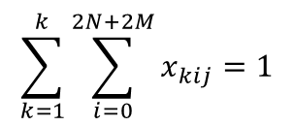
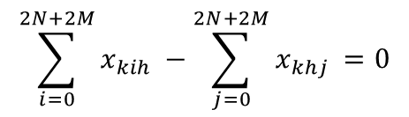
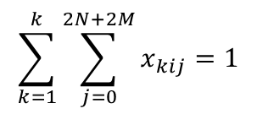
constraints
1. Exactly 1 vehicle goes into point [ j ] for every
point [ j ] $≠$ 0
for j in range(1,2 * N + 2 * M + 1): c = 0 for k in range(1, K + 1): for i in range(2 * N + 2 * M + 1): if i != j: c += x[k][i][j] model.Add(c == 1)
$$\sum_{k=1}^{k}{\sum_{i=0}^{2N+2M}{x_{kij}=1}}$$
2. Exactly 1 vehicle goes out of point [ i ] for every
point [ i ] $≠$ 0
for i in range(1,2 * N + 2 * M + 1): c = 0 for k in range(1, K + 1): for j in range(2 * N + 2 * M + 1): if i != j: c += x[k][i][j] model.Add(c == 1)
$$\sum_{k=1}^{k}{\sum_{j=0}^{2N+2M}{x_{kij}=1}}$$
3. If a vehicle go into point h $≠$ 0, then it has to go
out of point h
for k in range(1, K + 1): for h in range(1,2 * N + 2 * M + 1): c1 = 0 for i in range(2 * N + 2 * M + 1): if i!= h: c1 += x[k][i][h] c2 = 0 for j in range(2 * N + 2 * M + 1): if j != h: c2 += x[k][h][j] model.Add(c1 - c2 == 0)
$$\sum_{i=0}^{2N+2M}{x_{kih} −\sum_{j=0}^{2N+2M}{x_{khj} =0}}$$

Slide 17
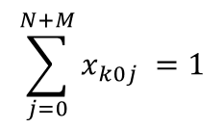
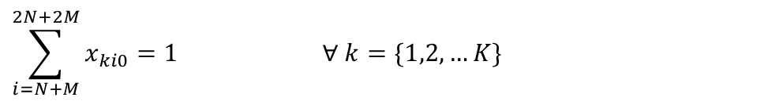
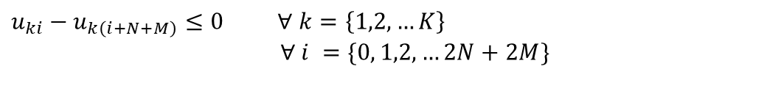
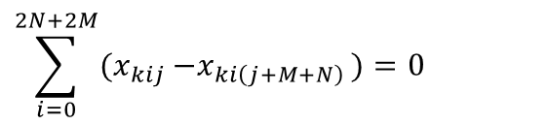
4. If vehicle k goes through pick-up point I, it has to go
through the delivery point i+N+M later in its path
for k in range(1, K + 1): for j in range(1, N + M + 1): c1 = 0 for i in range(2 * N + 2 * M + 1): c1 += x[k][i][j] - x[k][i][j + N + M] model.Add(c1 == 0)
$$\sum_{i=0}^{2N+2M}{{(x}_{kij} −x_{ki\left(j+M+N\right) })=0}$$
5. All vehicles have to start at point 0
for k in range(1, K + 1): c = 0 for j in range(1,N+M+1): c += x[k][0][j] model.Add(c == 1)
$$\sum_{j=0}^{N+M}{x_{k0j} =1}$$
6. All vehicles have to end at point 0
for k in range(1, K + 1): c = 0 for i in range(N+M+1,2 * N + 2 * M + 1): c += x[k][i][0] model.Add(c == 1)
$$\sum_{i=N+M}^{2N+2M}{x_{ki0}=1 ∀ k=\{1,2,…K\}}$$
7. Vehicles have to pass the pickup point of
person/package before go to their deliver point
for k in range(1,K+1): for k in range(1, K + 1): for i in range(1, N + M + 1): model.Add(u[k][i] - u[k][i + N + M] <= 0)
$$u_{ki}−u_{k\left(i+N+M\right)}≤0 ∀ k=\left\{1,2,…K\right\}$$
$$∀ i =\{0, 1,2,…2N+2M\}$$

Slide 18
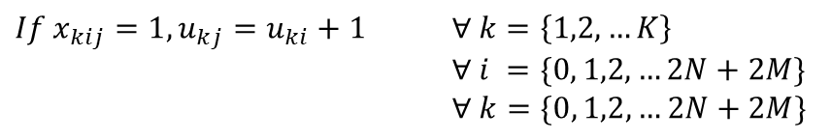
8. Weight inside vehicle [k] after
passing point [0] is 0
for k in range(1, K + 1): model.Add(w[k][0] == 0)
$$w_{k0}=0 ∀ k=\{1,2,…K\}$$
9. The order of point 0 is always 0
for k in range(1, K + 1): model.Add(u[k][0] == 0)
$$u_{k0}=0 ∀ k=\{1,2,…K\}$$
10. Order of the next point in path is
order of previous point + 1, this also
eliminates sub-tours
for k in range(1,K+1): for i in range(2*N+2*M+1): for j in range(1,2*N+2*M+1): if i != j: b = model.NewBoolVar('b') model.Add(x[k][i][j] == 1).OnlyEnforceIf(b) model.Add(x[k][i][j] != 1).OnlyEnforceIf(b.Not()) model.Add(u[k][j] == u[k][i] + 1).OnlyEnforceIf(b)
$$If x_{kij}=1, u_{kj}=u_{ki}+1 ∀ k=\left\{1,2,…K\right\}$$
$$∀ i =\{0, 1,2,…2N+2M\}$$
$$∀ k=\{0, 1,2,…2N+2M\}$$

Slide 19
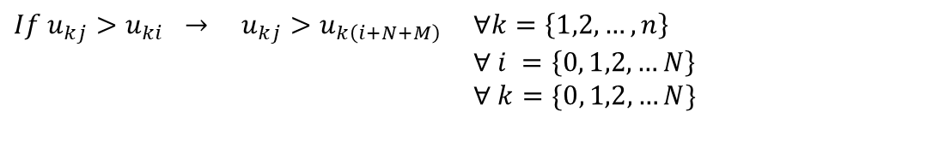
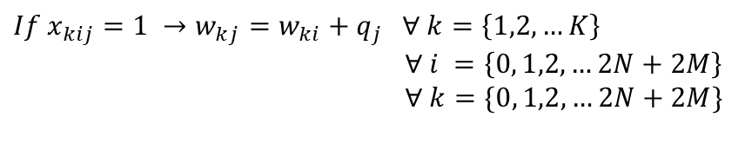
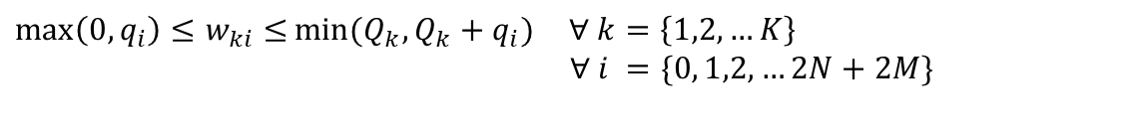
11. If vehicles go from point i to j, the weight
on vehicle after point j = weight after
point i + weight at point j
for k in range(1,K+1): for i in range(2*N+2*M+1): for j in range(1,2*N+2*M+1): if i !=j: b = model.NewBoolVar('b') model.Add(x[k][i][j] == 1).OnlyEnforceIf(b) model.Add(x[k][i][j] != 1).OnlyEnforceIf(b.Not()) model.Add(w[k][j] == w[k][i] + q[j-1]).OnlyEnforceIf(b)
$$If x_{kij}=1 →w_{kj}=w_{ki}+q_{j} ∀ k=\left\{1,2,…K\right\}$$
$$∀ i =\left\{0, 1,2,…2N+2M\right\}$$
$$∀ k=\{0, 1,2,…2N+2M\}$$
12. If vehicles pick up a person, it has to deliver
them before pickup anyone else
for k in range(1,K+1): for i in range(1,N+1): for j in range(1,N+1): if i != j: b = model.NewBoolVar('b') model.Add( u[k][j] > u[k][i]).OnlyEnforceIf(b) model.Add(u[k][j] <= u[k][i]).OnlyEnforceIf(b.Not()) model.Add( u[k][j] > u[k][i + N + M] ).OnlyEnforceIf(b)
$$If u_{kj}>u_{ki} → u_{kj}>u_{k\left(i+N+M\right)} ∀k=\left\{1,2,…,n\right\}$$
$$∀ i =\left\{0, 1,2,…N\right\}$$
$$∀ k=\{0, 1,2,…N\}$$
13. Weight on vehicles after passing point i has to be bigger than 0 or the weight of package at
point i, and smaller than vehicle capacity or vehicle capacity minus weight of package at point i
$$\max\left(0,q_{i}\right)≤w_{ki}≤\min{(Q_{k}, Q_{k}+q_{i})} ∀ k=\left\{1,2,…K\right\}$$
$$∀ i =\{0, 1,2,…2N+2M\}$$
for k in range(1,K+1): for i in range(2*N+2*M+1): model.Add(max(0,q[i-1]) <= w[k][i] <= min(capacity[k-1],capacity[k-1]+q[i-1]))

Slide 20
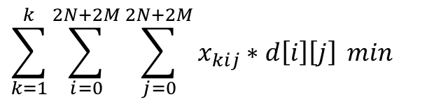
objective function
Minimize the total travel distances
c = 0 for k in range(1, K + 1): for i in range(2 * N + 2 * M + 1): for j in range(2 * N + 2 * M + 1): c += x[k][i][j] * d[i][j] model.Minimize(c) solver = cp_model.CpSolver() status = solver.Solve(model)
$$\sum_{k=1}^{k}{\sum_{i=0}^{2N+2M}{\sum_{j=0}^{2N+2M}{x_{kij}∗d\left[i\right]\left[j\right]}}} min$$

Slide 21

<
M
I
P

Slide 22
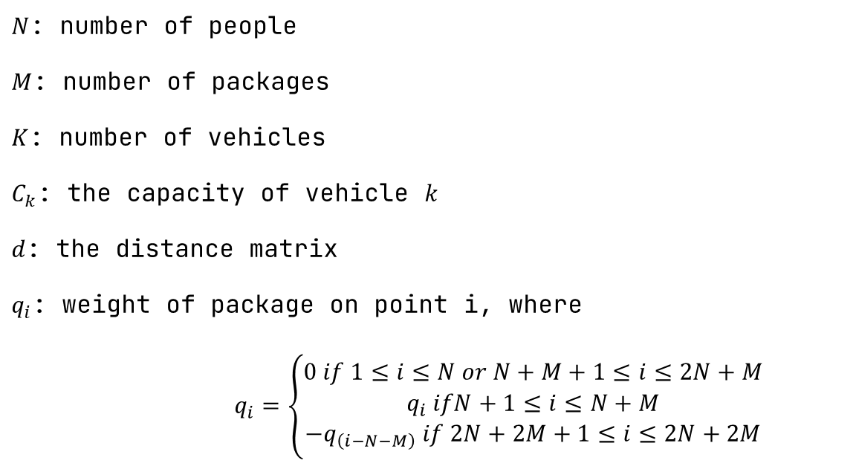
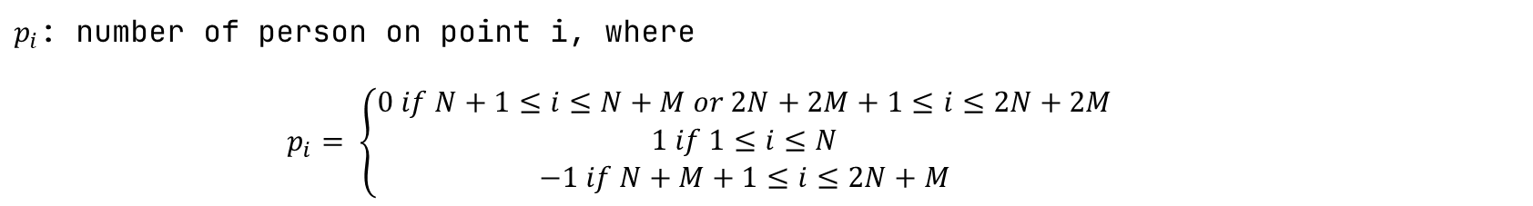
initialize data
$N$: number of people
$M$: number of packages
$K$: number of vehicles
$C_{k}$: the capacity of vehicle $k$
$d$: the distance matrix
$q_{i}$: weight of package on point i, where
$$q_{i}=\left\{\begin{aligned}0 if 1≤i≤N or N+M+1≤i≤2N+M \\ q_{i} ifN+1≤i≤N+M \\ −q_{\left(i−N−M\right)} if 2N+2M+1≤i≤2N+2M\end{aligned}\right.$$
$p_{i}$: number of person on point i, where
$$p_{i}= \left\{\begin{aligned}0 if N+1≤i≤N+M or 2N+2M+1≤i≤2N+2M \\ 1 if 1≤i≤N \\ −1 if N+M+1≤i≤2N+M\end{aligned}\right.$$

Slide 23
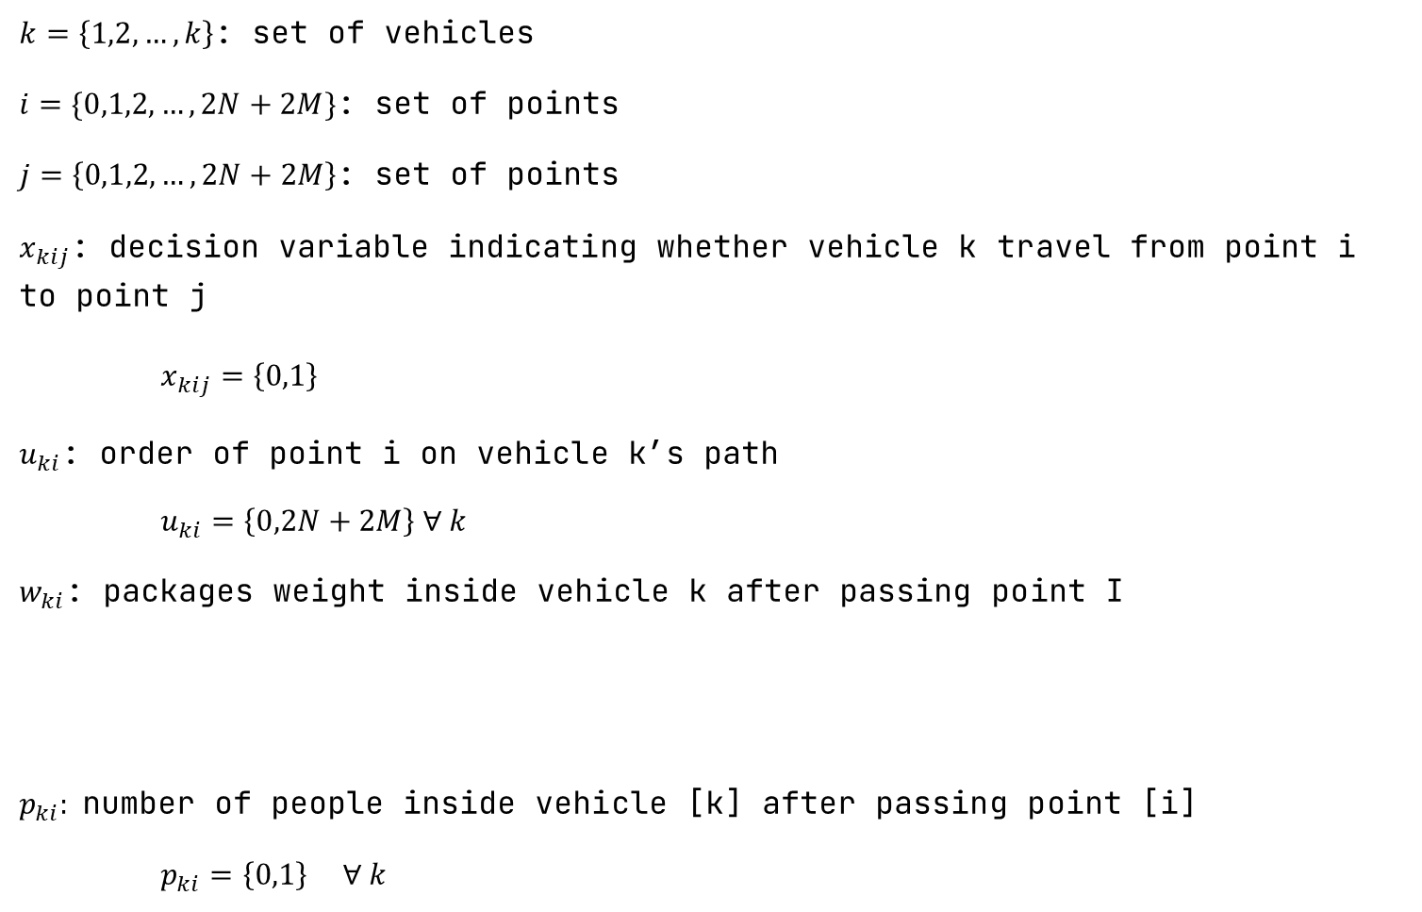
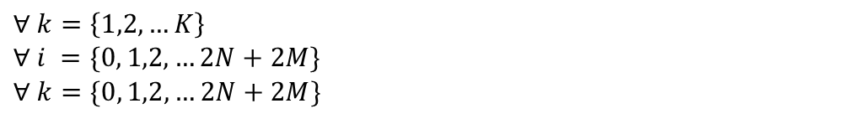
$k=\left\{1,2,…,k\right\}$: set of vehicles
$i=\{0,1,2, …,2N+2M\}$: set of points
$j=\left\{0,1,2,…,2N+2M\right\}$: set of points
$x_{kij}$: decision variable indicating whether vehicle k travel from point i to point j
$$x_{kij}=\left\{0,1\right\}$$
$u_{ki}$: order of point i on vehicle k’s path
$u_{ki}=\left\{0,2N+2M\right\} ∀ k$
$w_{ki}$: packages weight inside vehicle k after passing point I
$p_{ki}:$number of people inside vehicle [k] after passing point [i]
$p_{ki}=\left\{0,1\right\} ∀ k$
$$∀ k=\left\{1,2,…K\right\}$$
$$∀ i =\{0, 1,2,…2N+2M\}$$
$$∀ k=\{0, 1,2,…2N+2M\}$$

Slide 24

Exactly one vehicle goes in to point [j]
Exactly one vehicle goes out of point [i]
If vehicle [k] passes through point [h] it has to go into point [h] first
All vehicles start and end at point [0]
Order of point [0] in all vehicles path is equal to 0
If vehicle k goes through pick up point [i], it have to go through the corresponding deliver point [i+N+M]
Vehicles must go through pick up point [i] before go through corresponding deliver point [i+M+N]
Weight inside vehicle [k] after passing point [0] is 0
Max (0, weight in point [i]) < Current weight in vehicle [k] after go through point [i] < Max (Vehicle package capacity, Vehicle package capacity – weight in point [i]
We use the same implementation
This is CP
Constraints
{
10. Order of point [j] in vehicle [k] path is equal to the order of point
[i] plus 1 if vehicle [k] goes from point [i] to point [j]
11. Current weight in vehicle [k] after going through point [j] is equal to
the weight in vehicle [k] after going through point [i] plus weight in
point [j] if if vehicle [k] goes from point [i] to point [j]
12. Number of people in vehicle [k] after going through point [j] is equal
to the number of people in vehicle [k] after going through point [i]
plus the number of people in point [j] if the vehicle k goes from point
[i] to point [j]
We use different implementation
We remove this
constraint
13. If vehicles [k] goes to a human pickup point [i], it has to go to
corresponding deliver point [i+N+M] before going to another human pickup
point [j]
{
14. Max (0, Number of people in point [i]) < Number of person in vehicle [k]
after go through point [i] < Max (Vehicle people capacity, Vehicle
people capacity – number of people in point [i])
15. Number of people inside vehicle [k] after
passing point [0] is 0
And add this
constraint

Slide 25
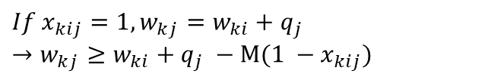
Constraints with different implementation
1. If vehicles go from point i to j, the order of
point j in path is order of point i +1
$$If x_{kij}=1, u_{kj}=u_{ki}+1$$
$$→u_{ki}− u_{kj}+\left(2N+2M+1\right)∗ x_{kij}+\left(2N+2M−1\right)∗ x_{kji}≤ 2N+2M$$
for k in range(1, K + 1): for i in range(2 * N + 2 * M + 1): for j in range(1, 2 * N + 2 * M + 1): if i != j: solver.Add(u[k][i] - u[k][j] + (2 * N + 2 * M + 1) * x[k][i][j] + (2 * N + 2 * M + 1 - 2) * x[k][j][i] <= 2 * N + 2 * M + 1 - 1)
2. If vehicles go from point i to j, the weight
on vehicle after point j = weight after
point i + weight at point j
$$If x_{kij}=1, w_{kj}=w_{ki}+q_{j}$$
$$→w_{kj}≥w_{ki}+q_{j} −M(1 −x_{kij})$$
for k in range(1, K + 1): for i in range(2 * N + 2 * M + 1): for j in range(1, 2 * N + 2 * M + 1): solver.Add(w[k][j] >= w[k][i] + q[j - 1] - 9999 * (1 - x[k][i][j]))

Slide 26
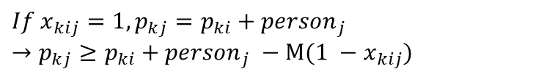
Constraints with different implementation
3. If vehicles go from point i to j, number of perple
in vehicle after point j = number of people in
vehicle after point i + number of people at point j
$$If x_{kij}=1, p_{kj}=p_{ki}+{person}_{j}$$
$$→p_{kj}≥p_{ki}+{person}_{j} −M(1 −x_{kij})$$
for k in range(1, K + 1): for i in range(2 * N + 2 * M + 1): for j in range(1, 2 * N + 2 * M + 1): if i != j: solver.Add(p[k][j] >= p[k][i] + person[j - 1] - 9999 * (1 - x[k][i][j]))

Slide 27
Added constraints
4. Number of people inside vehicle [k] after
passing point [0] is 0
for k in range(1, K + 1): solver.Add(p[k][0] == 0)
$$p_{k0}=0 ∀ k=\{1,2,…K\}$$
5. Number of people vehicles after passing point i has to be bigger than 0 or the
number of people at point i, and smaller than vehicle capacity or vehicle capacity
minus number of people at point i
$$\max\left(0,{person}_{[i]}\right)≤p_{ki}≤\min{(1, 1+{person}_{[i]})} ∀ k=\left\{1,2,…K\right\}$$
$$∀ i =\{0, 1,2,…2N+2M\}$$
for k in range(1, K + 1): for i in range(2 * N + 2 * M + 1): c = 0 for j in range(1, 2 * N + 2 * M + 1): if i != j: c += x[k][i][j] solver.Add(max(0, person[i - 1]) <= p[k][i] <= min(1, 1 + person[i - 1]))

Slide 28
:final analyze

Slide 29
 | Size | Heuristic | CP | MIP | Optimal
 | 10 K = 2 | Obj: 52 Time: 0.00099s | Obj: 42 Time: 0.214s | Obj: 42 Time: 1.39s | 42
 | 14 K = 2 | Obj: 55 Time: 0.00099s | Obj: 43 Time: 38.77s | Obj: 43 Time: 4.732s | 43
 | 18 K = 3 | Obj: 112 Time: 0.00099s | Obj:69 Time: 356.48s | Obj: 69 Time: 87.76s | 69
 | 20 K = 4 | Obj: 112 Time: 0.00099s | Obj: N/A Time: Unsolvable | Obj: 59 Time: 1147.51s | 59
 | 50 K = 10 | Obj: 279 Time: 0.0029s | Obj: N/A Time: Unsolvable | Obj: N/A Time: Unsolvable | N/A
 | 100 K = 20 | Obj: 590 Time: 0.0049s | Obj: N/A Time: Unsolvable | Obj: N/A Time: Unsolvable | N/A
final analyze

Slide 30
/
/
solution
Heuristic
Non-optimal solution
MIP
Optimal solution
CP
Optimal solution

Slide 31
/
/
run time
Heuristic
At least it is fast
MIP
Just slow
CP
Depends on solution set

Slide 32
/
/
difficulty
Heuristic
Easy to code
MIP
Difficulties with non-linear constraints
CP
Medium difficulty

Slide 33
Any question?
Please don’t

