Slide 1

IT Jobs Analysis
14PFIEV3 DUT
Nhu Nguyen – Van Tuan – Hoang Phuc

Slide 2
Content
Situation
Problems
Why we need data analysis
What we do
Functionalities
Q&A

Slide 3
SITUATION

Slide 4
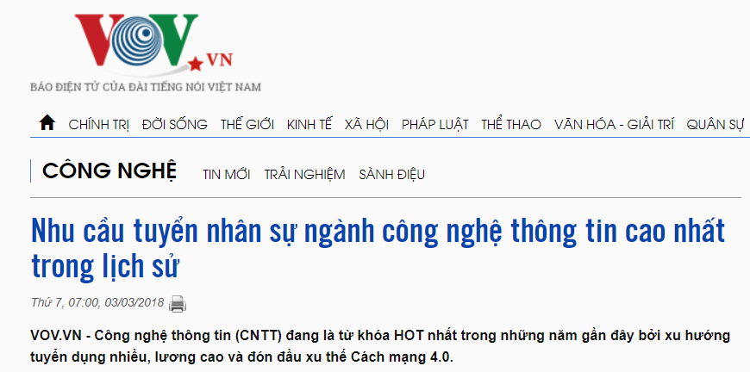
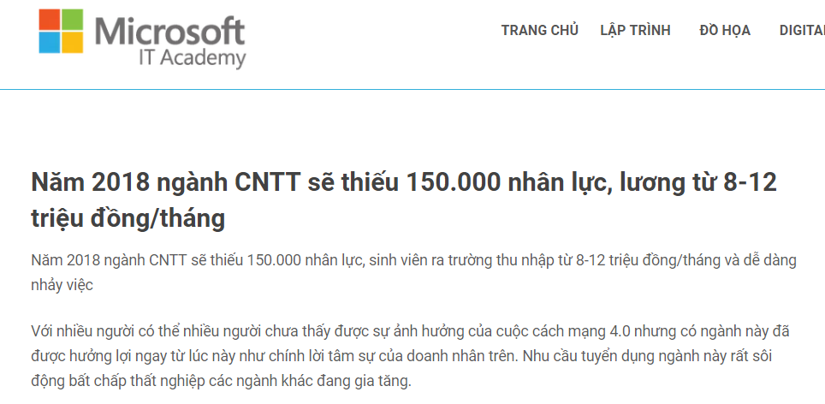
Large image
https://vov.vn/cong-nghe/nhu-cau-tuyen-nhan-su-nganh-cong-nghe-thong-tin-cao-nhat-trong-lich-su-735194.vov
http://msita.udn.vn/lap-trinh-da-nang/lap-trinh-vien-chuyen-nghiep/

Slide 5
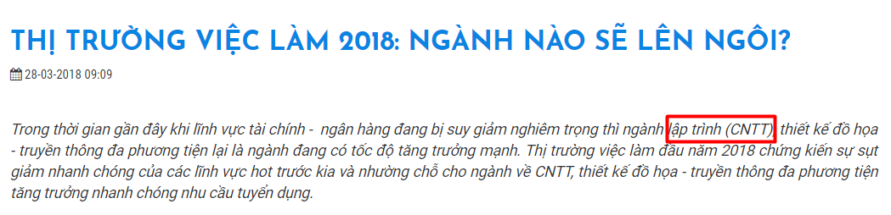
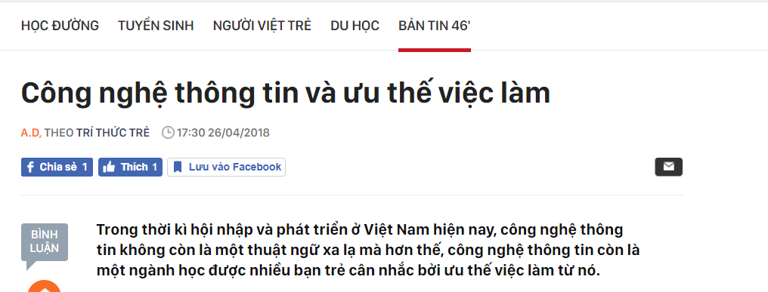
http://itplus-academy.edu.vn/thi-truong-viec-lam-2018-nganh-nao-se-len-ngoi-1659.html
http://kenh14.vn/cong-nghe-thong-tin-va-uu-the-viec-lam-20180426173032377.chn

Slide 6
https://www.facebook.com/groups/jobITDaNang/

Slide 7
PROBLEMS

Slide 8


Slide 9
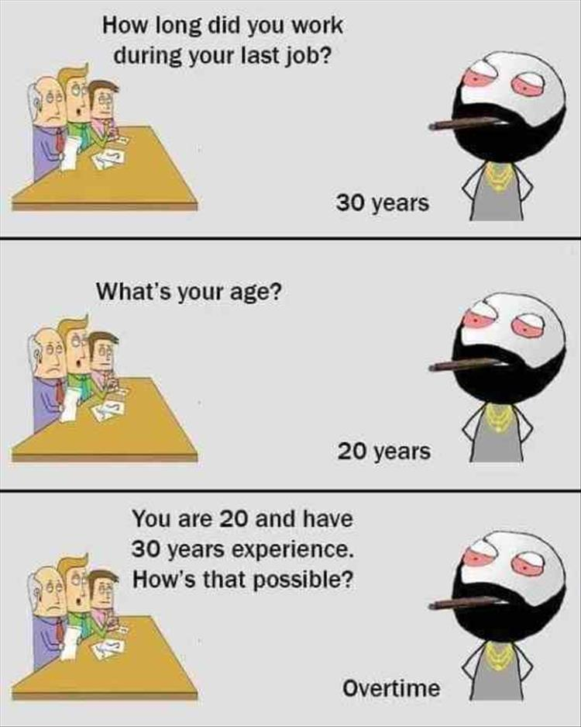
Problems
Job Description
Salary
Environment
Career Path
The company
Notes:
JD: don’t know exactly → not well-prepared; same field but different between companies
Salary: maybe you can get higher offer with more benefits at another company
Environment: international or just local area?
Career Path: specialist or business management?
Company: review from the ex-employees, why they changed their jobs?

Slide 10
?
DATA ANALYSIS

Slide 11
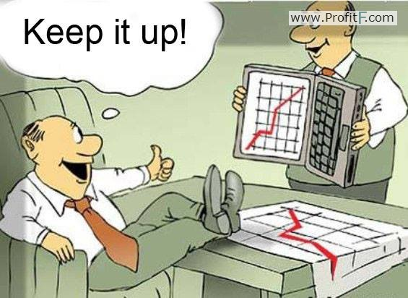
Notes:
Right point of view about IT market (hot trend)

Slide 12
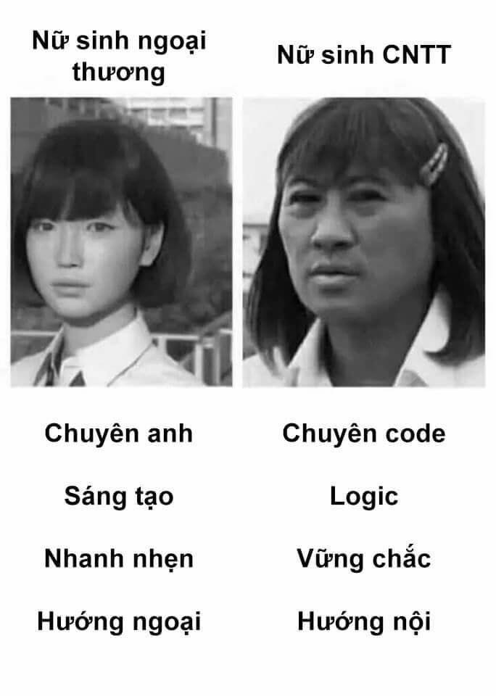
Notes:
Understanding more about the expectation of recruiters, where we are, what we will prepare

Slide 13

Notes:
Bring the best benefits for us

Slide 14
WHAT WE DO

Slide 15
Sources
There are many websites, Facebook’s groups that gives us the data about IT jobs
Facebook
Websites
https://www.facebook.com/groups/jobITDaNang
https://www.vietnamworks.com/
https://itviec.com/it-jobs
https://jobseekers.vn/

Slide 16





Slide 17
FUNCTIONALITIES

Slide 18
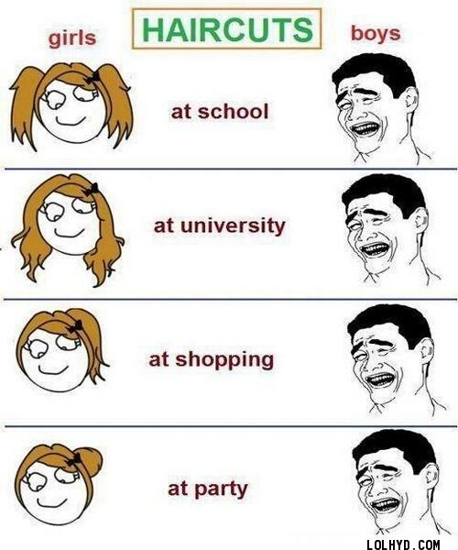
Comparison
Notes:
Salary
Benefits

Slide 19
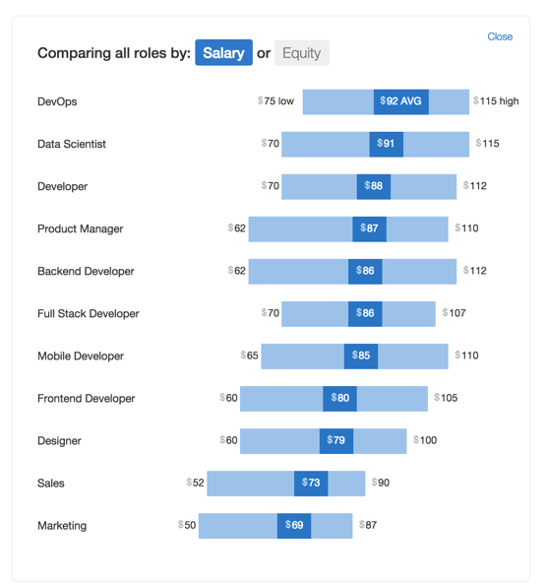
Chart (salary, …)
Notes:
Average salary of a job
Highest to lowest salaries

Slide 20

Statistics (most common requirements, reviews, …)

Slide 21

Job trending

Slide 22
Project in detail

Slide 23
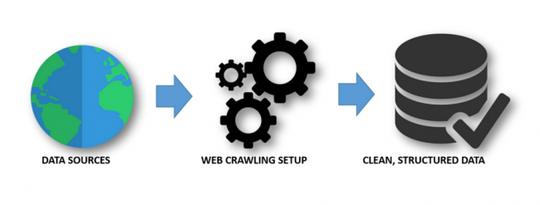


Data processing
Itviec.com
topItWorks.com

Slide 24
Salary:
500$
400 – 1.200$ …
You will love it (missing value)
Name of company, Job’s Name:
Frontend Developer (JavaScript/React) (Front-end, Front –End, FE, …)
….
jobs.txt

Slide 25





Server RestAPIs
Run 2 scripts, regularly updated
Hosted by

Slide 26
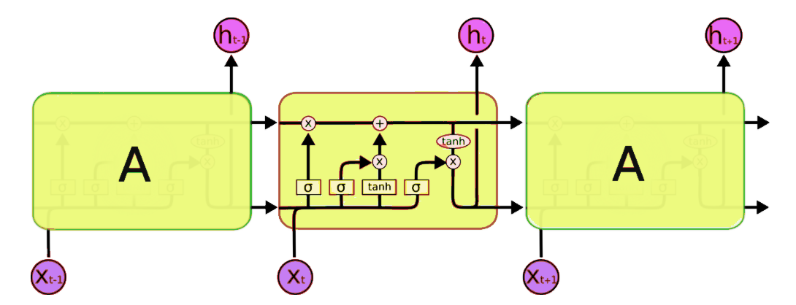
Long short term memory

Slide 27
Functional Screens

Slide 28
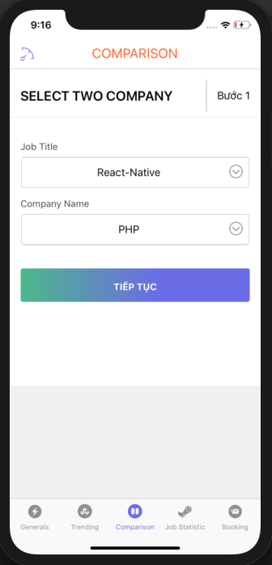
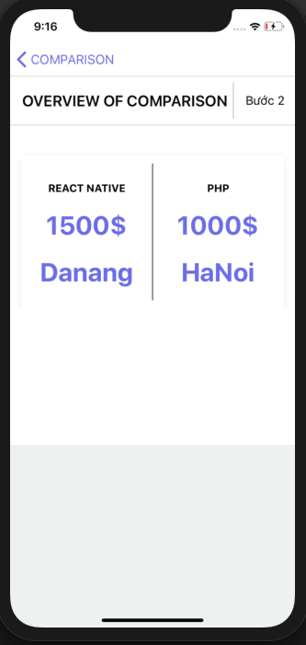
Comparison

Slide 29
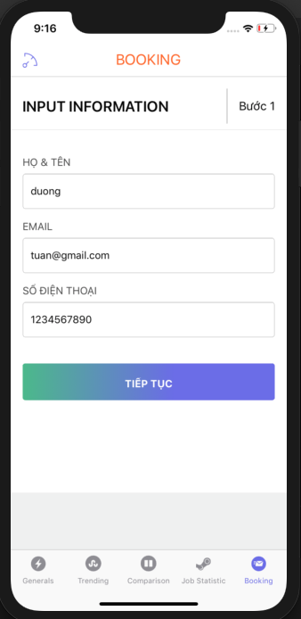
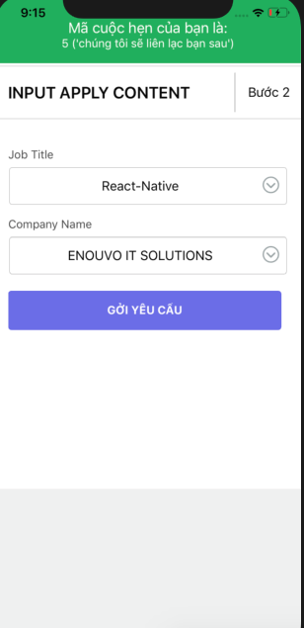
CV Submission

Slide 30
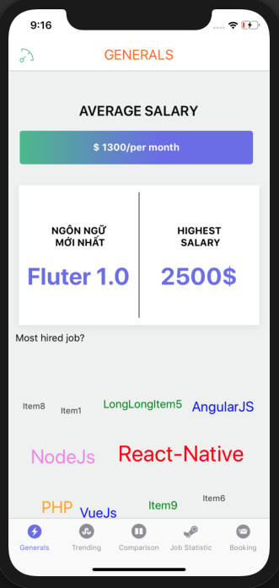
Job in detail

Slide 31
Task delivery
Task | PIC
Data Crawling | Phuc, Nguyen
Preprocessing | Phuc, Nguyen
Deployment | Nguyen, Phuc
API | Tuan, Phuc
Mobile UI App | Tuan
LSTM | Nguyen

Slide 32
Q&A

Slide 33

Thank You

