Slide 1

Notes:
abvs

Slide 2


NEO4J QUERY SYSTEM
USING CHATGPT MODEL
Instructor:
Assoc. Prof. Dr. Cao Tuan Dung
Project 3:
Name: Nguyen Huu Tuan Duy
ID: 20204907
Class: IT-E10-01

Slide 3

Table of Content
Overview
Neo4j
Wikidata service
Fine-tuning
Demonstration

Slide 4
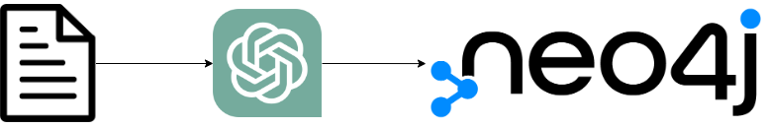
1. Overview

Slide 5
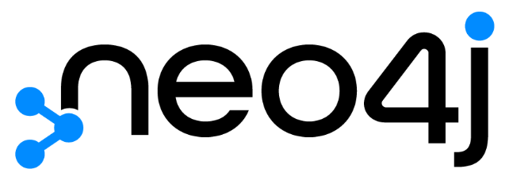
2. Neo4j
2.1 Graph Database
2.2 Cypher Query Language
2.3 Neosemantics (n10s)

Slide 6
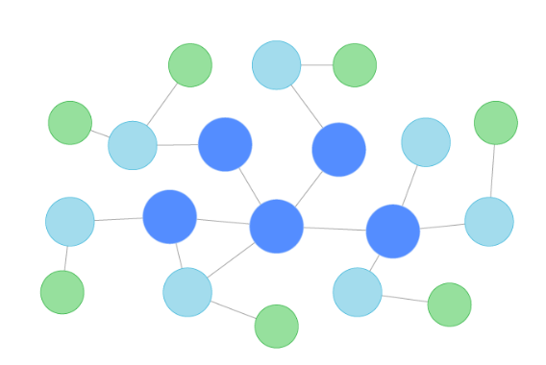
2.1 Graph database
A graph database is a specialized, single-purpose platform for creating and manipulating graphs.
Graphs contain nodes, edges, and properties:
Nodes are the entities in the graph
Edges displays the relationship between two node entities
Properties provide details about the entities

Slide 7
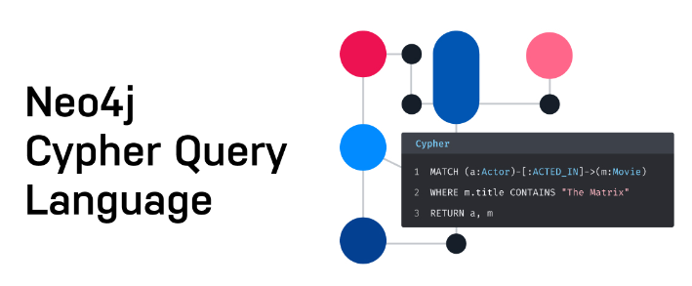
2.2 Cypher query language

Slide 8

a. MATCH:
Find nodes with specific properties

Slide 9


b. WHERE:
Specifying properties can also be done with the WHERE clause.

Slide 10


c. DELETE
Delete a property
Delete all nodes and relationships

Slide 11

2.3 Neosemantics (n10s)
Store RDF data in Neo4j in a lossless manner
On-demand export property graph data from Neo4j as RDF

Slide 12

3. Wikidata

Slide 13

3.1 Resource Description Framework (RDF)
The Resource Description Framework (RDF) is a standard model for data interchange on the Web
Key features of RDF:
Triple Structure
Graph-Based Model
URI-Based Identifiers
Extensibility
Data Interchange

Slide 14

3.2 SPARQL
RDF data is often queried using SPARQL, a powerful RDF query language that allows for complex querying and manipulation of RDF graphs.

Slide 15
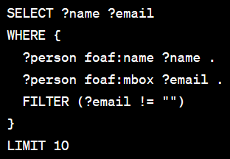
a. SELECT
This specifies the variables to be returned in the query results.
Variables in SPARQL are prefixed with a question mark (?).

Slide 16
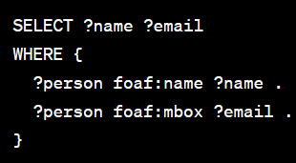
b. WHERE
This contains a set of triple patterns and optional filters. It describes the pattern that must be matched in the RDF data for the variables in the SELECT clause to be returned.

Slide 17
4. Fine-tuning
4.1 Dataset
4.2 Prepare the dataset
4.3 Train a new fine-tuned model
4.4 Evaluation

Slide 18
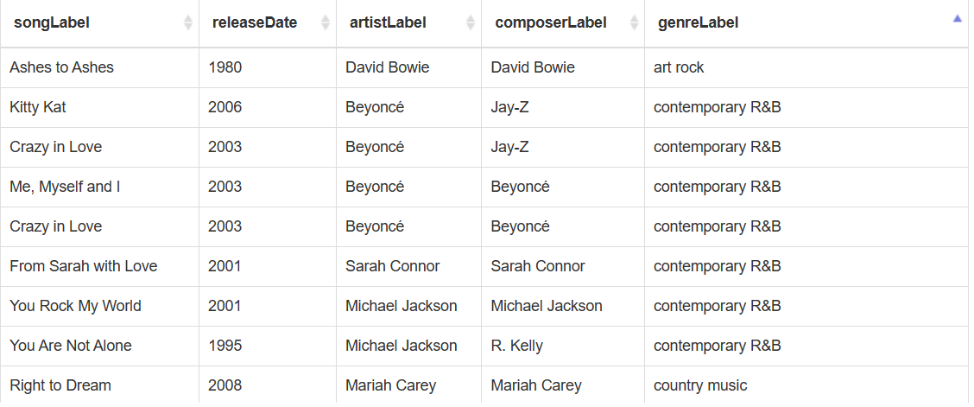
4.1 Dataset

Slide 19
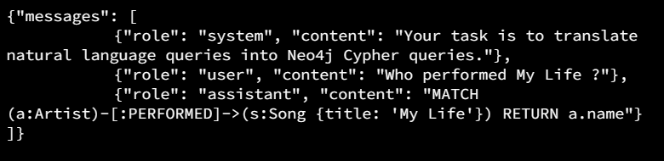
4.2 Prepare the dataset
The dataset should not contain duplicate examples.
The examples are utf-8 encoded.
The data should be clean and accurate.
Data must be relevant to the specific task the model is being fine-tuned
The dataset should be sufficiently large to train the model effectively

Slide 20
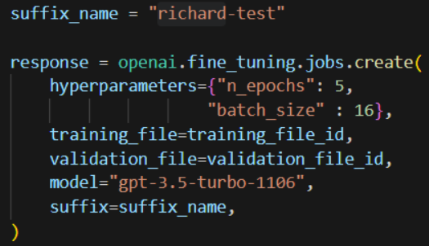
4.3. Train a new fined-tune model
Create a fine-tuned model
Using OpenAI JDK

Slide 21
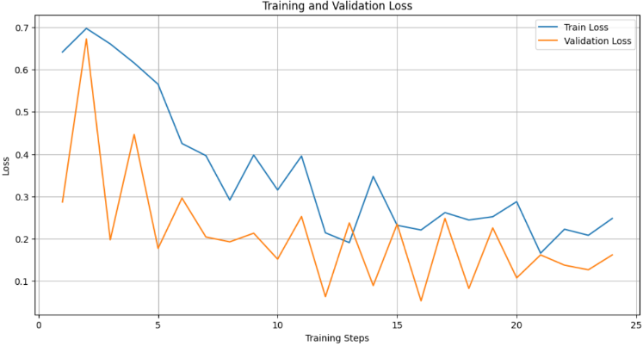
4.4 Evaluation

Slide 22
5. Application
5.1 Create the graph database
5.2 Create the application GUI
5.3 Explanation

Slide 23
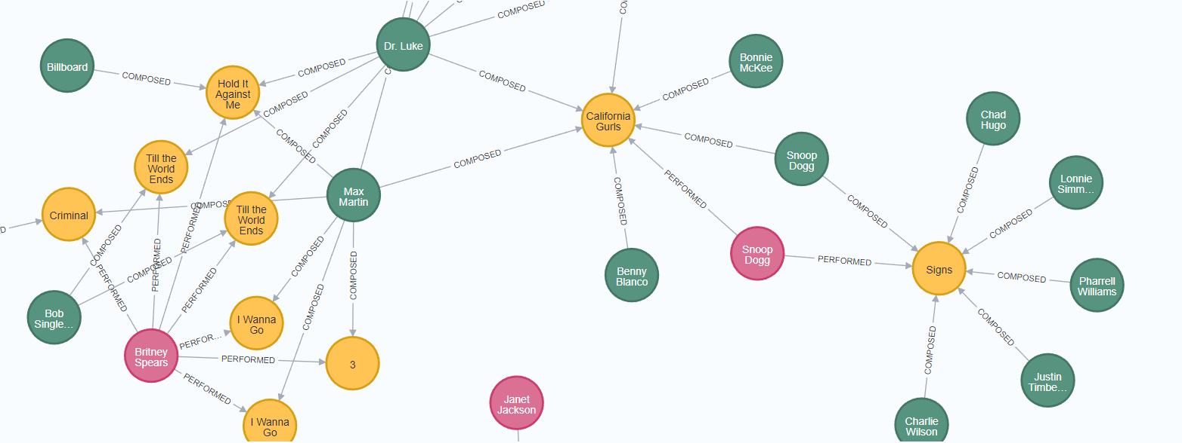
5.1 Create graph database

Slide 24
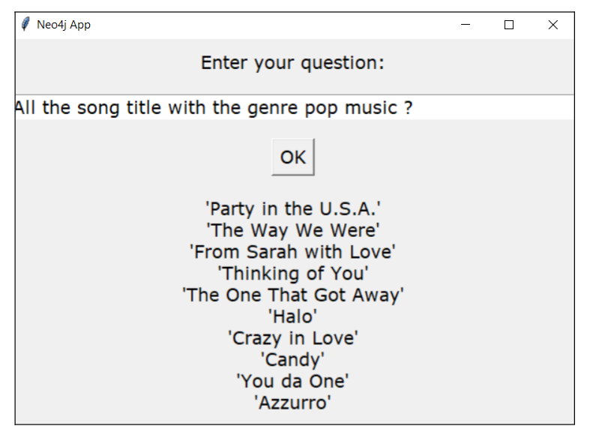
5.2 Create the application GUI

Slide 25
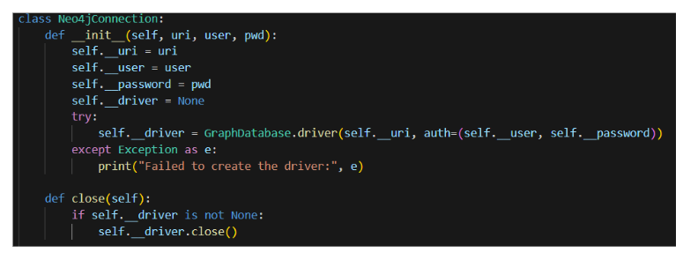
5.3 Explanation
The Neo4jConnection Class helps us to connect to the graph database in
Neo4j using username and password

Slide 26
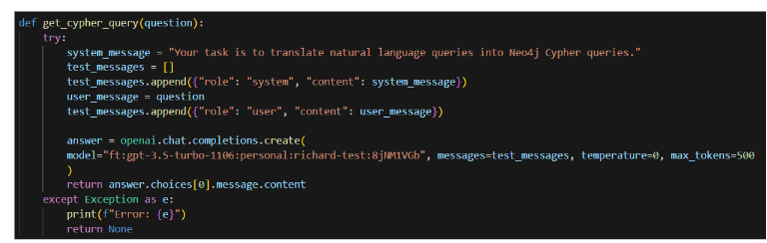
5.3 Explanation
The get_cypher_query( ) function will return the cypher query equivalent to the given natural sentences.

Slide 27
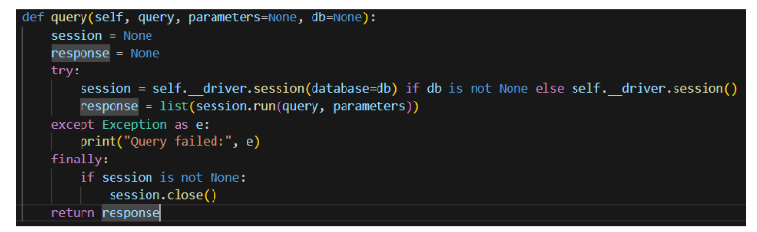
5.3 Explanation
The query( ) function will take the given Cypher query into Neo4j to get the desired result.

Slide 28
THANKS FOR LISTENING!

