Slide 1
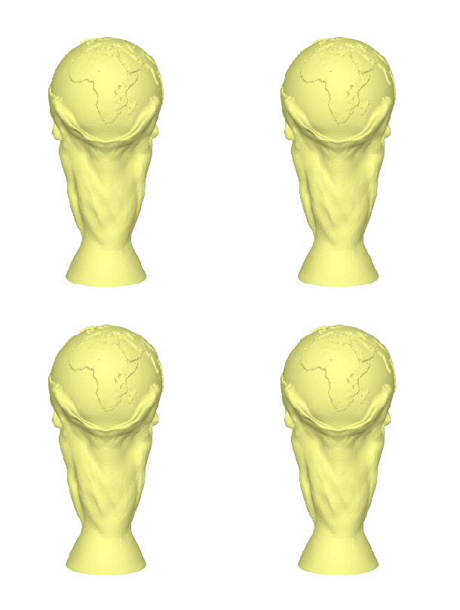
Pinch
Lift
Grab
&
Lift
Grab

