Slide 1
Cyclistic_case_study
File created on: 8/31/2023 6:49:48 AM

Slide 2
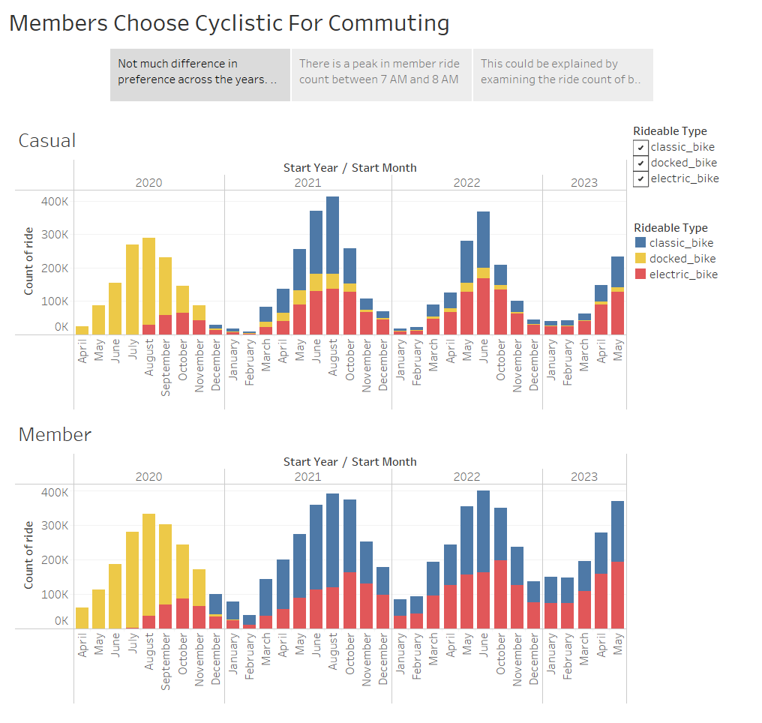
Notes:
Not much difference in preference across the years. A clear seasonality factor affects both types of customers. There is one interesting note. After 2021, no docked bike rent was recorded in member rider.

Slide 3
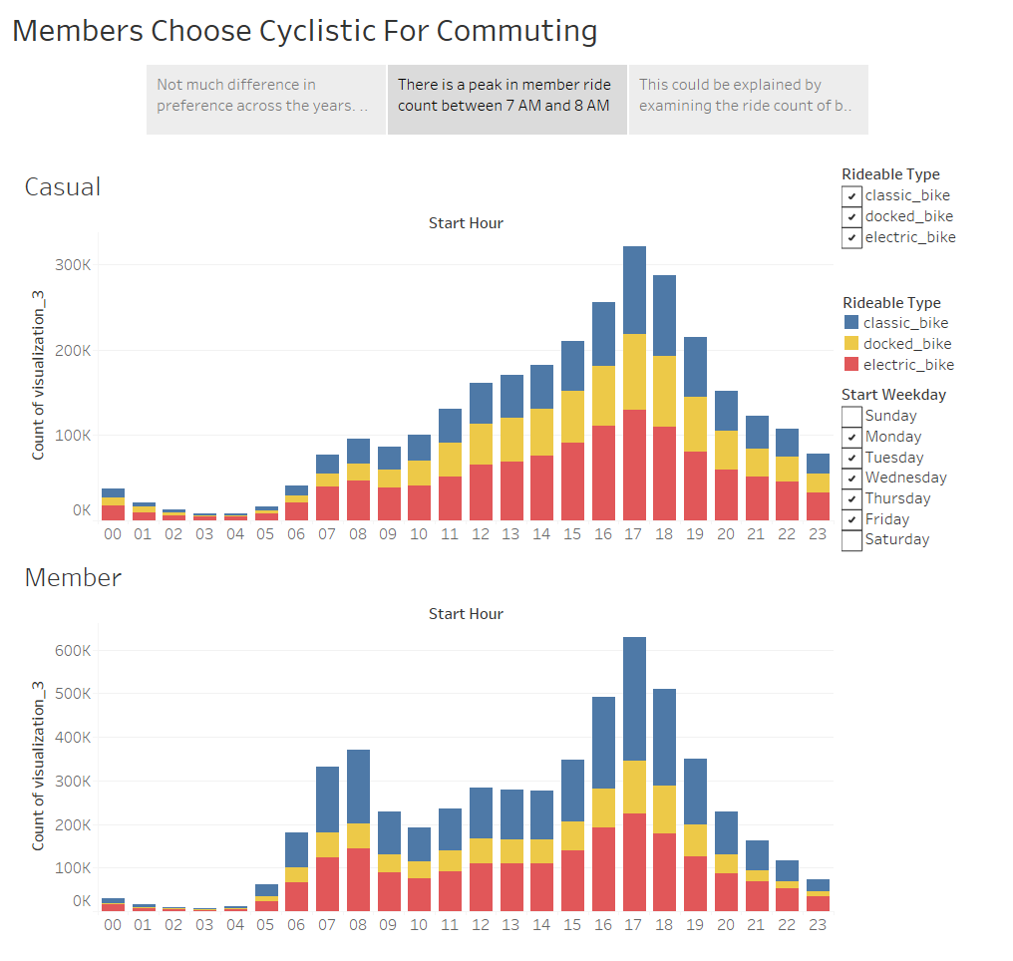
Notes:
There is a peak in member ride count between 7 AM and 8 AM.

Slide 4
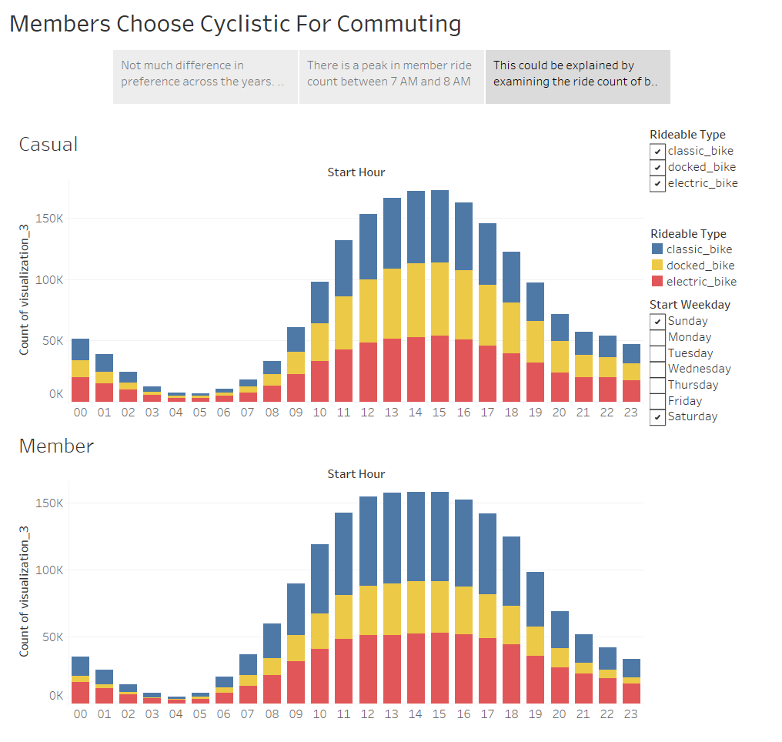
Notes:
This could be explained by examining the ride count of both customer types on the weekend.

