Slide 1
Cyclistic_case_study
File created on: 8/31/2023 6:52:31 AM

Slide 2
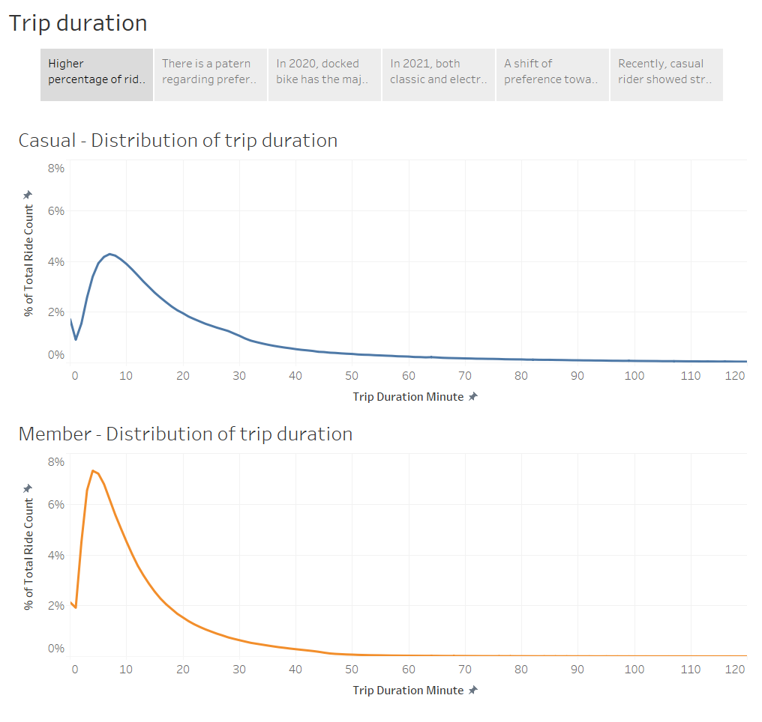
Notes:
Higher percentage of ride count for member riders in short-length trip.

Slide 3
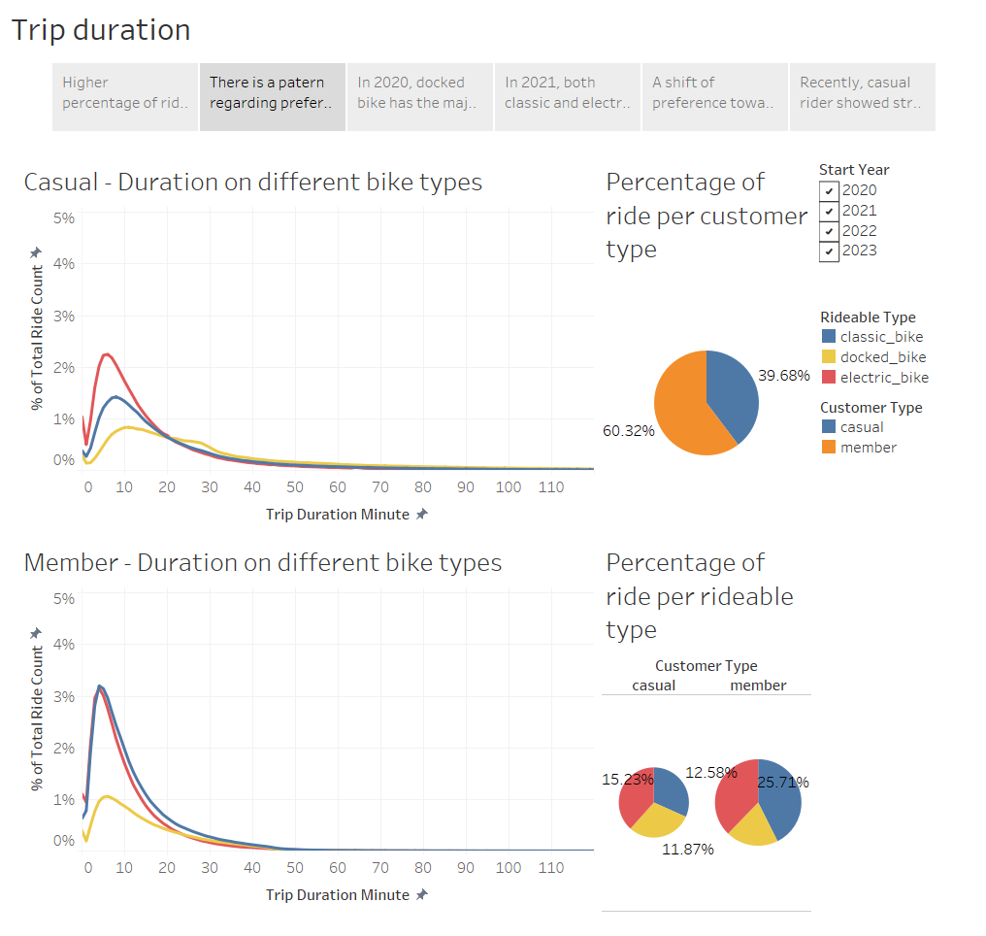
Notes:
There is a pattern regarding preference in rideable type for two customer types. However, it is necessary to understand changes in preferences in different years.

Slide 4
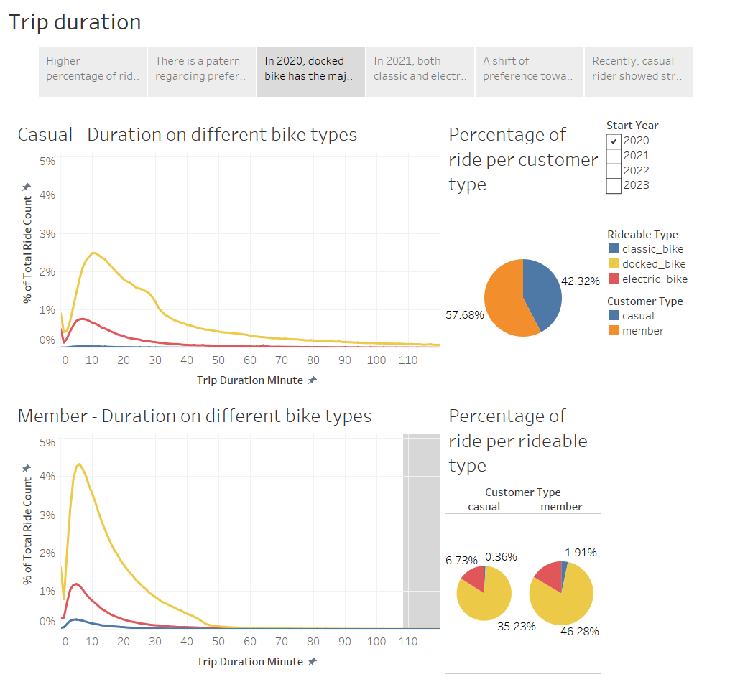
Notes:
In 2020, docked bike has the majority usage.

Slide 5
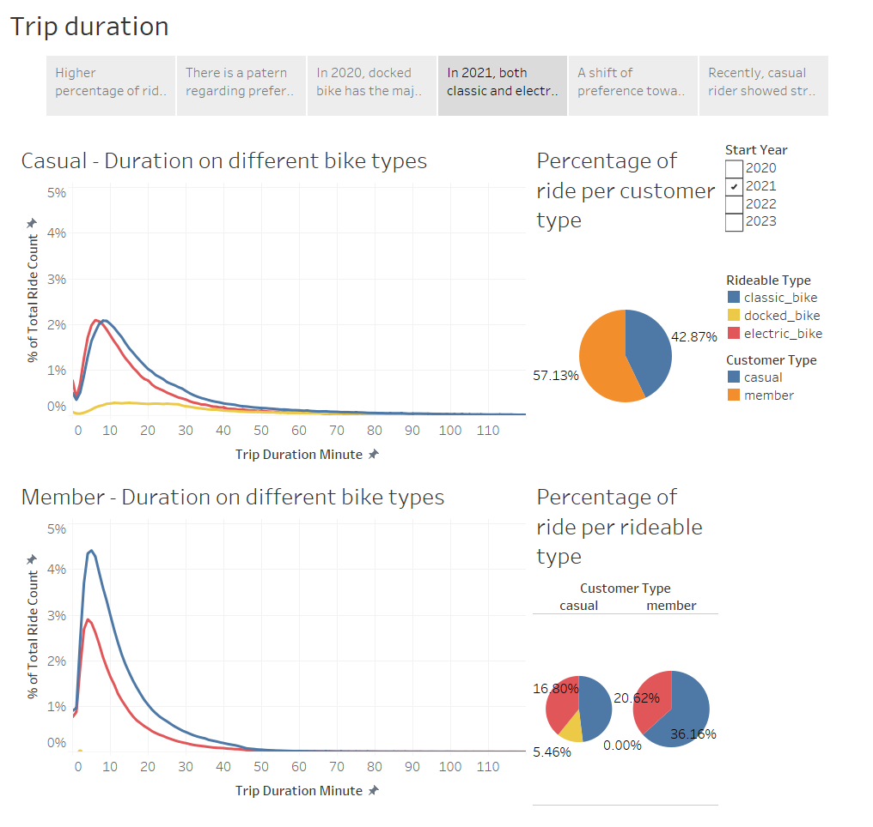
Notes:
In 2021, both classic and electric bicycles outperformed docked bikes, with member riders showing a clear preference for the classic bike. These abrupt shifts may signal potential changes in the business operations, warranting a more thorough investigation.

Slide 6
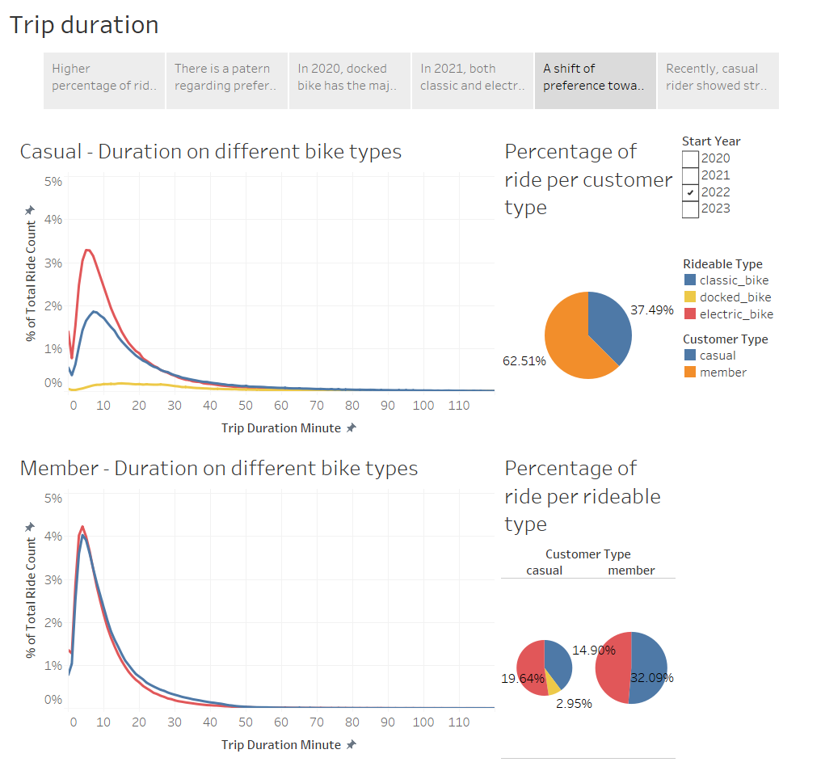
Notes:
A shift of preference towards electric bike in 2022 witnessed in both customer types.

Slide 7
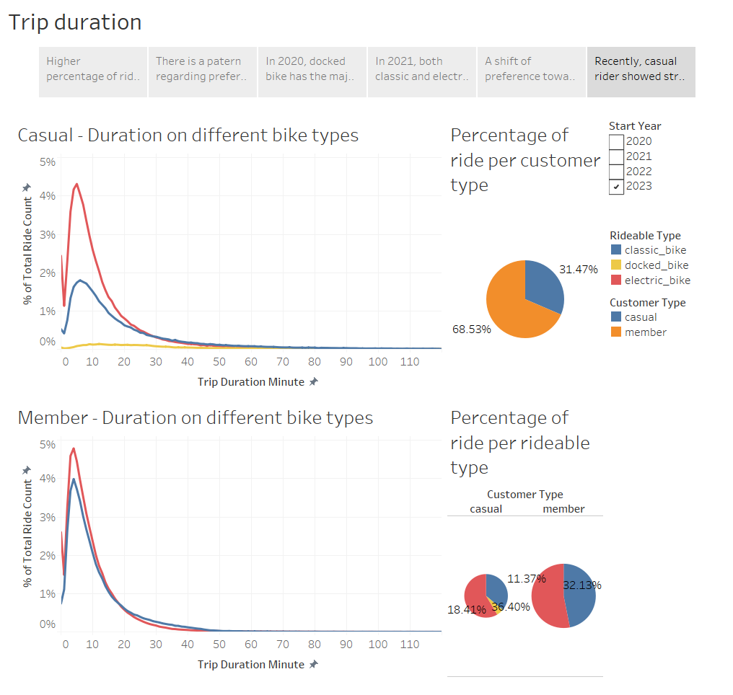
Notes:
Recently, casual riders showed a strong preference for electric variety.

