Slide 1
Cyclistic_case_study
File created on: 8/31/2023 6:54:44 AM

Slide 2
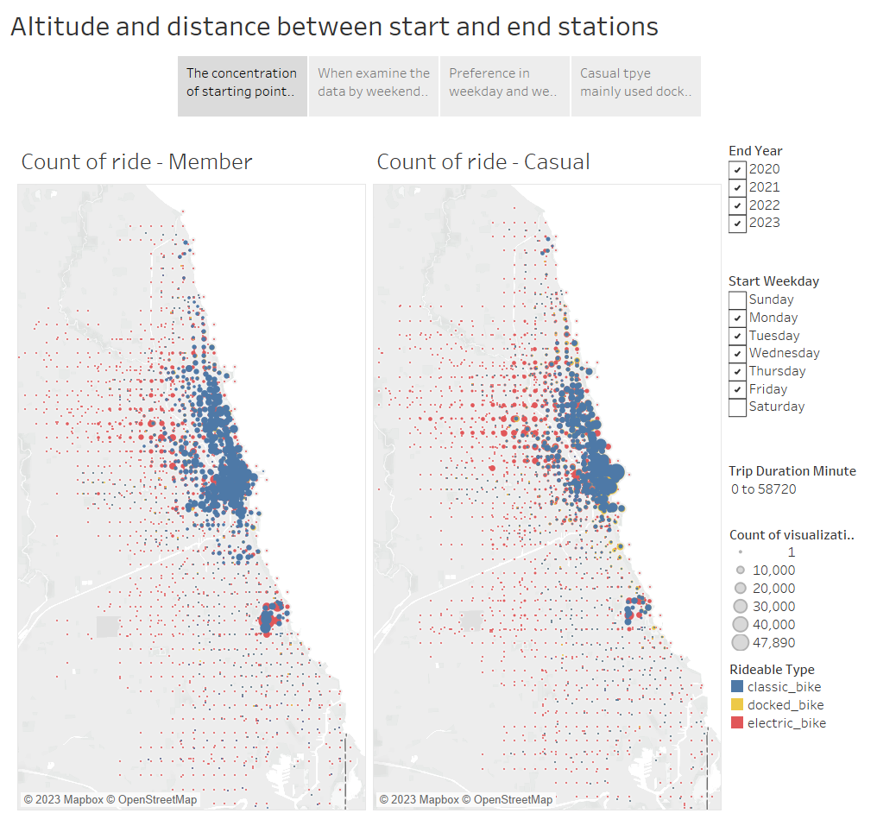
Notes:
The concentration of starting points is distributed equally to both types.

Slide 3
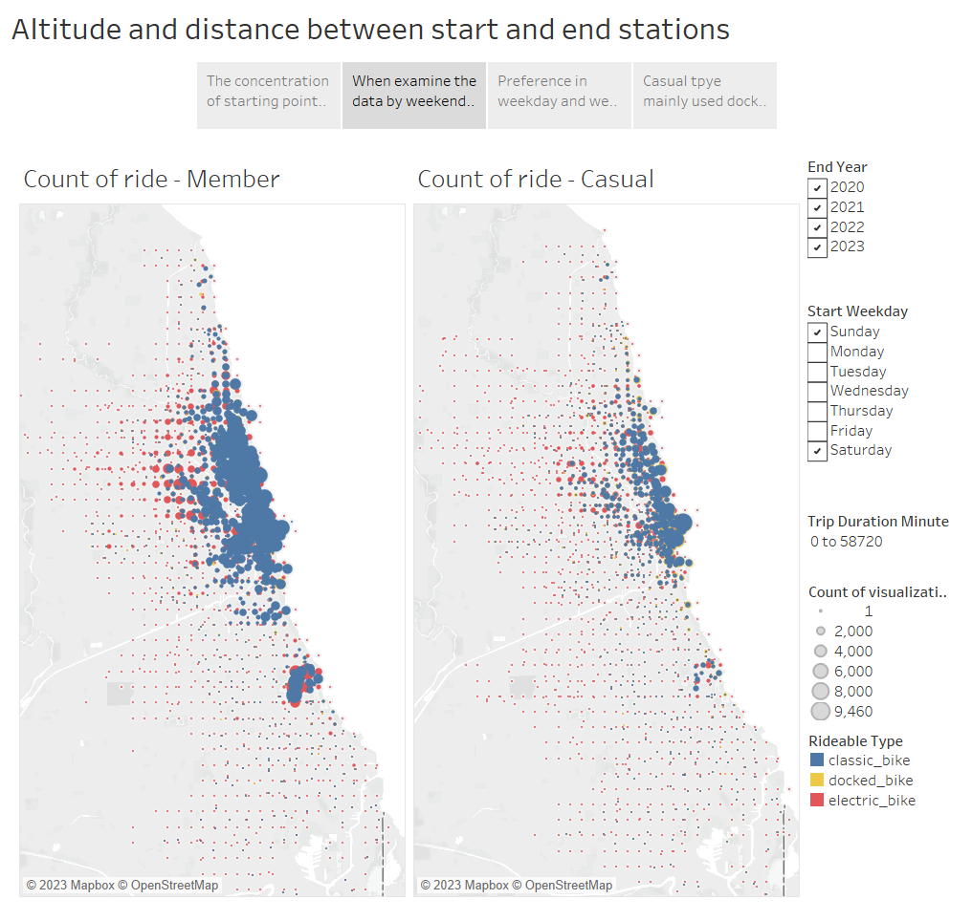
Notes:
However, when examining the data by weekends and weekdays, a denser distribution of member rides could be seen on weekends and vice versa regarding casual rides.

Slide 4
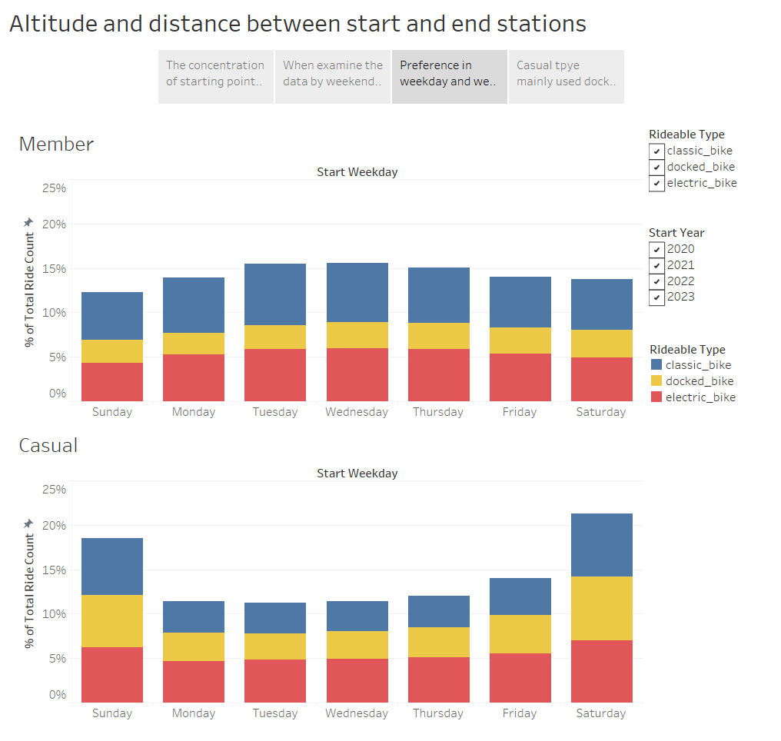
Notes:
Preference in weekday and weekend trips of member, and casual respectively.

Slide 5
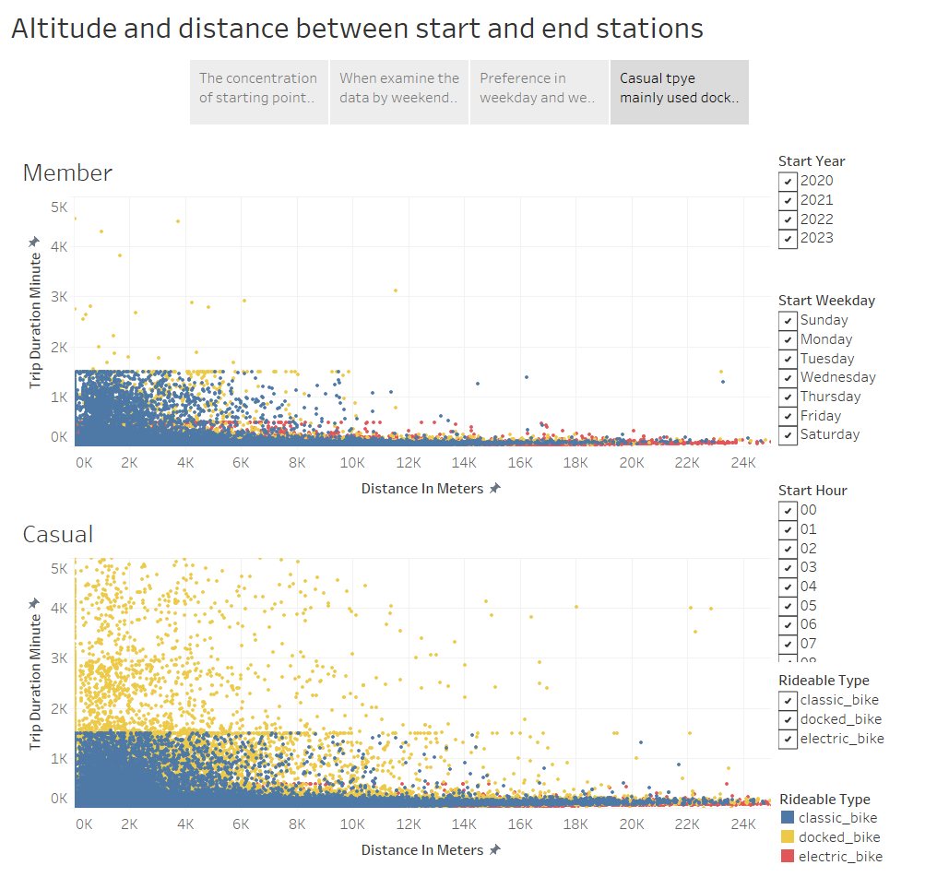
Notes:
Casual type mainly used docked bikes for long-duration travel trips.

