Slide 1
Project 1
HTML Home Page
(Not graded)

Slide 2
Project 1
Create a “home page” for yourself and publish it in your CSE Department web site as home_page.html
  OK to use a different site if you prefer.
The page should include
  <h1> and <h2> headings
  An image
  A table showing a class schedule
  A link to the CSE Department home page
Similar to the example on next slide

Slide 3
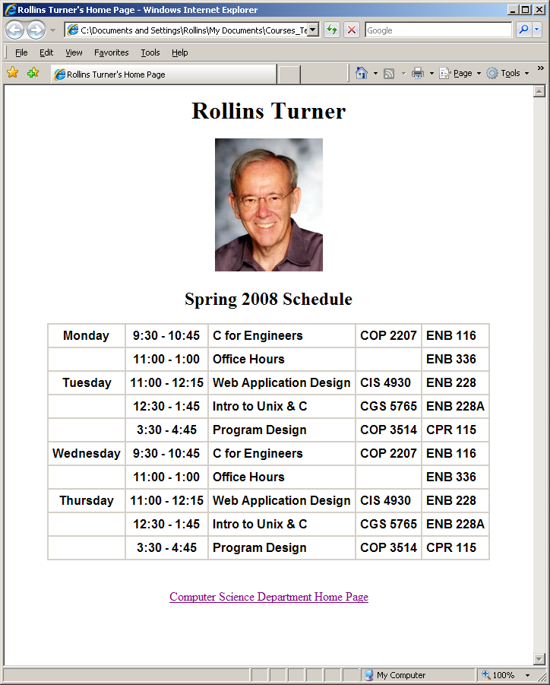
Example

Slide 4
Alignment
Use CSS to control layout.
Headings, image, and table are centered
First two columns of table are centered.
Remaining columns are left aligned.
Text in table is Arial, bold

Slide 5
About Content
If you are concerned about privacy –
The image does not have to be a picture of you.
  Use any image you like.
The schedule does not have to be accurate.
This project is an exercise in writing HTML.
Your page should match the example in format and style.
    Content is not significant.

Slide 6
Ground Rules
You may work with a partner if you wish.
  Or multiple partners.
  OK to work alone if you prefer.
If you do work as a pair or group
  All members are expected to contribute.
  Each should create their own home page
  Each should submit their URL.

Slide 7
Submission
Project is due by 11:59 PM, Wednesday May 23
  No late submissions will be accepted.
Deliverables:
  HTML File (as Blackboard Assignment submission)
  Web page on your own web site
    Including image (separate file)
Submit your HTML file using the Blackboard Assignment for this class.
  Include your URL as a comment.
If you work as a pair or a group, each should set up their own home page and submit their own URL.

Slide 8
Submission
Put the URL for your page into the Blackboard submission comments box.
  Example:
    http://www.cse.usf.edu/~turnerr/home_page.html
Substitute your username

