Slide 1
Project 2
Temperature Conversion
(Not graded)

Slide 2
Project 2
Write a web app to convert temperatures from Fahrenheit to Celsius and from Celsius to Fahrenheit.
The web form should be similar to that shown on the next slide.

Slide 3
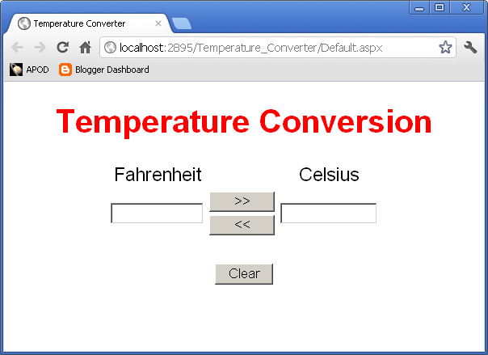
The Web Form

Slide 4
Functional Requiremens
The user can enter a decimal number into either TextBox and click the corresponding “Convert” button.
The app does the conversion and displays the result in the other TextBox.
The user must then click the Clear button before doing anything else.

Slide 5
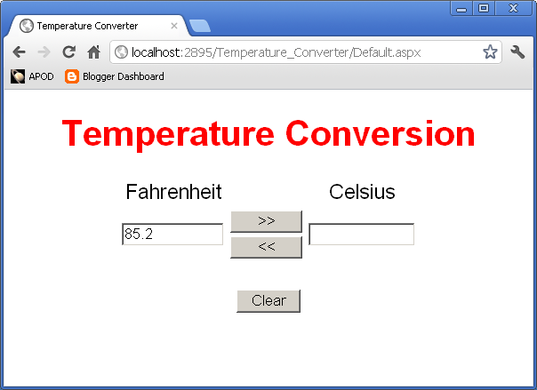
Example
User enters 85.2 into the Fahrenheit input box.
User then clicks the >> button.

Slide 6
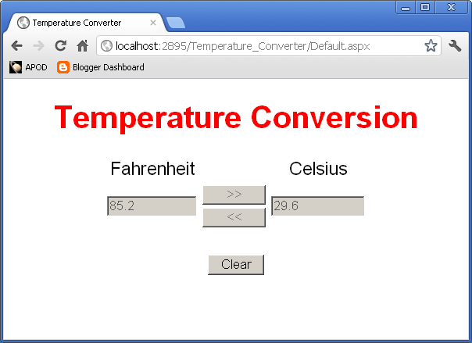
Example
App displays the corresponding Celsius temperature.
Convert buttons and input boxes are now disabled until user clicks Clear.

Slide 7

Example
User clicks Clear and app returns to initial state.

Slide 8
Initial State
All buttons are enabled.
Both TextBoxes are empty but enabled.
User can enter text into either TextBox.
After entering text into either TextBox
  User can change contents of either TextBox.

Slide 9
Convert Buttons
When the user clicks a “convert” button (<< or >>)
  If the corresponding input is valid
    Do the conversion.
    Put the output into the other TextBox
    Disable both Convert buttons.
    Disable both TextBoxes.
  If the input is not valid
    Display an error message.
    Disable both Convert buttons.
    Disable both TextBoxes.

Slide 10
The Clear Button
The Clear button should always be enabled.
When the user clicks the “Clear” button
  Revert to the initial state
    Clear both TextBoxes.
    Enable both TextBoxes.
    Clear the Error Message.
    Enable both “Convert” buttons.

Slide 11
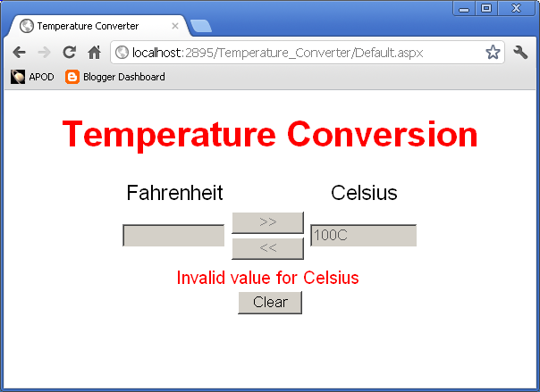
Error Example
User enters 100c as Celsius input and clicks <<.
App displays error message and disables both inputs and both Convert buttons.
User must click Clear in order to continue.

Slide 12
Specifications
Use the C# Decimal type for all numerical values and arithmetic operations.
  See Chapter 2 of textbook.
Show conversion results with one decmal place.
Page contents should stay centered (left to right) if page is resized.

Slide 13
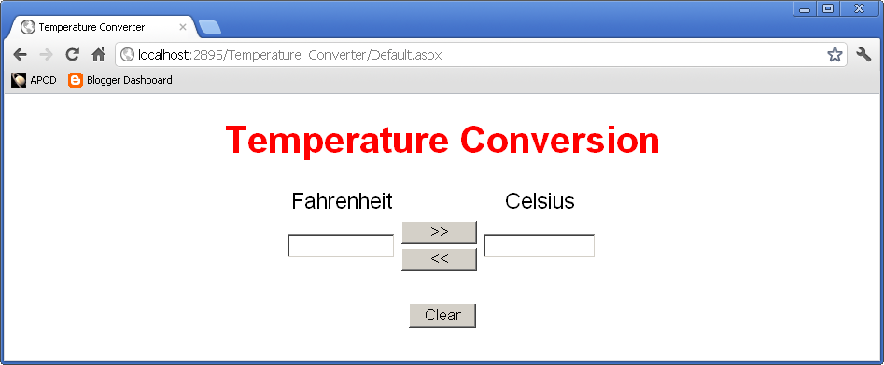
Wider Page

Slide 14
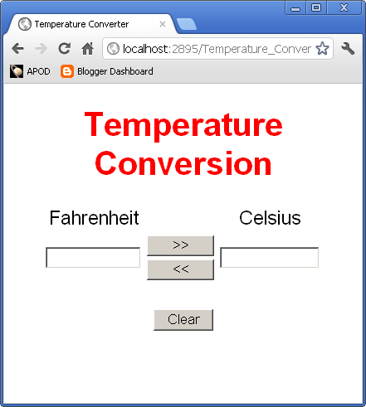
Narrow Page

Slide 15
Hints and Tips
All C# numeric types have a TryParse method and a ToString method.
  Look these up if you are not familar with them. They will be useful for this project.
Use an HTML table to control layout.
  The buttons will need to be in a table inside a cell of an outer table.

Slide 16
Submission
Project is due by 11:59 PM, Wednesday, May 30.
  No late submissions will be accepted.
Deliverables:
  Default.aspx
  Default.aspx.cs
Submit your ASPX files using the Blackboard Assignment for this class.
If you work as a pair or a group, each member should submit their own copies of the files.

