Slide 1
Project 3: Chomp
(Not graded)

Slide 2
Project 3
The game of Chomp was described in a Math Trek column in Science News:
http://www.sciencenews.org/view/generic/id/3683

Slide 3
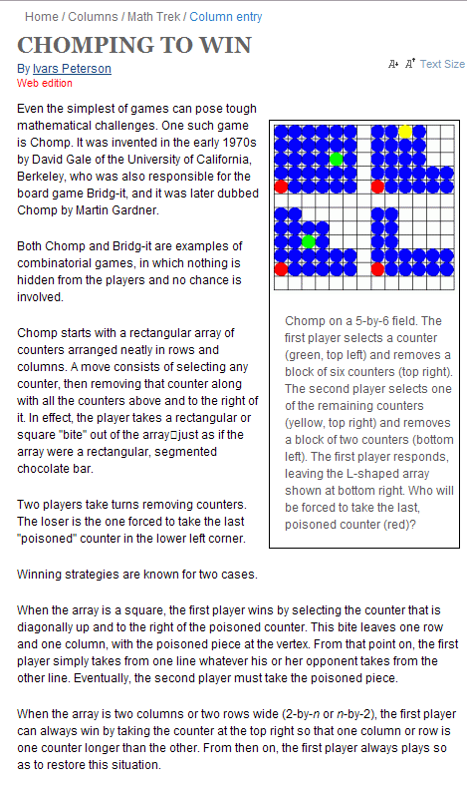
The Game of Chomp

Slide 4
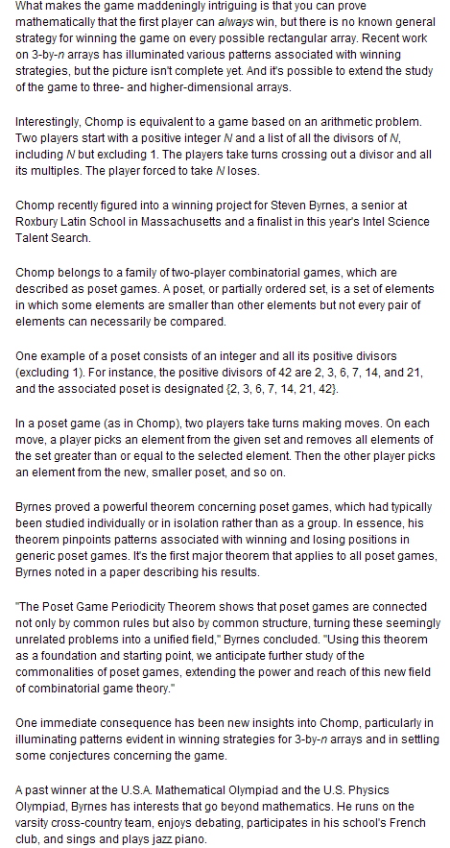
The Game of Chomp

Slide 5

Assignment
Write a web application to permit two players, sharing the same browser, to play Chomp on a grid of 6 rows and 7 columns:

Slide 6
Implementation Specifications
Each square is a ASPX button.
The red square in the lower left corner is disabled.
  No player can select that square.
  When a player has no other choice, the other player wins.
Players alternate clicking on a blue square.
  When a player clicks on a square, that square and all squares above it and to its right disappear.
A label below the grid says which player is to play next
  Or which has won.
A button below the grid permits the players to start a new game at any time.

Slide 7
Example
There is a working example at
http://rollinsturner.net/Chomp6x7/
Your app should look approximately the same and have the same behavior.

Slide 8
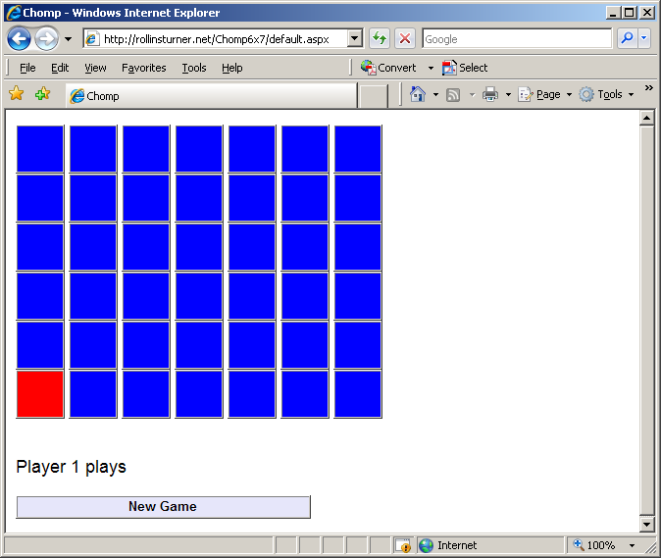
Start of a Game

Slide 9
Implementation Tips
It's easier to lay out the buttons in the Source View than the Design View.
Put one button on the page in Design View. Set its properties in Design View. Then copy, paste, and modify its Source View representation.
Put each row of buttons inside <div> ... </div>

Slide 10
Implementation Tips
Name the buttons systematically so that you can determine a button’s row and column from its ID.
  Example: btn34 for row 3, column 4
Provide a single click handler for all buttons.
  Use the sender parameter to determine which button was clicked.
  protected void btn_Click(object sender, EventArgs e)
  {
  Button btn = (Button) sender;
  int clicked_row = int.Parse(btn.ID.Substring(3, 1));
  int clicked_col = int.Parse(btn.ID.Substring(4, 1));

Slide 11
Implementation Tips
To make a button disappear while still occupying its place on the page
  Set BackColor property to System.Drawing.Color.White;
  Set BorderStyle property to System.Web.UI.WebControls.BorderStyle.None
To make it reappear
  Set BackColor property to System.Drawing.Color.Blue;
  Set BorderStyle property to System.Web.UI.WebControls.BorderStyle.Ridge
Ensure that an invisible button cannot be clicked.

Slide 12
Implementation Tips
To find a button with a given ID, use the FindControl() method:
String ID = "btn" + i.ToString() + j.ToString();
Button next_button = (Button) FindControl(ID);

Slide 13
Submission
Submit your web site files via Blackboard Assignments:
  Default.aspx
  Default.aspx.cs
  web.config
Zip your web site folder using the Windows “Send to Compressed Folder” command.
Attach the .zip file to your Blackboard submission.
  Be sure to click Attach after selecting the file.
  Be sure to click Submit after attaching the file.

Slide 14
Ground Rules
You may work with one or more other students.
  OK to work alone if you prefer.
If you do collaborate
  All group members are expected to contribute.
  Each group member should deploy the project to their class web site.
  Each group member should submit the website files. (This is practice for the graded projects.)

Slide 15
Ground Rules
Do not share your work with other students (outside your group.)
  Before or after submitting the project.
  OK to discuss the project.
  OK to look at others’ web sites with a browser.
Do not copy any other student’s code.
  Or even look at it.
Do not let anyone copy or examine your code.

Slide 16
Ground Rules
Except for code posted on the class web site
Do not copy code from the Internet
  or any other source.
Write your own code.

Slide 17
Submission
Deploy your application to your directory on the scorpius web site.
  OK to use a different IIS server if you have access to one.
Put the URL for your page into the Blackboard submission comments box.
  Example:
    http://cis4930wp.eng.usf.edu/wpusr40
Substitute your user ID for wpusr40.
Grader should be able to view your page by copying and pasting the link

Slide 18
Due Date
Project is due by 11:59 PM, Wednesday, June 6.
  No late submissions will be accepted.
End of Presentation

